Slide 1
A Level Physics
Delivery Guide

Slide 2
Modelling Decay of Charge
Key Concepts

Slide 3
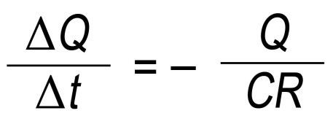
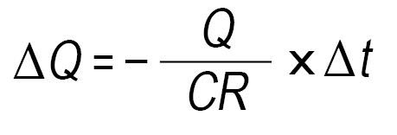
Capacitor discharge
Key equation
Therefore
In this example, initial charge = 1000 C, CR of 5.0 s and Δt of 0.1 s.

Slide 4
t / s | ΔQ / μC | Q / μC
0 | 20 | 1000
0.1
0.2
0.3
etc .........
This is the initial charge.
This shows the charge leaving capacitor in 0.1 s.

Slide 5
t / s | ΔQ / μC | Q / μC
0 | 20 | 1000
0.1
0.2
0.3
etc .........
This is the initial charge.
This shows the charge leaving capacitor in 0.1 s.

Slide 6
The charge left on capacitor is:
t / s | ΔQ / μC | Q / μC
0 | 20.0 | 1000
0.1 | 19.6 | 980
0.2
0.3
etc .........
This shows the charge leaving capacitor in the next 0.1 s.
Now repeat the process .........

Slide 7
Thank you for using
this OCR resource
Other OCR resources are available at www.ocr.org.uk
To give us feedback on, or ideas about the OCR resources you have used, email resourcesfeedback@ocr.org.uk
OCR Resources: the small print
OCR’s resources are provided to support the teaching of OCR specifications, but in no way constitute an endorsed teaching method that is required by the Board, and the decision to use them lies with the individual teacher. Whilst every effort is made to ensure the accuracy of the content, OCR cannot be held responsible for any errors or omissions within these resources.
© OCR 2014 - This resource may be freely copied and distributed, as long as the OCR logo and this message remain intact and OCR is acknowledged as the originator of this work.

