Slide 1
A Level Sociology
Culture, Norms and Values

Slide 2
Culture
Is shaped by norms and values

Slide 3
Objectives
To explore sociological ideas about culture
To be able to define culture
To understand what is meant by values and norms and understand how these shape culture
To understand some of the ways that cultures can vary

Slide 4
Definition of culture
The ideas, customs, and social behaviour of a particular people or society

Slide 5
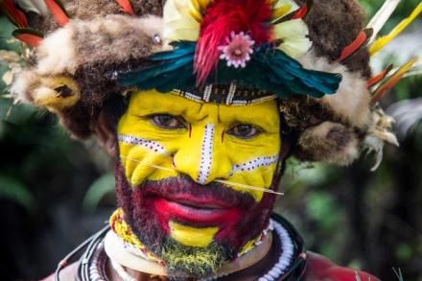
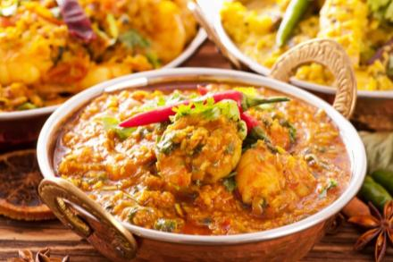
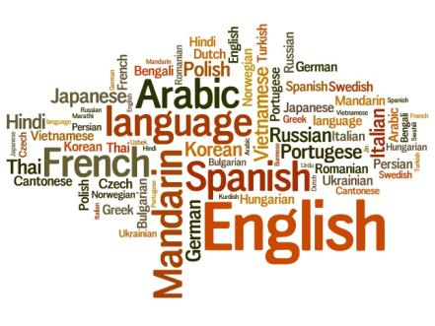
How is culture expressed?

Slide 6
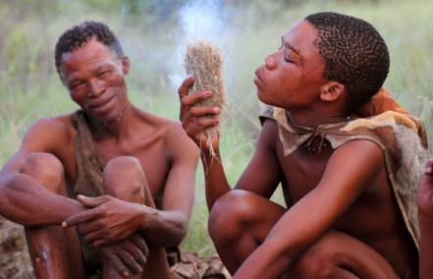
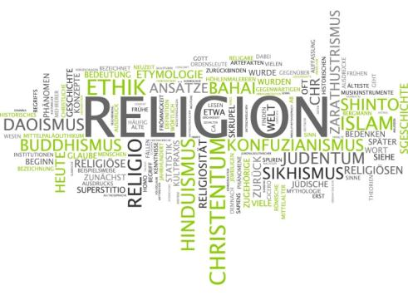
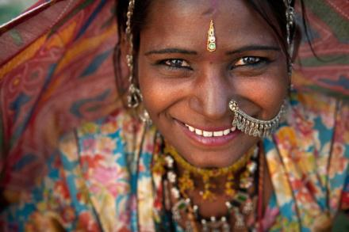
How is culture expressed?

Slide 7
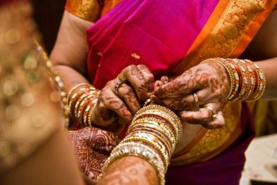
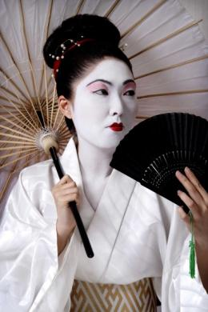
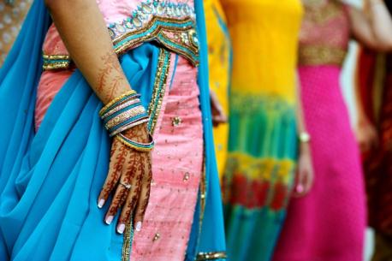
How is culture expressed?

Slide 8
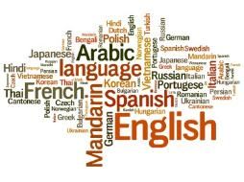
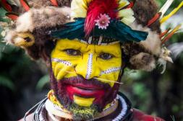
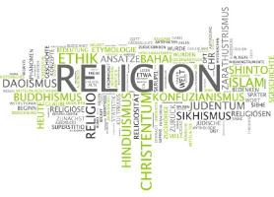
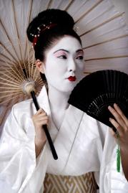
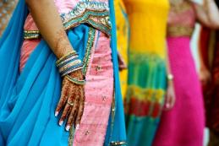
How is culture expressed?

Slide 9
Norms and values
Norm: behaviour that is considered normal in any society.
What is considered normal in your culture?
Value: things that people have strong beliefs about in society.
What values does your culture have?

Slide 10
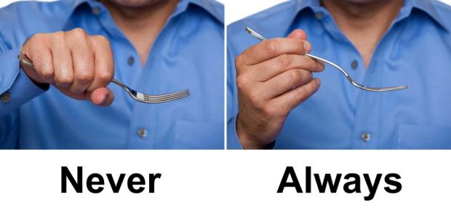
Which norms are being demonstrated here?

Slide 11
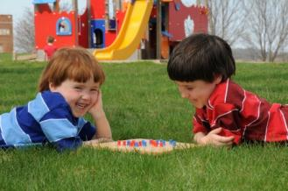
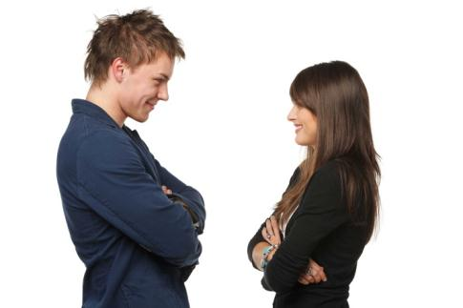
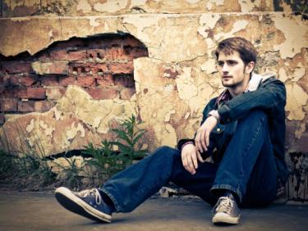
Which norms are being demonstrated here?

Slide 12
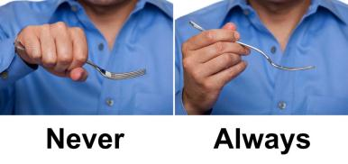
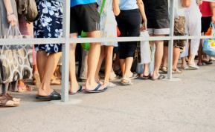
Which norms are being demonstrated here?

Slide 13
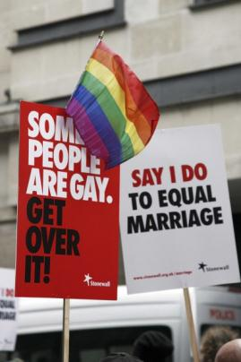
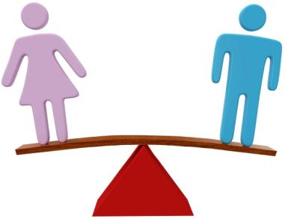
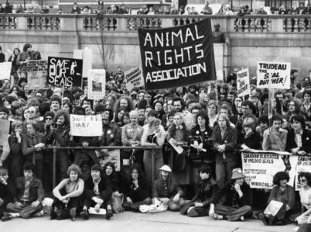
Which values are being demonstrated here?

Slide 14
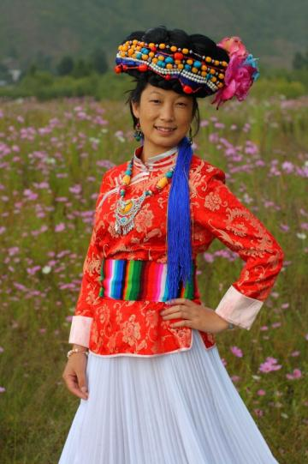
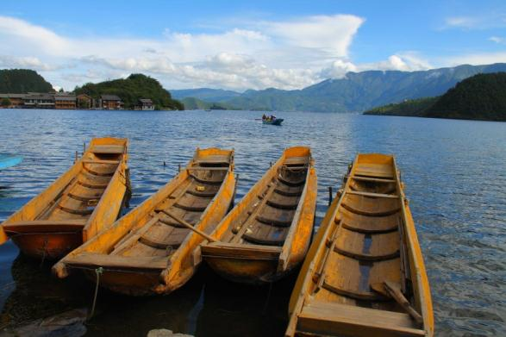
The Na (The Mosuo)

Slide 15
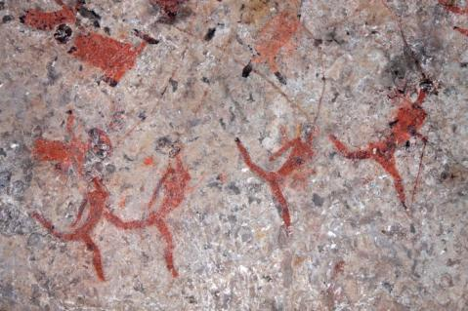
The San

Slide 16
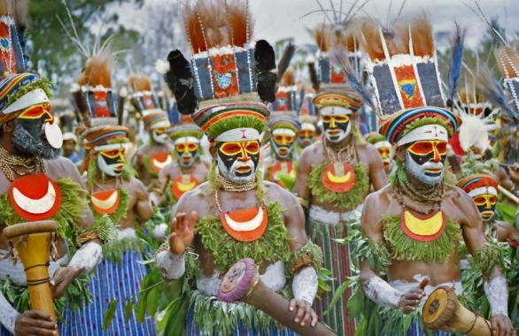
Papua New Guinea

Slide 17
Thank you for using this OCR Resource
Other OCR resources are available at www.ocr.org.uk
OCR Resources: the small print
OCR’s resources are provided to support the teaching of OCR specifications, but in no way constitute an endorsed teaching method that is required by the Board, and the decision to use them lies with the individual teacher. Whilst every effort is made to ensure the accuracy of the content, OCR cannot be held responsible for any errors or omissions within these resources.
© OCR 2014 - This resource may be freely copied and distributed, as long as the OCR logo and this message remain intact and OCR is acknowledged as the originator of this work.
OCR acknowledges the use of the following content:
● Slide 6 and 9 – Papua New Guinea Tribesman: Amy-Nichole-Harris/Shutterstock.com, Selection of Indian food: HLPhoto/Shutterstock.com, Language word cloud: Tupungato/Shutterstock.com  Slide 7 and 9 - Religion word cloud: PlusONE/Shutterstock.com, San tribesman: Dietmar-Temps/Shutterstock.com, Rajasthani woman: wong-yu-liang/Shutterstock.com  Slide 8 and 9- Hindu Indian wedding ceremony: Andy Lim /Shutterstock.com, Women with henna and saris: infinity21/Shutterstock.com, Geisha: nunosilvaphotography/Shutterstock.com  Slide 10 - question mark pile – eyeidea/Shutterstock.com  Slide 11 and 13 - Ways of holding a fork: Carlos-Yudica/Shutterstock.com, Queue: Oleksii-Sagitov/Shutterstock.com, Girl reading: Zurijeta/Shutterstock.com  Slide 12 and 13 – Two people saying ‘thank you’: iQoncept/Shutterstock.com, children playing outside: Rossario/Shutterstock.com, Man sitting against wall: Mike Laptev/Shutterstock.com, Man and woman talking: paffy/Shutterstock.com  Slide 14 - Gender equality: Michael-D-Brown/Shutterstock.com, Gay pride parade: Bikeworldtravel/Shutterstock.com, Diversity sign: Nelosa/Shutterstock.com, Animal rights protest: David-Fowler/Shutterstock.com  Slide 15 – Mosuo girl and Boats on lake: Yu-Zhang/Shutterstock.com  Slide 16 – San tribesmen: Dietmar-Temps/Shutterstock.com, San cave painting: EcoPrint/Shutterstock.com  Slide 17 – Papua New Guinea Warriors: rhfletcher/Shutterstock.com, Papua New Guinea flag: Stephen Finn/Shutterstock.com

