Slide 1
Geography A
H070 Topic Title
H470 Topic Title

Slide 2
Guide to the SAMs
Component 1 –
Living in the UK today

Slide 3
J383/01 Living in the UK today
Within the study of Living in the UK today learners get the opportunity to investigate the dynamic and diverse geography of the UK.
There will be study of landscapes of the UK, the UK’s economic development and the people who live in the UK, and some of the environmental challenges that the country faces.
But what will the assessments look like?
This guide will give you an understanding of the format and structure of the exam, an insight into the assessment objectives and a question by question explanation of the sample assessment for J383/01 Living in the UK today. This guide can also be used with your students to support revision.

Slide 4
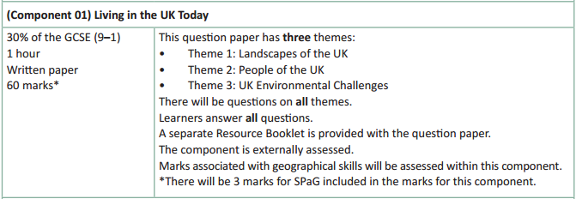
How will Living in the UK today be assessed?
No optionality – students know what they need to do and will not get confused as to which option they should answer.
7 marks for AO4 (skills)
A separate Resource Booklet so students can access resources easily when answering questions.
3 marks for SPaG will be on the 12 mark question.

Slide 5
How will Living in the UK today be assessed?
The exam will be 60 marks (3 of which are for SPaG) and there is 1 hour to complete the exam (a minute per mark).
The Assessment Objective breakdown for the overall paper is:
There are three sections within Living in the UK today, with multi-part questions on Landscapes of the UK, People of the UK and UK Environmental Challenges.
But let’s have a look at the assessment in more detail on the following slides.
 | AO1 (Knowledge) | AO2 (Understanding) | AO3 (Application) | AO4 (Skills) | SPaG | Total
Marks | 14 | 21 | 15 | 7 | 3 | 60

Slide 6
Living in the UK today
There will be one multi-part question on each of the themes studied within Living in the UK today (Landscapes of the UK, People of the UK and UK Environmental Challenges) and, whilst the exact number of marks within each theme will vary year on year, there will be roughly the same number of content marks between the themes – in the sample assessment material the themes vary between 17 and 21 marks.
Each topic will start with short answer, point marked questions (1, 2, 3 and 4 mark questions) before finishing with a level of response question of either 6 marks, 8 marks or 12 marks.
Whether the theme ends with a 6 mark, 8 mark or 12 mark question will vary year on year – but there will always be one 6 mark, one 8 mark and one 12 mark question on the paper as a whole.
The 12 mark question will also have 3 SPaG marks available (total of 15 marks for the question).

Slide 7
Other things to know about the assessment…
There are a few other important things to highlight for the assessment and to help you understand the mark scheme, so now we will run through:
SPaG
Quality of Extended Responses
Marking Guidance

Slide 8
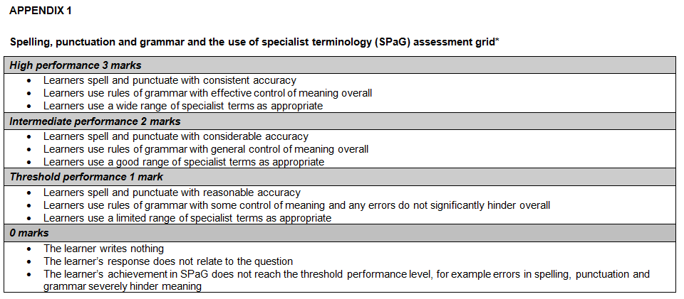
SPaG
SPaG – also known as spelling, punctuation and grammar and the use of specialist terminology – is assessed against one of the longer questions in the exam with 3 marks available. In the ‘Living in the UK today’ assessment, SPaG will always be assessed on the 12 mark question.
There are clear descriptors for each level of SPaG, which are separate from the geographical content of the rest of the question. The student’s answer is read holistically and the SPaG marks are awarded on the whole answer.

Slide 9
Quality of Extended Responses
‘Quality of extended response’ is assessed within each level for questions of 8 marks or above and is indicated by an asterisk (*) beside the question. The following are the descriptors placed within the levels for 12 mark questions:
Level 4
There is a well-developed line of reasoning which is clear and logically structured. The information presented is relevant and substantiated.
Level 3
There is a line of reasoning presented with some structure. The information presented is in the most-part relevant and supported by some evidence.
Level 2
The information has some relevance and is presented with limited structure. The information is supported by limited evidence.
Level 1
The information is basic and communicated in an unstructured way. The information is supported by limited evidence and the relationship to the evidence may not be clear.
The way that a student has structured their response would need to be considered when you are deciding which level to place the student in – but the quality of the geographical content within the answer should always be the most important consideration.

Slide 10
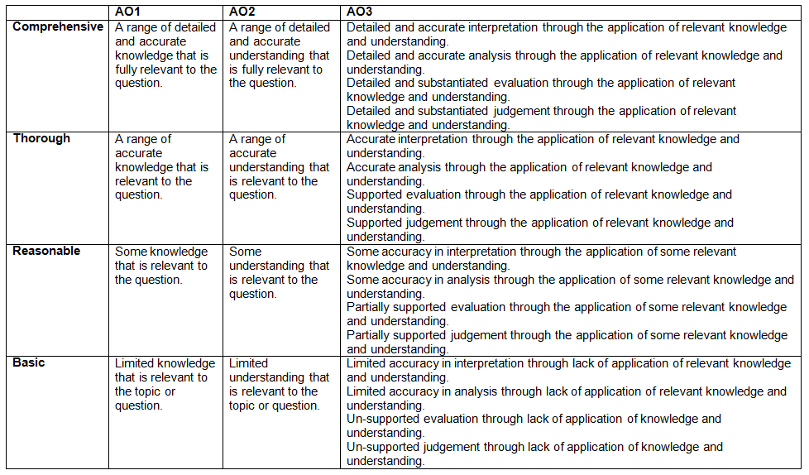
Level of Response Questions Marking Guidance
At the beginning of each mark scheme the following table is included to help you understand the level of response questions mark schemes. The wording in each level (from basic to comprehensive) indicates how answers develop and progress within each assessment objective.

Slide 11
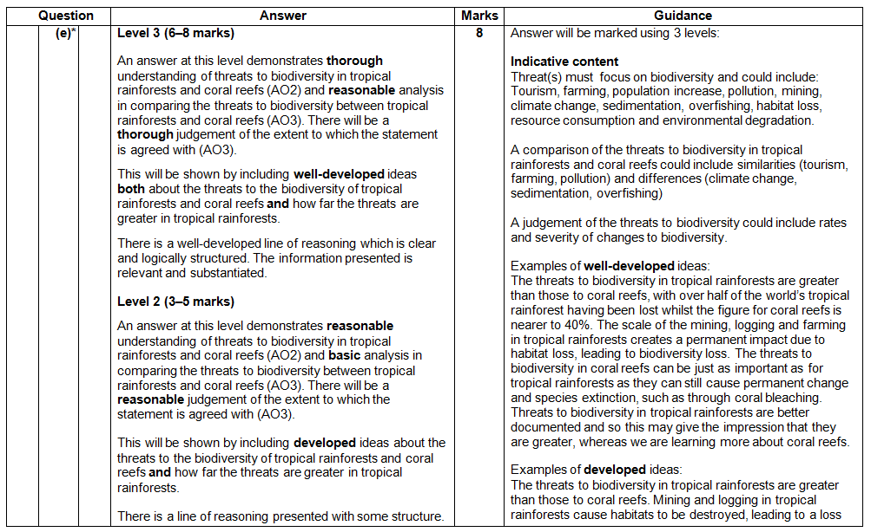
Level of Response Question Mark Scheme
The ‘Answer’ column includes information on how the assessment objectives link to the question and the standard required for the question parts.
The ‘Indicative content’ part of the mark scheme shows some of the content which could be included in students answers. This is not an exhaustive list.
A statement to indicate the level of development for answers to reach each level.
In the ‘Guidance’ column there are examples of ‘well-developed’, ‘developed’ and ‘simple’ ideas – these are examples of parts of answers – they are not full answers. The examples should show how an answer can develop from ‘simple’ to ‘developed’ to ‘well-developed’.
If ‘Quality of Extended Responses’ and/or ‘place-specific detail’ are being assessed they will be shown here.

Slide 12
Assessment Objectives
The assessment objectives are set by Ofqual and are vital to exam boards when designing assessments and for teachers in understanding styles of questions and their requirements.
For GCSE (9–1) Geography there are 4 Assessment Objectives :
AO1 (Knowledge)
AO2 (Understanding)
AO3 (Application of knowledge and understanding)
AO4 (Skills).
For all of the GCSE Geography specifications there are set assessment objectives with exact percentages of marks which must be attributed to each assessment objective within the qualification throughout the lifetime of the specification.
The next few slides will explain what the four assessment objectives mean and clarify their use in this assessment.

Slide 13
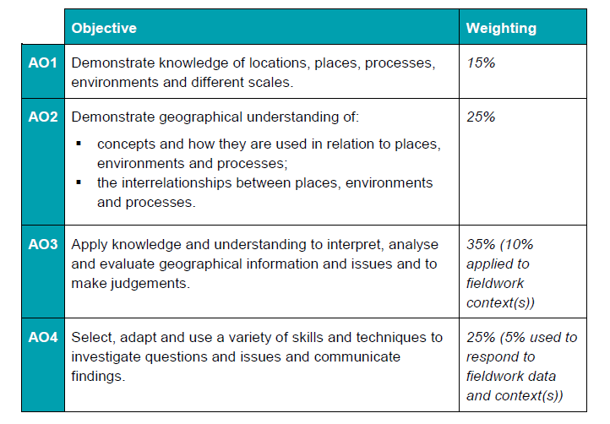
The 4 Assessment Objectives (AOs)
15% of the qualification
marks will be allocated to assessing students knowledge of the specification content (AO1)
25% of the qualification marks will be allocated to assessing students understanding of the specification content (AO2)
35% of the qualification
marks will be allocated to assessing students application of their knowledge and understanding of the specification content (AO3)
25% of the qualification
marks will be allocated to assessing students ability to select, adapt and use geographical skills and communicate findings in this context (AO4)

Slide 14
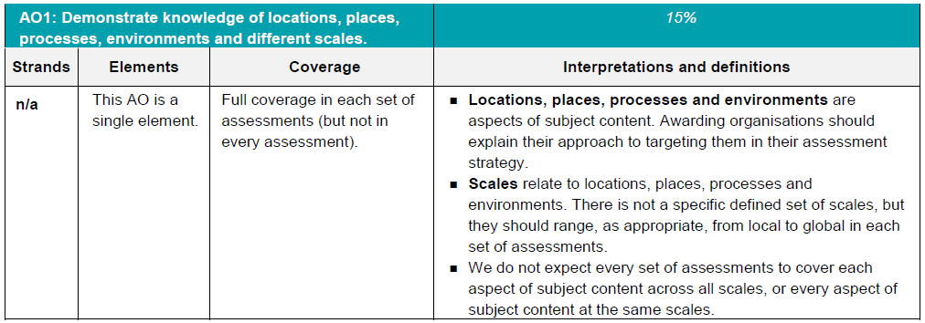
AO1 - Knowledge
Locations, places, processes and environments simply cover the subject content. There are other ways which you may describe content areas but all must be placed in these four aspects when we are creating our assessments.
Each year across the range of assessments there must be knowledge marks for locations, places, processes, environments and different scales but AO1 marks do not have to be included in every assessment.
Each year assessments will cover different scales
from local to global but not for every bit of content
or necessarily for all of locations, places, processes
and environments.

Slide 15
AO1 command words
AO1 requires candidates to demonstrate knowledge of the specification content through recalling information – including in a case study context.
Questions which target AO1 alone would tend to be shorter answer questions but longer questions may have AO1 marks allocated to them as well when combined with another assessment objective – particularly where case study information is required in an answer.
The following are some of the command words which may be used for short answer questions with AO1 marks:
Describe
Define
Outline
State
All of these command words are asking students to write down something that they have learnt from the specification and so are unlikely to be targeting a combination of assessment objectives.

Slide 16
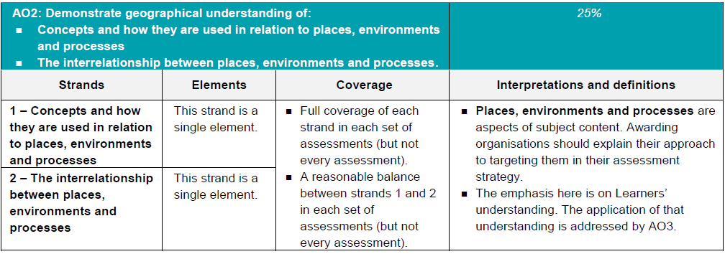
AO2 - Understanding
How concepts relate to the aspects of content.
Like with AO1 – places, processes and environments simply cover the subject content.
There must an appropriate balance in terms of the number of marks allocated to questions on the understanding of how concepts relate to content and how aspects of content relate to each other throughout the assessments.
How aspects of content relate to each other

Slide 17
AO2 command words
Questions with AO2 marks will focus on:
how concepts relate to the aspects of content
how aspects of content relate to each other
All AO2 marks will focus on understanding. AO2 marks will be directly linked to the specification but not just recalling what has been learnt, instead ensuring that students comprehend the content.
The following are some of the command words which may be used for questions with AO2 marks:
Explain how
Explain reasons/one reason
Discuss
AO2 marks may also be targeted in higher mark tariff questions but the command word may focus on a different assessment objective (e.g. AO3).
These command words may be used to solely target AO2 but may also be used in combination with other AO’s to target multiple assessment objectives, for example questions 1(d) or 2(b) of component 01 Living in the UK today.

Slide 18
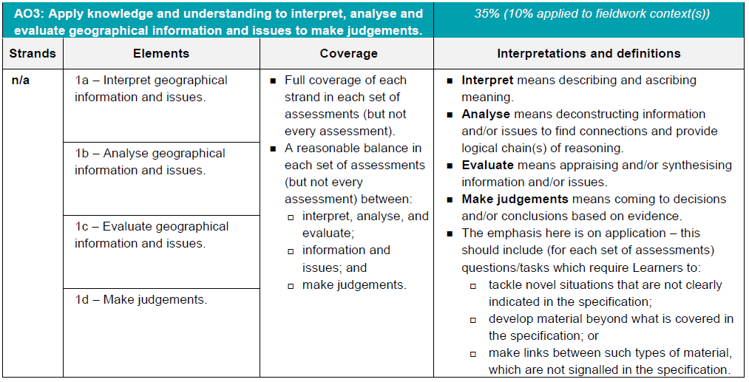
AO3 - Application
10% of the marks for the qualification must be allocated to the application of knowledge and understanding in a fieldwork context.
Three ways that students will need to apply their knowledge and understanding:
‘tackle novel situations’ could mean applying knowledge and understanding to a
resource
‘developing material beyond the specification’ could be evaluating the success of a
management strategy when the specification doesn’t explicitly ask for that
‘making links between such types of material which are not signalled in the
specification’ could be synoptic questions.

Slide 19
AO3 command words
Command words will vary depending on whether students are applying their knowledge and understanding by interacting with a resource(s) or not.
The following are some of the command words which may be used for questions with AO3 marks:
Weigh up whether a statement is true.
Interacting with resource | No resource
Describe | Assess
Give | Examine
Suggest | Evaluate
Outline | To what extent do you agree
Look in close detail and establish the key facts and important issues.
Give your verdict after providing evidence which both agrees with and contradicts an argument.
How much you agree with a statement based on the evidence in the argument.

Slide 20
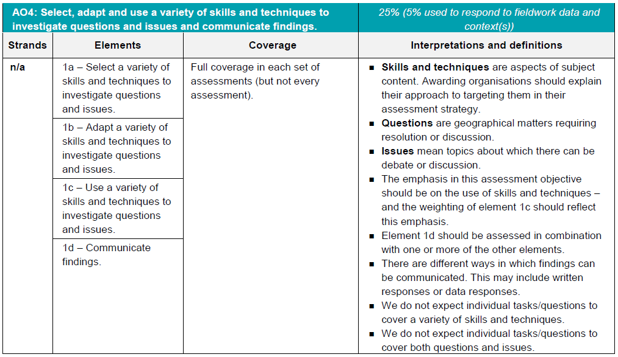
AO4 - Skills
5% of the marks for the qualification must be allocated to geographical skills in a fieldwork context.
Most of the AO4 marks will be allocated to using geographical skills – however there must be marks targeting ‘questions’ and ‘issues’ for selecting skills, adapting skills and using skills, as well as marks targeting ‘communicating findings’.

Slide 21
AO4 command words
AO4 requires students to select, adapt and use geographical skills, as well as communicate findings.
The following are some of the command words which may be used for questions with AO4 marks:
Describe the pattern
Using data
Calculate
Identify
Make a prediction
Commands words may vary depending on the level of interaction with a resource.

Slide 22
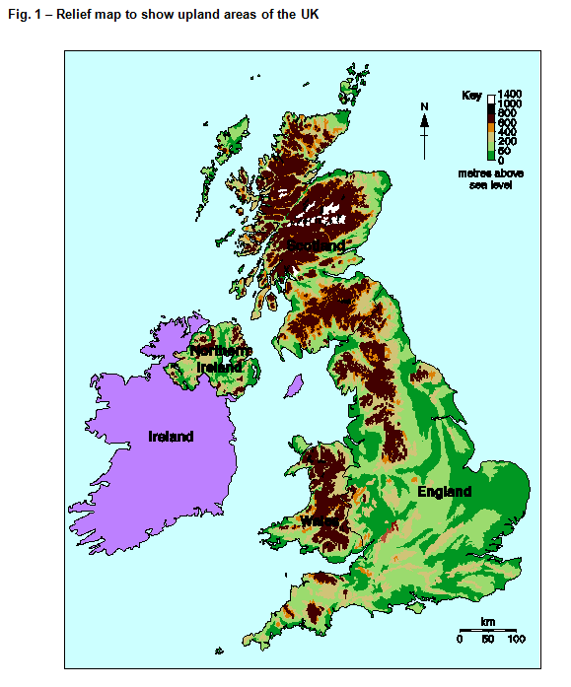
Question 1(a)
Study Fig. 1 which shows a relief map to show upland areas of the UK.
Questions will refer to the map in Fig. 1 and could be on any aspect at the moment, students should read the question first so they know what to focus on.

Slide 23
Question 1(a)(i) – 2 mark
Identify two features of the distribution of upland areas over 400m shown on the map.
This question is an AO4 (skills) question targeting students map reading skills.
Students need to focus on the distribution of the upland areas (over 400m) of the UK and identify two features of the distribution.
Any appropriate answer should be credited and some examples include
Large areas in Scotland (✓)
Covers most of Wales (✓)
Large area of N / NW England (✓)
Covers much of SW England (✓)
Covers some of Northern Ireland (✓)

Slide 24
Question 1(a)(ii) – 1 mark
Which one of the following is not likely to be located in an upland area of the UK?
A Nuclear power station
B Sheep farm
C Ski resort
D Water storage reservoir
This is an AO3 (application) multiple choice question. Students need to apply their knowledge and understanding of the characteristics of upland areas in order to make a judgement as to which of the four choices would be least likely to be located in an upland area of the UK.
The answer is ‘A: Nuclear power station’ as this is the most likely choice not to be located in an upland area of the UK, with sheep farms, ski resorts and water storage reservoir all more likely choices to be located in upland areas.

Slide 25
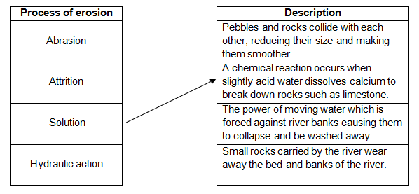
Question 1(b) – 2 marks
The table below names four processes of erosion which take place within a river basin. Use arrows to match each process of erosion with the correct description.
One has been done for you.
Abrasion:
Small rocks carried by the river wear away the bed and banks of the river (✓)
Attrition:
Pebbles and rocks collide with each other, reducing their size and making them smoother (✓)
Hydraulic action:
The power of moving water which is forced against river banks causing them to collapse and be washed away (✓)
This is an AO1 (knowledge) question as students need to recall the description of the processes in order to make the links. There is 1 mark available for 1 or 2 correct matches and 2 marks for all 3 correct matches.

Slide 26
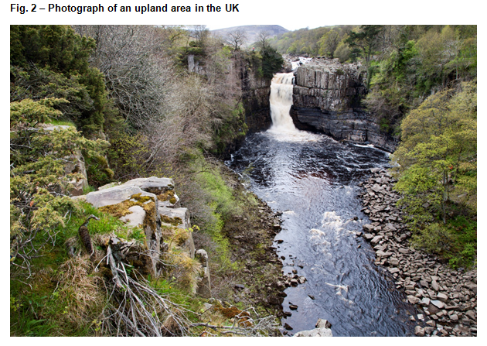
Question 1(c)(i) – 3 marks
Study Fig. 2 which shows a photograph of an upland area in the UK.
Describe how the landscape shown in Fig. 2 is characteristic of an upland area.
This is an AO3 (application) question as students need to apply their knowledge and understanding of characteristics of upland landscapes to the photograph to describe how the landscape shown is characteristic of an upland area.
The answers must be interpreted from the photograph. Potential characteristics which could be picked out from the photograph include:
Steep slopes (✓)
Uneven surface (✓)
Presence of a waterfall (✓)
Hard igneous rock (✓)
Thin vegetation covering (✓)

Slide 27
Question 1(c)(ii) – 3 marks
Explain the stages in the formation of a gorge.
This is an AO2 (understanding) question. Within the specification students are required to learn about the formation of a gorge, but this question asks for an explanation of the stages. It requires understanding to explain the stages in the formation of a gorge and not just state what the stages are.
There is one mark for each valid explanation of the stages in the formation of a gorge – but the response must be appropriate for UK landscapes. An exemplar from the mark scheme is below:
Water flows over hard and soft rock eroding the soft rock more quickly than the hard rock at a point of weakness (✓)
Erosion by hydraulic action or abrasion leads to the formation of a waterfall (✓)
A waterfall retreats upstream as erosion causes undercutting and an overhang collapses leaving a steep gorge (✓)

Slide 28
Question 1(d)* – 8 marks
CASE STUDY – a UK coastal landscape
Name of coastal landscape area in the UK
Examine how far human activity has positively impacted the coastal landscape in your chosen area.
An 8 mark question which is split between AO1 (knowledge), AO2 (understanding) and AO3 (application).
As this is a case study question there are marks for AO1 (knowledge), in this case for knowledge of human activity in the chosen coastal landscape. There are also AO2 (understanding) marks for including information on how human activity has impacted the landscape.
‘Examine’ is a command term that automatically means AO3 (application) and in this instance there are key words of ‘how far’ immediately after it. Students need to apply their knowledge and understanding to evaluate how far human activity has positively impacted the coastal landscape. The ‘how far’ element of the question means that students may want to discuss positive and negative impacts.
The asterisk (*) shows that ‘Quality of extended response’ will be assessed in this question – you can find out more about the Quality of Extended Response descriptors on slide 9.

Slide 29
Question 1(d)* – The mark scheme
Level 3 (6–8 marks)
An answer at this level demonstrates reasonable knowledge of human activity at the chosen coastal landscape (AO1) with reasonable understanding of how human activity has impacted the landscape (AO2). There is a thorough evaluation of how far human activity has positively impacted the coastal landscape (AO3).
This will be shown by including well-developed ideas about the impacts of human activity on the landscape and the answer must also include place-specific details of the distinctive landscape. Amount of relevant place-specific detail determines credit within level.
Level 2 (3–5 marks) looks for the same focuses in answers but with reasonable knowledge and evaluation but only basic understanding through developed ideas with no place-specific detail credited up to middle of the level.
Level 1 (1–2 marks) looks for the same focuses in answers but with basic knowledge, understanding and evaluation through simple ideas.
‘Quality of extended response’ is assessed within each level – you can find out more about the Quality of Extended Response descriptors on slide 9.

Slide 30
Question 1(d)* – The mark scheme
The case study studied by students will determine what area is used in their responses – case studies will vary between schools and as long as the case study meets the specification criteria (and therefore can be used to answer this question) then it is an appropriate case study.
Human activity which could be studied might include (but is not restricted to) tourism, footpath trampling, sport, industry and coastal management strategies (e.g. groynes, off-shore reef, sea wall, gabions, beach nourishment, rip rap and rock armour).
Examples of well-developed ideas:
It can be argued that human activity along the Norfolk coast has impacted the landscape in both positive and negative ways. Blakeney salt marsh has been protected as a Site of Special Scientific Interest which ensures the habitats and ecosystems are studied and preserved. Coastal management can have unintentional negative impacts and so schemes like the groynes which protect towns such as Sheringham and Cromer can then starve smaller villages of coastal sediment down the coast, such as Happisburgh. This can impact the landscape negatively starving depositional features and leaving it open to increased coastal erosion.
Overall human activity has been largely positive in terms of its impact on the coastal landscape as the management strategies have protected (marsh) and retained (beaches) areas as sympathetically as possible. Whilst some impacts can be negative such as loss of sediment, these have been factored in by decisions makers.
This well-developed idea begins with a sentence framing the rest of the answer in terms of the application part of the question.
It is then followed by sentences which solidify this comment by integrating knowledge and understanding with evaluative comments.
It discusses positive and negative impacts on the landscape which shows a high level of complexity in response to the question of how far human activity has positively impacted the coastal landscape.

Slide 31
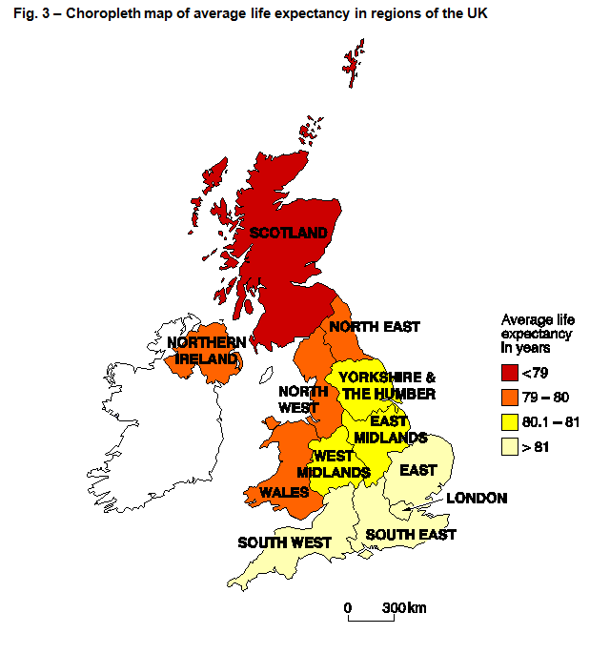
Question 2(a)
Study Fig. 3 which shows a choropleth map of average life expectancy in regions of the UK.
Questions will refer to the map in Fig. 3 and could be on any aspect at the moment, students should read the question first so they know what to focus on.

Slide 32
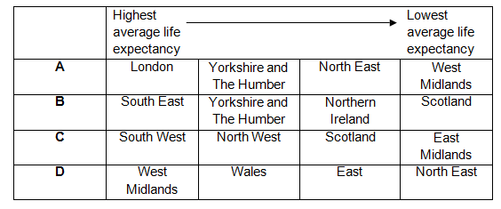
Question 2(a)(i) – 1 mark
Which one of the following correctly ranks the regions shown in Fig. 3 from highest to lowest average life expectancy?
This is an AO4 (skills) question targeting students map reading skills. Students use their map reading skills to pick information straight from the choropleth map and work out which of the four options correctly ranks the regions shown from highest to lowest average life expectancy.
The answer is ‘B: South East – Yorkshire and the Humber – Northern Ireland – Scotland’ as this is the only option where the following region always has a lower average life expectancy on the map.

Slide 33
Question 2(a)(ii) – 2 mark
Suggest two reasons for the regional variation in average life expectancy between London and Scotland, as shown in Fig. 3.
This is an AO3 (application) question where students must apply their knowledge and understanding to the map in order to suggest two reasons for the regional variation in average life expectancy between London and Scotland.
Students need to apply their knowledge and understanding to the context which the map shows – that London has a higher life expectancy than Scotland.
The following are reasons given in the mark scheme, but other appropriate reasons would also gain marks:
Access to healthcare/medical treatment (✓)
Difference in social/housing conditions (✓)
Variation in income/standard of living (✓)
Difference in diet/malnourished/obesity (✓)
Number of smoking/alcohol related diseases (✓)

Slide 34
Question 2(b) – 4 marks
Explain how investment in infrastructure can lead to uneven development within the UK.
This question has 2 marks for AO1 (knowledge) and 2 marks for AO2 (understanding). ‘The causes of uneven development within the UK, including infrastructure’ is directly taken from the specification and so students should know how investment in infrastructure can lead to uneven development in the UK – so this is knowledge of the content (AO1). However, to be able to explain how investment in infrastructure can lead to uneven development requires an understanding of the content (AO2).
There are 2 marks for identifying the investment in infrastructure (✓) which can lead to uneven development in the UK (recalling this from their study) and 2 marks for the explanation of how investment in infrastructure contributes to uneven development (DEV) (showing their understanding of this from their study).
Explanations such as:
More geographically remote areas such as the Scottish highlands or the South West of England have poor transport links with little investment (✓) which can stifle the economy as young people leave to find work elsewhere (DEV). Investment in the planned HS2 rail link will connect major cities in the North, such as Manchester and Birmingham, with the South (✓). This investment may rebalance the economy and reduce the North/South divide for cities however it could increase the uneven development between rural and urban areas (DEV).

Slide 35
Question 2(c) – 4 marks
Explain two effects of an ageing population in the UK.
This question has 2 marks for AO1 (knowledge) and 2 marks for AO2 (understanding). ‘An understanding of the causes and the effects of, and responses to an ageing population’ is directly taken from the specification and so students should know effects of an ageing population in the UK –this is therefore knowledge of the content (AO1). However, to be able to explain two effects of an ageing population in the UK requires an understanding of the content (AO2).
There are 2 marks for identifying the effects of an ageing population (✓) (recalling this from their study) and 2 marks for the explanation of the effects of an ageing population (DEV) (showing their understanding of this from their study).
Effects can be positive or negative but the explanation must be coherently linked to the effect identified.
Effects such as:
Increased demand for medical treatment (✓) for diseases such as dementia / arthritis which puts strain on the NHS (DEV)
Older generation takes care of grandchildren (✓) which reduces cost of childcare for parents (DEV)

Slide 36
Question 2(d) – 6 marks
Discuss the social and economic impacts of immigration on the UK in the 21st century.
This question is all AO2 (understanding) marks. As part of the specification students need to know about flows of immigration into the UK in the 21st century including an overview of the social and economic impacts on the UK. Therefore to be able to discuss the social and economic impacts of immigration on the UK in the 21st century students must show that they understand the impacts.
Following the command word of ‘discuss’ there is only wording directly from the specification – therefore there is no application required in this question. There is no need for evaluative or conclusive comments but these may be naturally made as part of the discussion of social and economic impacts.

Slide 37
Question 2(d) – The mark scheme
Level 3 (5–6 marks)
An answer at this level demonstrates thorough understanding of the impact of immigration on the UK (AO2).
This will be shown by including well-developed ideas about both social and economic impacts.
Level 2 (3–4 marks) looks for the same focus in answers but with reasonable understanding through developed ideas about social and/or economic impacts..
Level 1 (1–2 marks) looks for the same focus in answers but with basic understanding through simple ideas about either social or economic impacts.
The mark scheme also states that students can only receive a maximum of Level 1 if the 21st century is not addressed. This does not mean that they must use the words ‘since 2000’ or ‘in the 21st century’ but if the impacts they discuss do not have any relevance to the 21st century then they will only be able to get a maximum of 2 marks.

Slide 38
Question 2(d) – Indicative Content
The impacts of immigration that the students discuss can vary and the selection given in the mark scheme (and below) are just an example of some which could be discussed. To reach the top level students must discuss both social and economic impacts (as the question asks for) but there is nothing to suggest that there needs to be a certain balance between the two in the answer.
Social:
Strain on local services such as housing / schools / hospitals
Bring their own culture such as food / customs
Conflict with locals / feeling that town is ‘swamped’
Economic:
Increases workforce for low-paid / unpopular jobs
Fills gap in job market, such as nursing / construction
Competition with local people for jobs
Contribute financially to local / national economy

Slide 39
Question 2(d) – Well-developed? Developed? Simple?
Examples of simple ideas:
Puts pressure on schools or hospitals.
Bring their own food and language.
Immigrants compete for jobs with locals.
Examples of developed ideas:
Immigrants bring their own culture such as shops which can have a positive benefit to areas. Immigrants need schools and doctors, putting a strain on these services.
Economically, immigration provides a workforce, especially for unpopular work, such as fruit picking. People are also available to do jobs such as nursing which helps the NHS due to shortages in this industry, this can benefit the economy.
Examples of well-developed ideas:
Immigrants bring their own culture such as foods, customs and shops which can have a positive benefit to the local community. Immigrants need access to schools and doctors, putting a strain on these services and more staff may be needed to cope with the demand.
Economically, immigration provides workforce, especially for unpopular, low paid jobs which locals will not do, such as fruit picking. Immigrants can fill gaps in the labour market such as nursing which helps the NHS due to shortages in this industry, this benefits the national economy.
This slide shows how ideas may progress from simple to developed and then well-developed. There is an example for both social and economic impacts.

Slide 40
Question 3(a) – 1 mark
In 2010 Rochdale experienced a flood which caused chaos for local people.
Using Fig. 4 an OS map extract in North West England, give one piece of evidence from the map which suggests that Rochdale could experience another flood?
This AO3 (application) question requires students to apply their knowledge and understanding by interpreting the resource (an OS map extract in this instance) and give one piece of evidence which suggests that Rochdale could experience another flood.
As students need to study the causes of a flood within their case study in the UK Environmental Challenges theme they need to apply their knowledge and understanding in order to answer this question. Students are tackling a novel situation – one of the three ways application (AO3) must be assessed – within their answer to this question.
Potential answers could include (but are not restricted to):
High urban density with little green space (✓)
A river runs through Rochdale (✓)
A river to the south of Rochdale (✓)

Slide 41
Question 3(b) – 4 marks
Case Study – a flood event in the UK caused by extreme weather conditions
Name of UK flood event:
Explain the effects of the UK flood event on people.
This question has 2 marks for AO1 (knowledge) and 2 marks for AO2 (understanding). As it is a case study question there has to be AO1 (knowledge) marks and explaining the effects of the UK flood event on people requires an understanding of the case study (AO2).
Case study: flood event in the UK caused by extreme weather conditions
In 2009 over 1300 properties in Cockermouth were flooded (✓), which included homes and businesses with an average cost of damage per home of £28000 (DEV). People were forced to abandon their homes due to the flood damage (✓) and some people could not return for more than three months, this caused distress and physiological damage (DEV).
There are 2 marks for stating effects of the UK flood event on people (✓) (recalling this from their study) and 2 marks for explaining the effects (DEV) (showing their understanding of this).
The explanation of the impact on people must be related to the effect of the flood event.

Slide 42
Question 3(c)(i) – 1 mark
Study Fig. 4 an OS map extract in North West England, which shows a wind farm.
In which one of the following grid squares are wind turbines located?
A 8216
B 8217
C 8417
D 8517
The geographical skill assessed is the ability to understand coordinates in the context of an OS map.
The map has a key for reference and to allow access to the question.
The correct answer is ‘C: 8417’, with no wind turbines being located in any of the other three potential answers.

Slide 43
Question 3(c)(ii) – 1 mark
Using Fig. 4, describe the relief of the land where the wind farm is located.
The geographical skill (AO4) assessed is the ability to use and understand gradient, contour and spot height in the context of an OS map.
The map has a key for reference and to allow access to the question.
Example points given in the mark scheme include:
Highland/upland areas
Over 350m
Steeply sloping land
Any valid point will receive marks but points do need to be able to come from the OS map. This does not mean that each point has to have reference to the OS map but they should all be able to be interpreted from the resource.

Slide 44
Question 3(d)* – 12 marks (+3 SPaG)
Study Figs 5 and 6 in the separate Resource Booklet
Using Figs 5 and 6 and your own knowledge and understanding, assess whether the sustainable management of energy has been successful at a local scale.
This is a 12 mark question which is split evenly between AO1 (knowledge), AO2 (understanding) and AO3 (application).
The question asks students to use Figs 5 and 6 (which will require application) as well as use their knowledge (AO1) and understanding (AO2). The specification requires study of ‘strategies for sustainable use and management of energy at local and UK national scales, including the success of these strategies’. Knowledge is required of sustainable management of energy at a local scale as well as an understanding of its success.
Assess is a command term that automatically means AO3 (application) and means that students need to weigh up whether sustainable management of energy has been successful at a local scale using the resources as well as their knowledge and understanding.
The asterisk (*) shows that ‘Quality of extended response’ will be assessed in this question – you can find out more about the Quality of Extended Response descriptors on slide 9.
There are marks for SPaG (Spelling, punctuation and grammar and the use of specialist terminology) you can find out more about the SPaG descriptors on slide 8.

Slide 45
Question 3(d)* – The mark scheme
Level 4 (10–12 marks)
An answer at this level demonstrates comprehensive knowledge of sustainable management of energy at a local scale (AO1) and comprehensive understanding of the success of the sustainable management (AO2). There will be a comprehensive analysis of the resources to determine whether the sustainable management of energy can be successful (AO3).
This will be shown by including well-developed ideas about the sustainable management of energy at a local scale and whether these are successful.
Level 3 (7–9 marks) looks for the same focuses in answers but with thorough knowledge, understanding and analysis through well-developed ideas about either sustainable management of energy or how sustainable management has been successful developed ideas about the other question focus.
Level 2 (4–6 marks) looks for the same focuses in answers but with reasonable knowledge, understanding and analysis through developed ideas about either sustainable management of energy or how sustainable management has been successful simple ideas about the other question focus.
Level 1 (1–3 marks) looks for the same focuses in answers but with basic knowledge, understanding and analysis through simple ideas about sustainable management of energy or how sustainable management has been successful.
‘Quality of extended response’ is assessed within each level – you can find out more about the Quality of Extended Response descriptors on slide 9.

Slide 46
Question 3(d)* – The mark scheme
The indicative content gives some idea as to what candidates may discuss, including things from the resource such as in Fig.5 that larger wind turbines equate to great carbon dioxide being offset and from Fig. 6 the combination of energy sources used to generate electricity for 1500 homes. It also acknowledges that students may suggest a range of sustainable management strategies and that UK national energy strategies influence local scale strategies too.
Examples of well-developed ideas:
Local sustainable management plans are required to meet national targets and this helps to show their success in reducing carbon emissions. For example in Cambridge the local government is attempting to manage energy sustainably through investments in energy efficiency and renewable / low carbon energy projects to meet national targets. For example, when building new homes there is an aim to be ‘zero carbon’ through insulation to reduce heat loss and solar panels are used to generate electricity. Residents have reported a reduction in bills through the energy savings and therefore this can be said to be a success.
Figs 5 and 6 show how renewable and alternative energies can supply energy. Fig 5 shows that the largest wind turbine offsets 1400 times more carbon than a 1kW wind turbine which would power one home. Cambridge’s County Council has also used strategies to increase renewable energy sources through wind farms and solar technologies as well as community energy networks for the heating of buildings. Fig. 6 shows a hybrid energy system where a combination of energy sources providing both heat and power largely from biomass supplies for 1500 homes. It is small scale but still produces double the amount of energy and heat needed and can be sold back to the national grid or recycled.
This well-developed idea integrates knowledge, understanding and application of the knowledge and understanding of Figs 5 and 6 to help assess whether the sustainable management of energy has been successful at a local scale.
There is a range of recalled information and resource material included as well as mention of how it relates to ‘success’.

Slide 47
We’d like to know your view on the resources we produce. By clicking on ‘Like’ or ‘Dislike’ you can help us to ensure that our resources work for you. When the email template pops up please add additional comments if you wish and then just click ‘Send’. Thank you.
Whether you already offer OCR qualifications, are new to OCR, or are considering switching from your current provider/awarding organisation, you can request more information by completing the Expression of Interest form which can be found here: www.ocr.org.uk/expression-of-interest
Looking for a resource? There is now a quick and easy search tool to help find free resources for your qualification: www.ocr.org.uk/i-want-to/find-resources/
OCR Resources: the small print OCR’s resources are provided to support the delivery of OCR qualifications, but in no way constitute an endorsed teaching method that is required by the Board, and the decision to use them lies with the individual teacher. Whilst every effort is made to ensure the accuracy of the content, OCR cannot be held responsible for any errors or omissions within these resources. © OCR 2017 - This resource may be freely copied and distributed, as long as the OCR logo and this message remain intact and OCR is acknowledged as the originator of this work.
OCR acknowledges the use of the following content: n/a
Please get in touch if you want to discuss the accessibility of resources we offer to support delivery of our qualifications: resources.feedback@ocr.org.uk

