Slide 1
Balancing Equations
Lesson Element

Slide 2
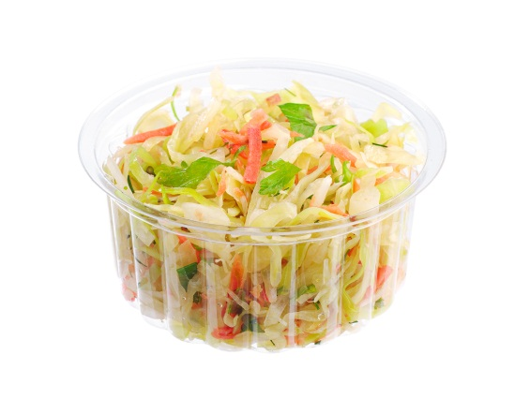
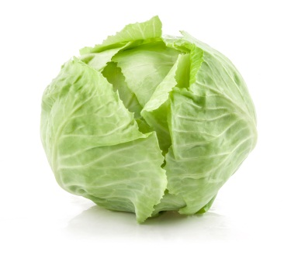
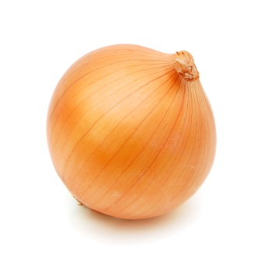
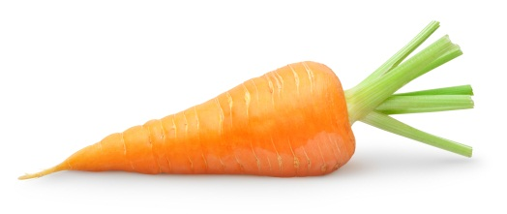
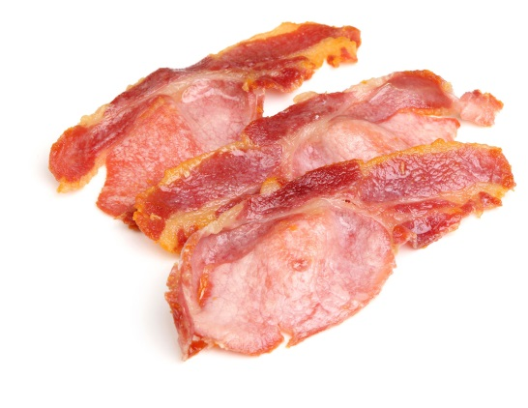
Balancing Equations
P
+
+
=
O
+
+
=

Slide 3
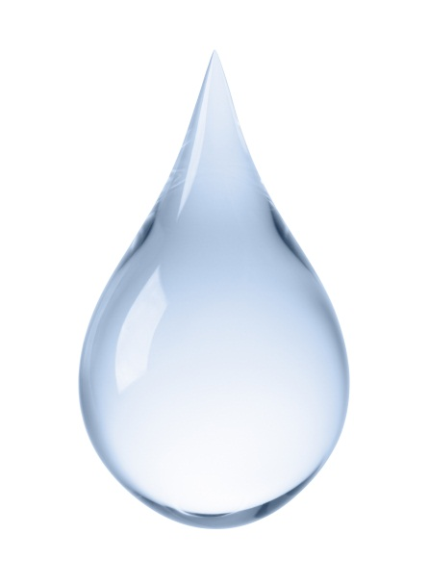
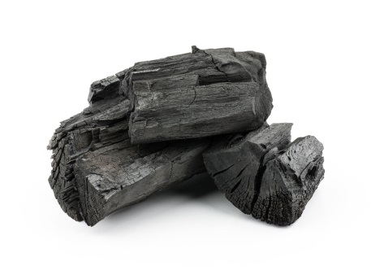
Balancing Equations
Oxygen
P
+
=
Hydrogen
Water
O
Oxygen
+
=
Hydrogen
Carbon

Slide 4
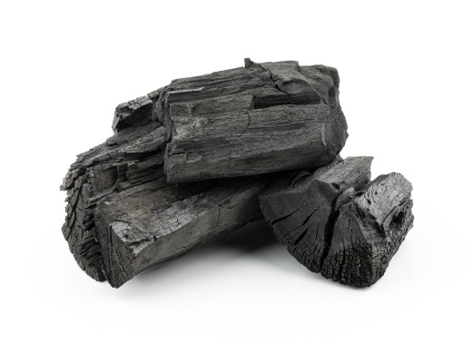
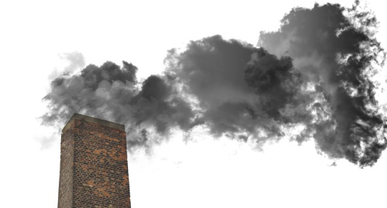
Balancing Equations
The mass on each side of
the equation must be equal.
Oxygen
+
=
Carbon Dioxide
Carbon
1 x 12 = 12g
2 x 16 = 32g
1 x 12 = 12g
+
2 x 16 = 32g
12
32
= 44g

Slide 5
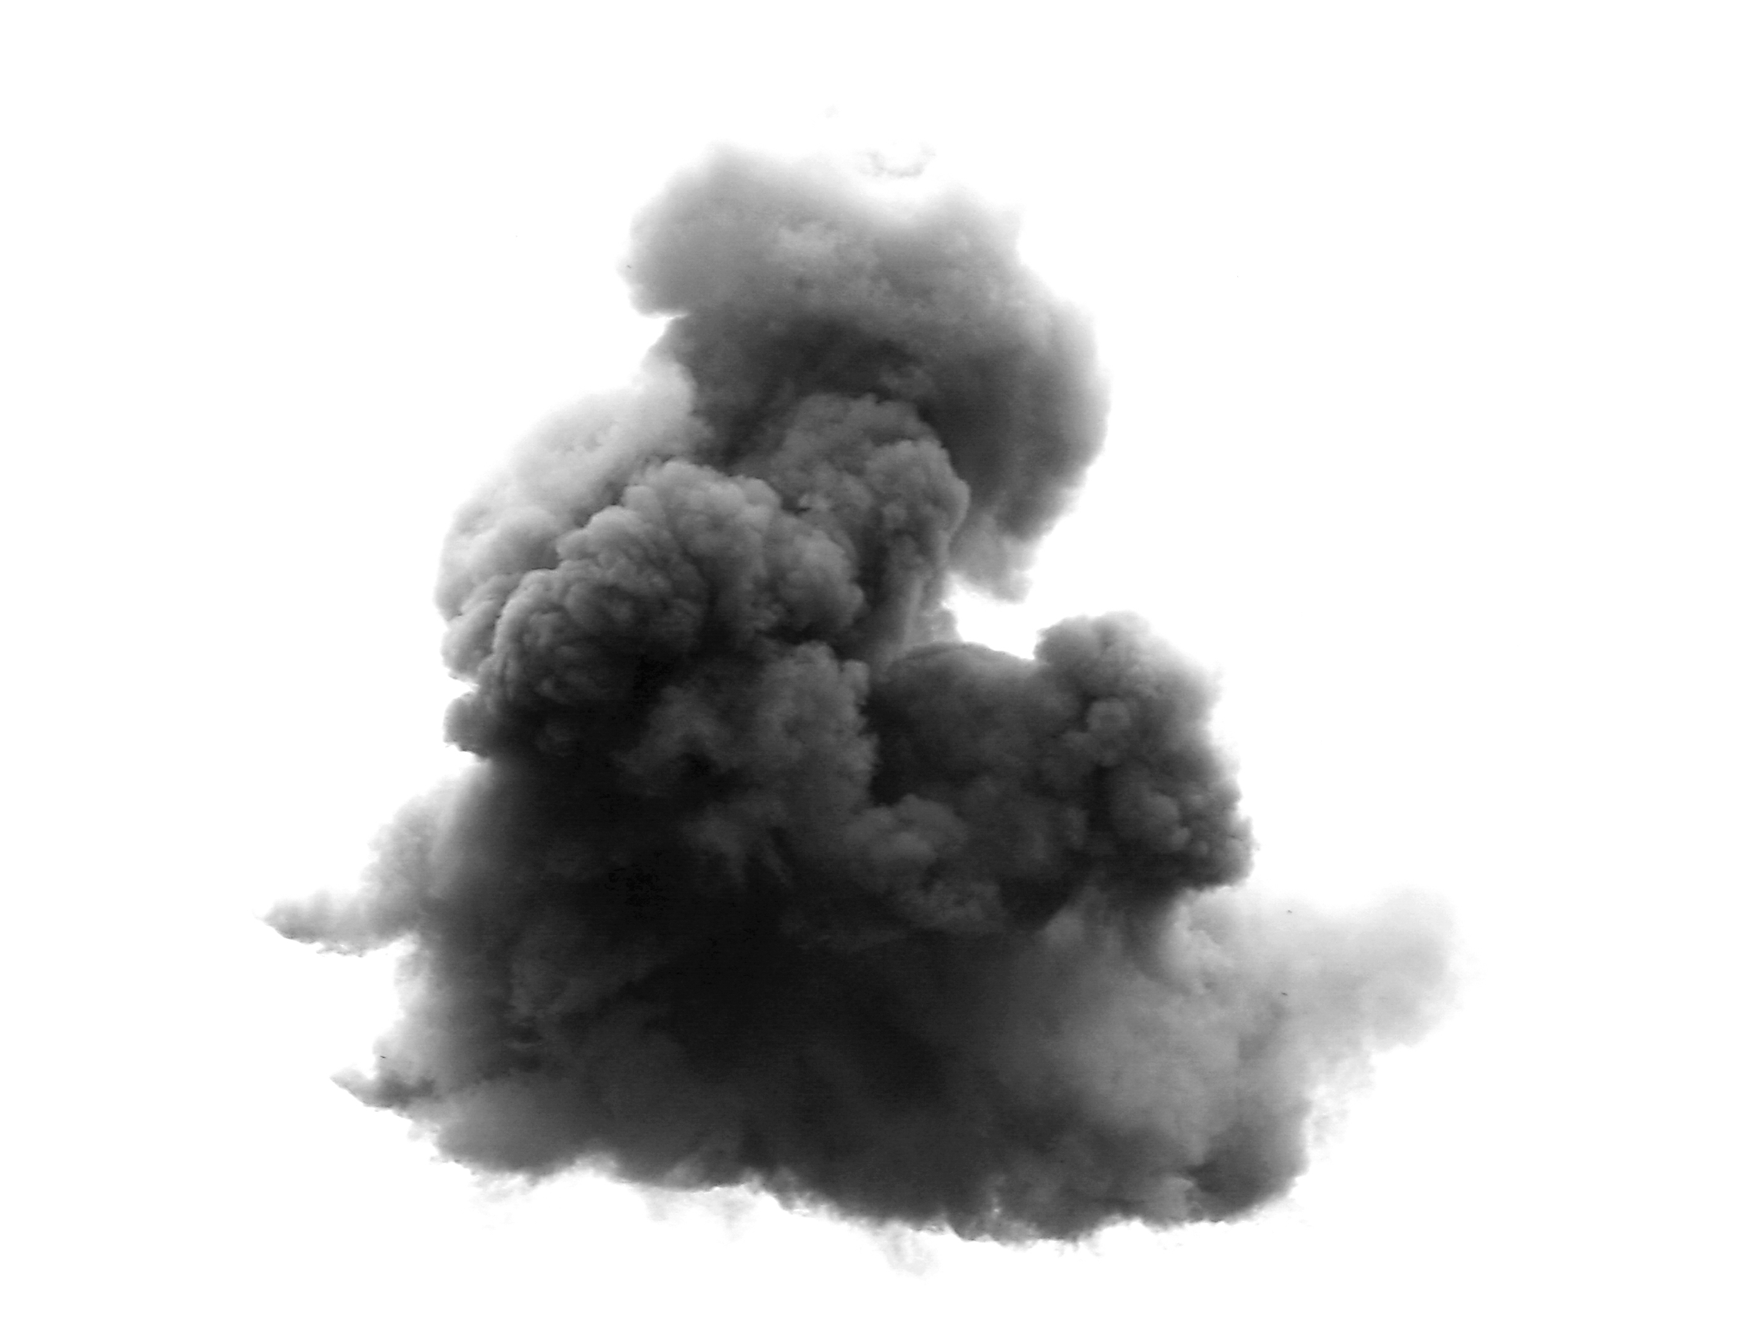
Balancing Eqautions
What happens if the masses are not equal/
Then the equation needs to be balanced.
Carbon Monoxide
Oxygen
+
=
Carbon
2C
+
O₂
=
2CO
2 x 12 = 24g
2 x 16 = 32g
2 x 12 = 24g
+
2 x 16 = 32g
24
32
= 56g

Slide 6
Small Print
We’d like to know your view on the resources we produce. By clicking on ‘Like’ or ‘Dislike’ you can help us to ensure that our resources work for you. When the email template pops up please add additional comments if you wish and then just click ‘Send’. Thank you.
Whether you already offer OCR qualifications, are new to OCR, or are considering switching from your current provider/awarding organisation, you can request more information by completing the Expression of Interest form which can be found here: www.ocr.org.uk/expression-of-interest
Looking for a resource? There is now a quick and easy search tool to help find free resources for your qualification: www.ocr.org.uk/i-want-to/find-resources/
OCR Resources: the small print OCR’s resources are provided to support the delivery of OCR qualifications, but in no way constitute an endorsed teaching method that is required by the Board, and the decision to use them lies with the individual teacher. Whilst every effort is made to ensure the accuracy of the content, OCR cannot be held responsible for any errors or omissions within these resources. © OCR 2017 - This resource may be freely copied and distributed, as long as the OCR logo and this message remain intact and OCR is acknowledged as the originator of this work.
OCR acknowledges the use of the following content: slide 2: cabbage – NinaM/Shutterstock.com, onion – Hong Vo/Shutterstock.com, carrot - Anna Kucherova/Shutterstock.com, coleslaw – Aleksandrs Samuilovs/Shutterstock.com, bacon – Joe Gough/Shutterstock.com, slides 3, 4 and 5: canisters – Marynchenko Oleksandr/Shutterstock.com, coal – Nuttapong/Shutterstock.com, slide 3: water droplet – ifong/Shutterstock.com, slide 4: carbon dioxide – Jurand/Shutterstock.com, slide 5: black smoke – ChiccoDodiFC/Shutterstock.com
Please get in touch if you want to discuss the accessibility of resources we offer to support delivery of our qualifications: resources.feedback@ocr.org.uk

