Slide 1
Y540
Pure Core
Annotated sample assessment materials
Notes:
These annotated SAMs commentaries have been developed by OCR to offer guidance on the wording of questions on the new sample assessment materials and what candidates should do in response to them.

Slide 2
Guidance
This guide is designed to take you though the A Level Pure Core Y540 sample assessment paper. Its aim is to explain how candidates should approach each paper and how marks are awarded to the different questions.
The orange text boxes offer further explanation on the questions on the exam
paper. They offer guidance on the wording of questions and what candidates
should do in response to them.
The green text boxes focus on the awarding of marks for each question.
This is a ‘show that’ question i.e. the answer has been given. A clear mathematical argument must be seen.
[this is an example]
The examiner is looking for a clear method for rationalising the denominator. [this is an example]

Slide 3
This is a ‘show that’ question i.e. the answer has been given.
Typing the LHS into a calculator will give the RHS
Examiners will check that an answer has not been ‘fudged’

Slide 4
There are a number of ways that questions will clearly indicate, through the use of defined command words (see specification), that a numerical result obtained from a calculator will be insufficient to gain full credit. One is, as this question, ‘In this question you must show detailed reasoning.’. This is not a restriction on a candidate’s use of a calculator when tackling the question, e.g. for checking an answer or evaluating a function at a given point, but it is a restriction on what will be accepted as evidence of a complete method.
For part (i) of this question the first mark is for making clear the conjugate pair, 2+3i and 2-3i. There are then two method marks for the attempt to find each of the quadratic factors, with the final accuracy mark awarded for f(x) written as the product of the two quadratic factors.
For part (ii) the mark is dependent upon clear working, either seen in part (i) or shown here.

Slide 5
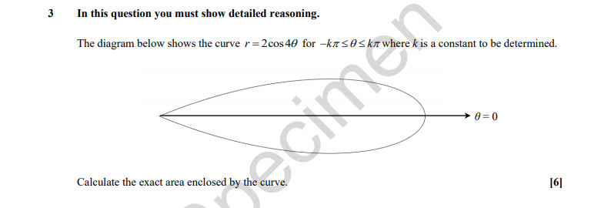
Like the previous question all working must be shown. There are many calculators which will provide an exact answer for a definite integral but when the question specifically states ‘show detailed reasoning’ then the candidate is expected to show the mathematics required to find the answer, hence all working must be shown. In this case, where the value of a definite integral needs to be found the method of doing the integration must be shown.
Additionally you are asked for the ‘exact’ area. That means that any irrational numbers that appear such as square roots, logs or e or π should be left in your answer rather than giving an approximate answer from your calculator.
The DR means that a clear argument is provided.
Alternate routes could be given, provided a clear line of thinking shown.

Slide 6
In a situation where a graph is required there may be one of three demands.
Plot means that you calculate or are given coordinates of a number of points to mark accurately on a graph. You may then draw carefully the straight line or curve through them. A grid will be provided to indicate the range of values you should work with.
Sketch requires you to show the general shape and to mark significant features, such as intercepts on the axes and turning values. Any asymptotes should be included and the nature of the curve as it approaches the asymptotes. There will, in general, be a blank space rather than a grid.
Draw means a rather more accurate sketch than indicated above. Such a drawing will be typically somewhere between a sketch and a plot. Sometimes a grid will be given but if not then a blank space will be provided.
The examiner is looking for the key features to be annotated.
Note also the fact that one of the inequalities is a ‘strictly less than’ and the other is ‘less than or equal to’. In the former the boundary line is dotted and in the latter it is drawn bold.

Slide 7
Part (i) is a ‘show that’ question so a clear link to the terms substituted into the formulae.
Part (ii) simply asks for candidates to find, some candidates may spot the link with part (i) and write an answer directly.
The explanation of part (i) has to be sufficiently detailed to cover every step of the working.
In part (ii), ‘Find’ indicates that while some working may be necessary to answer the question, no justification is required. If a candidate can obtain the solution from the efficient use of a calculator they may do so bearing in mind that they are advised to write down what they are evaluating and use the correct mathematical notation. It is always advisable to include some working so that part marks can be earned; an incorrect answer with no working will not earn any marks. In this case, application of the formulae would be a likely approach.

Slide 8
This is a ‘find’ question, so some working may be necessary to answer the question but justification is not required.
In this case, stating the product and the sum of the roots and how you find them for the new equation would be a likely approach.

Slide 9
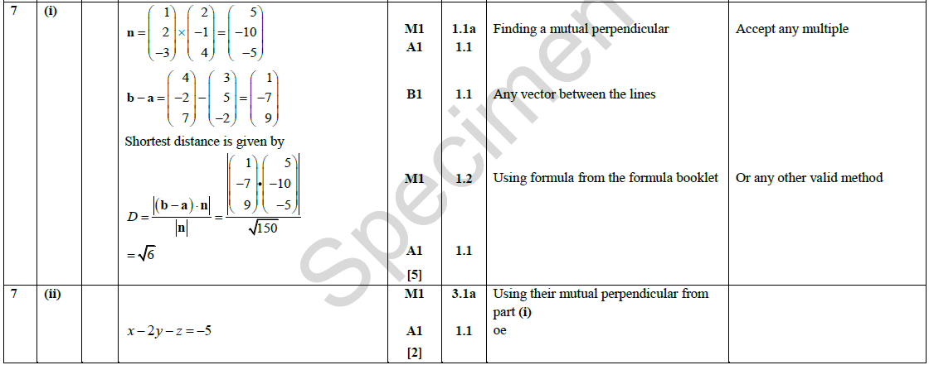
This is a ‘find’ question, so some working may be necessary to answer the question but justification is not required. The formula for finding the shortest distance between two skew lines is now provided in the reformed specification and so the entries in the formula need to be seen but how they were derived is not necessary.

Slide 10
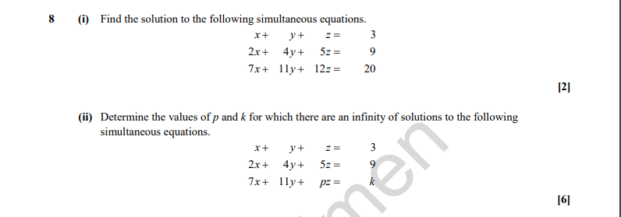
i) In the reformed specification, candidates can use their calculator to find the solution to three simultaneous equations. When using calculators, candidates are advised to write down explicitly any expressions that they use the calculator to evaluate and use the correct mathematical notation (rather than ‘calculator notation’).
The mark scheme has BC, by calculator, in the mark scheme and the use of the command word ‘find’ in this instance means that there is no requirement to justify answers.

Slide 11
(ii) ‘Determine’ is rather stronger than ‘find’; justification should be given for any results found, including working where appropriate.
In this case, no assumptions should be made without stating them.

Slide 12
‘Prove’ means candidates must provide a formal mathematical argument which demonstrates its validity. In this case, ‘prove by induction’ requires that all the steps of the inductive process should be seen.
These are:
Show by calculation that the formula is true for a particular value; generally this will be n = 1.
Assume that the formula is true for some value of n, say n = k
By adding an extra term and doing some algebraic manipulation show that it is also true for n = k + 1.
Finish the process with the conclusion ‘Since it is true for n = k then it is also true for n = k + 1. But it is true for n = 1 and so is true generally’.

Slide 13
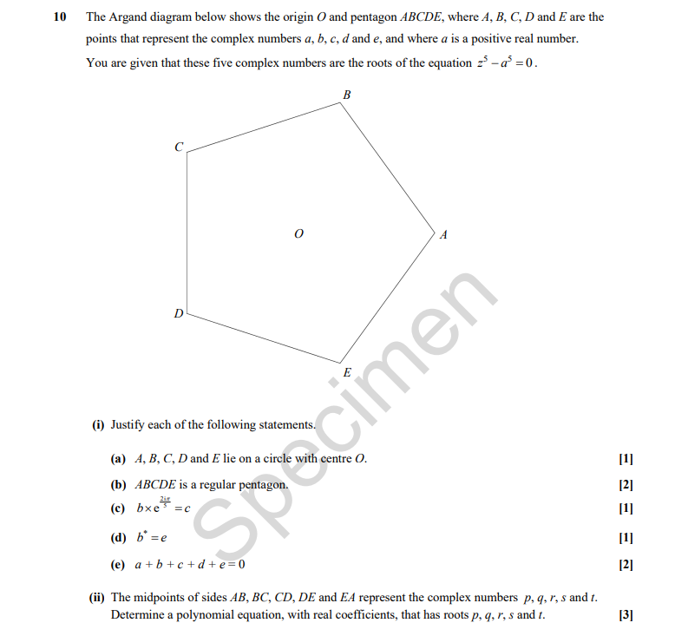

Slide 14
(i) ‘Justify’ means that you need to give a clear explanation as to why the statement is true.

Slide 15
(i) ‘Justify’ means that you need to give a clear explanation as to why the statement is true.

Slide 16
(i) ‘Justify’ means that you need to give a clear explanation as to why the statement is true.

Slide 17
(i) ‘Justify’ means that you need to give a clear explanation as to why the statement is true.

Slide 18
(i) ‘Justify’ means that you need to give a clear explanation as to why the statement is true.

Slide 19
(ii) Using complex roots of unity to solve geometric problems is new content in the reformed specification.
The command word ‘determine’ used so clear justification needed.

Slide 20
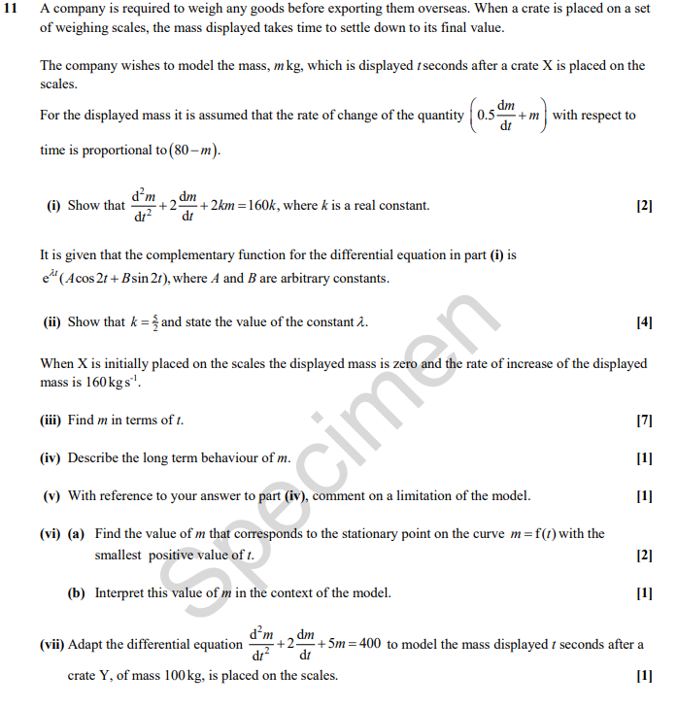
The meanings of most of the command words in this question should be taken as the ordinary English meaning.

Slide 21
Part (i) is a ‘show that’ question so clear use and manipulation of the information provided is needed
Take care that each line of working follows on from the previous line. A common cause of dropped marks for this type of question is for a sign error to be spotted but not corrected throughout the solution.

Slide 22
This is a ‘show that’ question so clear use of the complementary function needs to be seen.

Slide 23
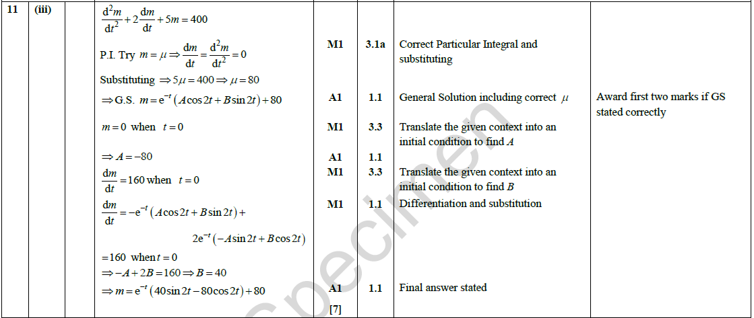
As a ‘Find’ question, working is not required, but recommended.

Slide 24
(iv) ‘Describe’ means give a detailed account in words to say what is happening. It does not need to be perfect English or punctuated correctly, but an examiner needs to be able to see that you know what is happening.
(v) ‘Comment’ means make a statement to indicate the limitation of the model.
Bear in mind there is only 1 mark for each of these. Long responses risk contractions.

Slide 25
(vi) (a) ‘Find’ so no working required, but expected.
(vi)(b) ‘Interpret’ means that something is happening and you need to be able to explain what that is in this situation.
(vii) ‘Adapt’ means that as one or more of the initial values or assumptions has been changed, the equation needs to reflect this change, so you need to write down the new equation.

