Slide 1
Y544
Discrete Mathematics
Annotated sample assessment materials

Slide 2
Guidance
This guide is designed to take you though the A Level Further Maths H245 Discrete Mathematics optional paper. Its aim is to explain how candidates should approach each paper and how marks are awarded to the different questions.
The orange text boxes offer further explanation on the questions on the exam
paper. They offer guidance on the wording of questions and what candidates
should do in response to them.
The green text boxes focus on the awarding of marks for each question.
This is a ‘show that’ question i.e. the answer has been given. A clear mathematical argument must be seen.
[this is an example]
The examiner is looking for a clear method for rationalising the denominator. [this is an example]

Slide 3
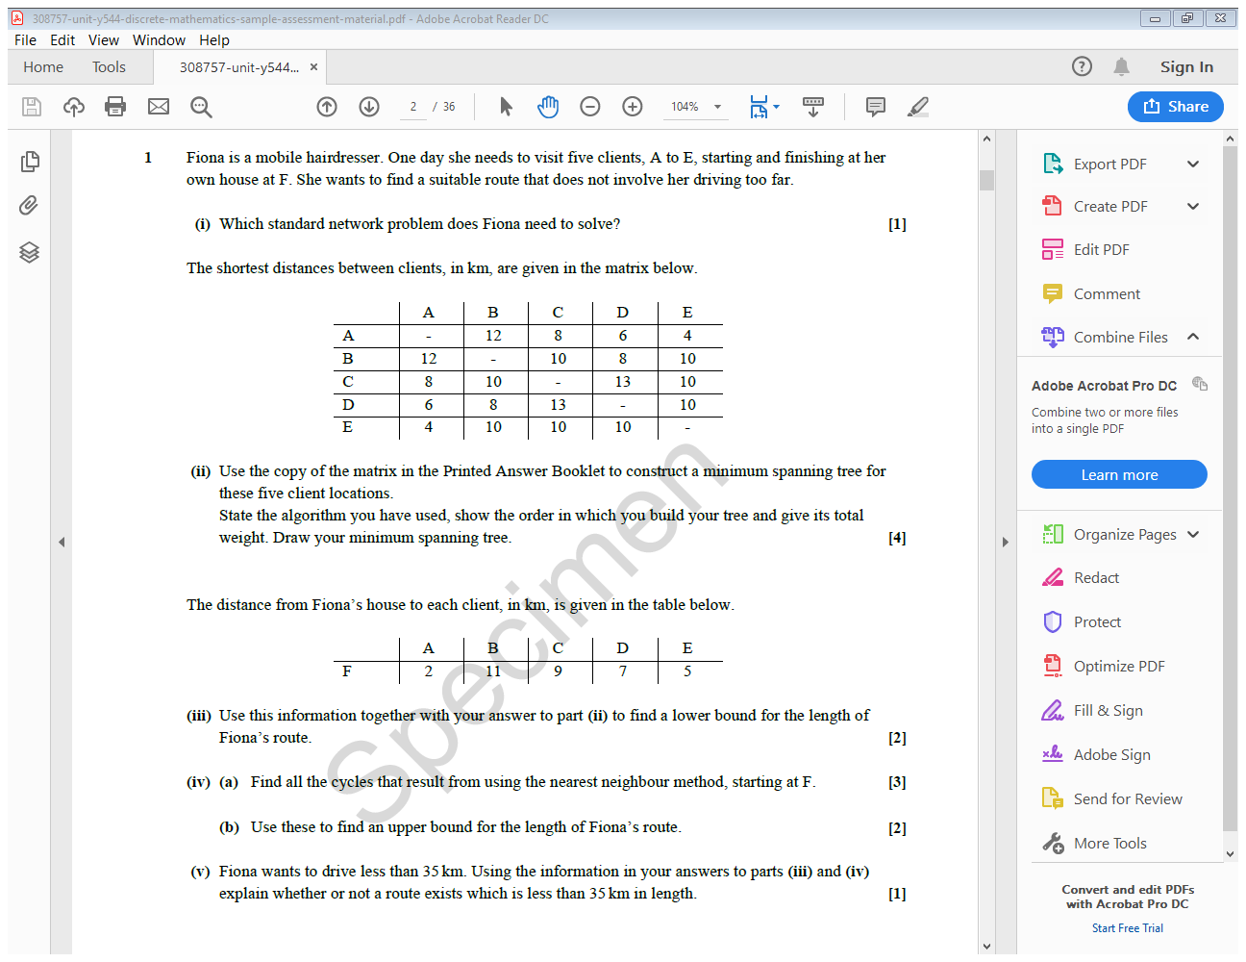
This question starts with topics from 7.02 and 7.04 that could be tested on the AS paper and then develops into A Level material.

Slide 4
This problem requires a closed cycle through the vertices.
1 mark AO1 for recalling a fact.

Slide 5
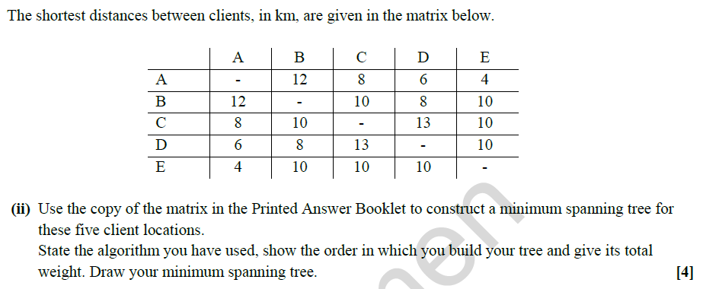
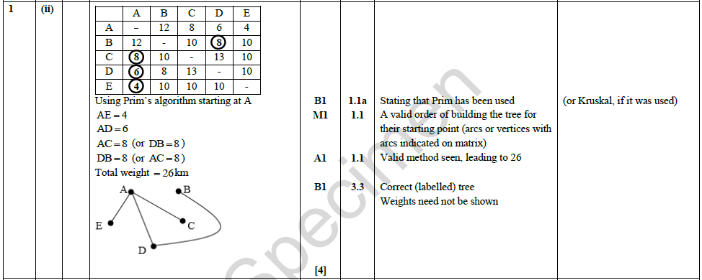
The problem wants the total distance to be minimised, or as short as can be found.
The standard network problem is the travelling salesperson problem.
The tabular/matrix form of Prim’s algorithm should be used. This is given in the Formulae Booklet (see page 121 of the specification).
1 mark A03 for translating a problem given in context into a mathematical model and 3 marks AO1 for selecting and carrying out routine procedures.
These instructions tell candidates what is needed for each of the marks.

Slide 6
Another clue that this question is about the travelling salesperson problem.
The method is given in the Formulae Booklet (see page 122 of the specification).
The question is now about the network with vertices A, B, C, D, E, F and the minimum spanning tree for the reduced network with vertices A, B, C, D, E has already been found. The sum of the two least weights to F needs to be added.
Note that two different least weights are required.
1 mark AO3 for using a mathematical model and 1 mark AO1 for carrying out a routine procedure.

Slide 7
The method is given in the Formulae Booklet (see page 122 of the specification).
Nearest to F is A (FA = 2) and nearest (that has not already been used) to A is E (AE = 4).
There is then a choice: EB = 10, EC = 10 or ED = 10. Taking each of these in turn gives three possible cycles.
1 mark AO3 for using a mathematical model and 2 marks AO1 for carrying out a routine procedure.

Slide 8
Each cycle is a solution to TSP and the length of the shortest cycle is an upper bound for the optimal solution.
1 mark AO3 for using a mathematical model and 1 mark AO2 for making a deduction.

Slide 9
We know that 33 ≤ length ≤ 41, but, without further work, we do not know whether a route of length < 35 exists.
1 mark AO2 for reasoning from partial evidence to results that are likely to be correct.

Slide 10
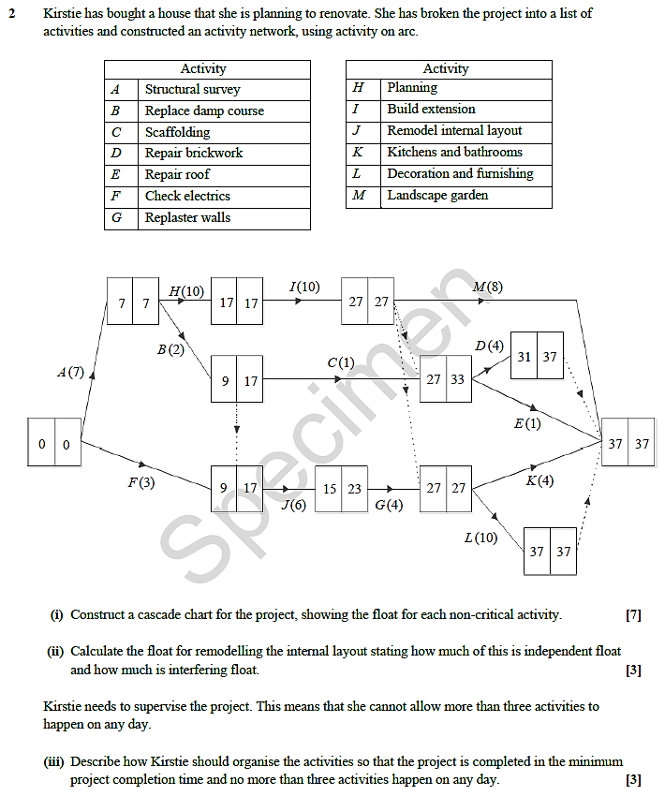
This question starts with topics from 7.05 that could be tested on the AS paper and then develops into A Level material.

Slide 11
This is an unstructured question where candidates need to think their own way through the problem.
Request requires candidates to have experience at constructing cascade charts. Activities (rows) should be labelled and there needs to be a time axis. The rows should be in alphabetical order (up or down). The critical activities may be combined into a single row.
1 mark AO3 for translating a problem given in context into a mathematical model, 5 marks AO1 for carrying out routine procedures and 1 mark AO2 for making a deduction.
Float can be shown using a dashed box, or shading, after the activity.

Slide 12
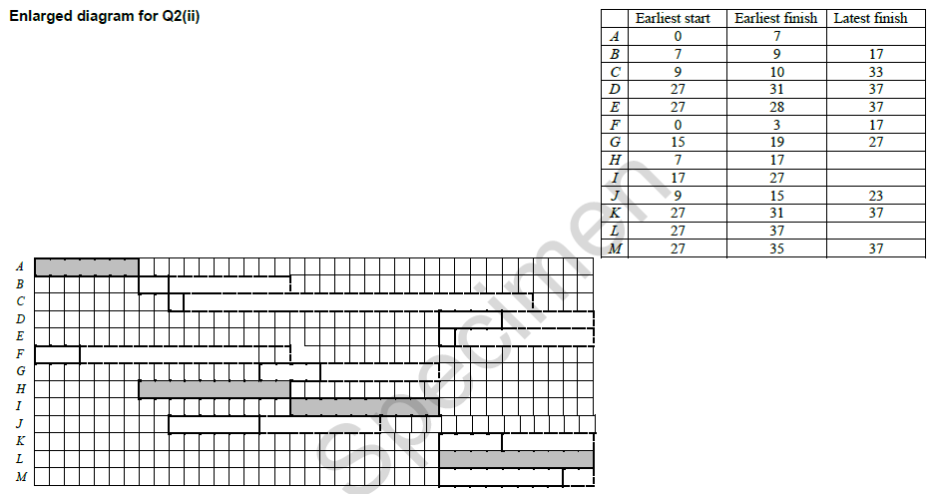
The ‘maximum window’ for J is from
9 to 23 = 6 + float 8
The ‘minimum window’ for J is not big enough for J to happen. So if J is pushed to start as late as possible (by either B or F) then it has a knock-on effect on G and there is no independent float (float attached to J alone).
1 mark A03 for using a mathematical model and 2 marks AO1 for carrying out routine procedures.

Slide 13
The cascade chart can be used to identify where the restriction causes a problem (times are in days) and then shift non-critical activities to achieve a valid solution.
When activities are shifted any activities that are dependent on them need to be shifted as well.
1 mark AO3 for translating a problem into a mathematical context, 1 mark AO3 for using a mathematical model and 1 mark AO2 for making a deduction.

Slide 14
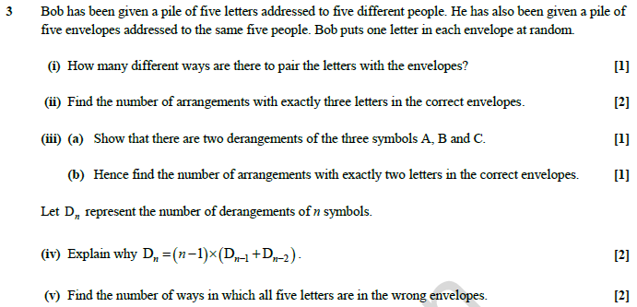
This question tests topics from 7.01. Some of these could be tested on the AS paper but the question is essentially at A Level standard. Many of the topics in this section of the specification are new, in particular the idea of derangements.

Slide 15
Imagine having the five envelopes laid out on the table and then assigning the letters to them. This is equivalent to asking for the number of arrangements of the five letters.
1 mark AO1 for carrying out a routine procedure.

Slide 16
Counting arrangements with a restriction.
If arrangements are just listed there needs to be an explanation of how it is known that this is a complete enumeration.
2 marks AO1 for carrying out a routine procedure.

Slide 17
Request requires candidates to understand what a derangement is.
1 mark AO1 for carrying out a routine procedure.

Slide 18
‘Hence’ indicates that the next step should be based on what has gone before, i.e. use the previous part (or parts).
1 mark AO2 for making a deduction.

Slide 19
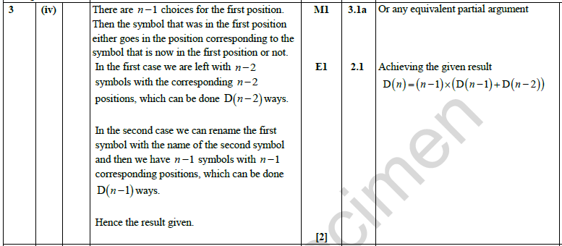
Candidates do not need to know this relationship; the specification says (7.01m) that the number of derangements can be found by ad hoc methods.
1 mark AO3 for translating a mathematical problem into a mathematical process and 1 mark AO2 for constructing a rigorous mathematical argument.

Slide 20
Candidates may use the previous results or start ‘from scratch’ using inclusion-exclusion.
1 mark AO3 for translating a mathematical problem into a mathematical process and 1 mark AO3 for interpreting the solution in the original context.

Slide 21
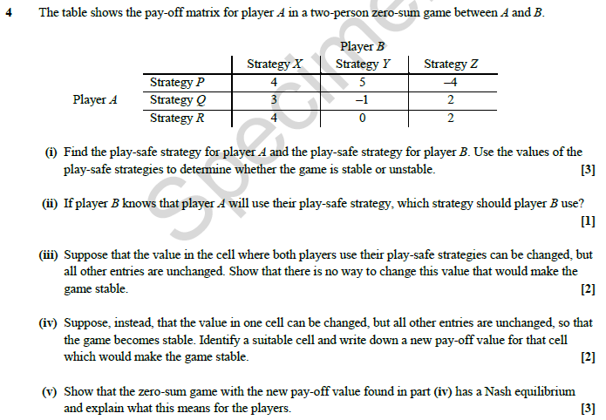
This question starts with topics from 7.08 that could be tested on the AS paper and then develops into A Level material.

Slide 22
The instructions to ‘Find’ two strategies and then ‘Use’ them indicates to candidates what is needed for each of the marks.
2 marks AO1 for carrying out routine procedures and 1 mark AO2 for making a deduction.

Slide 23
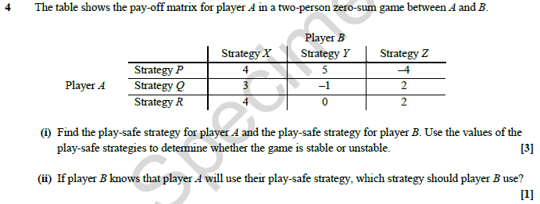
The request ‘If… which’ requires candidates to have experience of using pay-off matrices.
1 mark AO2 for making a deduction.

Slide 24
The wording ‘… can be changed…‘ indicates to candidates the need to consider the effect of an increase and of a decrease in the value.
2 marks AO2 for explaining reasoning.

Slide 25
The request to ‘… Identify a suitable cell and write down a new pay-off value…’ requires candidates to understand what a stable game is and be able to identify a suitable change that will achieve this.
1 mark AO2 for constructing a rigorous mathematical argument and 1 mark AO2 for assessing the validity of a mathematical argument.

Slide 26
Nash equilibrium is a new topic. A Nash equilibrium occurs when a cell is simultaneously the best in that column for the player on rows and the best in that row for the player on columns. For each player this is the best option if the other player sticks to their choice.
To find a Nash equilibrium first identify, for the player on rows, which cells are best in each column; then identify, for the player on columns, which cells are best in each row. Any cell that is in both lists is a Nash equilibrium.
In column X the best cells for player A are (P, X) and (R, X); in column Y the best cell for player A is (P, Y), unless the value in cell (R, Y) is increased to 5 or above; in column Z the best cells for player C are (Q, Z) and (R, Z)
In row P the best cell for player B (whose pay-offs are the negatives of the values in the zero-sum table) is (P, Z); in row Q the best cell for player B is (Q, Y); in row R the best cell for player B is (R, Z), unless the value in cell (R, Y) is increased to exactly 2 when (R, Y) is also a best cell.
The only cell in both lists is (R, Z), so this is a Nash equilibrium.
If player A sticks with row R then player B would not gain by changing from column Z.
If player B sticks with column Z then player A would not gain by changing from row R.
1 mark AO1 for carrying out a routine procedure, 1 mark AO2 for using mathematical language correctly and 1 mark AO2 for explaining reasoning.

Slide 27
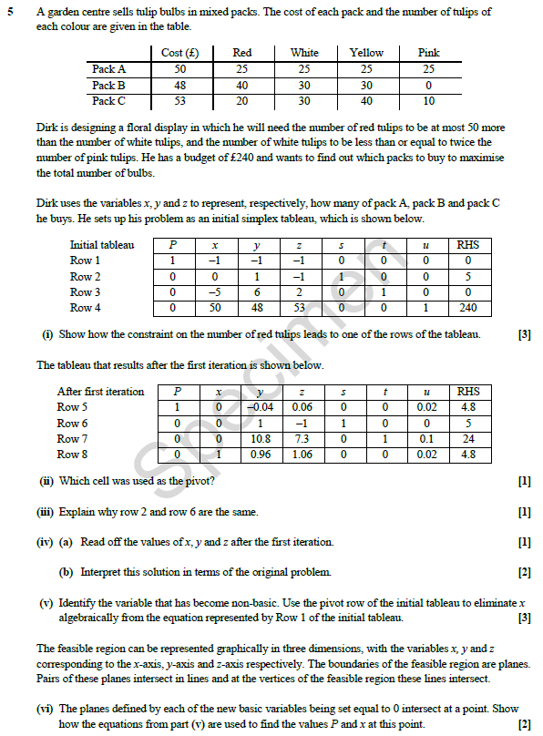
This question tests topics from 7.07 that are A Level material. Topic 7.06 is not explicitly tested in this paper.

Slide 28
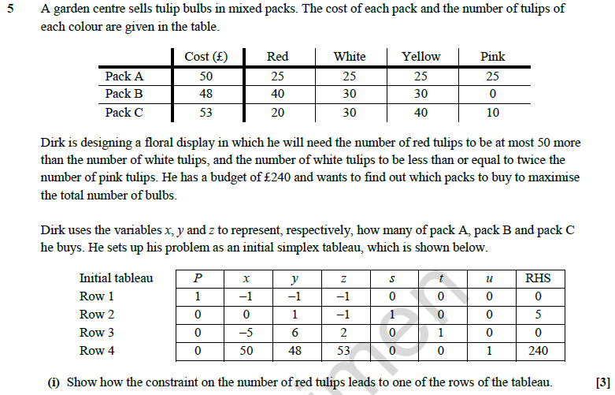
‘… number of red tulips to be at most 50 more than the number of white …’
This gives the constraint on the number of red tulips.
‘Show how …’ involves identifying the constraint on the red tulips and expressing it algebraically and then simplifying the coefficients to match one of the rows in the given tableau.
1 mark AO3 for translating a situation in context into a mathematical model and 2 marks AO1 for carrying out routine procedures.

Slide 29
Candidates need to be familiar with carrying out pivot operations.
1 mark AO1 for carrying out a routine procedure.

Slide 30
Candidates need to show that they are familiar with carrying out pivot operations.
1 mark AO1 for carrying out a routine procedure.

Slide 31
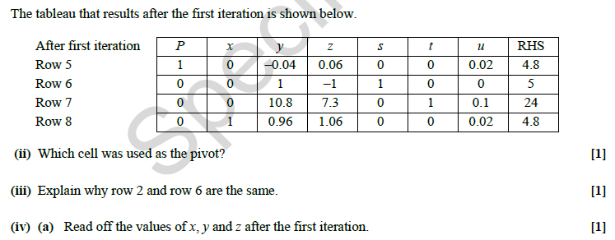
Candidates need to be familiar with reading the results of pivot operations
1 mark AO1 for carrying out a routine procedure.

Slide 32
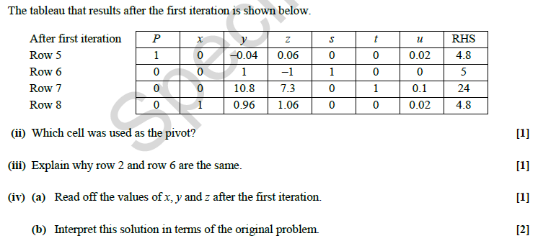
Two distinct comments are required for the two marks (not one comment written in two different ways.)
2 marks AO3 for using a mathematical model and evaluating the outcomes.

Slide 33
A basic variable is non-zero in the current solution and the corresponding column in the tableau consists of 0’s and a single 1, a non-basic variable is zero-valued in the current solution and the corresponding column in the tableau does not consist of only 0’s and a single 1.
3 marks AO1 for carrying out a routine procedure and using appropriate terminology.

Slide 34
This refers to the equations (from part (v)) that are represented in the iterated tableau. The question requires candidates to use the equations to find P and x, and not just read off the output values.
2 marks AO2 for making deductions.

Slide 35
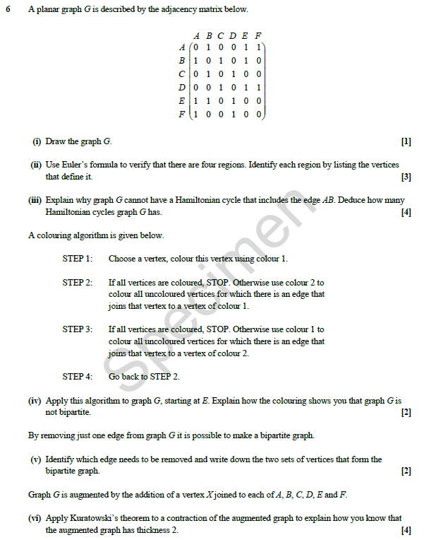
This question starts with topics from 7.02 and 7.04 that could be tested on the AS paper and then develops into A Level material.

Slide 36
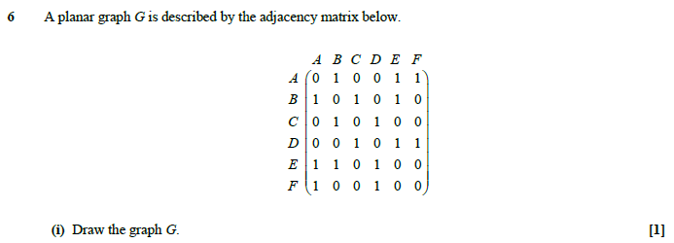
Candidates need to understand and accurately interpret the adjacency matrix.
1 mark AO1 for carrying out a routine procedure.

Slide 37
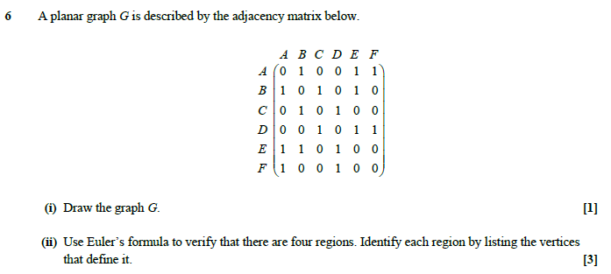
As well as showing the use of Euler’s formula, candidates need to identify the regions in the format indicated.
3 marks AO1 for selecting and carrying out routine procedures.

Slide 38
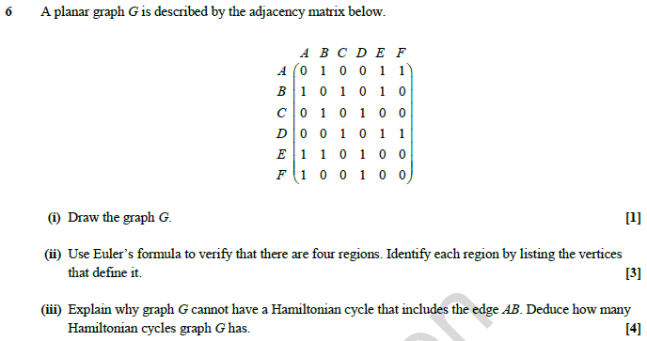
The explanation should start by considering what happens if edge AB is included and explaining why this is impossible. Candidates should then consider what happens if edge AB is included and making sure that every possibility has been considered.
1 mark AO1 for carrying out a routine procedure,
1 mark AO2 for explaining reasoning and 2 marks AO3 for translating the problem into mathematical processes and interpreting the solution in context.

Slide 39
This is about applying an algorithm that has been given in the paper and then explaining what it shows.
2 marks AO1 for carrying out routine procedures.

Slide 40
‘Identify …’ just means write down the arc.
‘Write down …’ the two sets, using set notation.
2 marks AO1 for carrying out routine procedures.

Slide 41
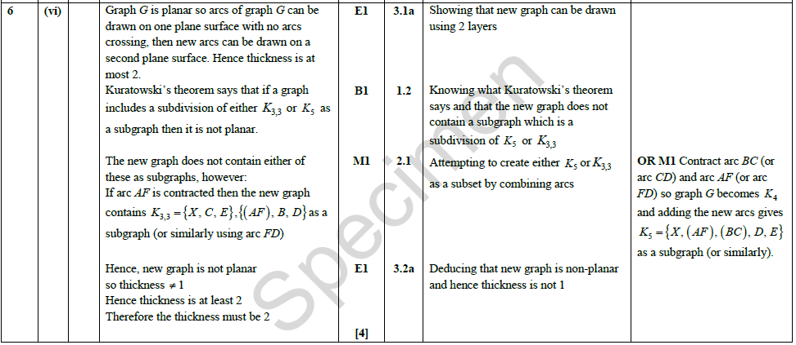
Candidates need to understand what terms such as ‘… Kuratowski’s … contracted arc … thickness …’ mean.
‘… augmented graph …’ refers to the graph described in the stem above part (vi).
The wording ‘… has thickness 2’
involves candidates showing that the thickness is at most 2 and that the thickness is not 1.
1 mark AO1 for recalling a definition, 1 mark AO2 for constructing a rigorous argument and 2 marks AO3 for translating a problem into a mathematical process and interpreting the result in context.

