Slide 2
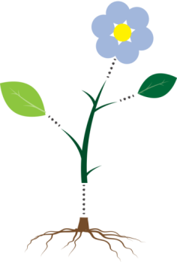
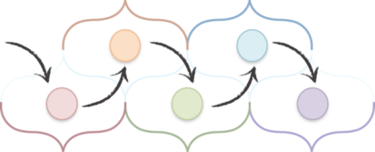
Build a plant by collecting a root, stem, leaves and a flower in a minimum of 5 moves by answering questions about transport in plants.
Pick a different coloured nucleus each time to build your plant.

Slide 3
Thank you for using
this OCR resource
Other OCR resources are available at www.ocr.org.uk
To give us feedback on, or ideas about, the OCR resources you have used email resourcesfeedback@ocr.org.uk
OCR Resources: the small print
OCR’s resources are provided to support the teaching of OCR specifications, but in no way constitute an endorsed teaching method that is required by the Board, and the decision to use them lies with the individual teacher. Whilst every effort is made to ensure the accuracy of the content, OCR cannot be held responsible for any errors or omissions within these resources.
© OCR 2015 - This resource may be freely copied and distributed, as long as the OCR logo and this message remain intact and OCR is acknowledged as the originator of this work.
OCR acknowledges the use of the following content:
Roots: kstudija/Shutterstock.com  Stems, leaves and flowers: art marta/Shutterstock.com  Carrot: Jane Rix/Shutterstock.com  Varigated leaf: paprika/Shutterstock.com
Please get in touch if you want to discuss the accessibility of resources we offer to support delivery of our qualifications: resources.feedback@ocr.org.uk

Slide 4
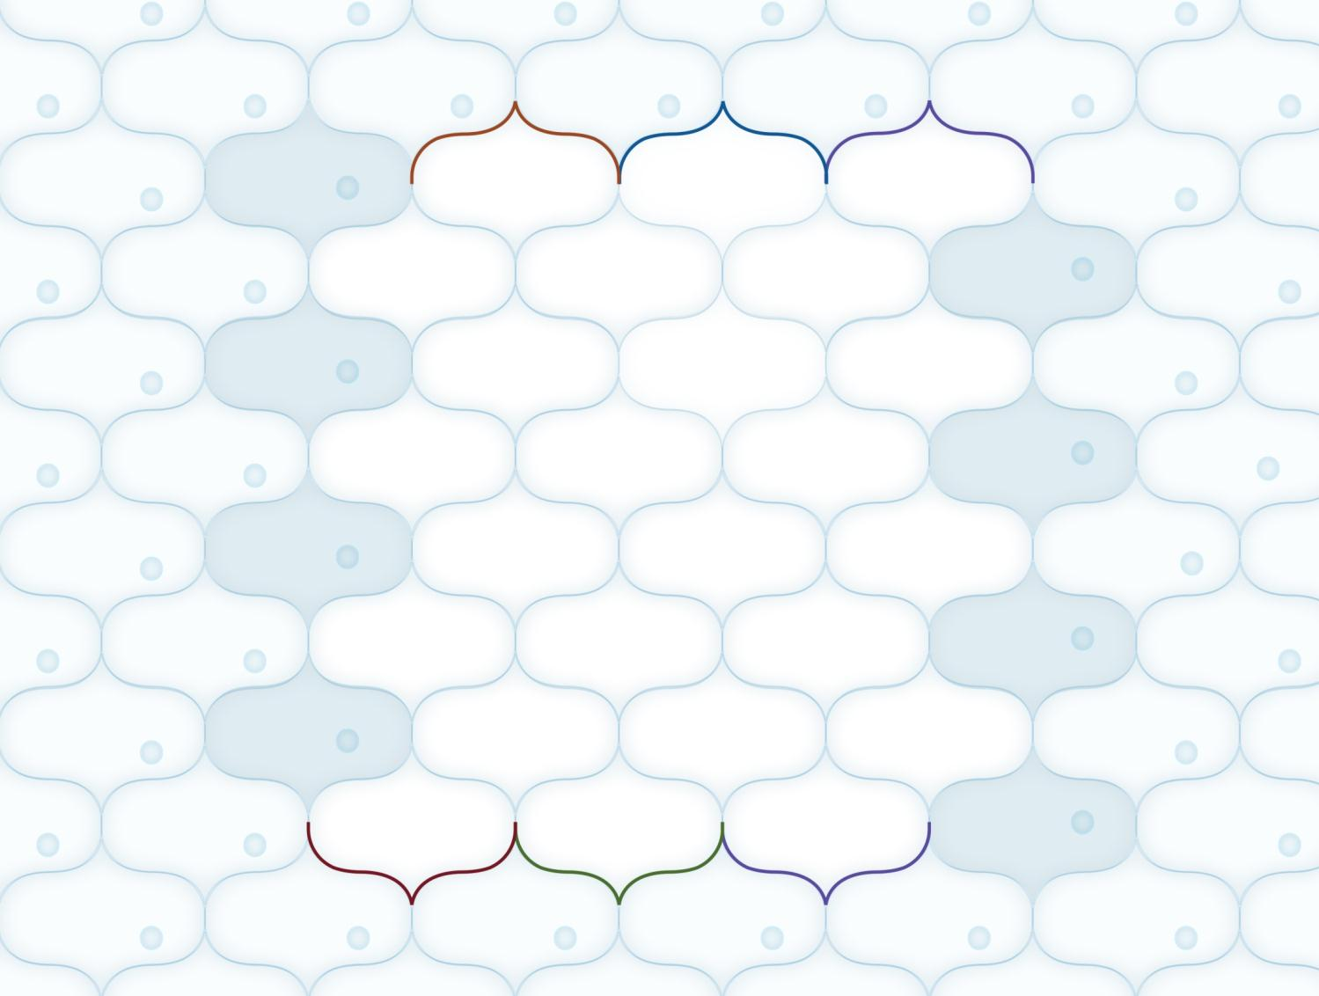
Stems
Leaves
Flowers
5
13
21
1
9
17
6
14
22
2
10
18
7
15
23
3
11
19
8
16
24
4
12
20
Roots
Leaves
Flowers

Slide 5
Question 1
Other than water, what else is taken up by a plant’s root hair cells?
Mineral ions

Slide 6
Question 2
What name is given to the tissue through which most water moves up the stem?
Xylem

Slide 7
Question 3
What is the name of the specialised plant cell that absorbs water from the ground?
Root hair cell

Slide 8
Question 4
What direction do substances travel in the xylem?
Upwards/from the root to the leaf

Slide 9
Question 5
What specialised plant cells control the opening and closing of the stomata?
Guard cells

Slide 10
Question 6
Which organ contains the xylem?
Vascular bundle/vein

Slide 11
Question 7
What direction do substances flow in the phloem?
Upwards/downwards

Slide 12
Question 8
What is transported in the phloem?
Dissolved food – sugar and amino acids

Slide 13
Question 9
What layer is between the upper and lower epidermis of a leaf?
Mesophyll

Slide 14
Question 10
What name is given to the process of water moving through a partially permeable membrane, from a higher water potential to a lower water potential?
Osmosis

Slide 15
Question 11
How are the xylem and phloem arranged in the stem?
In vascular bundles

Slide 16
Question 12
What is a transpiration stream?
Movement of water up a plant

Slide 17
Question 13
What factors affect the rate of water uptake by a plant?
Light intensity/air movement/ temperature

Slide 18
Question 14
How is water pulled up the xylem?
Due to water evaporation from the leaves

Slide 19
Question 15
What is between the cells of the spongy mesophyll?
Air

Slide 20
Question 16
What happens to the sugars made from photosynthesis?
Converted to starch and stored or used to make other substances

Slide 21
Question 17
What piece of equipment can be used to investigate water uptake by a plant?
Potometer

Slide 22
Question 18
What material supports the structure of the xylem?
Lignin

Slide 23
Question 19
Are xylem dead or living tissue?
Dead

Slide 24
Question 20
What has happened to cells when the plant has lost water and become soft?
It has become flaccid

Slide 25
Question 21
Why would water stop flowing up the xylem if it contained an air bubble?
Continuous chain of water is broken/loss of cohesion

Slide 26
Question 22
Why does a cut stem release sap?
Root pressure

Slide 27
Question 23
What theory can be used to explain transpiration pull?
Cohesion-tension

Slide 28
Question 24
How does evaporation occur in the mesophyll?
Some water molecules have sufficient energy to leave the liquid

