Slide 1
Name that salt!

Slide 2
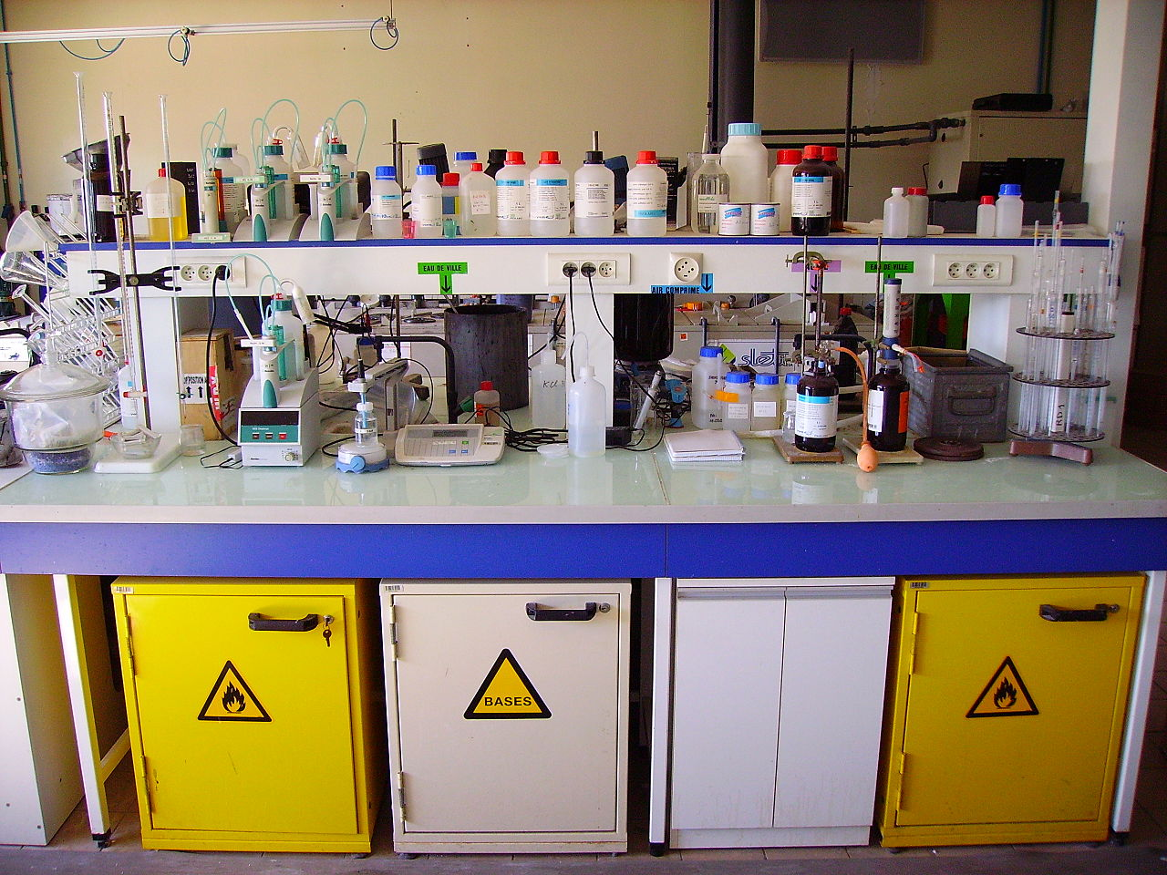
How many acids can you name?
Notes:
http://en.wikipedia.org/wiki/Laboratory#mediaviewer/File:Chemistry_Laboratory_-_Bench.jpg

Slide 3
Match the name to the formula
Hydrochloric acid
Nitric acid
HNO₃
Sulphuric acid
Ethanoic acid
H₂SO₄
HCl
CH₃COOH

Slide 4
Answers
Hydrochloric acid
HCl
Sulphuric acid
H₂SO₄
Nitric acid
HNO₃
Ethanoic acid
CH₃COOH

Slide 5
Key reactions with acids
acid | + | metal | → | salt | + | hydrogen
acid | + | metal oxide | → | salt | + | water
acid | + | metal hydroxide | → | salt | + | water
acid | + | metal carbonate | → | salt | + | water | + | carbon dioxide

Slide 6
Which acid makes which salt?
Hydrochloric acid
Sulphate
Sulphuric acid
Ethanoate
Nitric acid
Nitrate
Ethanoic acid
Chloride

Slide 7
Which acid makes which salt?
Hydrochloric acid
Chloride
Sulphuric acid
Sulphate
Nitric acid
Nitrate
Ethanoic acid
Ethanoate

Slide 8
The name of the acid and the name of the metal are joined together to make the name of the salt
hydrochloric acid | + | sodium hydroxide | → | sodium chloride | + | water
2HCl | + | 2NaOH | → | 2NaCl | + | H₂O

Slide 9
What salt will you make?
potassium chloride
hydrochloric acid + potassium hydroxide
copper sulphate
sulphuric acid + copper oxide
nitric acid + sodium hydroxide
sodium nitrate
magnesium ethanoate
ethanoic acid+ magnesium oxide
ammonium nitrate
nitric acid + ammonium hydroxide
Notes:
Extend for pupils and ask them the other products made…

