Slide 1
/12
The English Reformation c.1520–c.1550 with Castles: Form and Function c.1000–1750
Annotated Sample Question Paper

Slide 2
Guidance
This guide is designed to take you though J410/12 GCSE (9–1) History A (Explaining the Modern World) exam paper. Its aim is to explain how candidates should approach each paper and how marks are awarded to the different questions.
The orange text boxes offer further explanation on the questions on the exam
paper. They offer guidance on the wording of questions and what candidates
should do in response to them.
The green text boxes focus on the awarding of marks for each question. They give
further information on the percentage of each assessment objective attributed
to each question. The percentage given is over the whole qualification.
This Guidance has been produced using The English Reformation c.1250-c.1550 with castles: Form and Function c.1000-1750 Depth Study as an example, but it is also applicable to both of the other British Depth Studies (J410/11 and J410/13).
This will always be a comparison of two primary sources requiring evaluation of the sources in their historical context.
AO3 (5%)

Slide 3
There will never be optional questions in this exam paper.
Section A The English Reformation c.1520–c.1550
Answer all the questions You are advised to spend about 45 minutes on this section.
1. Explain why the church was wealthy in the early 1530s. 1979-1990. [10]
Study Sources A–C.
‘The Dissolution of the monasteries was a popular measure.’ How far do Sources A-C convince you that this statement is correct? Use the sources and your knowledge to explain your answer. [20]
Spelling, punctuation and grammar and the use of specialist terminology [5]
This question is marked against both AO1 and AO2 assessment objectives. This question is marked against the same levels mark scheme as the ‘explain’ question in paper 1 J410/01-07
The question stem will always be 'Explain…'
The question will target conceptual understanding, for example why something happened/the reasons for something - cause, results consequence, how something is the same/different -
diversity/change/continuity etc.) as well as knowledge and understanding.
This question is marked against both AO1, AO2 and AO3 assessment objectives, with half the marks allocated to source analysis and evaluation (AO3)
The question stem will always be 'Study sources A-C…' and then a statement.
Learners will be asked how far the sources convince them that the statement is correct. The use of sources is the primary focus here, supported by knowledge and understanding and explanation using conceptual understanding. The statement has to be analysed using the sources critically.
Marks are awarded for SPaG on question 2 only.

Slide 4
Source A
Lichfield: “two of the nuns were with child”
Whitby: “Abbot Hexham took a share of the proceeds from piracy”
Bradley: “the prior has six children”
Abbotsbury: “abbot wrongfully selling timber”
Pershore: “monks drunk at mass”
From a report on monastic houses published in 1535. The report was commissioned by King Henry VIII and supervised by the king’s chief minister Thomas Cromwell
Source B
So much sin and disgusting living is seen daily in the small abbeys, priories, and other religious houses of monks, canons and nuns. This is upsetting to Almighty God and the king. Therefore these small houses will be utterly suppressed. The monks and nuns in them will be moved to the great and honourable monasteries in this realm, where they may be required to improve their lives. The possessions of these houses shall be put to better uses. They will be given to the king and his heirs to honour God and for the good of the realm.
From the Act to Suppress the Lesser Houses (the smaller monasteries and convents), 1535.
Source C
The closing of the monasteries means that religious services will not be carried out, and the poor will not be looked after. The monasteries are much loved by the people.
From a letter by Robert Aske, one of the leaders of the Pilgrimage of Grace, 1536.
Sources set for this question will be contemporary to the period and will include a short explanation of their provenance. This is typical of the length of sources set.
Sources can be written or visual.

Slide 5
Section B
Castles: Form and Function c.1000–1750 Answer all the questions. You are advised to spend about 30 minutes on this section.
Explain why Conwy Castle fell into disrepair in the period 1400–1600 [10]
Study Sources D and E. Which of these sources is more useful to a historian studying the first hundred years of Conwy Castle (from the 1280s to the 1380s)? [10]
This question is marked against both AO1 and AO2 assessment objectives. This question is marked against the same levels as Question 1 on this paper.
The question stem will always be 'Explain…'
The question will target conceptual understanding, for example why something happened/the reasons for something - cause, results consequence, how something is the same/different -
diversity/change/continuity etc.) as well as knowledge and understanding.
The question therefore targets AO3, with knowledge and understanding only
being credited here where it is explicitly used to analyse sources.
The question stem will always be 'Study sources D and E...' (about or relating to the set site) and then a question in which the sources are compared. The question targets analysis and evaluation of sources and of the site.

Slide 6
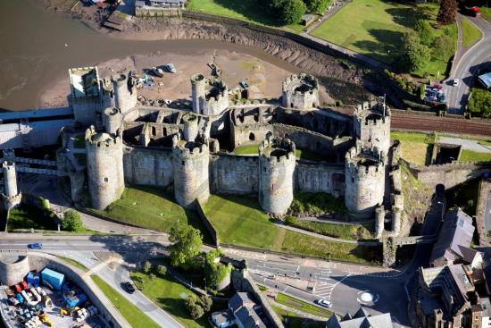
Source D
An aerial photograph of the remains of Conwy Castle in North Wales.
Source E
March 1283 to November 1284 £5819
December 1284 to December 1292 £7870
February 1296 to February 1301 £500
December 1304 to December 1330 £88
Extracts from accounts showing spending on Conwy Castle in the period 1283-1330. [From History of the King’s Works by HM Colvin]
Sources can be written or visual.

