Slide 1
Geographical Stories
Simon Ross
rosstrout@aol.com

Slide 2
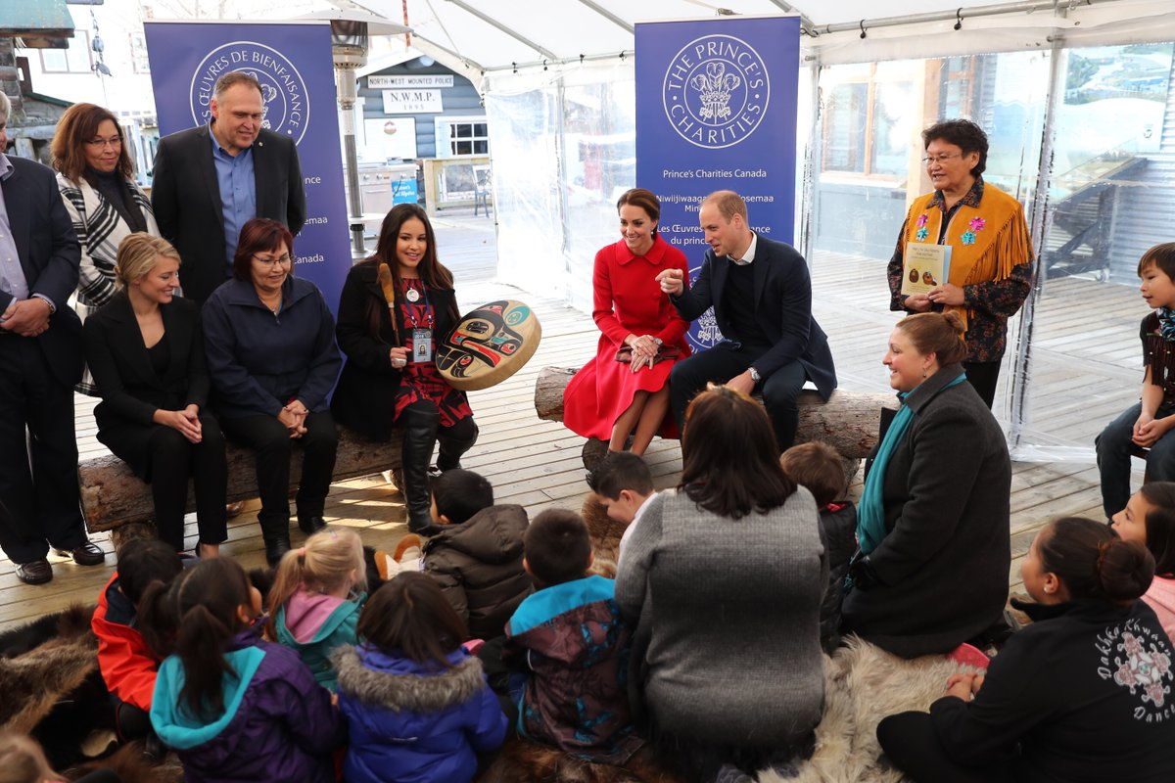
Storytelling in Canada

Slide 3
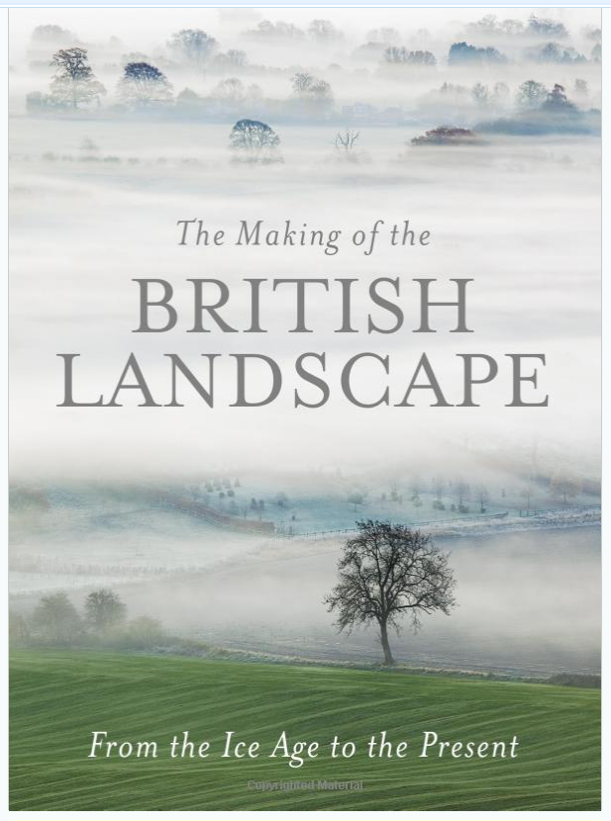

“to care about a place, you must know it’s story”
Nick Crane

Slide 4
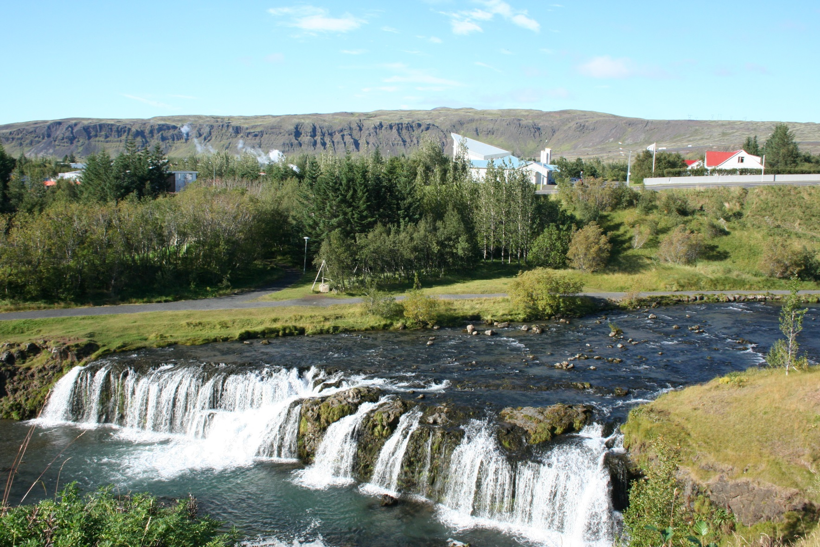
Landscape Stories

Slide 5
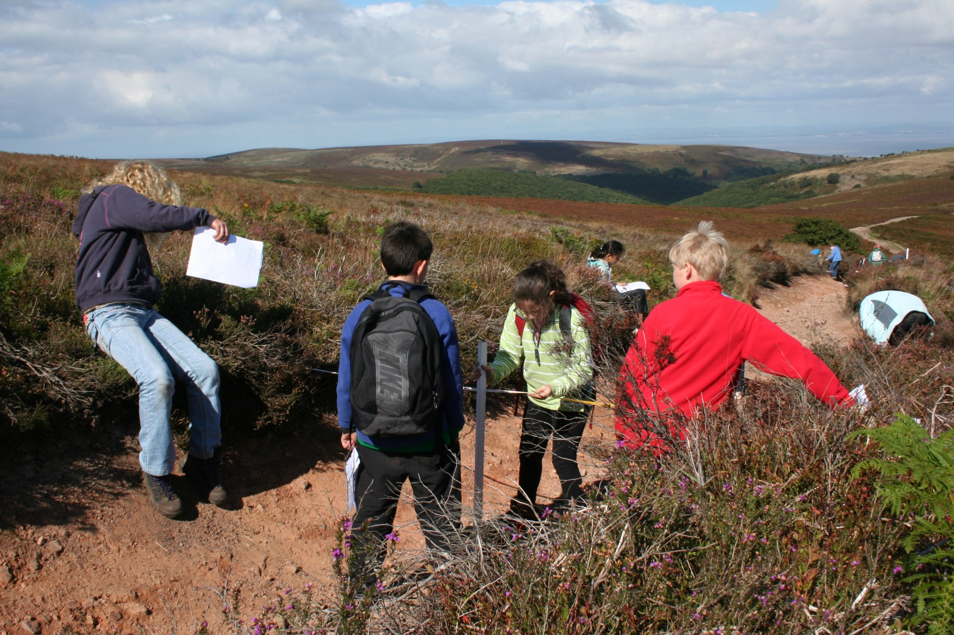
The Quantocks – landscape story

Slide 6
Why use geographical stories?
Provides an interesting and creative narrative
Appeals to the imagination and helps to create mental images and associations
Provides a ‘hook’ for learning
Essentially a story is sequential – with a beginning, middle and end – similar to many aspects of geography where changes over time (and place) are central
Fundamental aspect of human interaction

Slide 7
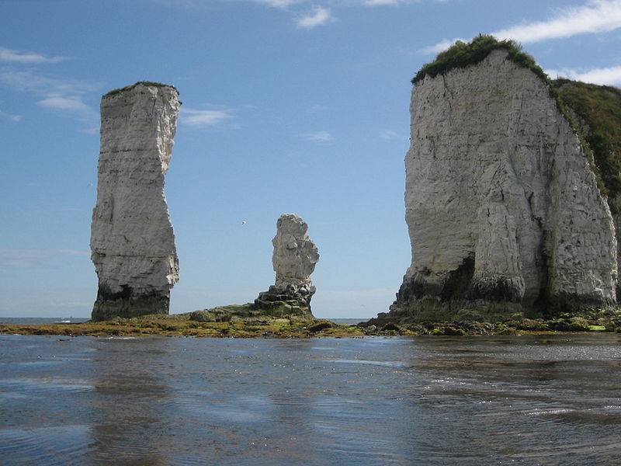
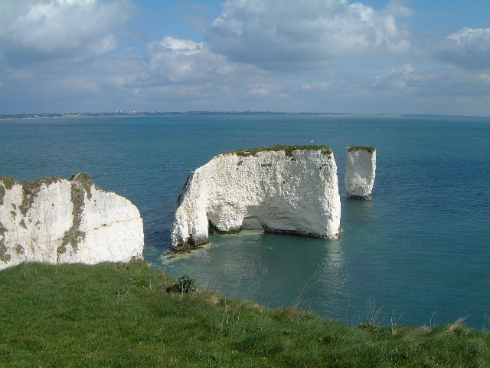
Old Harry stack

Slide 8
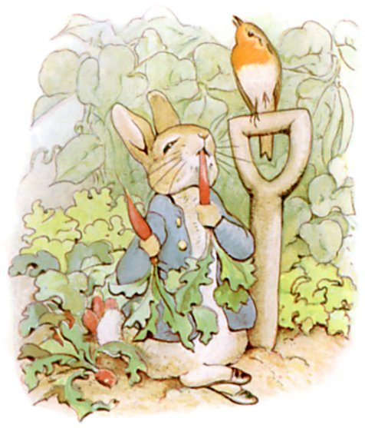
Lake District

Slide 9
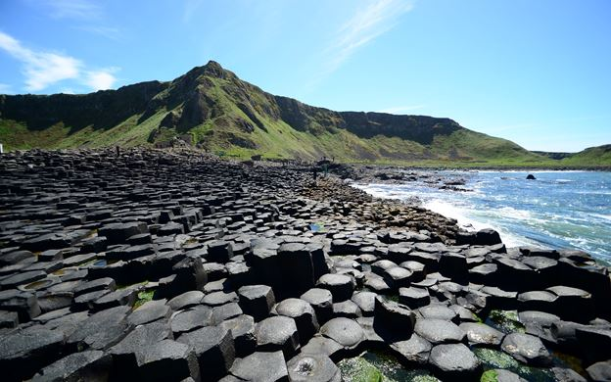
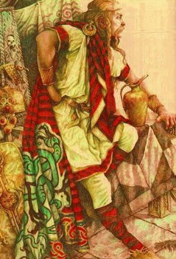
Myths and sagas: Giant’s Causeway
https://vimeo.com/45569144
http://myths.e2bn.org/mythsandlegends/textonly5639-finn-maccool-and-the-giants-causeway.html

Slide 10
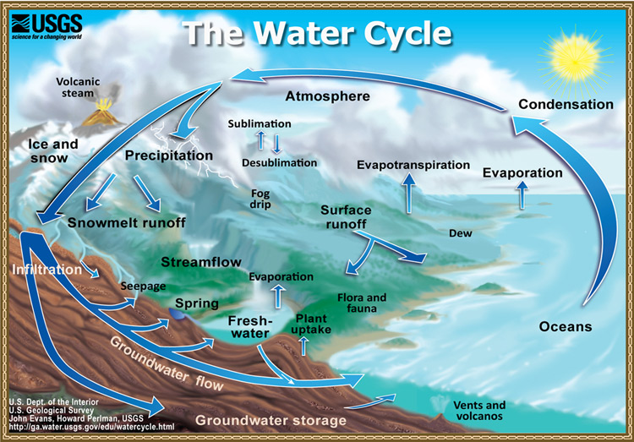
Water cycle – story of a raindrop

Slide 11
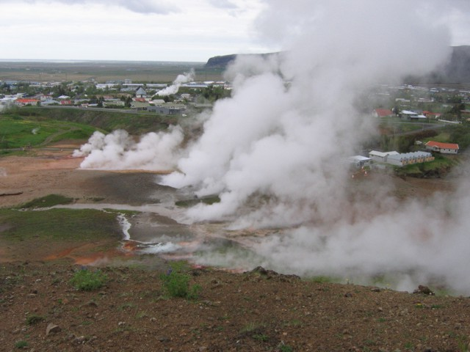
Hveragerdi – changing places

Slide 12
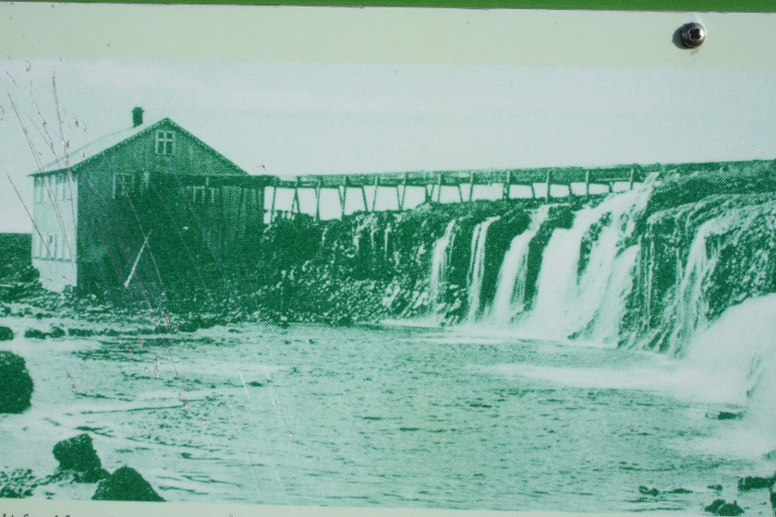
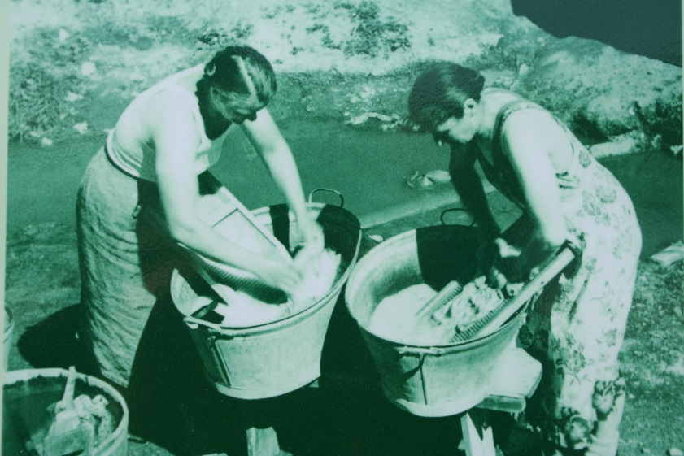
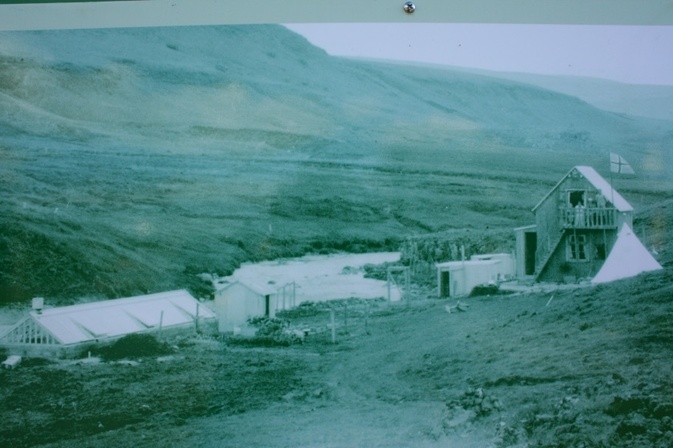
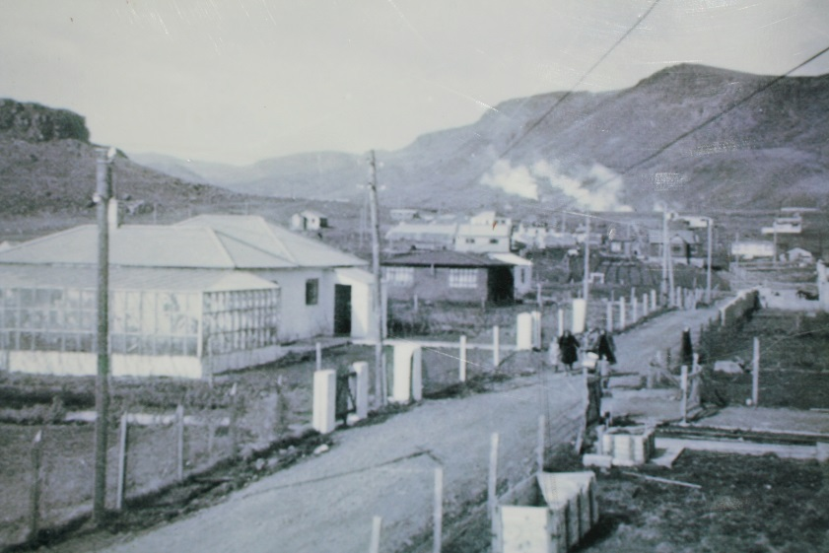
Hveragerdi – changing places

Slide 13
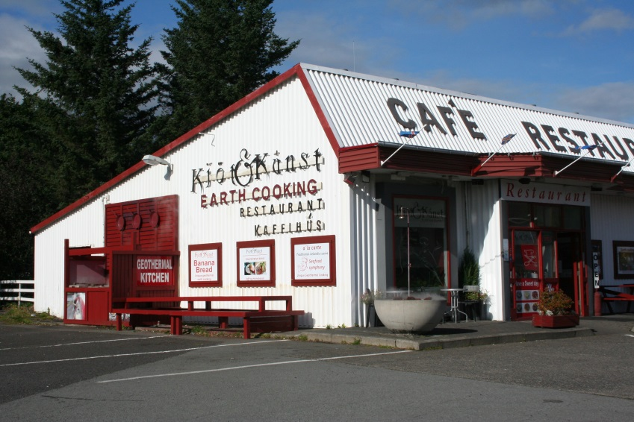
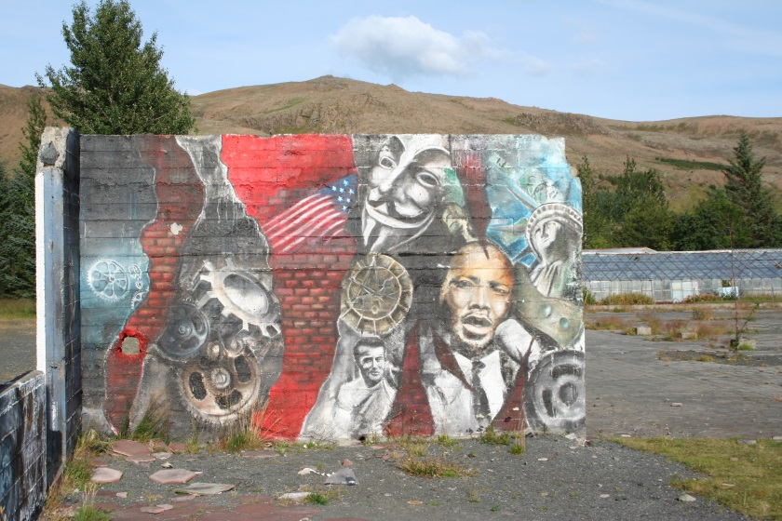
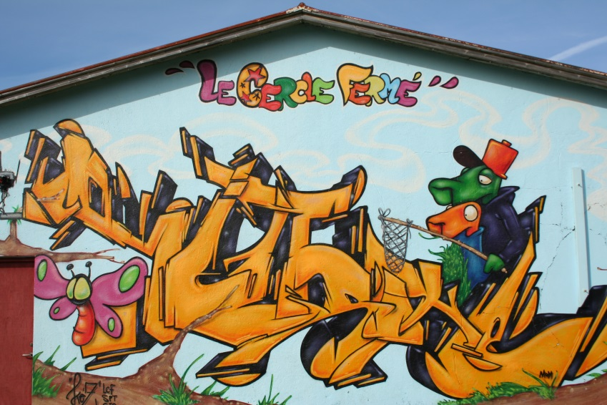
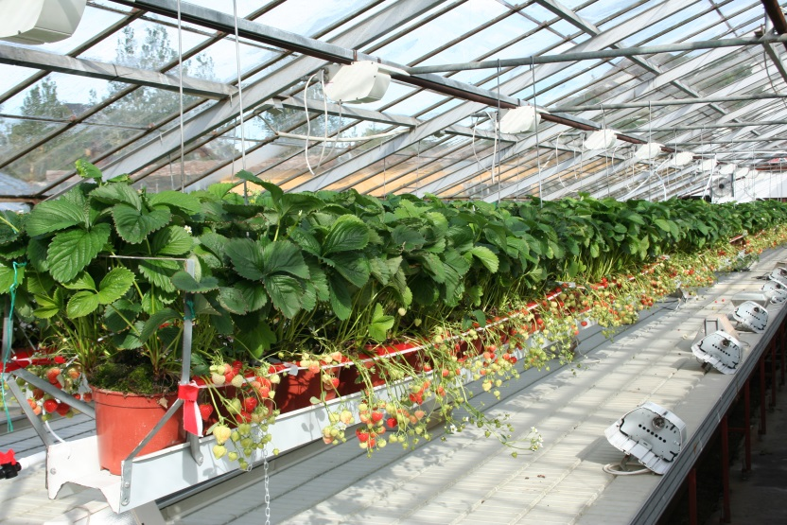
Hveragerdi – changing places

Slide 14
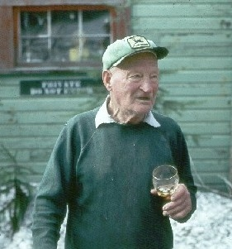
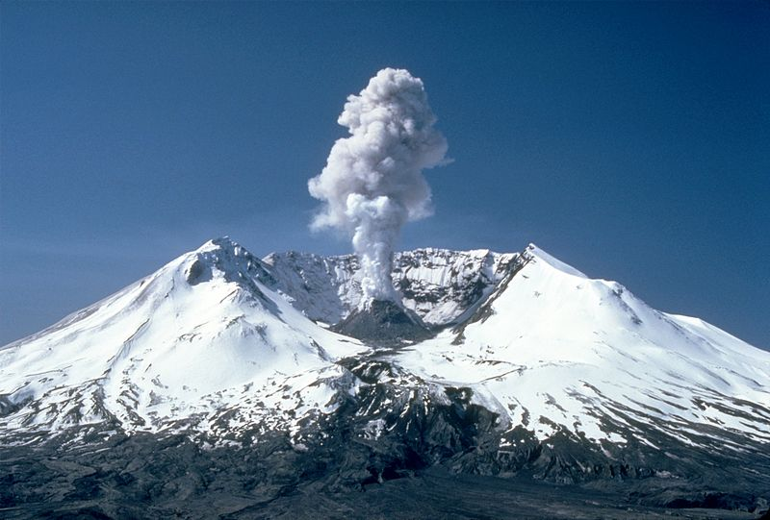
Mt St Helens

Slide 15
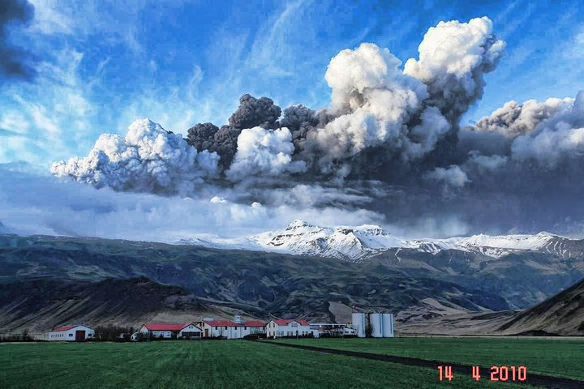
Eyjafjallajokull farm
https://www.youtube.com/watch?v=Vuhsm9OlEg4

Slide 16
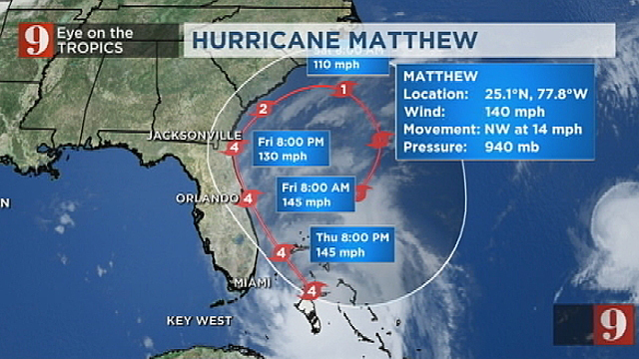
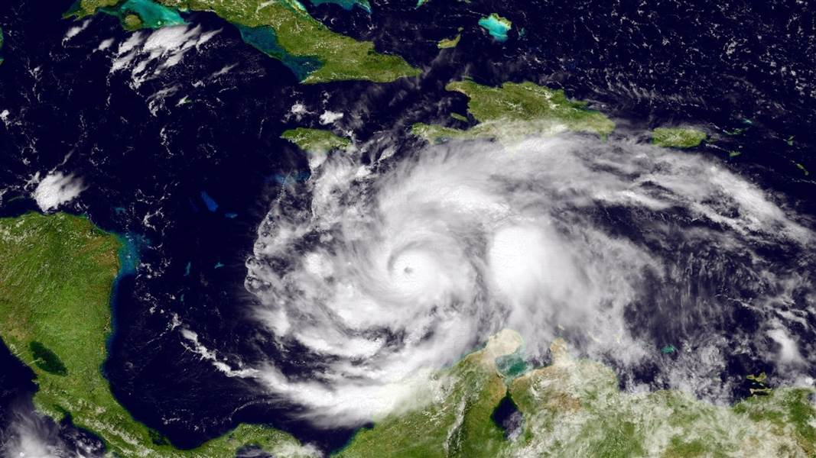
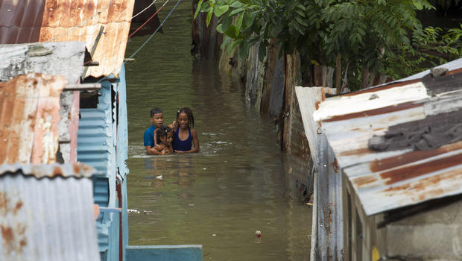
Hurricane Matthew 2016

Slide 17
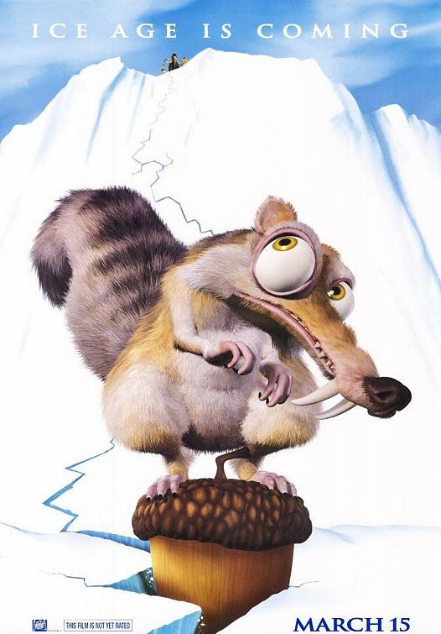
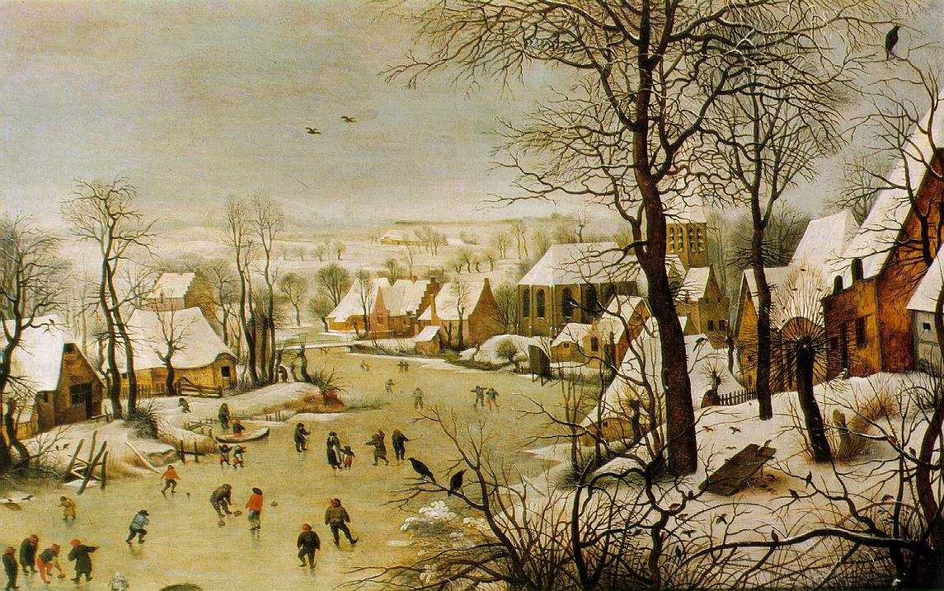
Beyond geographical stories
Art
Poems and literary extracts
Songs/music
Films
Television
Winterlandschaft mit Vogelfalle (‘Winter Landscape with Skaters and Bird Trap’) by Pieter Brueghel the Elder (1601)

