Slide 1

Student conceptions of geographical knowledge and option choice: a study of ethnic minority students stories
Becky Kitchen

Slide 2

Doctoral research listening to the stories of eight Sixth Form students.
The students have different ethnicities and different experiences of geography.
Interested to explore how students conceive of geographical knowledge, the stories that relate to these conceptions and how the students account for their option choices at GCSE and A level.

Slide 3
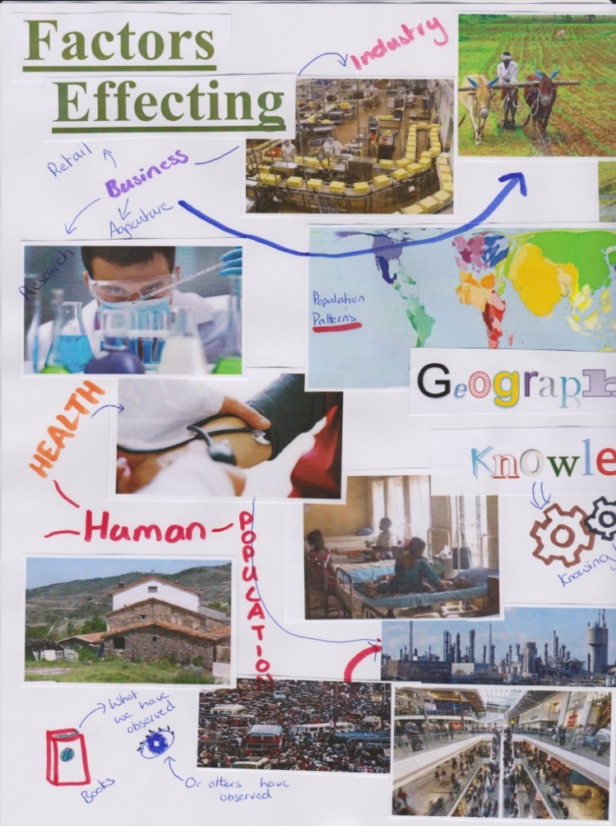
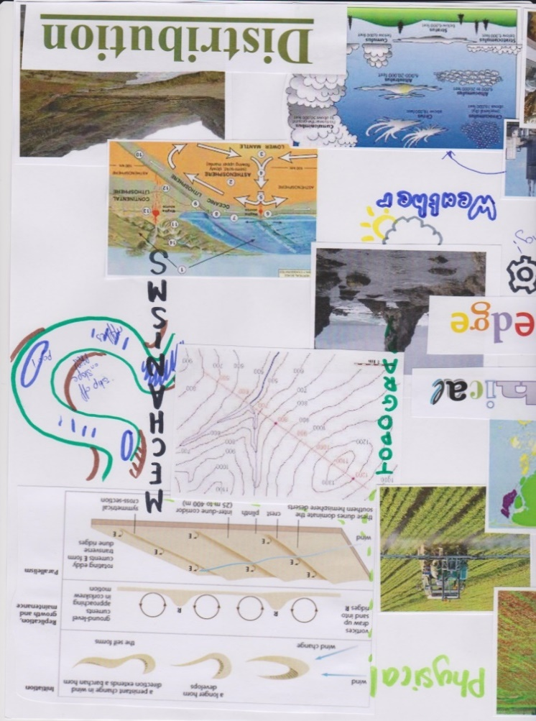
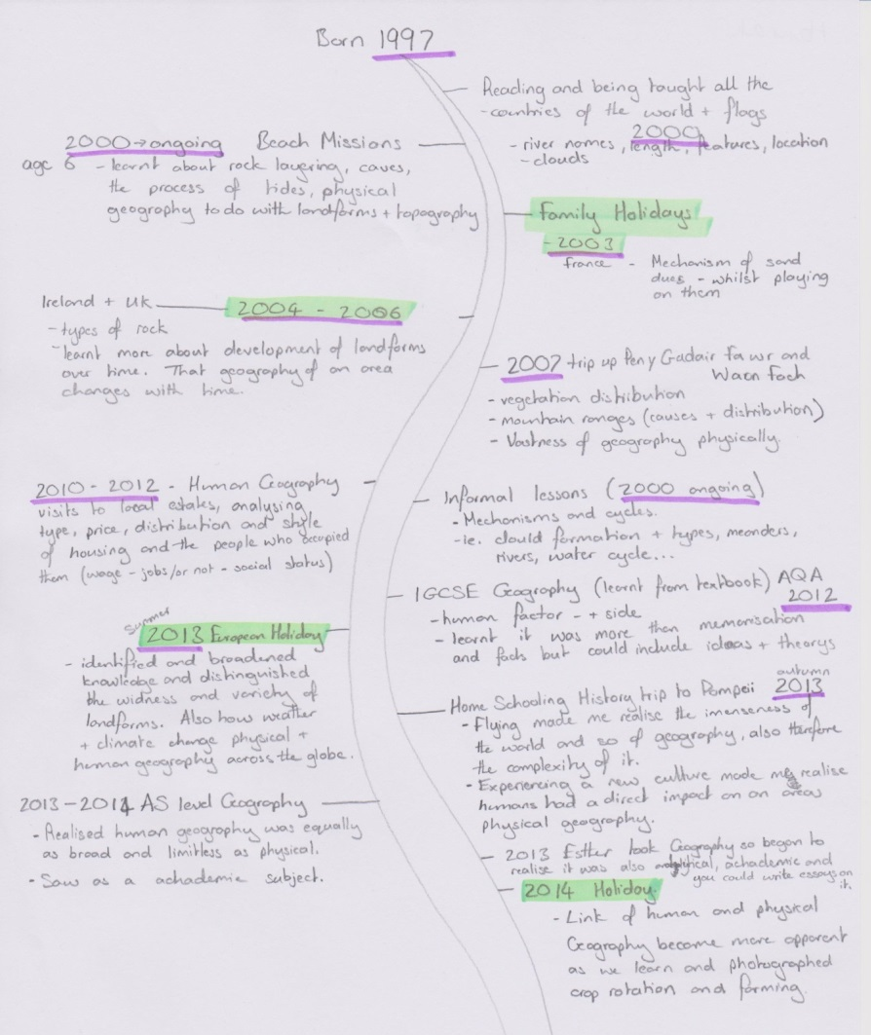
Philippa’s story

Slide 4
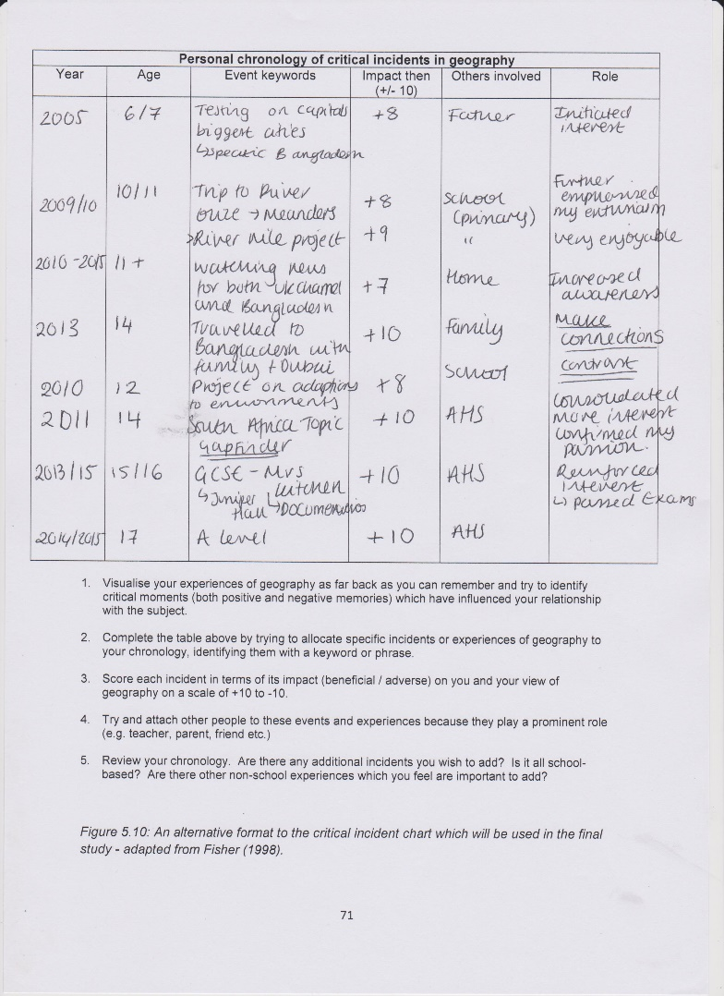
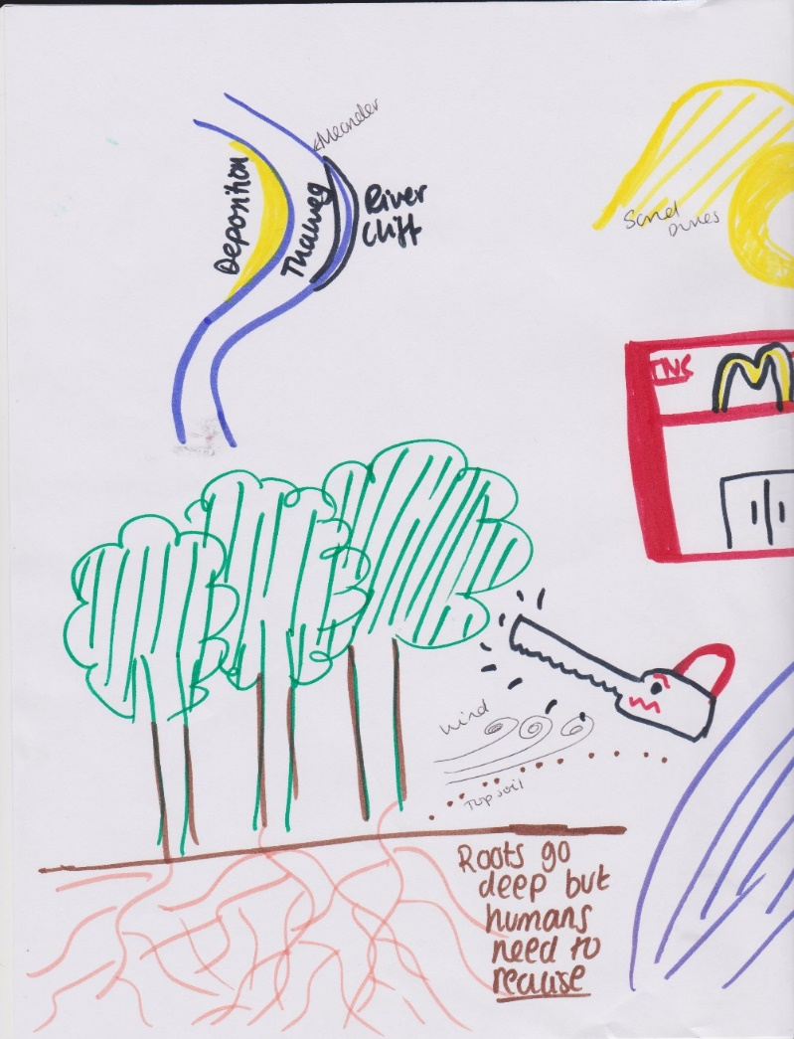
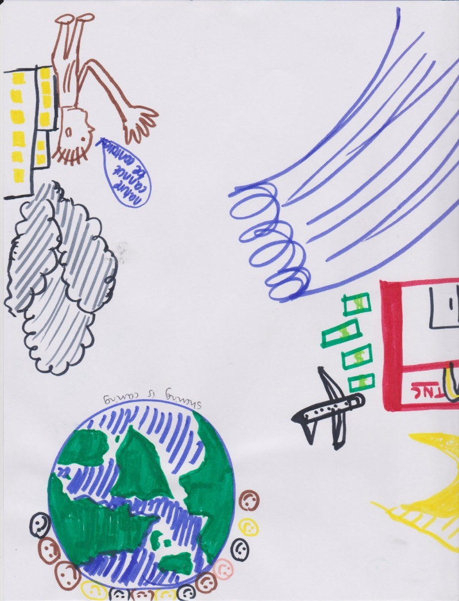
Qabilah’s story

Slide 5
‘You meet people on a daily basis, if you go somewhere the people are what strikes you the most. Whereas…I hadn't experienced any volcanoes and things. So, it was all well and good learning about these volcanoes and things but it didn't really apply to me. I felt I was learning it for the sake of being tested.’ Olivia
‘Well pretty much what I did is I looked at all the levels I was getting in each subject…I was getting about the same scores in RS and Geography, I was getting level 8s in both, so I thought I should pick one between them. So, I just went for RS because I like the ethics side.’ Sabah

Slide 6
‘I mean there was a brief time when I was like “Oh, I’ll go to a conservatoire”. I’ll go to play music or I’ll go to do composition or whatever and no, it’s not seen as… I think that if I was less academic then everyone would be saying “Oh, you should do that, that’s what you should do”. But because I’m predicted the high grades it’s seen as a waste. And I will go and do something academic and will go and get a high paying job.’ Marie
‘I find it [Geography] fascinating and that’s what really annoys me, because my view of the world is shaped by going to an all girls’ grammar school. That annoys me massively. It’s not your nuclear engineering if that makes sense, but it’s still valid, it’s still an academic subject. It’s not your cream of the crop. I mean, we’re always told we’re the cream of the crop and expected to go for the cream of the crop subjects, your maths, your sciences, it gets all the funding.’ Naomi

Slide 7
Findings
Diverse range of conceptions which are dynamic
Mostly shaped by most recent formal experiences e.g. KS3, GCSE, A level geography, but also other subjects e.g. Science, World Development
Informal experiences e.g. travel, media also play a part.

Slide 8
Findings
Enjoyment, perceived ability and whether or not a subject would be useful for their chosen career are important factors.
Students generally enjoy geography but struggle to see how it is useful for careers such as medicine, law and engineering.
Geography is seen as more academic than creative subjects but not as academic as maths and science.

Slide 9
