Slide 1

Guide to the Assessment Objectives

Slide 2
About this guide
This guide is designed to give you a better understanding of the four GCSE (9-1) Geography Assessment Objectives.
This guide will explain the key points for each assessment objective.
This guide shows examples of the different types of exam questions and how assessment objectives are allocated to them.

Slide 3
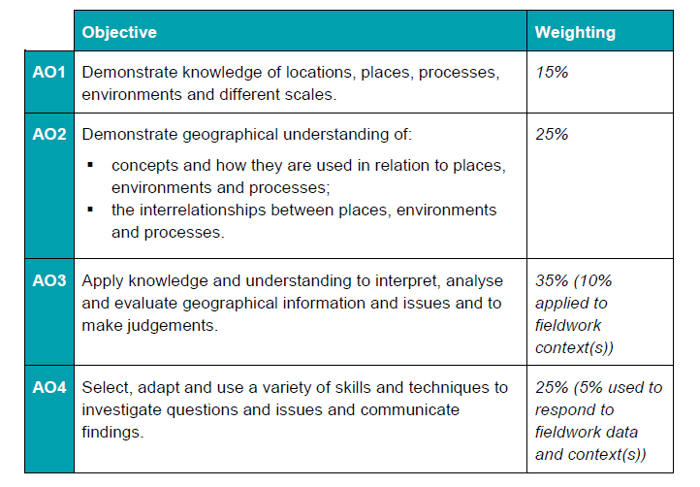
The Four Assessment Objectives (AOs)
The assessment objectives are vital when understanding the assessment and are set by Ofqual. For GCSE (9-1) Geography there are four Assessment Objectives – AO1 (Knowledge), AO2 (Understanding), AO3 (Application of knowledge and understanding) and AO4 (Skills).
15% of the qualification
marks will be allocated to assessing students knowledge of the specification content (AO1)
25% of the qualification marks will be allocated to assessing students understanding of the specification content (AO2)
35% of the qualification
marks will be allocated to assessing students application of their knowledge and understanding of the specification content (AO3)
25% of the qualification
marks will be allocated to assessing students ability to select, adapt and use geographical skills and communicate findings in this context (AO4)

Slide 4
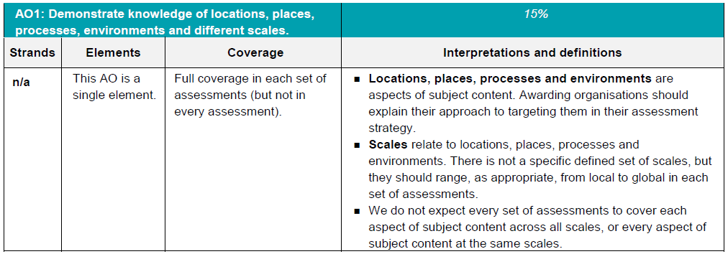
AO1 - Knowledge
Locations, places, processes and environments simply cover the subject content. There are other ways which you may describe content areas but all must be placed in these four aspects when we are creating our assessments.
Each year across the range of assessments there must be knowledge marks for locations, places, processes, environments and different scales but AO1 marks do not have to be included in every assessment.
Each year assessments will cover different scales
from local to global but not for every bit of content
or necessarily for all of locations, places, processes
and environments.

Slide 5
AO1 command words
AO1 requires students to demonstrate knowledge of the specification content through recalling information – including in a case study context.
Questions which target AO1 alone would tend to be shorter answer questions but longer questions may have AO1 marks allocated to them as well when combined with another assessment objective – particularly where case study information is required in an answer.
The following are some of the command words which may be used for short answer questions with AO1 marks:
  Describe
  Define
  Outline
  State
All of these command words are asking students to write down something that they have learnt from the specification and so are unlikely to be targeting a combination of assessment objectives.

Slide 6
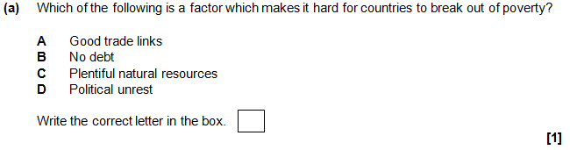

What are AO1 marks?
AO1 marks are given in questions where students need to recall information directly from what they have learnt from the specification, including when there is a case study focus. Questions on a case study will always have AO1 marks allocated for knowledge of the case study, an example of this is on slide 15.
These two examples are simple examples of questions where all marks are allocated to AO1. The information needed to answer them can be recalled by students as it is directly from what is taught through the specification content.
Below is an example of when AO1 marks are included with another assessment objective. This is a 4 mark question where 2 marks are for AO1 and 2 marks are for AO3. The AO1 marks are for recalling two sources of evidence of climate change – this is from the specification and there is 1 AO1 mark for each source named. Then there are 2 AO3 marks for comparing the two sources (one for each point).

Slide 7
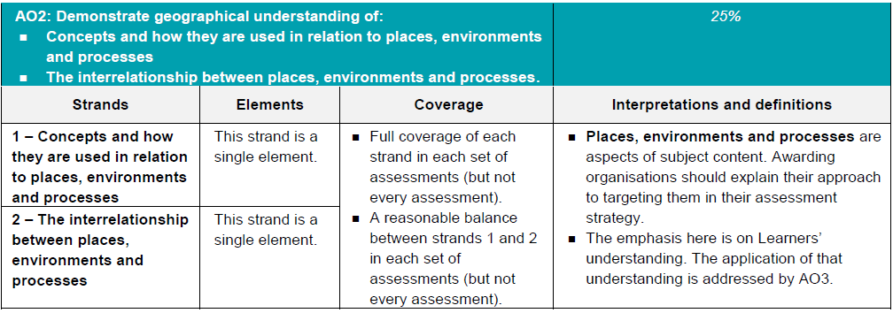
AO2 - Understanding
How concepts relate to the aspects of content.
Like with AO1 – places, processes and environments simply cover the subject content.
There must an appropriate balance in terms of the number of marks allocated to questions on the understanding of how concepts relate to content and how aspects of content relate to each other throughout the assessments.
How aspects of content relate to each other

Slide 8
AO2 command words
Questions with AO2 marks will focus on:
how concepts relate to the aspects of content
how aspects of content relate to each other
All AO2 marks will focus on understanding. AO2 marks will be directly linked to the specification but not just recalling what has been learnt, instead ensuring that students comprehend the content.
The following are some of the command words which may be used for questions with AO2 marks:
Explain how
Explain reasons/one reason
Discuss
AO2 marks may also be targeted in higher mark tariff questions but the command word may focus on a different assessment objective (e.g. AO3).
These command words may be used to solely target AO2 but may also be used in combination with other AO’s to target multiple assessment objectives, for example 2(c) or 3(d) of component 01 Our Natural World.

Slide 9
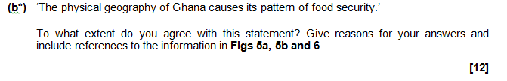

AO2.1 Concepts and how they are used in relation to places, environments and processes
These two questions have marks allocated to AO2.1 - how concepts relate to the aspects of content.
The question below is a 12 mark question with 6 x AO2.1 marks and 6 x AO3 (in this instance for analysis and make judgements). The AO2 marks are for an understanding of the concept of ‘food security’ in the context of the question.
The question below is a 3 mark question with 3 x AO2.1 marks. The AO2 marks are for an understanding of the concept of ‘uneven development’ and explaining how development indicators relate to this concept.

Slide 10
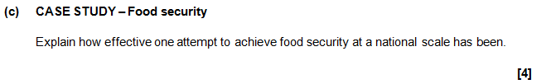

AO2.2 The interrelationship between places, environments and processes
These two questions have marks allocated to AO2.2 - how aspects of content relate to each other.
The question below is a 4 mark question with 2 x AO1 marks and 2 x AO2.2 marks. There are 2 marks for case study information about the attempt to achieve food security (AO1) and 2 marks for explaining how effective this attempt has been – this requires an understanding of the case study and also what effective means in this context.
The question below is a 6 mark question with 3 x AO2.2 marks and 3 x AO3 (analyse) marks. Students need to discuss the differences in extreme weather conditions in contrasting countries – therefore they need an understanding of what extreme means in this context and then apply this understanding to analyse the differences between the contrasting countries.

Slide 11
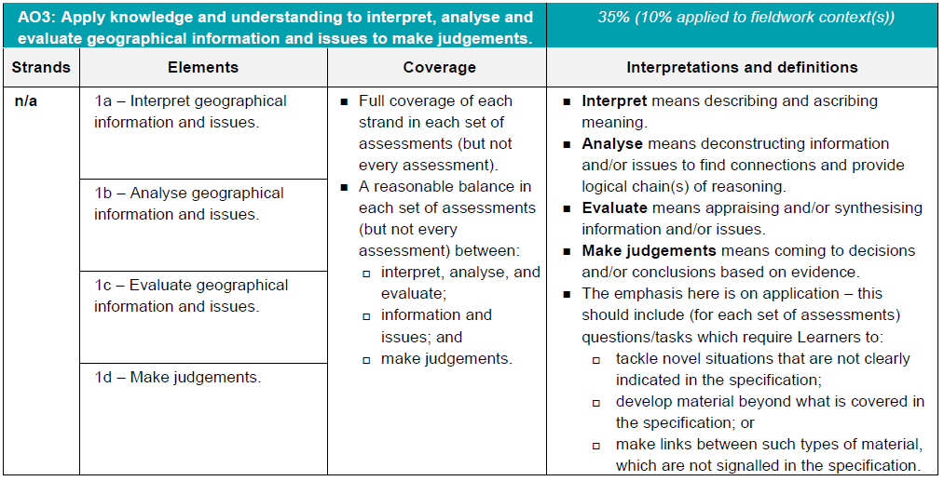
AO3 - Application
10% of the marks for the qualification must be allocated to the application of knowledge and understanding in a fieldwork context.
Three ways that students will need to apply their knowledge and understanding:
‘tackle novel situations’ could mean applying knowledge and understanding to a
resource
‘developing material beyond the specification’ could be evaluating the success of a
management strategy when the specification doesn’t explicitly ask for that
‘making links between such types of material which are not signalled in the
specification’ could be synoptic questions.

Slide 12
AO3 command words
Command words will vary depending on whether students are applying their knowledge and understanding by interacting with a resource(s) or not.
The following are some of the command words which may be used for questions with AO3 marks:
Weigh up whether a statement is true.
Interacting with resource | No resource
Describe | Assess
Give | Examine
Suggest | Evaluate
Outline | To what extent do you agree
Look in close detail and establish the key facts and important issues.
Give your verdict after providing evidence which both agrees with and contradicts an argument.
How much you agree with a statement based on the evidence in the argument.

Slide 13
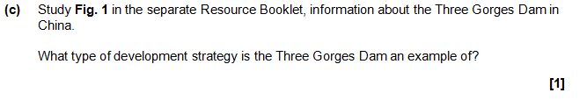
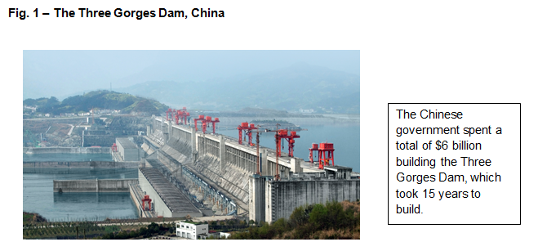
AO3 - Application
Students will need to apply their knowledge and understanding in 3 different ways:
  ‘tackle novel situations’ could mean applying knowledge and understanding to a resource
  ‘developing material beyond the specification’ could be evaluating the success of a management strategy when the specification doesn’t explicitly ask for that
  ‘making links between such types of material which are not signalled in the specification’ could be synoptic questions.
Firstly, applying their knowledge and understanding to tackle novel situations that are not clearly indicated in the specification.
This question is an example of this; students may know about development strategies, this question is asking students to apply what they know to the resource to interpret the answer.

Slide 14
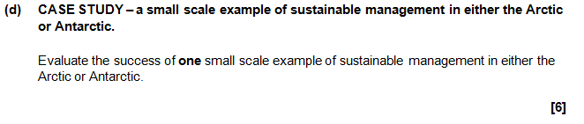
AO3 - Application
Students will need to apply their knowledge and understanding in 3 different ways:
  ‘tackle novel situations’ could mean applying knowledge and understanding to a resource
  ‘developing material beyond the specification’ could be evaluating the success of a management strategy when the specification doesn’t explicitly ask for that
  ‘making links between such types of material which are not signalled in the specification’ could be synoptic questions.
Secondly, applying their knowledge and understanding to develop material what is covered in the specification.
This questions requires students to develop what they know to be able to evaluate the success of one small scale example of sustainable management in either the Arctic or Antarctic. Students will have learnt about one small scale example of sustainable management in either the Arctic or Antarctic in a case study (so there will also be AO1 marks) in the specification but without the requirement to evaluate its success.

Slide 15
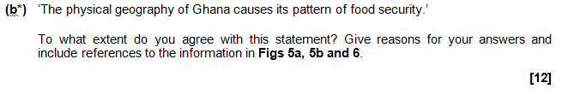
AO3 - Application
Students will need to apply their knowledge and understanding in 3 different ways:
  ‘tackle novel situations’ could mean applying knowledge and understanding to a resource
  ‘developing material beyond the specification’ could be evaluating the success of a management strategy when the specification doesn’t explicitly ask for that
  ‘making links between such types of material which are not signalled in the specification’ could be synoptic questions.
Thirdly, applying their knowledge and understanding to make links between such types of material which are not signalled in the specification.
The question above is an example of a question where students have to make links which are not explicitly signalled in the specification.
This a synoptic question – the question requires students to draw together knowledge and understanding from two different topics within the specification. In this instance they are from different components but they could also be from two topics within the same component.

Slide 16
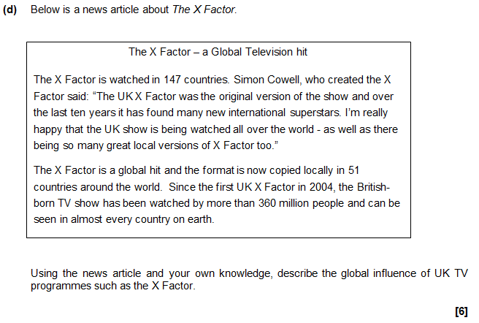
What are AO3 ‘interpret’ marks?
The two questions on this slide both have their marks allocated entirely as AO3 ‘interpret’.
In each case students need to apply their knowledge and understanding to describe or ascribe meaning (Ofqual wording) as a requirement of ‘interpret’. In these examples information is picked off an unseen resource in order to answer the questions.
The first question requires students to identify the development strategy from the information presented (ascribing meaning) and the second question requires to the selection of information from the resource to describe the global influence of UK TV programmes (describing).

Slide 17

What are AO3 ‘analyse’ marks?
The two questions on this slide both have marks allocated to AO3 ‘analyse’.
In each case students need to apply their knowledge and understanding to deconstruct information or issues to find connections or logical chains of reasoning (Ofqual wording) as a requirement of ‘analyse’.
The first question has two ‘analyse’ marks (comparing the reliability) and two marks for knowledge (to recall the two sources of evidence of climate change).
Analyse marks can also be found in longer mark questions where students may need to find connections and provide logical chains of reasoning when deconstructing information, however this would be in combination with other assessment objectives.

Slide 18
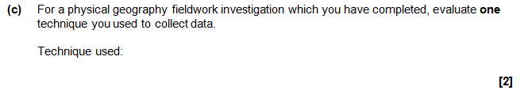
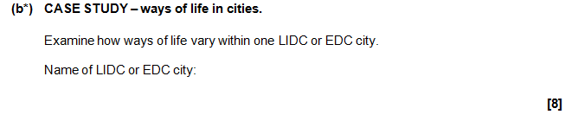
What are AO3 ‘evaluate’ marks?
Both of the questions on this slide have marks allocated to AO3 ‘evaluate’.
In each case students need to apply their knowledge and understanding to appraise or synthesise information and/or issues (Ofqual wording) as a requirement of ‘evaluate’.
The first question requires students to evaluate a fieldwork technique which was used to collect data (appraise).
The second question requires students to synthesise their knowledge and understanding of the case study city to examine how ways of life vary within the city. They must establish the key facts and important issues of this part of the case study and determine the ‘vary within’ element of the question.

Slide 19
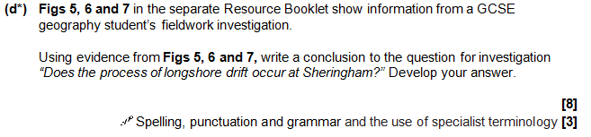
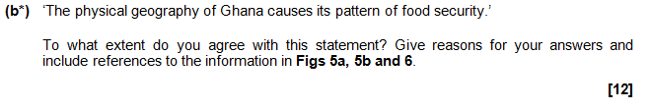
What are AO3 ‘make judgements’ marks?
The two questions on this slide all have marks allocated to AO3 ‘make judgements’.
In each case students need to apply their knowledge and understanding to come to a decision or conclusion based on evidence (Ofqual wording) as a requirement of ‘judgement’ – either through an unseen resource or their own knowledge and understanding.
The first question has four ‘make judgements’ marks for the conclusion based on the evidence in the resources.
The second question has three ‘make judgements’ marks for the extent to which the student agrees with the statement. There are also marks available for an understanding of the concept of food security (AO2) and for analysing the information in the resources (AO3 analysis).

Slide 20
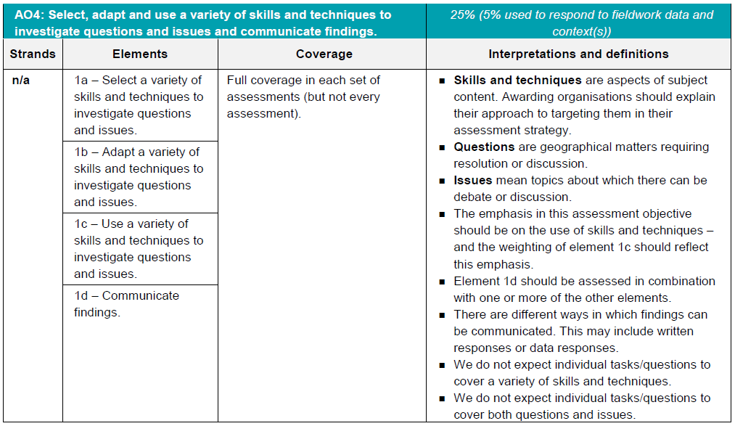
AO4 - Skills
5% of the marks for the qualification must be allocated to geographical skills in a fieldwork context.
Most of the AO4 marks will be allocated to using geographical skills – however there must be marks targeting ‘questions’ and ‘issues’ for selecting skills, adapting skills and using skills, as well as marks targeting ‘communicating findings’.

Slide 21
AO4 command words
AO4 requires students to select, adapt and use geographical skills, as well as communicate findings.
The following are some of the command words which may be used for questions with AO4 marks:
  Describe the pattern
  Using data
  Calculate
  Identify
  Make a prediction
Commands words may vary depending on the level of interaction with a resource.

Slide 22
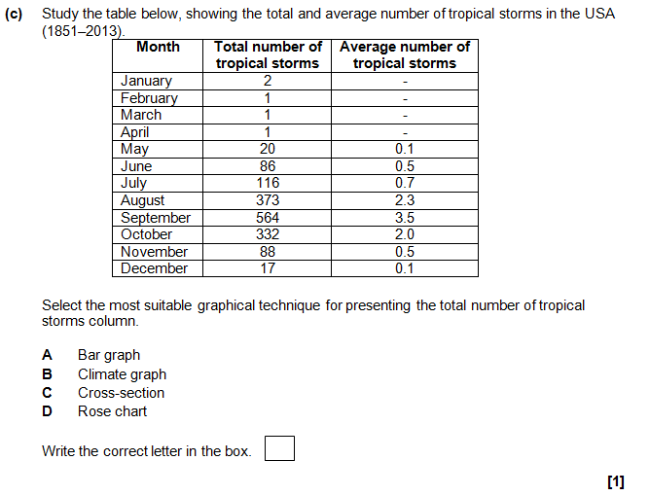
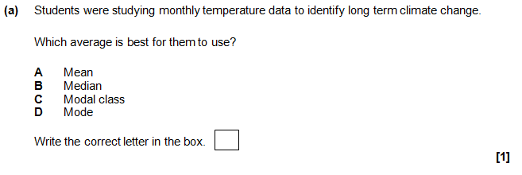

What are AO4 ‘select’ marks?
Questions targeting AO4 ‘select’ marks require students to choose an appropriate skill for the context which the question focuses on.
The first example students are faced with a table of data and must select the most appropriate graphical technique for presenting the data in the table.
In the second example students are faced with a multiple choice question and must choose the appropriate graph for the context (identifying long term climate change).
The third example shows how ‘select’ marks can be allocated in a fieldwork context. Students are required to name a suitable primary data collection technique and so are selecting the technique.

Slide 23
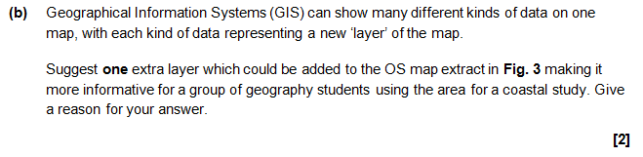
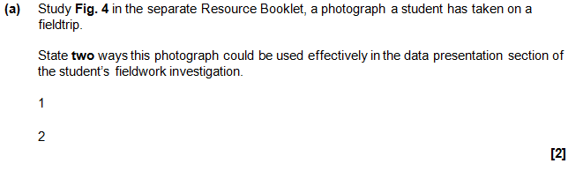
What are AO4 ‘adapt’ marks?
AO4 ‘adapt’ marks are allocated in questions where students must suggest improvements or changes to a resource.
The question above asks students to suggest an extra layer to be added to the OS map – they are therefore adapting the map. There could be questions in the future which ask students to actually change a resource on the question paper.
The question below asks students to state two ways in which the photograph could be used in the data presentation section of a fieldwork investigation – the student is therefore changing the use of the photograph in this investigation.

Slide 24
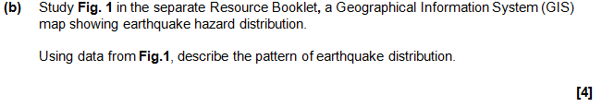
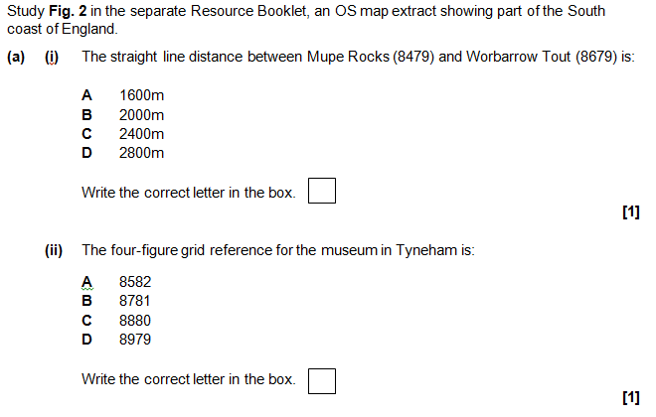
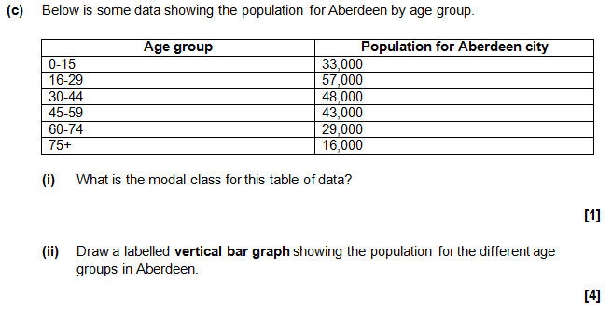
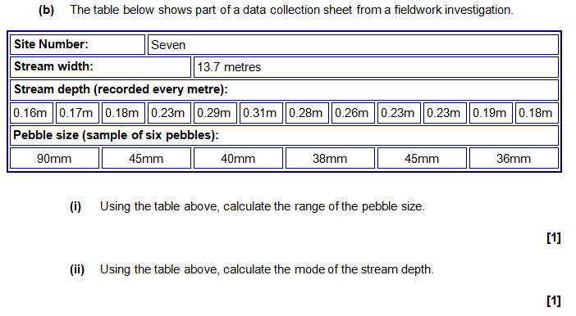
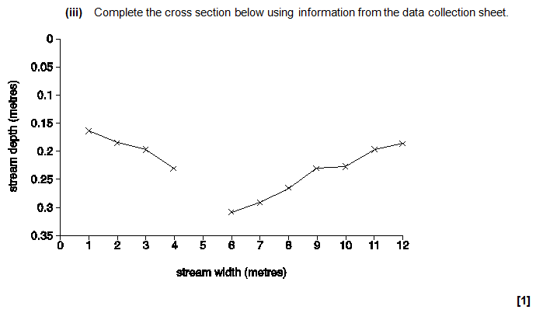
What are AO4 ‘use’ marks?
Most of the ‘skills’ questions will require students to use skills in a number of ways. Some different ways are shown on this slide - from making predictions, using OS maps, picking information from resources and answering statistical questions.

Slide 25

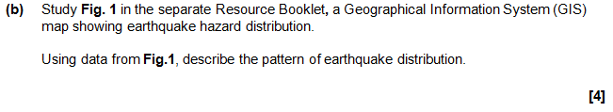
What are AO4 ‘communicate findings’ marks?
AO4 ‘communicate findings’ marks are allocated to questions where students must answer the question in the most appropriate and logical manner. These marks must be used in combination with another assessment objective element – for example ‘using’ skills.
A ‘communicate findings’ mark is available in questions where a student needs to describe a pattern in the following instances:
  there are three marks available and the question does not ask for data to be included
  there are more than three marks available, whether data is requested or not.
The two questions below both have a mark for ‘communicate findings’. The question on the left has three marks available, two are for points made describing the pattern and the other is for communicating the findings in a logical and appropriate order (general pattern first and then the specific point afterwards).
The question on the right has four marks available, two are for points made describing the pattern, one is for using data and the other is for communicating the findings in a logical and appropriate order (general pattern first and then the specific point afterwards – the data can be placed with either point).

Slide 26
We’d like to know your view on the resources we produce. By clicking on ‘Like’ or ‘Dislike’ you can help us to ensure that our resources work for you. When the email template pops up please add additional comments if you wish and then just click ‘Send’. Thank you.
Whether you already offer OCR qualifications, are new to OCR, or are considering switching from your current provider/awarding organisation, you can request more information by completing the Expression of Interest form which can be found here: www.ocr.org.uk/expression-of-interest
Looking for a resource? There is now a quick and easy search tool to help find free resources for your qualification:
www.ocr.org.uk/i-want-to/find-resources/
OCR Resources: the small print
OCR’s resources are provided to support the delivery of OCR qualifications, but in no way constitute an endorsed teaching method that is required by the Board, and the decision to use them lies with the individual teacher. Whilst every effort is made to ensure the accuracy of the content, OCR cannot be held responsible for any errors or omissions within these resources.
© OCR 2016 - This resource may be freely copied and distributed, as long as the OCR logo and this message remain intact and OCR is acknowledged as the originator of this work.
OCR acknowledges the use of the following content: n/a
Please get in touch if you want to discuss the accessibility of resources we offer to support delivery of our qualifications: resources.feedback@ocr.org.uk

