Slide 1

Guide to the SAMs
Component 01 –
Our Natural World

Slide 2
J384/01 Our Natural World
Within the study of Our Natural World learners get the opportunity to explore the natural world they live in, to understand why it looks the way it does and appreciate its value.
There will be study of global hazards, our changing climate, distinctive landscapes in the UK and global sustaining ecosystems.
But what will the assessments look like?
This guide will give you an understanding of the format and structure of the ‘Our Natural World’ exam, an insight into the assessment objectives and a question by question explanation of the sample assessment for J384/01 Our Natural World. This guide can also be used with your students to support revision.

Slide 3
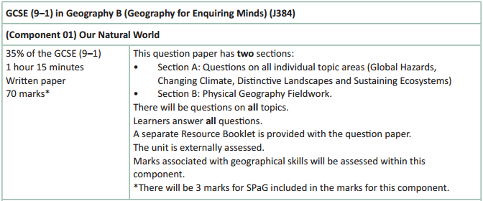
How will Our Natural World be assessed?
No optionality – students know what they need to do and will not get confused as to which option they should answer.
17 marks for AO4 (skills) in total – 5 of which will be in Section B for fieldwork
A separate Resource Booklet so students can access resources easily when answering questions.
3 marks for SPaG will be on the final question – the 8 marker on fieldwork in section B.

Slide 4
How will Our Natural World be assessed?
The overall exam will be 70 marks (3 of which are for SPaG) and there is 1 hour 15 minutes to complete the exam (just over a minute per mark).
The Assessment Objective breakdown for the overall paper is:
There are two sections to Our Natural World:
Section A which includes questions on the topics of Global Hazards, Changing Climate,
Distinctive Landscapes and Sustaining Ecosystems.
Section B which includes questions on Physical Geography Fieldwork.
But let’s have a look at the two sections in more detail on the following slides.
 | AO1 (Knowledge) | AO2 (Understanding) | AO3 (Application) | AO4 (Skills) | SPaG | Total
Marks | 14 | 14 | 22 | 17 | 3 | 70

Slide 5
Our Natural World - Section A
Four topics are assessed in Section A (Global Hazards, Changing Climate, Distinctive Landscapes and Sustaining Ecosystems) and there will be 13 marks on each topic in the exam.
Each topic will start with short answer, point marked questions (1, 2, 3 and 4 mark questions) before finishing with a level of response question of either 6 marks or 8 marks.
There will be only one 8 mark question in Section A each time and the topic it will be in will vary.
For Section A there will be questions on each assessment objective with the following totals across Section A:
 | AO1 (Knowledge) | AO2 (Understanding) | AO3 (Application) | AO4 (Skills) | Total
Marks | 14 | 14 | 12 | 12 | 52

Slide 6
Our Natural World - Section B
Physical geography fieldwork is assessed in Section B and there will be 18 marks in this section – which includes 3 SPaG marks.
This section will start with short answer, point marked questions (1 to 4 mark questions) before finishing with a level based question of 8 marks. The 8 mark question will also have 3 SPaG marks available (total of 11 marks for question).
In Section B there will be assessment of physical geography fieldwork both in relation to the students’ own experiences of fieldwork and unfamiliar contexts (resources) which students will first encounter in the exam.
Section B will include questions with marks targeting AO3 (application) and AO4 (skills). There will be 10 marks for AO3 and 5 marks for AO4 in this section.

Slide 7
Other things to know about the assessment…
There are a few other important things to highlight for the assessment and to help you understand the mark scheme, so now we will run through:
  SPaG
  Quality of Extended Responses
  Marking Guidance

Slide 8
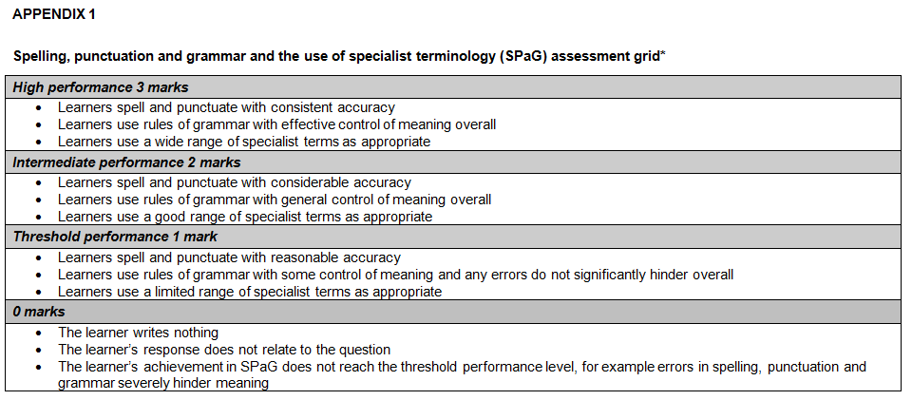
SPaG
SPaG – also known as spelling, punctuation and grammar and the use of specialist terminology is assessed against one of the longer questions in the exam with 3 marks available. In the ‘Our Natural World’ assessment SPaG will always be assessed on the 8 mark fieldwork question.
There are clear descriptors for each level of SPaG, which are separate from the geographical content of the rest of the question. The student’s answer is read holistically and the SPaG marks are awarded on the whole answer.

Slide 9
Quality of Extended Responses
‘Quality of extended response’ is assessed within each level for questions of 8 marks or above and is indicated by an asterisk (*) beside the question. The following are the descriptors placed within the levels for 8 mark questions:
Level 3
There is a well-developed line of reasoning which is clear and logically structured. The information presented is relevant and substantiated.
Level 2
There is a line of reasoning presented with some structure. The information presented is in the most-part relevant and supported by some evidence.
Level 1
The information is basic and communicated in an unstructured way. The information is supported by limited evidence and the relationship to the evidence may not be clear.
The way that a student has structured their response would need to be considered when you are deciding which level to place the student in – but the quality of the geographical content within the answer should always be the most important consideration.

Slide 10
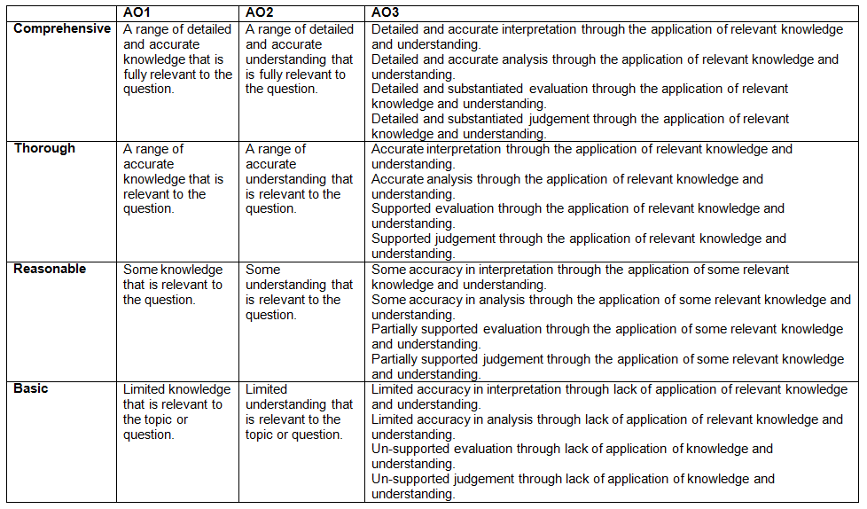
Level of Response Questions Marking Guidance
At the beginning of each mark scheme the following table is included to help you understand the level of response mark schemes. The wording in each level (from basic to comprehensive) indicates how answers develop and progress within each assessment objective.

Slide 11
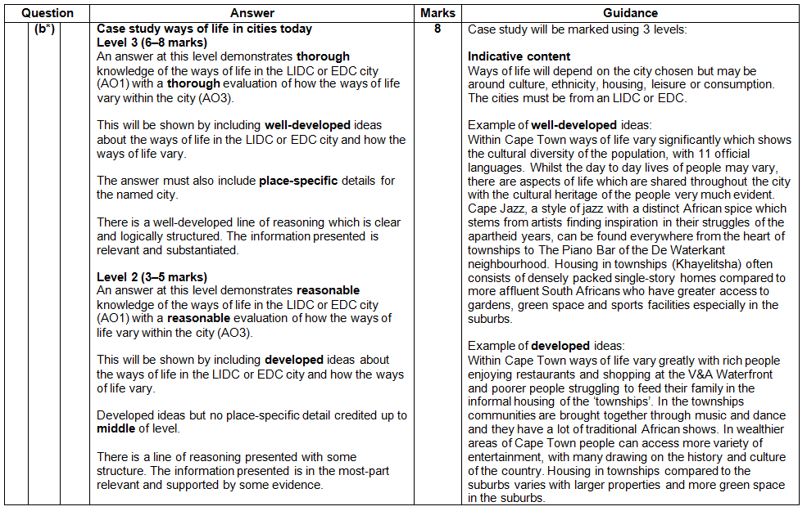
Level of Response Question Mark Scheme
The ‘Answer’ column includes information on how the assessment objectives link to the question and the standard required for the question parts.
The ‘Indicative content’ part of the mark scheme shows some of the content which could be included in students answers. This is not an exhaustive list.
A statement to indicate the level of development for answers to reach each level.
In the ‘Guidance’ column there are examples of ‘well-developed’, ‘developed’ and ‘simple’ ideas – these are examples of parts of answers – they are not full answers. The examples should show how an answer can develop from ‘simple’ to ‘developed’ to ‘well-developed’.
If ‘Quality of Extended Responses’ and/or ‘place-specific detail’ are being assessed they will be shown here

Slide 12
Assessment Objectives
The assessment objectives are set by Ofqual and are vital to exam boards when designing assessments and for teachers in understanding styles of questions and their requirements.
For GCSE (9-1) Geography there are 4 Assessment Objectives :
      AO1 (Knowledge)
      AO2 (Understanding)
      AO3 (Application of knowledge and understanding)
      AO4 (Skills).
For all of the GCSE Geography specifications there are set assessment objectives with exact percentages of marks which must be attributed to each assessment objective within the qualification throughout the lifetime of the specification.
The next few slides will explain what the four assessment objectives mean and clarify their use in this assessment.

Slide 13
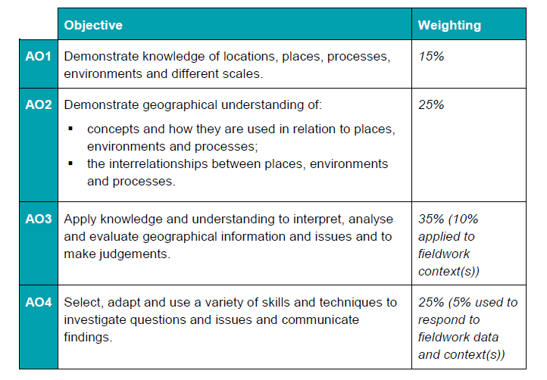
The 4 Assessment Objectives (AOs)
15% of the qualification
marks will be allocated to assessing students knowledge of the specification content (AO1)
25% of the qualification marks will be allocated to assessing students understanding of the specification content (AO2)
35% of the qualification
marks will be allocated to assessing students application of their knowledge and understanding of the specification content (AO3)
25% of the qualification
marks will be allocated to assessing students ability to select, adapt and use geographical skills and communicate findings in this context (AO4)

Slide 14
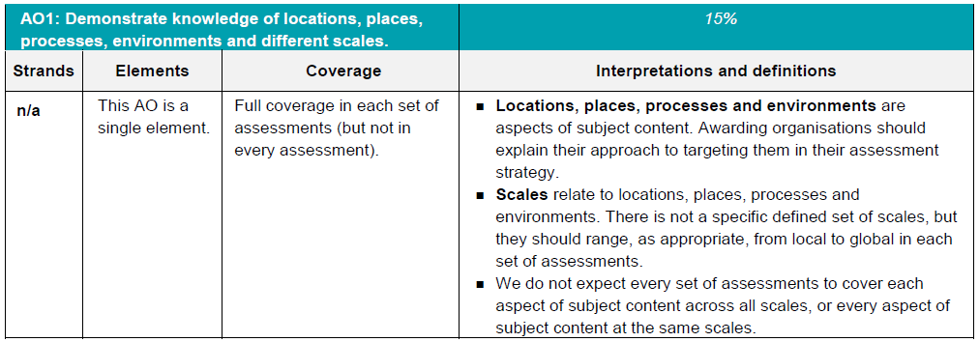
AO1 - Knowledge
Locations, places, processes and environments simply cover the subject content. There are other ways which you may describe content areas but all must be placed in these four aspects when we are creating our assessments.
Each year across the range of assessments there must be knowledge marks for locations, places, processes, environments and different scales but AO1 marks do not have to be included in every assessment.
Each year assessments will cover different scales
from local to global but not for every bit of content
or necessarily for all of locations, places, processes
and environments .

Slide 15
AO1 command words
AO1 requires students to demonstrate knowledge of the specification content through recalling information – including in a case study context.
Questions which target AO1 alone would tend to be shorter answer questions but longer questions may have AO1 marks allocated to them as well when combined with another assessment objective – particularly where case study information is required in an answer.
The following are some of the command words which may be used for short answer questions with AO1 marks:
  Describe
  Define
  Outline
  State
All of these command words are asking students to write down something that they have learnt from the specification and so are unlikely to be targeting a combination of assessment objectives.

Slide 16
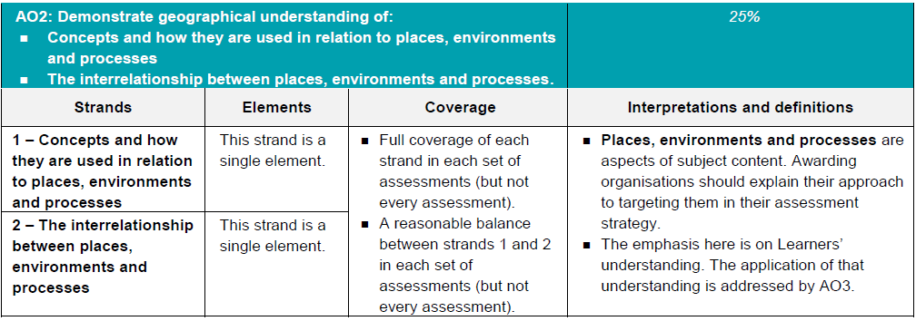
AO2 - Understanding
How concepts relate to the aspects of content.
Like with AO1 – places, processes and environments simply cover the subject content.
There must an appropriate balance in terms of the number of marks allocated to questions on the understanding of how concepts relate to content and how aspects of content relate to each other throughout the assessments.
How aspects of content relate to each other

Slide 17
AO2 command words
Questions with AO2 marks will focus on:
how concepts relate to the aspects of content
how aspects of content relate to each other
All AO2 marks will focus on understanding. AO2 marks will be directly linked to the specification but not just recalling what has been learnt, instead ensuring that students comprehend the content.
The following are some of the command words which may be used for questions with AO2 marks:
Explain how
Explain reasons/one reason
Discuss
AO2 marks may also be targeted in higher mark tariff questions but the command word may focus on a different assessment objective (e.g. AO3).
These command words may be used to solely target AO2 but may also be used in combination with other AO’s to target multiple assessment objectives, for example 2(c) or 3(d) of component 01 Our Natural World.

Slide 18
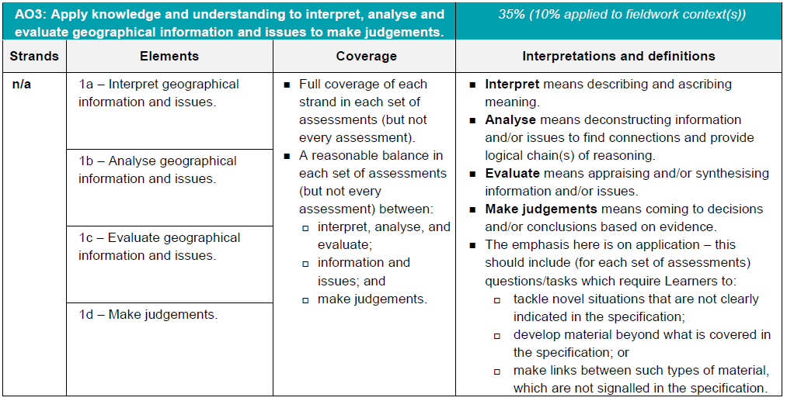
AO3 - Application
10% of the marks for the qualification must be allocated to the application of knowledge and understanding in a fieldwork context.
Three ways that students will need to apply their knowledge and understanding:
‘tackle novel situations’ could mean applying knowledge and understanding to a
resource
‘developing material beyond the specification’ could be evaluating the success of a
management strategy when the specification doesn’t explicitly ask for that
‘making links between such types of material which are not signalled in the
specification’ could be synoptic questions.

Slide 19
AO3 command words
Command words will vary depending on whether students are applying their knowledge and understanding by interacting with a resource(s) or not.
The following are some of the command words which may be used for questions with AO3 marks:
Weigh up whether a statement is true.
Interacting with resource | No resource
Describe | Assess
Give | Examine
Suggest | Evaluate
Outline | To what extent do you agree
Look in close detail and establish the key facts and important issues.
Give your verdict after providing evidence which both agrees with and contradicts an argument.
How much you agree with a statement based on the evidence in the argument.

Slide 20
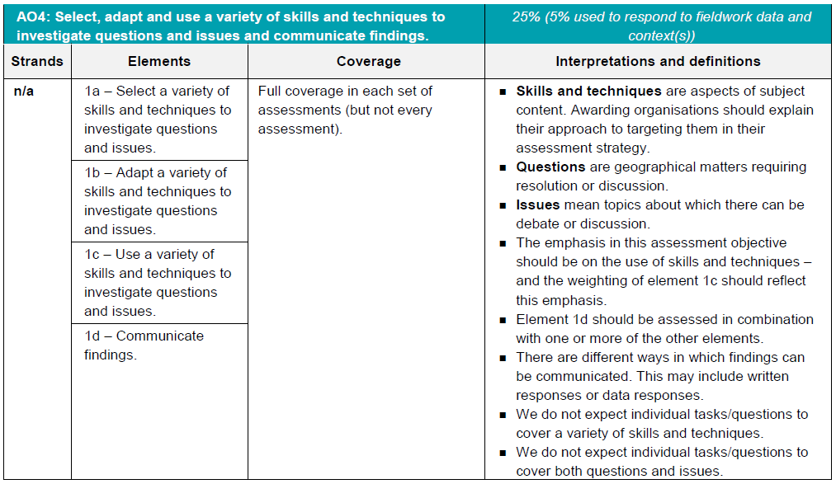
AO4 - Skills
5% of the marks for the qualification must be allocated to geographical skills in a fieldwork context.
Most of the AO4 marks will be allocated to using geographical skills – however there must be marks targeting ‘questions’ and ‘issues’ for selecting skills, adapting skills and using skills, as well as marks targeting ‘communicating findings’.

Slide 21
AO4 command words
AO4 requires students to select, adapt and use geographical skills, as well as communicate findings.
The following are some of the command words which may be used for questions with AO4 marks:
  Describe the pattern
  Using data
  Calculate
  Identify
  Make a prediction
Commands words may vary depending on the level of interaction with a resource.

Slide 22
Question 1(a) – 2 marks
‘Hot spot’ is straight from the specification (specification ref 1.2.a) and so describing a hot spot is AO1.
2 marks so assessors will be looking for two points to give marks – two ticks in the mark scheme
Mark scheme:
Describe what a hot spot is.
A small area of the earth’s crust where unusually high heat flow (✓) is linked to volcanic activity (✓)

Slide 23
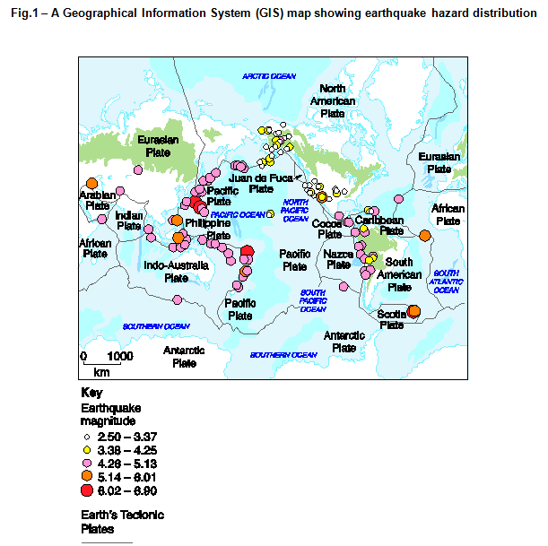
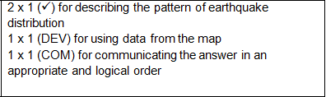
Question 1(b) – 4 marks
Study Fig. 1 in the separate Resource Booklet, a Geographical Information System (GIS) map showing earthquake hazard distribution.
Using data from Fig.1, describe the pattern of earthquake distribution.
This is a 4 mark ‘describing the pattern’ question, so there will be a mark for the order that the answer is written (communicating findings).
Also there is the command to use data from the resource – therefore there is a development mark for picking out data as it is giving evidence from the resource.
That leaves 2 marks for describing the pattern. So students need to make two points to describe the data, use data for one of the points and put the two points in the most logical order.
Make sure students take a couple of seconds to think about their two points before putting pen to paper, it might help them get the communicate findings mark!

Slide 24
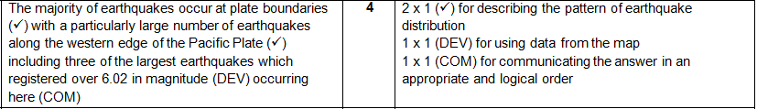
Question 1(b) – 4 marks
In the mark scheme example, the two marks for describing the pattern are indicated with a tick.
The data mark is shown with a (DEV) – it is specific information picked out from the resource – in this instance about the size of the three largest earthquakes.
The mark for communicating the answer in an appropriate and logical order (COM) is shown last – but that is because that is just where the answer finishes. The mark is specifically awarded because the general pattern is given first and then a specific point about the pattern is made afterwards.

Slide 25
Question 1(b) – The mark scheme
General pattern
Specific part of pattern
The majority of earthquakes occur at plate boundaries (✓) with a particularly large number of earthquakes along the western edge of the Pacific Plate (✓) including three of the largest earthquakes which registered over 6.02 in magnitude (DEV) (COM)
occurring here (COM)
Data from resource
Overall answer looked at – mark awarded as the general pattern is given first and then a specific point about the pattern is made afterwards.

Slide 26
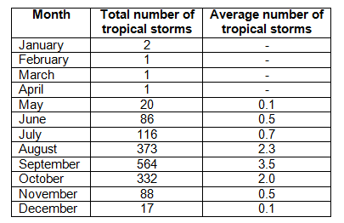
Question 1(c)
Study the table below, showing the total and average number of tropical storms in the USA (1851–2013).
The question is going to be on the table of data, make sure students read the question first – they may not need to use all of the data.
Multiple choice question so students need to read the choices carefully.
Remember the skill is to choose the most suitable graph from the list – students might be able to think of a better answer but still have to pick one of the choices.
Students must refer to the data in the table to make your choice, in this instance ‘A: Bar Graph’ is the most appropriate graph to because of the specific data in the total number of tropical storms column.
Select the most suitable graphical technique for presenting the total number of tropical storms column.
A Bar graph
B Climate graph
C Cross-section
D Rose chart

Slide 27
Question 1(d) – 6 marks
Extreme weather conditions vary in contrasting countries.
Discuss the differences in extreme weather conditions in contrasting countries.
You should develop your ideas fully.
This question contains AO2 marks as students need to understand extreme weather conditions (from the specification) – not just recall information about them. They need to choose the most appropriate pieces of information to demonstrate their understanding.
AO3 marks as students need to discuss the differences in extreme weather conditions in contrasting countries – in the specification it just asks students to know the extremes in weather conditions associated with wind, temperature and precipitation in contrasting countries, not to consider the differences between those countries. Therefore in discussing the differences the students are analysing them and applying their knowledge and understanding as part of AO3.

Slide 28
Question 1(d) – The mark scheme
Level 3 (5–6 marks)
An answer at this level demonstrates thorough understanding of extreme weather conditions in contrasting countries (AO2) and thorough analysis of the differences in extreme weather conditions in contrasting countries (AO3).
This will be shown by including well-developed ideas both about extreme weather conditions and the differences in extreme weather conditions in contrasting countries.
Level 2 (3–4 marks) looks for the same focuses in answers but with reasonable understanding and analysis through developed ideas.
Level 1 (1–2 marks) looks for the same focuses in answers but with basic understanding and analysis through simple ideas.
But which extremes in weather conditions might be discussed?
And what do we mean by ‘differences’?
And what are the differences between well-developed, developed and simple ideas?
The next few slides will answer these questions!

Slide 29
Question 1(d) – Indicative Content
Extremes in weather conditions most likely to be discussed are temperature, wind and precipitation. This is because this is what is defined in the specification. However, if students bring in other learning then they can discuss other extremes in weather conditions.
The differences in extreme weather conditions could include contrasts between the countries, but may also focus on differences between extremes and averages within the countries. This is deconstructing information (included in the analysis definition) and potentially quite high level.
Examples can be drawn from any countries but at least two should be discussed – otherwise they cannot look at the differences! The specification only asks for two but this wording also means that students can bring in other examples they have acquired if they wish to.
Countries must be contrasting in terms of their extreme weather conditions – this is a requirement of the specification and the question wording.

Slide 30
Question 1(d) – Well-developed? Developed? Simple?
Examples of simple ideas:
The extreme temperatures in Australia are much hotter than in England.
Australia is much hotter than England especially in the summer.
Examples of developed ideas:
Extreme temperatures in Australia are much higher than in England, with average summer temperatures in Australia being very similar to very hot weather in England which could be considered extreme.
Examples of well-developed ideas:
England and Australia have very different extremes in temperature when compared to each other but not necessarily as a difference from their own average temperatures. Average summer temperatures in England are around 20°C, with 30°C being considered extreme. This 10°C difference is mirrored in Australia with average summer temperatures being around 30°C and extremes at 40°C. So the differences in the extremes in temperature are very similar.
The developed idea builds on the simple idea with more explanation of the context of extreme weather conditions, here about how ‘average’ in Australia is considered very hot in England.
The well-developed idea builds again, with more contextualisation and deeper understanding being shown of what is extreme in Australia and England and more information being used in the development of ideas as students go up through the levels .

Slide 31
Question 2(a) – 1 mark
Students were studying monthly temperature data to identify long term climate change.
Which average is best for them to use?
A Mean
B Median
C Modal class
D Mode
The skill is to choose the which type of average is best for the data with the question referring to monthly temperature data to study long term climate change.
This question shows a different way statistical skills may be asked – students have to know why we would use the different types of average instead of just remembering how to work them out.
The answer in this instance is ‘A: Mean’ as it would minimise the amount of error from all the other values in the data set for that month and is the most appropriate statistical technique to use in this instance.

Slide 32
Question 2(b) – 4 marks
Compare the reliability of two sources of evidence of climate change.
4 marks – so where are the marks?
The question specifically asks for ‘two sources of evidence of climate change’ – that very clearly shows that there are two marks for recalling (AO1) the two sources of evidence of climate change.
Compare is an AO3 command word – and so there are AO3 (analyse) marks. Compare indicates that differences or similarities are required and in doing this students are analysing. These analysis marks are ‘development’ marks as they are taking the answer further than the recalling of the sources of evidence of climate change.

Slide 33
Question 2(b) – The mark scheme
Example from the mark scheme:
Historical records (✓) and ice cores (✓) are two sources of evidence of climate change. Historical records may be less reliable than ice cores as they are handwritten or drawn based on one person’s interpretation (DEV) without the use of modern thermometers (DEV)
In this example from the mark scheme historical records and ice cores were chosen as the two sources of evidence. This already gets the two AO1 knowledge marks available. Other sources of evidence of climate change would be fine to use.
Whilst the reliability of evidence relating to climate change is in the specification the command means that it is the reliability which needs to be compared. Two points comparing the reliability are required to access the development marks and achieve four out of four marks.

Slide 34
Question 2(c)* – 8 marks
Assess whether the social impacts of climate change experienced in the UK in the 21st century are greater than the environmental impacts.
An 8 mark question which is split evenly between AO2 (understanding) and AO3 (application).
Assess is a command term that means application of knowledge and understanding (AO3) and that information needs to be weighed up. The word ‘greater’ is also important because it shows what the answer must be focused on.
Social and environmental impacts of climate change in the UK in the 21st century are from the specification. However, this question needs an understanding of the severity of the impacts to aid the discussion of which is greater, rather than just recalling what the impacts are.
The asterisk (*) shows that ‘Quality of extended response’ will be assessed in this question, see slide 10 for more information on the ‘Quality of extended response descriptors’.

Slide 35
Question 2(c)* – The mark scheme
Level 3 (6–8 marks)
An answer at this level demonstrates thorough understanding of the social and environmental impacts of climate change experienced in the UK in the 21st century (AO2) and thorough analysis of whether the social impacts are greater than the environmental impacts (AO3).
This will be shown by including well-developed ideas about the social and environmental impacts of climate change experienced in the UK in the 21st century and which are greater.
Level 2 (3–5 marks) looks for the same focuses in answers but with reasonable understanding and analysis through developed ideas.
Level 1 (1–2 marks) looks for the same focuses in answers but with basic understanding and analysis through simple ideas.
‘Quality of extended response’ is assessed within each level – you can find out more about the Quality of Extended Response descriptors on slide 10.

Slide 36
Question 2(c)* – The mark scheme
Social and environmental impacts are listed under the indicative content – these are not exhaustive but show a range which could be discussed.
This well-developed idea begins with a sentence framing the rest of the answer in terms of the application (AO3) element.
It is then followed by two sentences showing an understanding (AO2) of social and environmental impacts of climate change.
There is then another sentence focusing on analysis to draw the understanding together. This is an example of students 'weighing up' their answer and evidence of analysis where they are applying their knowledge and understanding.
Examples of well-developed ideas:
The social impacts of climate change experienced in the UK in the 21st century have mainly been a consequence of environmental impacts and so could be considered greater. More precipitation in the winter and more chance of extreme storm conditions at all times bring an increased risk of flooding. This would mean people may become isolated from amenities and unable to get food supplies or to their place of work or even have to leave their homes or be rescued. As social impacts are added to the environmental ones, they increase the impact felt and so can be considered greater.

Slide 37
Question 3(a)(i) – 1 mark
Study Fig. 2 in the separate Resource Booklet, an OS map extract showing part of the South coast of England.
The straight line distance between Mupe Rocks (8479) and Worbarrow Tout (8679) is:
A 1600m
B 2000m
C 2400m
D 2800m
The geographical skill assessed is the ability to understand distance in the context of an OS map.
The map has a scale bar for reference and to allow access to the question.
Whilst a ruler or piece of string would be helpful in this instance, the differences between the potential answers are large enough that students should be able to work out the answer without something to measure the distance precisely (the answer is ‘C: 2400m’).

Slide 38
Question 3(a)(ii) – 1 mark
Study Fig. 2 in the separate Resource Booklet, an OS map extract showing part of the South coast of England.
The four-figure grid reference for the museum in Tyneham is:
A 8582
B 8781
C 8880
D 8979
The geographical skill assessed is the ability to understand coordinates in the context of an OS map.
The map has a key for reference and to allow access to the question.
The correct answer is ‘C: 8880’, whilst the other answers should provide alternatives which some students may choose if they rush the question. Remember students have more than a minute per mark for this exam so it is worth them checking all of the answers before choosing.

Slide 39
Question 3(b) – 2 marks
Geographical Information Systems (GIS) can show many different kinds of data on one map, with each kind of data representing a new ‘layer’ of the map.
Suggest one extra layer which could be added to the OS map extract in Fig. 3 making it more informative for a group of geography students using the area for a coastal study. Give a reason for your answer.
Two marks are available – one for suggesting the extra layer and one mark for justifying the layer with a reason.
The stem above the question reminds students what a ‘layer’ means for GIS. It is important that the layer is new – the question asks for ‘one extra layer’ and so suggesting something for which there is already a symbol will get no marks.
The reason must say what makes the layer more informative for the group of students – this does not have to be in terms for collecting data but may be for planning the study. This can be seen in the answers given in the mark scheme which include geology, public transport information or coastal management zones (any appropriate layer suggested is fine though).

Slide 40
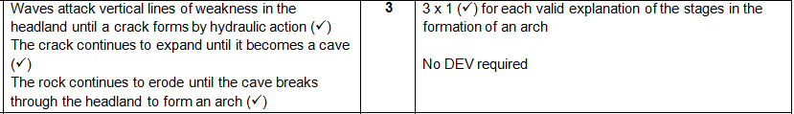
Question 3(c) – 3 marks
Explain the stages in the formation of an arch.
All 3 marks in this question are for understanding and the key to this is in the first half of the question. To explain the stages in the formation of an arch students must show understanding, not just recall how an arch is formed.
The answer is not a simple description of stages but instead the explanation of what happens within the stages. The three stages explained are enough for all three marks – wording would not have to be exactly as written here but would need the same level of understanding for each mark.

Slide 41
Question 3(d) – 6 marks
CASE STUDY – a river basin in the UK.
Name of river basin in the UK:
Explain how human activity has influenced the geomorphic processes in this landscape.
A 6 mark question which is split evenly between AO1 (knowledge) and AO2 (understanding).
A case study question which means that there will automatically be marks for AO1. In this instance ‘human activity’ and ‘geomorphic processes’ are the focuses of the question from the case study. Place-specific details must be included in the answer.
In the specification students study ‘how human activity, including management, works in combination with geomorphic processes to impact the landscape’. The word influenced is a slight change from the specification wording and so candidates must show their understanding of how human activity influences geomorphic process in this landscape. ‘Explain’ is a command word which indicates that understanding is required instead of just recalling information which is AO1.

Slide 42
Question 3(d) – The mark scheme
Level 3 (5–6 marks)
An answer at this level demonstrates a thorough knowledge of geomorphic processes (AO1) and a thorough understanding of how human activity has influenced the geomorphic processes (AO2).
This will be shown by including well-developed ideas both about the geomorphic processes and how human activity has influenced the geomorphic processes.
The answer must also include place-specific details for the landscape. Amount of relevant place-specific detail determines credit within level.
Level 2 (3–4 marks) looks for the same focuses in answers but with reasonable knowledge and understanding through developed ideas.
Level 1 (1–2 marks) looks for the same focuses in answers but with basic knowledge and understanding through simple ideas.

Slide 43
Question 3(d) – Indicative Content
The answer will very much depend on which case study is chosen. There is no single case study which must be used – as long as the case study meets the criteria in the specification then it is fine.
In the indicative content we have listed a number of different management strategies – the list is not exhaustive but should give a good indication of the types of things which could be discussed. However the question needs them to be related to geomorphic processes to explain how human activities have influenced these processes.
Management strategies could include:
Flood barriers/dams – silting up, restriction of sediment replenishment
River realigning/straightening – restriction of meanders/horizontal/lateral erosion
Channelisation – impact of erosion, decreased bedload, deposition, throughflow.
Building on flood plains – increased surface runoff,
Afforestation/deforestation
Artificial Levees/Embankments

Slide 44
Question 3(d) – Well-developed? Developed? Simple?
Examples of simple ideas:
One way humans have affected the river is by taking away the bends and making the river straighter.
Examples of developed ideas:
Channel straightening is one way that humans have altered the river Nene landscape in Northampton. They have used concrete to change the route of the river which has caused less erosion and flooding.
Examples of well-developed ideas:
Humans have straightened rivers and introduced channelisation to increase the discharge of the River Nene in Northampton. These changes alter the velocity of the river and reduce friction. These human activities reduce the amount of lateral and vertical erosion causing the river to not form a meander which would be the natural landscape.
The developed idea builds on the simple idea with more explanation of how the change to the river landscape (in this example the route) influences geomorphic processes and gives place-specific detail.
The well-developed idea builds again, with a greater explanation of how human activities have influenced geomorphic processes and an increase in the amount of place-specific detail for this landscape and complexity in geographical language used.

Slide 45
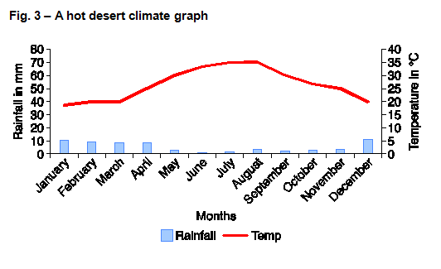
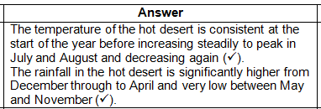
Question 4(a) – 2 marks
Study Fig. 3 in the separate Resource Booklet, showing a hot desert climate graph.
Describe the yearly temperature and rainfall patterns on the hot desert climate graph.
Two marks – one mark for describing the yearly temperature pattern and one mark for describing the yearly rainfall pattern .
Only two marks and question does not ask specifically for data – therefore data is not needed, just the patterns.
The skill is for interpreting the graph in order to be able to describe the pattern.

Slide 46
Question 4(b) – 1 mark
Which two statements best explain why the nutrient cycle of tropical rainforests is rapid?
1 Heavy rainfall washes away dead plant material
2 Nutrients are in high demand from the fast-growing plants
3 The forest floor conditions allow for quick decomposition of dead plant material
4 There is great biodiversity in tropical rainforests
A 1 and 2
B 1 and 4
C 2 and 3
D 3 and 4
This question targets understanding as students need to pick two statements which best explain why the nutrient cycle of tropical rainforests is rapid – they will have learnt about tropical rainforest nutrient cycles but this is phrased in a way that they must understand what happens instead of just recalling the process. The answer is ‘C: 2 and 3’ as although 1 and 4 are true they are not relevant for why the nutrient cycle is rapid in the tropical rainforest.

Slide 47
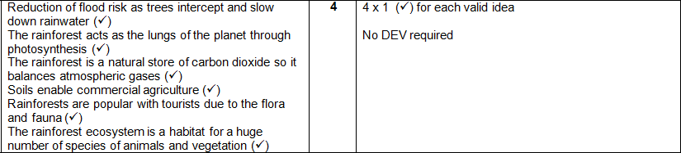
Question 4(c) – 4 marks
Describe how tropical rainforests provide valuable services.
All four marks in this question are for knowledge as the wording of the question is very similar to the specification. Students do not need to show understanding of how the services are valuable, just simply describe how tropical rainforests provide valuable services.
Marks are given for valid ideas – this is deliberately open so that the valuable services tropical rainforests provide can be to the animals and vegetation in the rainforest, to humans or even to the entire planet.

Slide 48
Question 4(d) – 6 marks
CASE STUDY – a small scale example of sustainable management in either the Arctic or Antarctic.
Evaluate the success of one small scale example of sustainable management in either the Arctic or Antarctic.
A 6 mark question which is split evenly between AO1 (knowledge) and AO3 (application).
A case study question which means that there will be marks for AO1. In this instance students will have studied either a small scale example of sustainable management in the Arctic or Antarctic. Place-specific details must be included in the answer as this is a case study question. The question must focus on a small scale example in either the Arctic or Antarctic.
The question requires students to apply their knowledge and understanding of the small scale example of sustainable management in the Arctic or Antarctic to evaluate it’s success. The specification does not require study of the success of the sustainable management.

Slide 49
Question 4(d) – The mark scheme
Level 3 (5–6 marks)
An answer at this level demonstrates thorough knowledge of a small scale sustainable management scheme (AO1) and a thorough evaluation of the success of the example of sustainable management (AO3).
This will be shown by including well-developed ideas about the small scale sustainable management scheme and its success.
The answer must also include place-specific details for the named management scheme. Amount of relevant place-specific detail determines credit within level.
Level 2 (3–4 marks) looks for the same focuses in answers but with reasonable knowledge and evaluation through developed ideas.
Level 1 (1–2 marks) looks for the same focuses in answers but with basic knowledge and evaluation through simple ideas.

Slide 50
Question 4(d) – Well-developed? Developed? Simple?
Examples of simple ideas:
People have been stopped from going on large ships to holiday in the Antarctic so that there is less damage to it.
Examples of developed ideas:
The Antarctic tour operators have rules to help protect it for example by only allowing a certain number of people to go there and no litter is allowed to be left there. This has meant there are less people destroying the pristine ecosystem and those who do go do as little damage as possible.
Examples of well-developed ideas:
Tour operators have an agreed set of rules for tourism for Antarctica, this includes the sustainable tourism management plan. Litter is one thing covered under the plan, and it has to be prevented and removed to maintain the areas ecosystems and natural beauty. This has had a positive impact on both the waste management and the habitats of birds and sea life in Antarctica. The plan has many positive points but also the tours themselves potentially have a number of negative impacts on ecosystems, such as interrupting species breeding routines. To mitigate this tour operators try to advise tourists on where to position themselves when viewing birds and animals to cause least impact.
The developed idea builds on the simple idea with more explanation of the rules of Antarctic tour operators and the success of the rules and gives place-specific detail.
The well-developed idea builds again, with a greater explanation of rules of Antarctic tour operators and the success of the sustainable management, with both positive and negative points included. There is also an increase in the amount of place-specific detail for this case study.

Slide 51
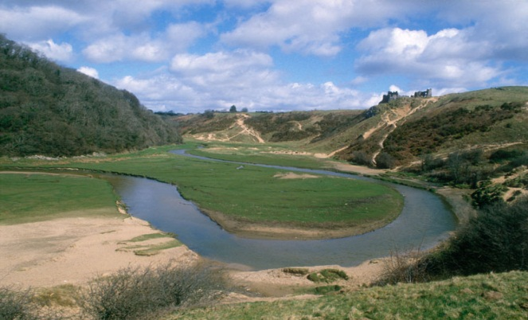
Question 5(a) – 2 marks
Study Fig. 4 in the separate Resource Booklet, a photograph a student has taken on a
fieldtrip.
State two ways this photograph could be used effectively in the data presentation
section of the student’s fieldwork investigation.
Two marks are available – both for stating ways that the photograph could be used effectively in the data presentation section – no development is required.
Examples may include:
To identify sample sites (✓)
To use in conjunction with a GIS map showing sample sites (✓)
With annotated labels of the landform (✓)
Geolocated to show its position on a map (✓)
Examples in the mark scheme are not exhaustive but indicate potential answers students may give.

Slide 52
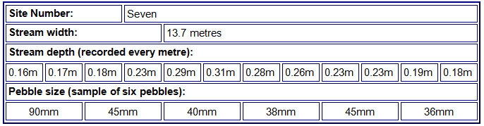
Question 5(b)(i) – 1 mark
The table below shows part of a data collection sheet from a fieldwork investigation.
Using the table above, calculate the range of the pebble size.
Answer is 54mm – 1 mark so students do not need to show working.
Remember, calculators are allowed in the exam!

Slide 53
Question 5(b)(ii) – 1 mark
The table below shows part of a data collection sheet from a fieldwork investigation.
Using the table above, calculate the mode of the stream depth.
Answer is 0.23m – the mode is the value that appears most often in a set of data. There is only 1 mark available and so students just need to give the correct answer, no working out.

Slide 54
Question 5(b)(iii) – 1 mark
Complete the cross section below using information from the data collection sheet.
There is 1 mark for correctly completing the graph by plotting the 0.29 point and joining the points on the graph. Only plotting the 0.29 point is not completing the cross section.

Slide 55
Question 5(c) – 2 marks
For a physical geography fieldwork investigation which you have completed,
evaluate one technique you used to collect data.
Technique used:
As the command word is evaluate there is no mark awarded for just stating the technique – but we have inserted a prompt of ‘Technique used’ to help focus students.
There are two marks available so students must make two evaluative points.
Any physical geography data collection technique can be used and the evaluation could refer to:
Limitations and merits of the technique in helping to answer the question for investigation
How easy the data collected was to analyse and present
Level of ease carrying out the technique at the time/day of collection
Example answer:
Measuring river depth this technique was limited due to health and safety (✓) where high bankfull discharge meant that we could not sample enough sites (✓)

Slide 56
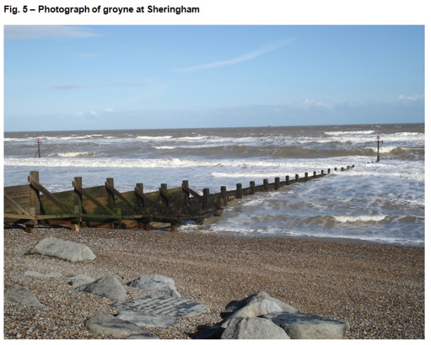
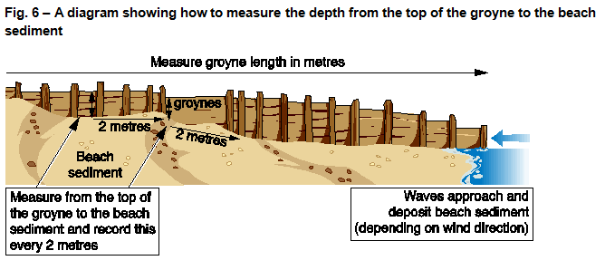
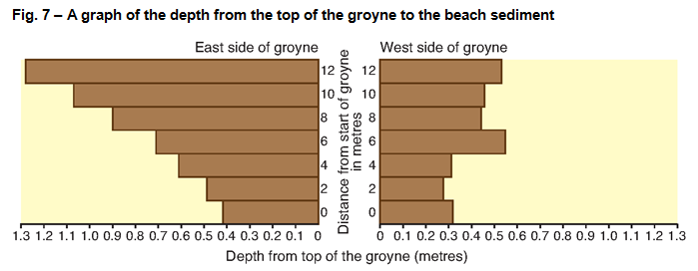
Question 5(d*) – 8 marks (+3 SPaG)
Figs 5, 6 and 7 in the separate Resource Booklet show information from a GCSE geography student’s fieldwork investigation.
Using evidence from Figs 5, 6 and 7, write a conclusion to the question for investigation “Does the process of longshore drift occur at Sheringham?” Develop your answer.

Slide 57
Question 5(d*) – 8 marks (+3 SPaG)
Figs 5, 6 and 7 in the separate Resource Booklet show information from a GCSE geography student’s fieldwork investigation.
Using evidence from Figs 5, 6 and 7, write a conclusion to the question for investigation “Does the process of longshore drift occur at Sheringham?” Develop your answer.
An 8 mark question which is all AO3 (application) – remember fieldwork questions cannot have any marks for AO1 or AO2 due to the Assessment Objective weightings set by Ofqual (see slide 13).
The question requires students to apply their knowledge and understanding of drawing evidenced conclusions and summaries from fieldwork transcripts and data to resources Figs 5, 6 and 7.
There are equal marks attributed to the analysis of the information in these resources and also for coming to a conclusion which answers the question.
The asterisk (*) shows that ‘Quality of extended response’ will be assessed in this question – see slide 10 for more information on the ‘Quality of extended response descriptors’.
There are marks for SPaG (Spelling, punctuation and grammar and the use of specialist terminology) you can find out more about the SPaG descriptors on slide 9.

Slide 58
Question 5(d*) – The mark scheme
Level 3 (6–8 marks)
The answer must include a thorough analysis of the fieldwork data (AO3) to come to a thorough conclusion that answers the question (AO3).
This will be shown by including well-developed ideas.
Level 2 (3-5 marks) looks for the same focuses in answers but with reasonable analysis and conclusions through developed ideas.
Level 1 (1-2 marks) looks for the same focuses in answers but with basic analysis and evaluation through simple ideas.
‘Quality of extended response’ is assessed within each level – you can find out more about the Quality of Extended Response descriptors on slide 10.

Slide 59
Question 5(d*) – Well-developed? Developed? Simple?
Examples of simple ideas:
Longshore drift does occur at Sheringham, you can see this from the graph where there is more sand on one side of the groyne.
Examples of developed ideas:
The table shows a difference in the amount of sediment on the east and west side of the groyne therefore longshore drift does occur. For example at 12m there is a 0.53m of sand on the east compared to 1.28m on the west. The graph shows an overall greater amount of sand on the west hand side of the groyne, indicating that longshore drift does occur.
Examples of well-developed ideas:
From the figures it can be concluded that longshore drift does occur at Sheringham. The raw data in the graph illustrates the differences in the sediment levels either side of the groyne which shows more sediment build up on the west side than on the east side. There is a difference of 2.62m of sand built up between the east and west side of the groyne. This indicates longshore drift is occurring and the groyne is working effectively to trap sand and slow the process of longshore drift.
The examples show what might be considered ‘well-developed’, ‘developed’ and ‘simple’ ideas and how an answer might progress from one to the other.

Slide 60
We’d like to know your view on the resources we produce. By clicking on ‘Like’ or ‘Dislike’ you can help us to ensure that our resources work for you. When the email template pops up please add additional comments if you wish and then just click ‘Send’. Thank you.
Whether you already offer OCR qualifications, are new to OCR, or are considering switching from your current provider/awarding organisation, you can request more information by completing the Expression of Interest form which can be found here: www.ocr.org.uk/expression-of-interest
Looking for a resource? There is now a quick and easy search tool to help find free resources for your qualification:
www.ocr.org.uk/i-want-to/find-resources/
OCR Resources: the small print
OCR’s resources are provided to support the delivery of OCR qualifications, but in no way constitute an endorsed teaching method that is required by the Board, and the decision to use them lies with the individual teacher. Whilst every effort is made to ensure the accuracy of the content, OCR cannot be held responsible for any errors or omissions within these resources.
© OCR 2016 - This resource may be freely copied and distributed, as long as the OCR logo and this message remain intact and OCR is acknowledged as the originator of this work.
OCR acknowledges the use of the following content: n/a
Please get in touch if you want to discuss the accessibility of resources we offer to support delivery of our qualifications: resources.feedback@ocr.org.uk

