Slide 1

Guide to the SAMs
Component 02 –
People and Society

Slide 2
J384/02 People and Society
Within the study of People and Society learners get the opportunity to investigate patterns and processes that shape the human planet and explore the connections between people and places.
There will be study of urban futures, dynamic development, the UK in the 21st century and resource reliance.
But what will the assessments look like?
This guide will give you an understanding of the format and structure of the ‘People and Society’ exam, an insight into the assessment objectives and a question by question explanation of the sample assessment material for J384/02 People and Society. This guide can also be used with your students to support revision.

Slide 3
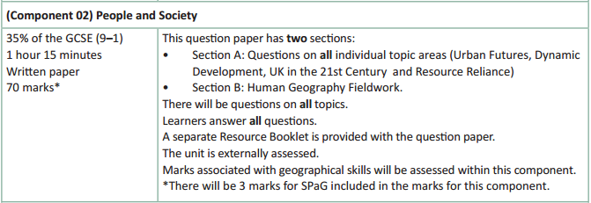
How will People and Society be assessed?
No optionality – students know what they need to do and will not get confused as to which option they should answer.
17 marks for AO4 (skills) in total – 5 of which will be in Section B for fieldwork
A separate Resource Booklet so students can access resources easily when answering questions.
3 marks for SPaG will be on the final question – the 8 marker on fieldwork in section B.

Slide 4
How will People and Society be assessed?
The overall exam will be 70 marks (3 of which are for SPaG) and there is 1 hour 15 minutes to complete the exam (just over a minute per mark).
The Assessment Objective breakdown for the overall paper is:
There are two sections to People and Society:
Section A which includes questions on the topics of Urban Futures, Dynamic Development,
UK in the 21st Century and Resource Reliance.
Section B which includes questions on Human Geography Fieldwork.
But let’s have a look at the two sections in more detail.
 | AO1 (Knowledge) | AO2 (Understanding) | AO3 (Application) | AO4 (Skills) | SPaG | Total
Marks | 14 | 14 | 22 | 17 | 3 | 70

Slide 5
People and Society - Section A
Four topics are assessed in Section A (Urban Futures, Dynamic Development, UK in the 21st Century and Resource Reliance) and there will be 13 marks on each topic in the exam.
Each topic will start with short answer, point marked questions (1, 2, 3 and 4 mark questions) before finishing with a level of response question of either 6 marks or 8 marks.
There will be only one 8 mark question in Section A each time and the topic it will be in will vary.
For Section A there will be questions on each assessment objective with the following totals across Section A:
 | AO1 (Knowledge) | AO2 (Understanding) | AO3 (Application) | AO4 (Skills) | Total
Marks | 14 | 14 | 12 | 12 | 52

Slide 6
People and Society - Section B
Human geography fieldwork is assessed in section B and there will be 18 marks in this section – which includes 3 SPaG marks.
This section will start with short answer, point marked questions (1 to 4 mark questions) before finishing with a level of response question of 8 marks. The 8 mark question will also have 3 SPaG marks available (total of 11 marks for question).
In Section B there will be assessment of human geography fieldwork both in relation to the students’ own experiences of fieldwork and unfamiliar contexts (resources) which students will first encounter in the exam.
Section B will include questions with marks targeting AO3 (application) and AO4 (skills). There will be 10 marks for AO3 and 5 marks for AO4 in this section.

Slide 7
Other things to know about the assessment…
There are a few other important things to highlight for the assessment and to help you understand the mark scheme, so now we will run through:
  SPaG
  Quality of Extended Responses
  Marking Guidance

Slide 8
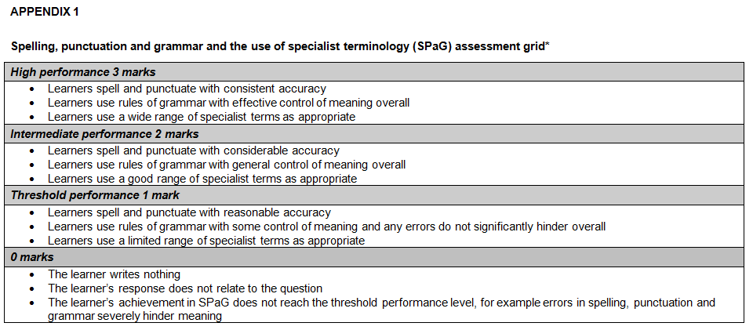
SPaG
SPaG – also known as spelling, punctuation and grammar and the use of specialist terminology is assessed against one of the longer questions in the exam with 3 marks available. In the ‘People and Society’ assessment SPaG will always be assessed on the 8 mark fieldwork question.
There are clear descriptors for each level of SPaG, which are separate from the geographical content of the rest of the question. The student’s answer is read holistically and the SPaG marks are awarded on the whole answer.

Slide 9
Quality of Extended Responses
‘Quality of extended response’ is assessed within each level for questions of 8 marks or above and is indicated by an asterisk (*) beside the question. The following are the descriptors placed within the levels for 8 mark questions:
Level 3
There is a well-developed line of reasoning which is clear and logically structured. The information presented is relevant and substantiated.
Level 2
There is a line of reasoning presented with some structure. The information presented is in the most-part relevant and supported by some evidence.
Level 1
The information is basic and communicated in an unstructured way. The information is supported by limited evidence and the relationship to the evidence may not be clear.
The way that a student has structured their response would need to be considered when you are deciding which level to place the student in – but the quality of the geographical content within the answer should always be the most important consideration.

Slide 10
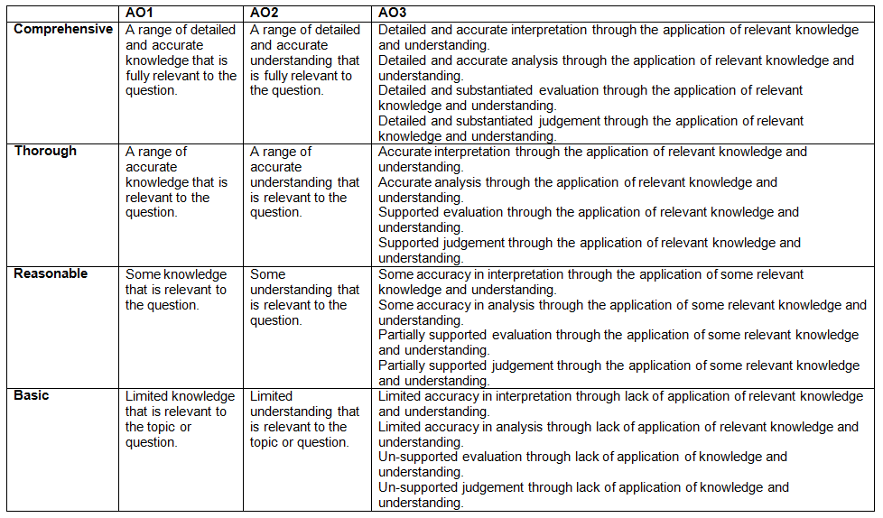
Level of Response Questions Marking Guidance
At the beginning of each mark scheme the following table is included to help you understand the level of response mark schemes. The wording in each level (from basic to comprehensive) indicates how answers develop and progress within each assessment objective.

Slide 11
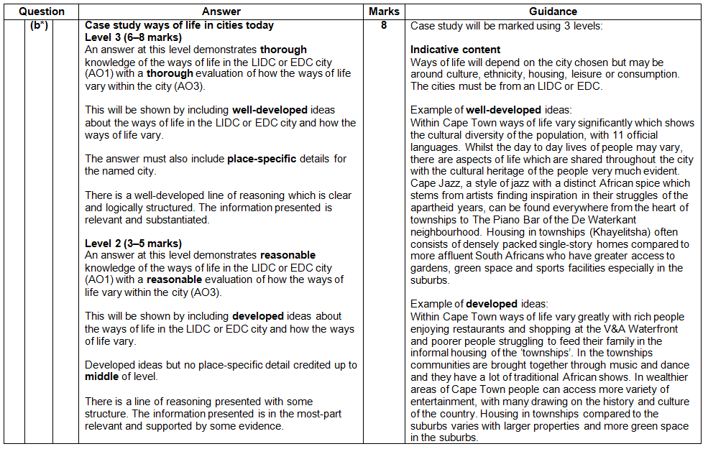
Level of Response Question Mark Scheme
The ‘Answer’ column includes information on how the assessment objectives link to the question and the standard required for the question parts.
The ‘Indicative content’ part of the mark scheme shows some of the content which could be included in students answers. This is not an exhaustive list.
A statement to indicate the level of development for answers to reach each level.
In the ‘Guidance’ column there are examples of ‘well-developed’, ‘developed’ and ‘simple’ ideas – these are examples of parts of answers – they are not full answers. The examples should show how an answer can develop from ‘simple’ to ‘developed’ to ‘well-developed’.
If ‘Quality of Extended Responses’ and/or ‘place-specific detail’ are being assessed they will be shown here

Slide 12
Assessment Objectives
The assessment objectives are set by Ofqual and are vital to exam boards when designing assessments and for teachers in understanding styles of questions and their requirements.
For GCSE (9-1) Geography there are 4 Assessment Objectives
      AO1 (Knowledge)
      AO2 (Understanding)
      AO3 (Application of knowledge and understanding)
      AO4 (Skills).
For all of the GCSE Geography specifications there are set assessment objectives with exact percentages of marks which must be attributed to each assessment objective within the qualification throughout the lifetime of the specification.
The next few slides will explain what the four assessment objectives mean and clarify their use in this assessment.

Slide 13
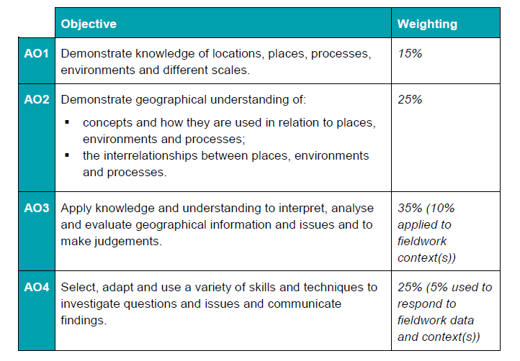
The 4 Assessment Objectives (AOs)
15% of the qualification
marks will be allocated to assessing students knowledge of the specification content (AO1)
25% of the qualification marks will be allocated to assessing students understanding of the specification content (AO2)
35% of the qualification
marks will be allocated to assessing students application of their knowledge and understanding of the specification content (AO3)
25% of the qualification
marks will be allocated to assessing students ability to select, adapt and use geographical skills and communicate findings in this context (AO4)

Slide 14
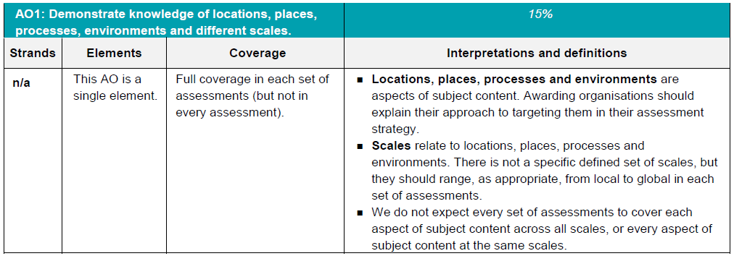
AO1 - Knowledge
Locations, places, processes and environments simply cover the subject content. There are other ways which you may describe content areas but all must be placed in these four aspects when we are creating our assessments.
Each year across the range of assessments there must be knowledge marks for locations, places, processes, environments and different scales but AO1 marks do not have to be included in every assessment.
Each year assessments will cover different scales
from local to global but not for every bit of content
or necessarily for all of locations, places, processes
and environments .

Slide 15
AO1 command words
AO1 requires students to demonstrate knowledge of the specification content through recalling information – including in a case study context.
Questions which target AO1 alone would tend to be shorter answer questions but longer questions may have AO1 marks allocated to them as well when combined with another assessment objective – particularly where case study information is required in an answer.
The following are some of the command words which may be used for short answer questions with AO1 marks:
  Describe
  Define
  Outline
  State
All of these command words are asking students to write down something that they have learnt from the specification and so are unlikely to be targeting a combination of assessment objectives.

Slide 16
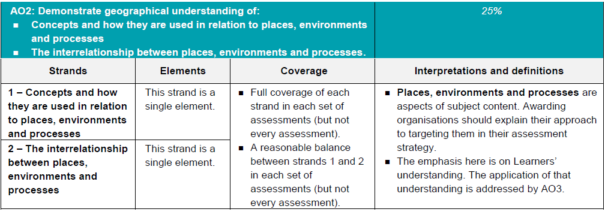
AO2 - Understanding
How concepts relate to the aspects of content.
Like with AO1 – places, processes and environments simply cover the subject content.
There must an appropriate balance in terms of the number of marks allocated to questions on the understanding of how concepts relate to content and how aspects of content relate to each other throughout the assessments.
How aspects of content relate to each other

Slide 17
AO2 command words
Questions with AO2 marks will focus on:
how concepts relate to the aspects of content
how aspects of content relate to each other
All AO2 marks will focus on understanding. AO2 marks will be directly linked to the specification but not just recalling what has been learnt, instead ensuring that students comprehend the content.
The following are some of the command words which may be used for questions with AO2 marks:
Explain how
Explain reasons/one reason
Discuss
AO2 marks may also be targeted in higher mark tariff questions but the command word may focus on a different assessment objective (e.g. AO3).
These command words may be used to solely target AO2 but may also be used in combination with other AO’s to target multiple assessment objectives, for example 2(c) or 3(d) of component 01 Our Natural World.

Slide 18
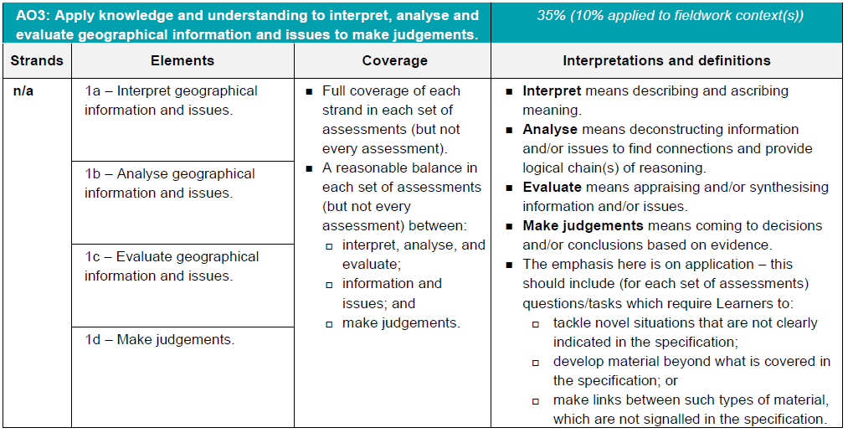
AO3 - Application
10% of the marks for the qualification must be allocated to the application of knowledge and understanding in a fieldwork context.
Three ways that students will need to apply their knowledge and understanding:
‘tackle novel situations’ could mean applying knowledge and understanding to a
resource
‘developing material beyond the specification’ could be evaluating the success of a
management strategy when the specification doesn’t explicitly ask for that
‘making links between such types of material which are not signalled in the
specification’ could be synoptic questions.

Slide 19
AO3 command words
Command words will vary depending on whether students are applying their knowledge and understanding by interacting with a resource(s) or not.
The following are some of the command words which may be used for questions with AO3 marks:
Weigh up whether a statement is true.
Interacting with resource | No resource
Describe | Assess
Give | Examine
Suggest | Evaluate
Outline | To what extent do you agree
Look in close detail and establish the key facts and important issues.
Give your verdict after providing evidence which both agrees with and contradicts an argument.
How much you agree with a statement based on the evidence in the argument.

Slide 20
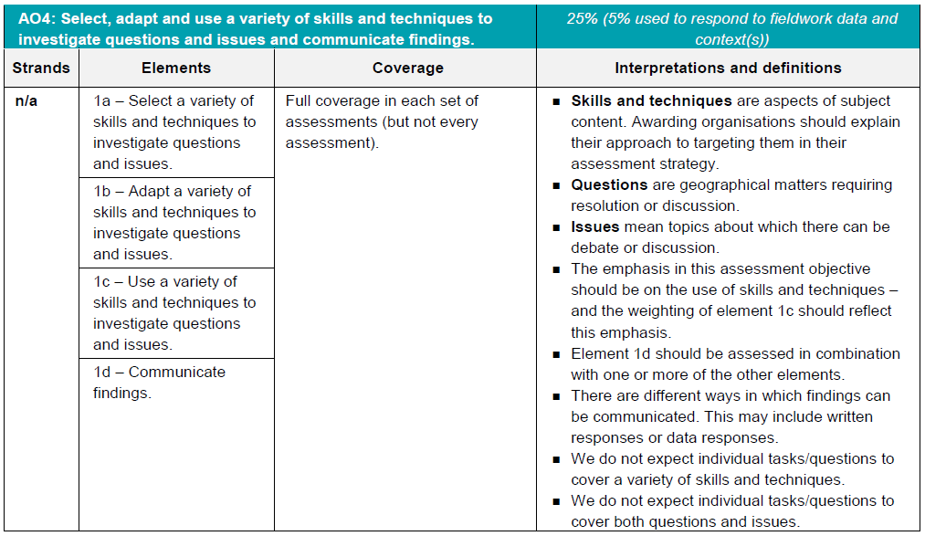
AO4 - Skills
5% of the marks for the qualification must be allocated to geographical skills in a fieldwork context.
Most of the AO4 marks will be allocated to using geographical skills – however there must be marks targeting ‘questions’ and ‘issues’ for selecting skills, adapting skills and using skills, as well as marks targeting ‘communicating findings’.

Slide 21
AO4 command words
AO4 requires students to select, adapt and use geographical skills, as well as communicate findings.
The following are some of the command words which may be used for questions with AO4 marks:
  Describe the pattern
  Using data
  Calculate
  Identify
  Make a prediction
Commands words may vary depending on the level of interaction with a resource.

Slide 22
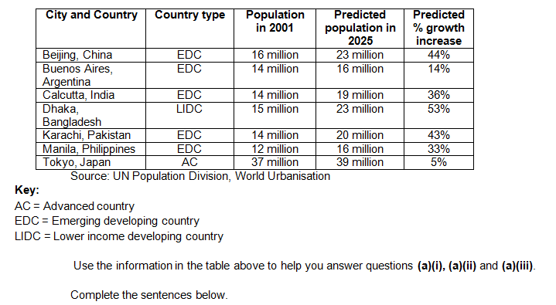
Question 1(a)
Study the table below, showing predicted growth in some of the world’s cities between 2001 and 2025.
The questions will refer to the table of data, students should ensure they read the questions carefully first so they know which bits of the data to focus on.

Slide 23
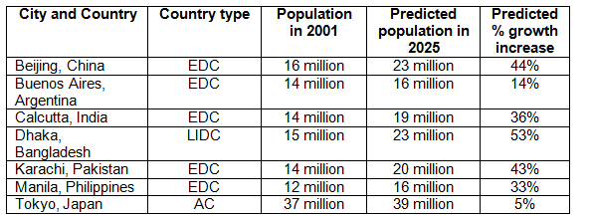
Question 1(a)(i) – 1 mark
The city with the slowest predicted population growth is ………………………………….
This is an AO4 (skills) question where students need to use the skill of interpreting tables of data to find the right answer.
The final column shows the predicted % growth increase for the cities. The smallest number there is 5% (therefore that is the slowest predicted growth rate) and so the answer is Tokyo.

Slide 24
Question 1(a)(ii) – 1 mark
The population of Dhaka is predicted to increase by ……...…………. million between 2001 and 2025.
This is an AO4 (skills) question where students need to show an understanding of numbers.
Students need to work out the difference between the population of Dhaka in 2001 (15 million) and the predicted population of Dhaka in 2025 (23 million). Subtracting 15 from 23 (the million is already written in the sentence and so is not necessary) gives the answer of 8 (eight). Remember, students can use calculators in the exam!

Slide 25
Question 1(a)(iii) – 3 marks
Describe the pattern in predicted population change between 2001 and 2025 for cities in the EDCs shown in the table.
This is an AO4 (skills) question where students need to use the skill of interpreting tables of data to find the right answer.
This is a 3 mark ‘describing the pattern’ question, so remember there will be a mark for the order that the answer is written (communicating findings).
That leaves 2 marks for describing the pattern. So students need to make two points to describe the data and put the two points in the most logical order.
Make sure students take a couple of seconds to think about their two points before putting pen to paper, it might help them get the communicate findings mark!

Slide 26
Question 1(a)(iii) – The mark scheme
In the mark scheme example, the two marks for describing the pattern are indicated with a tick.
The mark for communicating the answer in an appropriate and logical order (COM) is shown last – but that is because that is just where the answer finishes. The mark is specifically awarded because the general pattern is given first and then a specific point about the pattern is made afterwards. The following slide shows how the exemplar answer is broken down into the four marks.

Slide 27
Question 1(a)(iii)– The mark scheme
General pattern
Specific part of pattern
All of the EDCs are expected to increase in population with most of the EDCs having a large predicted growth rate (✓) with only Buenos Aires growing by a smaller predicted growth rate (✓) (COM)
Overall answer looked at – mark awarded as the general pattern is given first and then a specific point about the pattern is made afterwards.

Slide 28
Question 1(b)* – 8 marks
CASE STUDY – ways of life in cities.
Examine how ways of life vary within one LIDC or EDC city.
Name of LIDC or EDC city:
An 8 mark question which is split evenly between AO1 (knowledge) and AO3 (application).
A case study question which means that there will be marks for AO1. In this instance ways of life within an LIDC or EDC city is the focus of the question from the case study. Place-specific details must be included in the answer.
In the specification students ‘explore the ways of life in the city, such as culture, ethnicity, housing, leisure and consumption’. The specification does not ask for how ways of life vary within the case study city and by examining this students are developing material beyond the specification – one of the three ways application must be assessed.

Slide 29
Question 1(b)* – The mark scheme
Level 3 (6–8 marks)
An answer at this level demonstrates thorough knowledge of the ways of life in the LIDC or EDC city (AO1) with a thorough evaluation of how the ways of life vary within the city (AO3).
This will be shown by including well-developed ideas about the ways of life in the LIDC or EDC city and how the ways of life vary.
Level 2 (3–5 marks) looks for the same focuses in answers but with reasonable knowledge and evaluation through developed ideas.
Level 1 (1–2 marks) looks for the same focuses in answers but with basic knowledge and evaluation through simple ideas.
But what is considered to be a ‘way of life’?
And what are the differences between well-developed, developed and simple ideas?
The next few slides will answer!
‘Quality of extended response’ is assessed within each level – you can find out more about the Quality of Extended Response descriptors on slide 10.

Slide 30
Question 1(b)* – Indicative Content
There are marks for knowledge (AO1) of ways of life included in an answer. The ways of life discussed will depend on the city chosen – but may be focused around, for example, culture, ethnicity, housing, leisure or consumption.
However as long as the student can exemplify and justify the ‘way of life’ they are using then they could use a vast range. From coffee shops to jazz music. Supporting football teams to religion. Film festivals to carnivals. Ways of life will be different for so many cities that the important thing is that students are comfortable with why their chosen ways are life are appropriate for their case study city.
There are application (AO3) marks for students evaluating how ways of life vary within a city. This is an 8 mark question with equal weighting in terms of marks between knowledge (AO1) and application (AO3) so students should ensure they have sufficient focus on the variations between ways of life in the city within their answer.
The city chosen as a case study must be from an LIDC or EDC as the question asked, if a student used an AC case study then that would be a consideration for the Lead Marker and Team Leaders at the standardisation meeting.

Slide 31
Question 1(b)* – Well-developed? Developed? Simple?
Examples of simple ideas:
In Cape Town there are some rich people and lots of poor people who live in run down housing. Their ways of life are very different but they enjoy lots of music and dancing.
Examples of developed ideas:
Within Cape Town ways of life vary greatly with rich people enjoying restaurants and shopping at the V&A Waterfront and poorer people struggling to feed their family in the informal housing of the ‘townships’. In the townships communities are brought together through music and dance and they have a lot of traditional African shows. In wealthier areas of Cape Town people can access more variety of entertainment, with many drawing on the history and culture of the country. Housing in townships compared to the suburbs varies with larger properties and more green space in the suburbs.
Examples of well-developed ideas:
Within Cape Town ways of life vary significantly which shows the cultural diversity of the population, with 11 official languages. Whilst the day to day lives of people may vary, there are aspects of life which are shared throughout the city with the cultural heritage of the people very much evident. Cape Jazz, a style of jazz with a distinct African spice which stems from artists finding inspiration in their struggles of the apartheid years, can be found everywhere from the heart of townships to The Piano Bar of the De Waterkant neighbourhood. Housing in townships (Khayelitsha) often consists of densely packed single-story homes compared to more affluent South Africans who have greater access to gardens, green space and sports facilities especially in the suburbs.
The developed idea builds on the simple idea with more explanation of how ways of life vary in Cape Town.
The well-developed idea builds again, with more contextualisation and place specific detail. Ideas do not have to be the length of these exemplars.

Slide 32
Question 2(a) – 1 mark
Which of the following is a factor which makes it hard for countries to break out of poverty?
A Good trade links
B No debt
C Plentiful natural resources
D Political unrest
This multiple choice question is an AO1 (knowledge) question as it draws straight from the specification. Students need to explore the factors that make it hard for countries to break out of poverty, including debt, trade and political unrest.
The answer in this instance is ‘D – political unrest’. The other options are all factors associated with the development of a country but would all help a country to potentially break out of poverty.

Slide 33
Question 2(b) – 1 mark
Which of the following statements best describes the advantages a Trans National Company (TNC) can bring to an LIDC’s development?
A Encourages reliance on the TNC by supplying economic aid
B Has a political role and works to influence the government
C Provides management jobs for foreign workers
D Supports progress through trade links and building transport networks
This multiple choice question is an AO2 (understanding) question. Students learn about the benefits and problems of Trans National Company (TNC) investment in a case study (spec ref 6.2.b) and this question ensures they understand what a TNC is and how it can bring advantages to the development of an LIDC.
The answer in this instance is ‘D – supports progress through trade links and building transport networks’. This answer is an advantage for the country when the rest are advantages for the TNC or could have a negative impact on the LIDC.

Slide 34
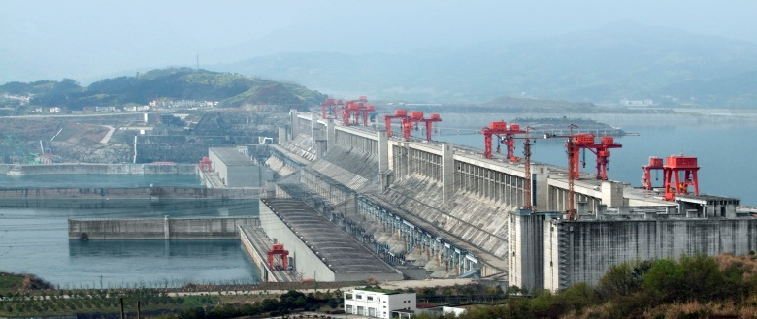
Question 2(c) – 1 mark
Study Fig. 1 in the separate Resource Booklet, information about the Three Gorges Dam in China.
What type of development strategy is the Three Gorges Dam an example of?
The Chinese government spent a total of $6 billion building the Three Gorges Dam, which took 15 years to build.
This question is an AO3 (application) question as students have to tackle a new situation by applying their knowledge and understanding to the resource.
Students may have learnt about the Three Gorges Dam before but as this is an unseen resource in the exam it is treated as a new situation.
The answer in this instance is a top down strategy – it is a one mark question so students do not need to explain why they think this.

Slide 35
Question 2(d)(i) – 4 mark
CASE STUDY – LIDC development.
Study the diagram of Rostow’s model of economic development.
For an LIDC you have studied, suggest which stage of the Rostow Model it has reached and give reasons for your answer.
LIDC studied:
There is one mark (✓) available for recalling (AO1) which stage the LIDC case study is at and then three marks for showing their understanding (AO2) by giving reasons for this (DEV).
We have included a diagram showing Rostow’s Model to help students if they don’t remember what Rostow’s Model looks like.
There is also a line in the question paper answer space for students to write the LIDC they have studied to help them focus on their answer.
Exemplar answer:
The Philippines is in the second stage - pre-conditions for take off (✓). There is some commercial farming, for example rice (DEV) but 33% of the population is still employed in farming so the economy needs to develop further (DEV). The World Bank predicts that the 15% of the population employed in industry will increase, suggesting a more complex economy is developing and the Philippines is ready for take off. (DEV)

Slide 36
Question 2(d)(ii) – 6 mark
CASE STUDY – LIDC development.
For an LIDC you have studied, evaluate how successful a development strategy has been.
This is a 6 mark question which involves AO1 (knowledge), AO2 (understanding) and AO3 (application).
As this question refers to a case study there will be marks for AO1. The case study is development in an LIDC, with part of the case study requiring students to compare advantages and disadvantages of one top-down and one bottom-up strategy in the country. Therefore students could pick either the top down or bottom up strategy they have studied to answer this question, with an understanding of what the chosen development strategy is aiming to achieve important for this question.
As the specification asks students to ‘compare advantages and disadvantages of one top-down and one bottom-up strategy in the country’, there is no requirement of teaching how successful strategies studied have been – just their advantages and disadvantages. Therefore students are developing material beyond the specification – one of the three ways application (AO3) must be assessed – in order to evaluate how successful the development strategy has been within their answer to this question.

Slide 37
Question 2(d)(ii) – The mark scheme
Level 3 (5–6 marks)
An answer at this level shows thorough knowledge of a development strategy in an LIDC (AO1) with thorough understanding of what the development strategy is aiming to achieve (AO2) and a thorough evaluation of how successful the development strategy has been (AO3).
This will be shown by including developed ideas about the development strategy, what it aims to achieve and how successful it has been.
Level 2 (3–4 marks) looks for the same focuses in answers but with thorough knowledge (through developed ideas) but basic understanding and evaluation (through simple ideas).
Level 1 (1–2 marks) looks for the same focuses in answers but with basic knowledge and either basic understanding or evaluation through simple ideas.

Slide 38
Question 2(d)(ii) – Indicative Content
LIDCs are those as defined by the IMF (a list can be found on our website) and the strategy chosen should relate to their LIDC case study. Any strategy could be used with top-down and bottom-up being studied as part of the case study in the specification.
The developed idea builds on the simple idea with more knowledge (AO1), understanding (AO2) and evaluation (AO3) of the development strategy in Kenya.
Examples of simple ideas:
Kenya Vision 2008–2030 has brought improvements in the numbers of children attending primary school. However many people are still poor.
Examples of developed ideas:
Kenya Vision 2008–2030 aims to develop Kenya into a middle income country by 2030 through a series of 5 year plans covering economic, social and political actions. The plan has had some successes, for example in increasing the percentage of children attending primary school to 96% but less in other areas as 45.5% of the population still live in poverty.

Slide 39
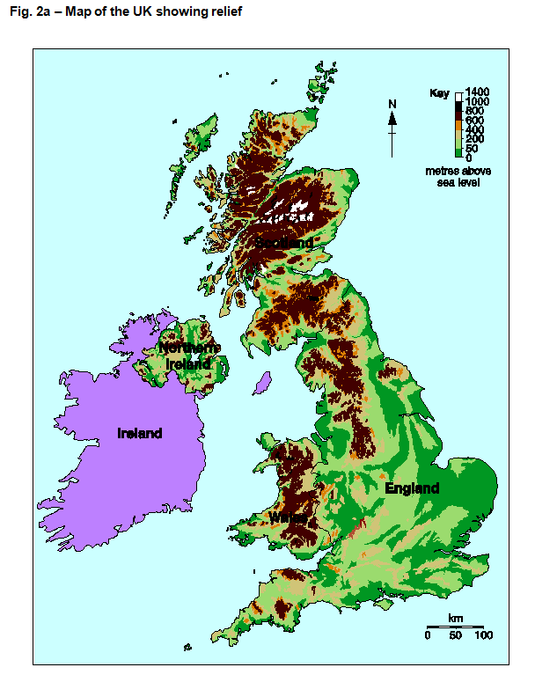
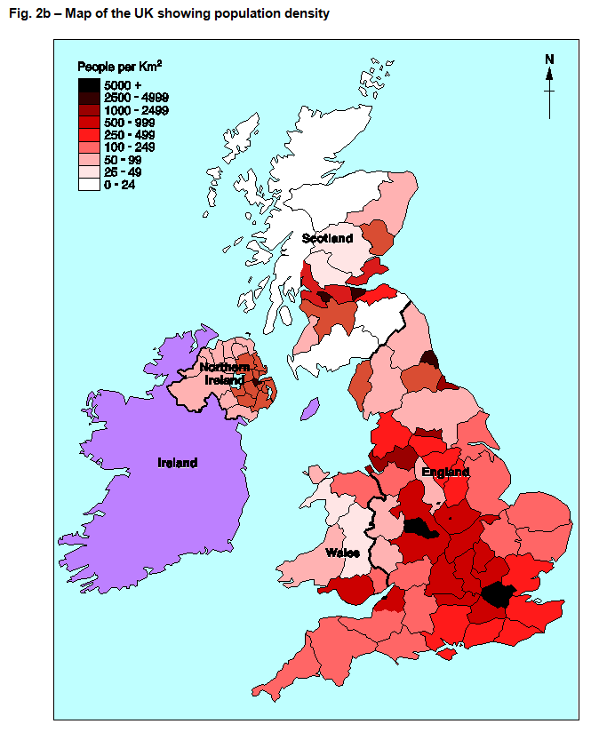
Question 3(a) and (b)
Study Figs 2a and 2b in the separate Resource Booklet, maps of the UK showing relief and population density, and then answer questions 3(a) and (b).
Questions will refer to the maps in Figs 2a and 2b and could be on any aspect at the moment, students should read the question first so they know what to focus on.

Slide 40
Question 3(a) – 1 mark
Which statement about the height of the land in the UK is correct?
A Most highland is in the North and West of the UK
B Most highland is in the South coast of the UK
C Most highland is in the South of the UK
D There is no highland in Wales
This is an AO4 (skills) question where students use their cartographic skills to interpret the map.
The answer is ‘A: most highland is in the North and West of the UK’ as the other three options are incorrect.

Slide 41
Question 3(b) – 1 mark
Which statement below correctly describes the pattern of population density in the UK?
A Highest population density is around the coast of the UK
B Highest population density is in England
C Highest population density is in highland areas of the UK
D Highest population density is in Wales
This is an AO4 (skills) question where students use their cartographic skills to interpret the map.
The answer is ‘B: highest population density is in England’ as the other three options are incorrect. If students are unsure about where highland areas are then they can refer to the other map for clarity.

Slide 42
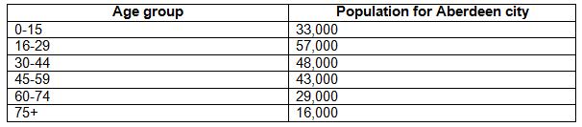
Question 3(c) (i) and (ii)
Below is some data showing the population for Aberdeen by age group.
The questions will refer to the table of data, students should ensure they read the questions carefully first so they know which bits of the data to focus on.

Slide 43
Question 3(c)(i) – 1 mark
What is the modal class for this table of data?
This is an AO4 (skills) question where students need to use their statistical skill to state what the model class is for the table of data.
The modal class is the class which occurs most often and therefore has the highest number associated with it. Therefore the correct answer is the ‘16-29 age group’ as this group (or class) has a population of 57,000 which is more than any other age group.

Slide 44

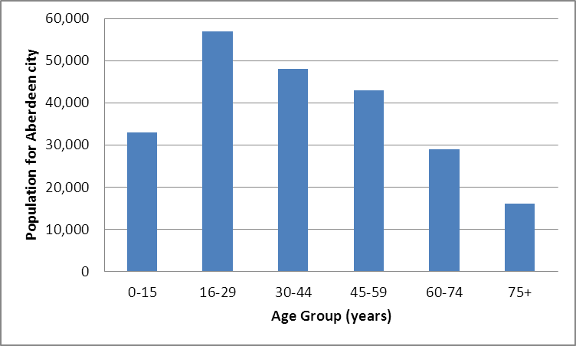
Question 3(c)(ii) – 4 mark
Draw a labelled vertical bar graph showing the population for the different age groups in Aberdeen.
This is an AO4 (skills) question where students need to use their graphical skill to construct appropriate graphs. The question paper has section of ‘graph’ paper and axis drawn to aid the student.
There are four marks available with marks available for:
1 mark for correctly labelling axis
1 mark for correctly adding scale to axis
2 marks for adding bars to graph correctly using the data in the table
In the mark scheme there is an example of a graph which would receive full marks.

Slide 45
Question 3(d) – 6 mark
Below is a news article about The X Factor.
Using the news article and your own knowledge, describe the global influence of UK TV programmes such as the X Factor.
The X Factor – a Global Television hit
The X Factor is watched in 147 countries. Simon Cowell, who created the X Factor said: “The UK X Factor was the original version of the show and over the last ten years it has found many new international superstars. I’m really happy that the UK show is being watched all over the world - as well as there being so many great local versions of X Factor too.”
The X Factor is a global hit and the format is now copied locally in 51 countries around the world. Since the first UK X Factor in 2004, the British-born TV show has been watched by more than 360 million people and can be seen in almost every country on earth.
This is a 6 mark question with marks available for AO1 (knowledge) and AO3 (application). As the specification requires students to ‘explore the UK’s media exports and their global influence including television programmes and film’ this question is AO1 (knowledge) as the question wording is very much lifted from the specification wording. There are also AO3 (application) marks as students are required to interpret information from the news article about the X Factor in their answer.

Slide 46
Question 3(d) – The mark scheme
Level 3 (5–6 marks)
An answer at this level shows thorough knowledge of the UK’s media exports global influence (AO1) and a reasonable interpretation of the news article (AO3) to describe UK’s media exports global influence
This will be shown by including well-developed ideas about the global influence of the UK’s TV programmes.
Level 2 (3–4 marks) looks for the same focuses in answers but with reasonable knowledge and interpretation through developed ideas.
Level 1 (1–2 marks) looks for the same focuses in answers but with basic knowledge and interpretation through simple ideas.

Slide 47
Question 3(d) – Indicative Content
There must be X Factor information interpreted from the news article to receive the AO3 (application) marks, although students can add extra information about the X Factor as AO1 (knowledge) marks. Interpretation ideas might potentially include the reach of the X Factor and the number of local versions which have been created.
Other information might include relevant facts about the value of UK media exports, examples of other TV shows which are shown abroad or named countries which import media from the UK.
Examples of simple ideas:
The X Factor is watched by over 360 million people around the world.
Examples of developed ideas:
Programmes such as the X Factor are shown in a lot of countries around the world which increases awareness of the British way of life and the English language.
Examples of well-developed ideas:
As more people internationally watch the X Factor, already more than 360 million people worldwide have watched the show, and other programmes made in the UK the understanding of the English language increases around the world. In addition, British values and beliefs are more widely shared which may also boost sales of associated products.
The developed idea builds on the simple idea with more description of the global influence of UK TV programmes. The well-developed idea builds again on the developed idea.

Slide 48
Question 4(a) – 1 mark
Which two statements best describe an ethical consumer?
1 Someone who does not consider the source of products they buy
2 Someone who always buys the cheapest products
3 Someone who chooses products made with minimal environmental damage
4 Someone who prefers to buy fairly traded food products
A 1 and 2
B 1 and 4
C 2 and 3
D 3 and 4
This is an AO2 (understanding) question as ethical consumerism is part of the specification but describing an ethical consumer is not. Therefore this question requires students to have that understanding to be able to answer the question.
The answer is ‘D: 3 and 4’ (someone who chooses products made with minimal environmental damage and prefers to buy fairly traded food products).

Slide 49
Question 4(b) – 2 marks
Describe what it means for a person to be food secure.
This question is an AO2 (understanding) question. Students need to understand the term ‘food security’ in the specification and so describing food security would just be recall and knowledge. But as the question is asking students to describe what it means to be food secure, this is a slightly different angle on this topic. Students need to understand what food security is to be able to describe what it means to be food secure.
The answer in the mark scheme is:
To be food secure a person would have physical and economic access to food (✓) that meets dietary needs and food preferences (✓).
To access the two marks students would not have to give the exact answer from mark scheme example but would need to include the key information.

Slide 50
Question 4(c) – 4 marks
CASE STUDY – Food security
Explain how effective one attempt to achieve food security at a national scale has been.
This question has a case study focus so there will be AO1 (knowledge) marks and there are also AO2 (understanding) marks for the explanation of how effective one attempt to achieve food security at a national scale has been.
There are 2 marks for details of food security attempt valid use from the resources (✓) (recalling the case study information) and 2 marks for the explanation of how effective the attempt is to achieve food security (DEV) (showing their understanding of how effective the attempt to achieve food security at a national scale has been).
As the specification already asks for the effectiveness of an attempt to achieve food security at a national scale to be studied this is not application of knowledge and understanding.
Case study: Food security
Example:
In Cuba, the government have attempted to become more food secure by increasing self-sufficiency (✓), with the scheme being effective as Cuba is now 90% self-sufficient in fruit and vegetables (DEV). In Havana over 200 urban farms called Organopónicos have opened, where fruit and vegetables are grown on any land possible such as rooftops or waste sites (✓), which have been effective in helping increase the amount of fruit and vegetable production but does not produce other products which help to achieve food security (DEV).

Slide 51
Question 4(d) – 6 mark
Evaluate the success of one technological strategy to sustainably improve food security.
This is a 6 mark question with marks available for AO2 (understanding) and AO3 (application). The specification requires students to ‘explore the environmental, economic and social sustainability of attempts to achieve food security, in relation to: technological developments, such as GM crops and hydroponics’ and so students need to understand this topic in order to answer about how one technological strategy has sustainably improved food security.
As the command of the question asks students to ‘evaluate the success’ there is clear AO3 (application) requirement as this is not from the specification. Therefore students are developing material beyond the specification – one of the three ways application (AO3) must be assessed – within their answer to this question.

Slide 52
Question 4(d) – The mark scheme
Level 3 (5–6 marks)
An answer at this level shows thorough understanding of how one technological strategy attempts to improve food security (AO2) and thorough evaluation of the success of the technological strategy to sustainably improve food security (AO3).
This will be shown by including well-developed ideas about how one technological strategy improves food security and its success.
Level 2 (3–4 marks) looks for the same focuses in answers but with reasonable understanding and evaluation through developed ideas.
Level 1 (1–2 marks) looks for the same focuses in answers but with basic understanding and evaluation through simple ideas.

Slide 53
Question 4(d) – Well-developed? Developed? Simple?
Examples of simple ideas:
GM crops are bad for the environment but can be helpful if people are hungry.
Examples of developed ideas:
There are more types of GM crops grown (such as rice) to provide food for a growing population. They are not always good for the environment and people’s health but more food has been produced and that has helped starving populations.
Examples of well-developed ideas:
The amounts of GM crops (such as rice) produced has increased over the years in an attempt to provide enough food to feed growing populations (social sustainability) and to produce crops adapted to changing climatic conditions in drier areas such as sub-Saharan Africa (environmental sustainability). However whilst GM crops have increased yields and meant adaptions could be made, they have also been criticised for producing mono-cultures which threatens crop diversity.
The developed idea builds on the simple idea with more evaluation of GM crops and a clearer understanding of the role of GM crops.
The well-developed idea builds again by giving further detail as part of the understanding and having clearer and more varied points within the evaluation.

Slide 54
Question 5(a) – 1 mark
Name a primary data collection technique suitable for carrying out a human geography
fieldwork investigation looking at the issue of shop closures within an economic hub.
This is an AO4 (skills) fieldwork question using the fieldwork skill of understanding the range of techniques and methods used in fieldwork. This is ‘select’ part of AO4 as the student is required to choose a relevant technique in this fieldwork context (an economic hub). Any suitable answer would be acceptable as long as it is a primary data collection method and so could include:
  a land use map
  a transect
  photographs
An economic hub has been chosen as the context for this question as it is an area of the specification and so it should be more accessible for students to think what they could use as a fieldwork skill, even if they have not completed fieldwork directly on an economic hub.

Slide 55
Question 5(b) – 4 marks
State two types of data which could be used to identify an economic hub and give reasons for your choices.
This is an AO4 (skills) fieldwork question using the fieldwork skill of understanding the range of techniques and methods used in fieldwork. This is targeted at the ‘select’ part of AO4 as the student is required to choose two types of data relevant in this fieldwork context (an economic hub). Any suitable answer would be acceptable as long as it is a type of data which would be useful for identifying an economic hub.
There are 2 marks for naming the data types selected as well as 2 marks for the reasons why the data type was selected, for example about how it could be used.
Here are two examples given in the mark scheme but any other reasonable types of data linked to economic hubs would be credited.
Air traffic business passenger numbers (✓) is an indication that an area has many key important businesses (DEV)
Number of financial institutions, headquarters of international companies (✓) as this is an indication that an area is a financial hub (DEV)

Slide 56
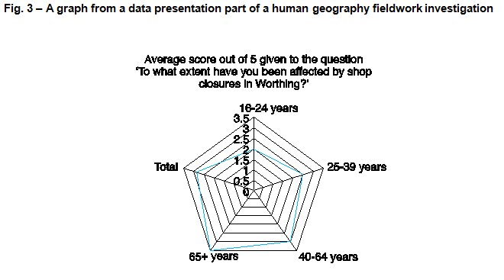
Question 5(c) – 2 marks
Study Fig. 3 in the separate Resource Booklet, a graph from a data presentation part of a human geography fieldwork investigation.
Suggest what Fig. 3 indicates about the impact of shop closures in Worthing.
This question is an AO3 (application) question. Students need to apply their knowledge and understanding of analysing and explaining data collected in the field to the graph in Fig. 3 to suggest what the graph indicates about the impact of shop closures.
There are 2 marks – one for any reasonable idea from the rose diagram which demonstrates analysis (✓) and one for evidence interpreted from the diagram to support the idea (DEV). The answer in we have given in the mark scheme is shown here:
Older people are more affected by shop closures than younger people (✓) as the score for the 65+ age group is 3 out of 5 (DEV)

Slide 57
Question 5(d*) – 8 mark (+3 SPaG)
You will have carried out some human geography fieldwork as part of your GCSE (9–1) Geography course.
Name the fieldwork:
Explain how your fieldwork conclusions improved your understanding of a geographical question or issue.
This is an 8 mark question which is all AO3 (application) – remember fieldwork questions cannot have any marks for AO1 or AO2.
The question requires students to apply their knowledge and understanding of their fieldwork skill of reflecting critically on fieldwork data, methods used, conclusions drawn and knowledge gained. There are marks attributed to the analysis, evaluation and judgements as to how the students fieldwork questions have improved their understanding of a geographical question or issue. There is space for students to write out their fieldwork title to help focus their answer.
The asterisk (*) shows that ‘Quality of extended response’ will be assessed in this question – you can find out more about the Quality of Extended Response descriptors on slide 10.
There are marks for SPaG (Spelling, punctuation and grammar and the use of specialist terminology) you can find out more about the SPaG descriptors on slide 9.

Slide 58
Question 5(d) – The mark scheme
Level 3 (6–8 marks)
An answer at this level demonstrates thorough analysis (AO3) and evaluation (AO3) of the how the fieldwork conclusions improved understanding of a geographical question or issue. There will be a reasonable judgement as to whether the fieldwork conclusions improved understanding of a question or issue (AO3).
This will be shown by including well-developed ideas.
Level 2 (3–5 marks) looks for the same focuses in answers but with reasonable analysis and evaluation with a basic judgement through developed ideas.
Level 1 (1–2 marks) looks for the same focuses in answers but with basic analysis and evaluation through simple ideas with no judgement.
‘Quality of extended response’ is assessed within each level – you can find out more about the Quality of Extended Response descriptors on slide 10.

Slide 59
Question 5(d) – Well-developed? Developed? Simple?
Examples of simple ideas:
Name the fieldwork:
Housing quality in Newcastle upon Tyne.
I found out about the types of housing in Newcastle which was different in different parts.
Examples of developed ideas:
Name the fieldwork: Housing quality and distance from the city centre of Newcastle upon Tyne.
I found that in some areas the housing quality improved with distance from the centre but in others it seemed to get worse. This is because in some areas old housing had been knocked down and new estates built. This helped me understand urban land use.
Examples of well-developed ideas:
Name the fieldwork: Does housing quality improve with distance from the city centre of Newcastle upon Tyne?
I found that in two directions (west and east) the types of housing remained more similar than to the north, so I was able to conclude that housing quality does not change in the same way with distance from the city centre. This helped me understand the reasons behind changing land use in a city, for example redevelopment and gentrification.
The developed idea builds on the simple idea with more analysis and evaluation of how the fieldwork improved understanding of a question or issue, with a judgement included too.
The well-developed idea builds again on all three of these parts of the answer.

Slide 60
We’d like to know your view on the resources we produce. By clicking on ‘Like’ or ‘Dislike’ you can help us to ensure that our resources work for you. When the email template pops up please add additional comments if you wish and then just click ‘Send’. Thank you.
Whether you already offer OCR qualifications, are new to OCR, or are considering switching from your current provider/awarding organisation, you can request more information by completing the Expression of Interest form which can be found here: www.ocr.org.uk/expression-of-interest
Looking for a resource? There is now a quick and easy search tool to help find free resources for your qualification:
www.ocr.org.uk/i-want-to/find-resources/
OCR Resources: the small print
OCR’s resources are provided to support the delivery of OCR qualifications, but in no way constitute an endorsed teaching method that is required by the Board, and the decision to use them lies with the individual teacher. Whilst every effort is made to ensure the accuracy of the content, OCR cannot be held responsible for any errors or omissions within these resources.
© OCR 2016 - This resource may be freely copied and distributed, as long as the OCR logo and this message remain intact and OCR is acknowledged as the originator of this work.
OCR acknowledges the use of the following content: n/a
Please get in touch if you want to discuss the accessibility of resources we offer to support delivery of our qualifications: resources.feedback@ocr.org.uk

