Slide 1

Guide to the SAMs
Component 03 –
Geographical Exploration

Slide 2
J384/03 Geographical Exploration
The assessment of this component will be synoptic in nature and will draw on both the Our Natural World 01 and People and Society 02 components. The synoptic nature of bringing together ideas from different topics will allow learners to ‘think like a geographer’.
Although there is no specific content prescribed for this component, within this assessment there will be a geographical exploration of a country (if this was within the UK it could be for a particular place or issue) which will focus on the content of at least two topics from within the first two components of this qualification (Our Natural World 01 and People and Society 02).
But what will the assessments look like?
This guide will give you an understanding of the format and structure of the exam, an insight into the assessment objectives and a question by question explanation of the sample assessment for J384/03 Geographical Exploration. This guide can also be used with your students to support revision.

Slide 3
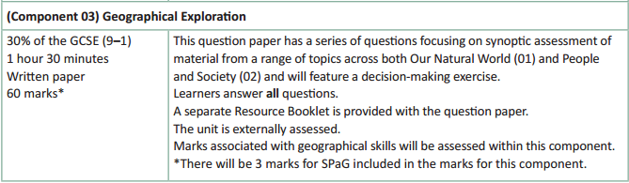
How will Geographical Exploration be assessed?
No optionality – students know what they need to do and will not get confused as to which option they should answer.
14 marks for AO4 (skills) in total
3 marks for SPaG will be on the final 12 mark question.
A separate Resource Booklet so students can access resources easily when answering questions.

Slide 4
How will Geographical Exploration be assessed?
The overall exam will be 60 marks (3 of which are for SPaG) and there is 1 hour 30 minutes to complete the exam (a minute and a half per mark).
The Assessment Objective breakdown for the overall paper is:
The assessment will run through an exploration of a country or place/issue within the UK. As students progress through the paper they will use resources which will introduce different elements of the topic to them. As can be seen in the table above, there are no marks for AO1 (knowledge) within this assessment. As there are no AO1 (knowledge) marks this means that case study knowledge will not be required within this assessment – any information needed on the actual place contextualising the Geographical Exploration’ assessment will be available in the Resource Booklet.
But let’s have a look at the two sections in more detail on the following slides.
 | AO1 (Knowledge) | AO2 (Understanding) | AO3 (Application) | AO4 (Skills) | SPaG | Total
Marks | 0 | 20 | 23 | 14 | 3 | 60

Slide 5
Geographical Exploration
There will be a mixture of short answer, point marked questions (1, 2, 3 and 4 mark questions) and level of response questions of 6 marks and 12 marks.
There will always be two 12 mark questions on the paper as a whole and these will be synoptic in nature (so will require students to apply their knowledge and understanding of content from at least two of the different topics of the specification).
The final question of the assessment will be a 12 mark question with a decision making element to it. This 12 mark question will also have 3 SPaG marks available (total of 15 marks for question).

Slide 6
Other things to know about the assessment…
There are a few other important things to highlight for the assessment and to help you understand the mark scheme, so now we will run through:
  SPaG
  Quality of Extended Responses
  Marking Guidance

Slide 7
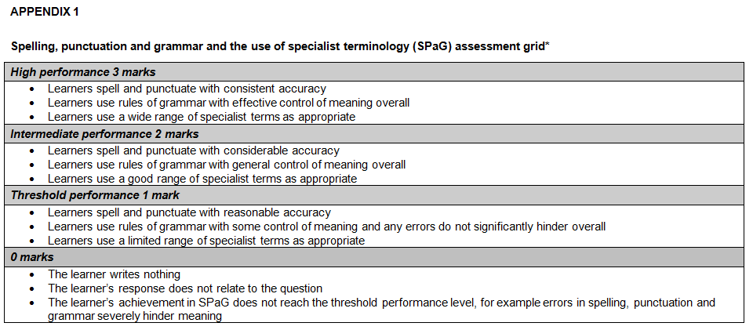
SPaG
SPaG – also known as spelling, punctuation and grammar and the use of specialist terminology – is assessed against one of the longer questions in the exam with 3 marks available. In the ‘Geographical Exploration’ assessment SPaG will always be assessed on the final 12 mark question.
There are clear descriptors for each level of SPaG, which are separate from the geographical content of the rest of the question. The student’s answer is read holistically and the SPaG marks are awarded on the whole answer.

Slide 8
Quality of Extended Responses
‘Quality of extended response’ is assessed within each level for questions of 8 marks or above and is indicated by an asterisk (*) beside the question. The following are the descriptors placed within the levels for 12 mark questions:
Level 4
There is a well-developed line of reasoning which is clear and logically structured. The information presented is relevant and substantiated.
Level 3
There is a line of reasoning presented with some structure. The information presented is in the most-part relevant and supported by some evidence.
Level 2
The information has some relevance and is presented with limited structure. The information is supported by limited evidence.
Level 1
The information is basic and communicated in an unstructured way. The information is supported by limited evidence and the relationship to the evidence may not be clear.
The way that a student has structured their response would need to be considered when you are deciding which level to place the student in – but the quality of the geographical content within the answer should always be the most important consideration.

Slide 9
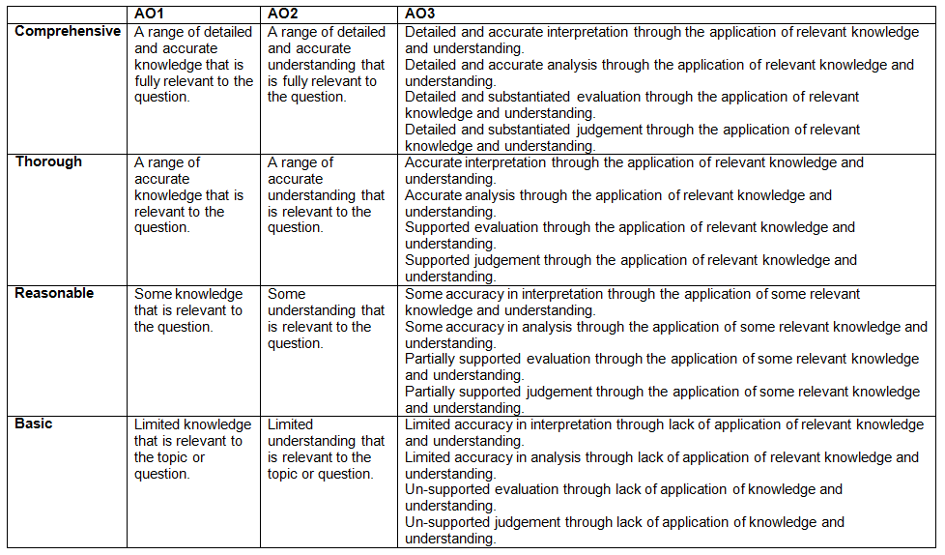
Level of Response Questions Marking Guidance
At the beginning of each mark scheme the following table is included to help you understand the level of response mark schemes. The wording in each level (from basic to comprehensive) indicates how answers develop and progress within each assessment objective.

Slide 10
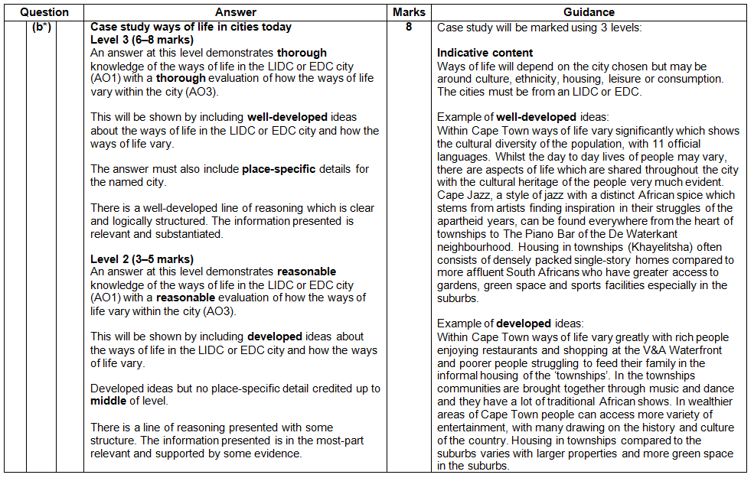
Level of Response Question Mark Scheme
The ‘Answer’ column includes information on how the assessment objectives link to the question and the standard required for the question parts.
The ‘Indicative content’ part of the mark scheme shows some of the content which could be included in students answers. This is not an exhaustive list.
A statement to indicate the level of development for answers to reach each level.
In the ‘Guidance’ column there are examples of ‘well-developed’, ‘developed’ and ‘simple’ ideas – these are examples of parts of answers – they are not full answers. The examples should show how an answer can develop from ‘simple’ to ‘developed’ to ‘well-developed’.
If ‘Quality of Extended Responses’ and/or ‘place-specific detail’ are being assessed they will be shown here.

Slide 11
Assessment Objectives
The assessment objectives are set by Ofqual and are vital to exam boards when designing assessments and for teachers in understanding styles of questions and their requirements.
For GCSE (9-1) Geography there are four Assessment Objectives :
      AO1 (Knowledge)
      AO2 (Understanding)
      AO3 (Application of knowledge and understanding)
      AO4 (Skills).
For all of the GCSE Geography specifications there are set assessment objectives with exact percentages of marks which must be attributed to each assessment objective within the qualification throughout the lifetime of the specification.
The next few slides will explain what the four assessment objectives mean and clarify their use in this assessment.

Slide 12
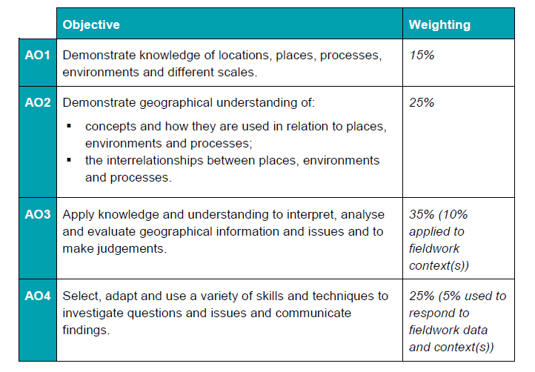
The 4 Assessment Objectives (AOs)
15% of the qualification
marks will be allocated to assessing students knowledge of the specification content (AO1)
25% of the qualification marks will be allocated to assessing students understanding of the specification content (AO2)
35% of the qualification
marks will be allocated to assessing students application of their knowledge and understanding of the specification content (AO3)
25% of the qualification
marks will be allocated to assessing students ability to select, adapt and use geographical skills and communicate findings in this context (AO4)

Slide 13
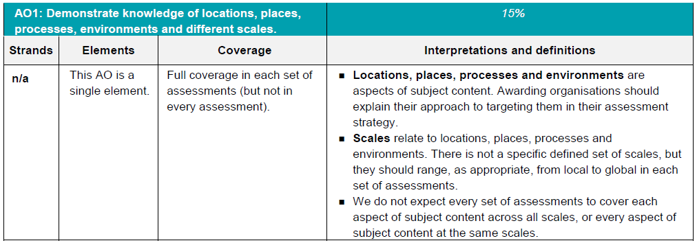
AO1 - Knowledge
Locations, places, processes and environments simply cover the subject content. There are other ways which you may describe content areas but all must be placed in these four aspects when we are creating our assessments.
Each year across the range of assessments there must be knowledge marks for locations, places, processes, environments and different scales but AO1 marks do not have to be included in every assessment.
Each year assessments will cover different scales
from local to global but not for every bit of content
or necessarily for all of locations, places, processes
and environments .

Slide 14
AO1 command words
AO1 requires students to demonstrate knowledge of the specification content through recalling information – including in a case study context.
Questions which target AO1 alone would tend to be shorter answer questions but longer questions may have AO1 marks allocated to them as well when combined with another assessment objective – particularly where case study information is required in an answer.
The following are some of the command words which may be used for short answer questions with AO1 marks:
  Describe
  Define
  Outline
  State
All of these command words are asking students to write down something that they have learnt from the specification and so are unlikely to be targeting a combination of assessment objectives.

Slide 15
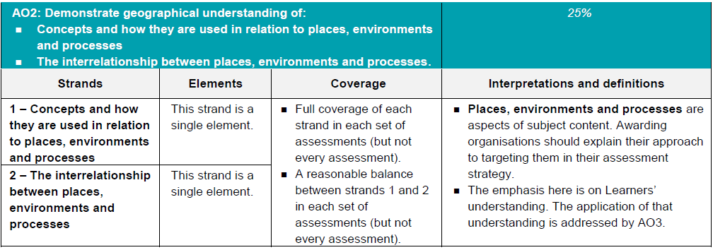
AO2 - Understanding
How concepts relate to the aspects of content.
Like with AO1 – places, processes and environments simply cover the subject content.
There must an appropriate balance in terms of the number of marks allocated to questions on the understanding of how concepts relate to content and how aspects of content relate to each other throughout the assessments.
How aspects of content relate to each other

Slide 16
AO2 command words
Questions with AO2 marks will focus on:
how concepts relate to the aspects of content
how aspects of content relate to each other
All AO2 marks will focus on understanding. AO2 marks will be directly linked to the specification but not just recalling what has been learnt, instead ensuring that students comprehend the content.
The following are some of the command words which may be used for questions with AO2 marks:
Explain how
Explain reasons/one reason
Discuss
AO2 marks may also be targeted in higher mark tariff questions but the command word may focus on a different assessment objective (e.g. AO3).
These command words may be used to solely target AO2 but may also be used in combination with other AO’s to target multiple assessment objectives, for example 2(c) or 3(d) of component 01 Our Natural World.

Slide 17
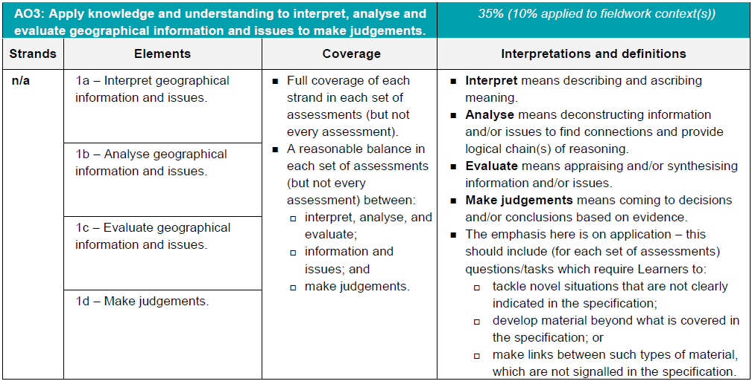
AO3 - Application
10% of the marks for the qualification must be allocated to the application of knowledge and understanding in a fieldwork context.
Three ways that students will need to apply their knowledge and understanding:
‘tackle novel situations’ could mean applying knowledge and understanding to a
resource
‘developing material beyond the specification’ could be evaluating the success of a
management strategy when the specification doesn’t explicitly ask for that
‘making links between such types of material which are not signalled in the
specification’ could be synoptic questions.

Slide 18
AO3 command words
Command words will vary depending on whether students are applying their knowledge and understanding by interacting with a resource(s) or not.
The following are some of the command words which may be used for questions with AO3 marks:
Weigh up whether a statement is true.
Interacting with resource | No resource
Describe | Assess
Give | Examine
Suggest | Evaluate
Outline | To what extent do you agree
Look in close detail and establish the key facts and important issues.
Give your verdict after providing evidence which both agrees with and contradicts an argument.
How much you agree with a statement based on the evidence in the argument.

Slide 19
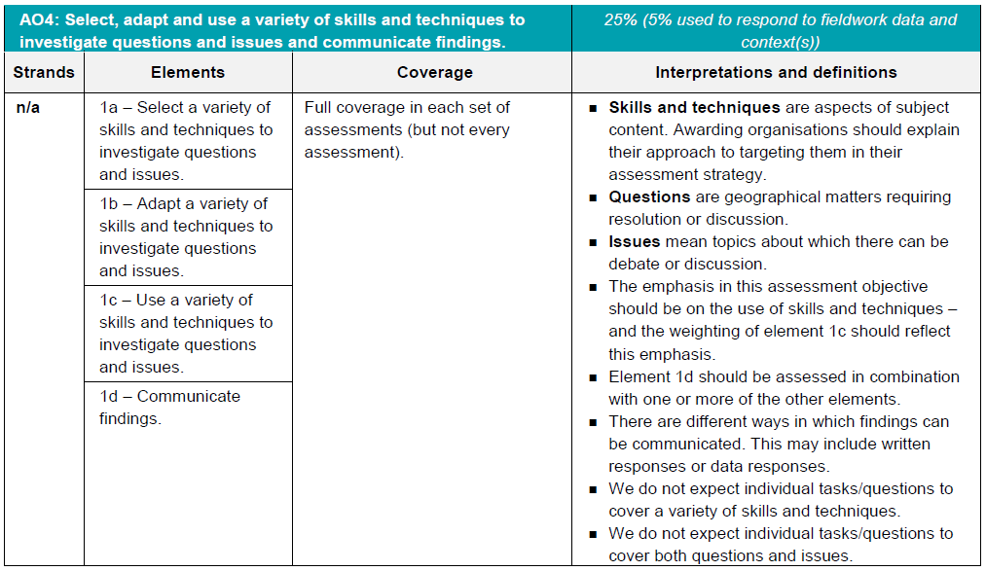
AO4 - Skills
5% of the marks for the qualification must be allocated to geographical skills in a fieldwork context.
Most of the AO4 marks will be allocated to using geographical skills – however there must be marks targeting ‘questions’ and ‘issues’ for selecting skills, adapting skills and using skills, as well as marks targeting ‘communicating findings’.

Slide 20
AO4 command words
AO4 requires students to select, adapt and use geographical skills, as well as communicate findings.
The following are some of the command words which may be used for questions with AO4 marks:
  Describe the pattern
  Using data
  Calculate
  Identify
  Make a prediction
Commands words may vary depending on the level of interaction with a resource.

Slide 21
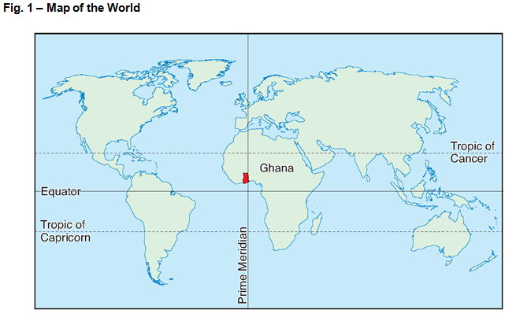
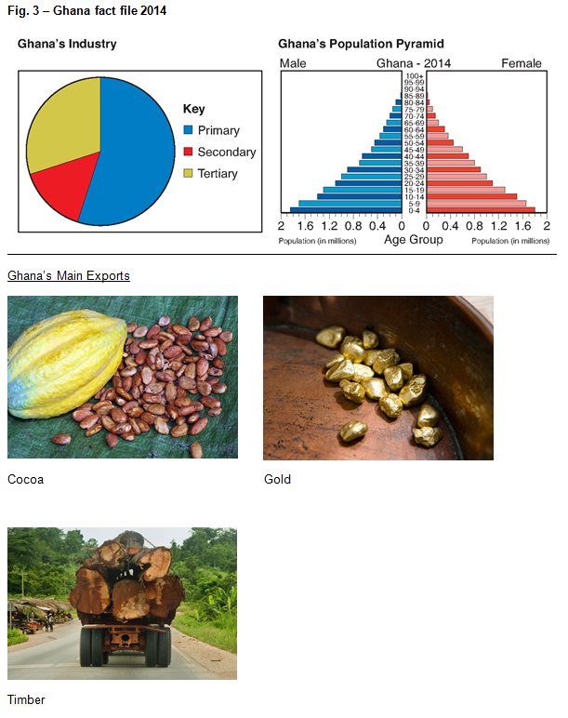
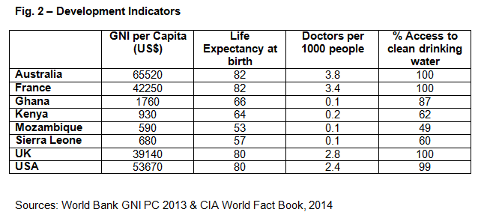
Question 1
Study Figs 1, 2 and 3 in the separate Resource Booklet, a map of the world, a table of development indicators and a Ghana fact file for 2014.
Questions will refer to the resources in Figs 1, 2 and 3 and could be on any aspect at the moment, students should read the questions first so they know what to focus on.

Slide 22
Question 1(a)(i) – 2 marks
Using Fig. 1, describe the location of Ghana.
This question is an AO4 (skills) question targeting students map reading skills.
Students need to describe the location of Ghana, taking information from Fig.1 for their answer.
Any appropriate answer will be credited and some examples include:
In Africa (✓)
Just North of the Equator (✓)
In West Africa (✓)
Between the Equator and the Tropic of Cancer (✓)
On the Prime Meridian (✓)

Slide 23
Question 1(a)(ii) – 1 mark
Fig. 2 gives development indicators for different countries, including Life Expectancy at birth information. The Life Expectancy at birth for the UK is 80 and for Kenya it is 64.
Write the ratio 80:64 in its simplest form.
This question is an AO4 (skills) question targeting students ability to understand and correctly use ratio.
A ratio is a way to compare amounts of something. They can be simplified by finding common factors. The highest number that both of these numbers are divisible by 16, so the ratio in it’s simplest form is 5:4.
There are no marks for working out, as students are not asked to do this in the question and there is only one mark available. Remember also that students can use calculators in this exam!

Slide 24
Question 1(b)(i) – 2 marks
Using the data in Fig. 2, complete this scatter graph by plotting the points for the UK and Ghana.
This question is an AO4 (skills) question targeting students ability to effectively present and communicate data through graphs and charts.
Students need to correctly place points for the UK and Ghana on the scatter graph. The mark scheme instructs examiners to accept within 0.1 range of the doctors per 1000 people figure and 1 year range for life expectancy at birth.
The point needs to be placed at:
UK = Life Expectancy at Birth 80, Number of Doctors per 1000 people 2.8 (✓)
Ghana = Life Expectancy at Birth 66, Number of Doctors per 1000 people 0.1 (✓)

Slide 25
Question 1(b)(ii) – 1 mark
Describe the relationship shown between the number of doctors per 1000 people and life expectancy.
This question is an AO4 (skills) question targeting students ability to describe relationships in bivariate data. Bivariate data is simply data for two variables (usually two types of related data) – in this case the number of doctors per 1000 people and life expectancy at birth.
There is only one mark available so there does not need to be any development or multiple points.
The example in the mark scheme is:
There is a positive correlation between Doctors per 1000 people and Life Expectancy at Birth (✓).

Slide 26
Question 1(b)(iii) – 3 marks
Explain how development indicators, such as life expectancy, show evidence of uneven development.
This is a 3 mark AO2 (understanding) question as students need to show their understanding of the specification content ‘Economic and social measures of development, such as GNI per capita and Human Development Index, and how they illustrate the consequences of uneven development’ in order to answer this question. This is from topic 6 ‘Dynamic Development’.
There are three marks available for three points of explanation in an answer.
The example in the mark scheme is:
Development indicators show evidence of uneven development by comparing the development of regions or countries (✓). Countries perform differently for the various indicators and these can be used to indicate where a country is on the development spectrum (✓). Development indicators can be used within countries to shown patterns of uneven development between different geographical areas (✓).

Slide 27
Question 1(c) – 6 marks
Discuss how Ghana is typical of an LIDC. Justify your answer using evidence from Figs 2 and 3.
This question is split evenly between AO2 (understanding) and AO3 (application). Students need to show understanding (AO2) of the characteristics of LIDCs before applying this understanding to analyse (AO3) how Ghana is typical of an LIDC. Figs 2 and 3 should provide students with a contextualisation of Ghana so that they can discuss how Ghana is typical of an LIDC.
Students can use Fig. 2 to refer to GNI per capita, Life Expectancy at Birth, Doctors per 1000 people and the percentage access to clean drinking water. Fig. 3 gives information on Ghana’s industry, it’s population structure and main exports. All this information should help contextualise Ghana for students and aid their discussion.
There should be understanding of the characteristics of an LIDC, including low GNI per capita, life expectancy and number of doctors per 1000 people. Students should also understand that having a predominately primary industry make up and exports consisting of natural resources is more common with LIDCs. Ghana’s population pyramid is also more likely to be that of an LIDC.
However, some students may argue that Ghana is developed in some areas, such as having 87% access to clean water and so is not ‘typical’.

Slide 28
Question 1(c) – The mark scheme
Level 3 (5–6 marks)
An answer at this level demonstrates a thorough understanding of the characteristics of LIDCs (AO2) and a thorough analysis of how Ghana is typical of an LIDC (AO3).
This will be shown by including well-developed ideas about what an LIDC is and how Ghana is typical of an LIDC.
Level 2 (3–4 marks) looks for the same focus in answers but with reasonable understanding and analysis through developed ideas.
Level 1 (1–2 marks) looks for the same focus in answers but with basic understanding and analysis through simple ideas.

Slide 29
Question 2(d) – Well-developed? Developed? Simple?
Examples of simple ideas:
Ghana has low numbers of doctors 0.1 per 1000 people and LIDCs do not have many doctors.
Examples of developed ideas:
LIDCs typically have low statistics for development indicators and Ghana has a low number of doctors per 1000 people with just 0.1. This is because there is not enough money to build hospitals so fewer doctors will be employed. It is likely that less people are educated as doctors in the first place.
Examples of well-developed ideas:
Ghana is typical of an LIDC to some extent as it is low for some development indicators, such as number of doctors, at just 0.1 per 1000 people. This is at great contrast when compared to an AC, like Australia which has 3.8 doctors per 1000 people. This indicates that Ghana has less money available to develop healthcare systems and lower investment in education for doctors. However, Ghana has 87% access to clean drinking water which is high compared to other LIDC countries such as Kenya with 62% which indicates that it is more than a ‘typical’ LIDC.
This slide shows how ideas may progress from simple to developed and then well-developed.

Slide 30
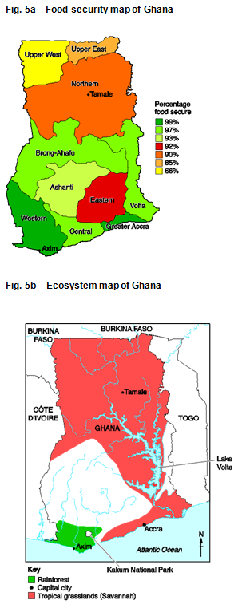
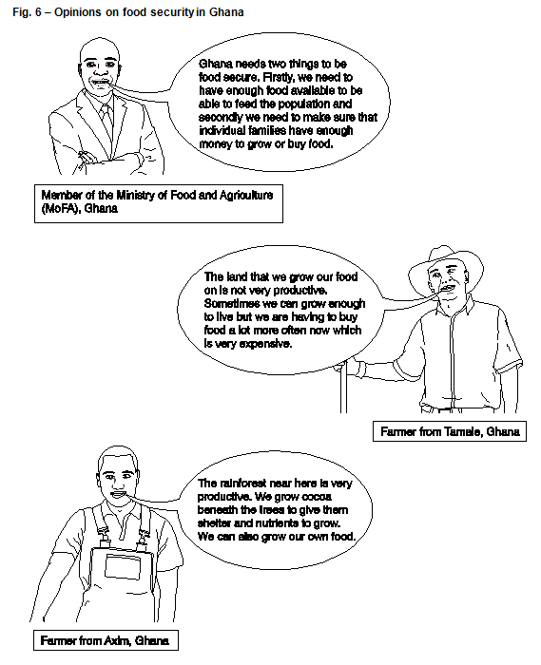
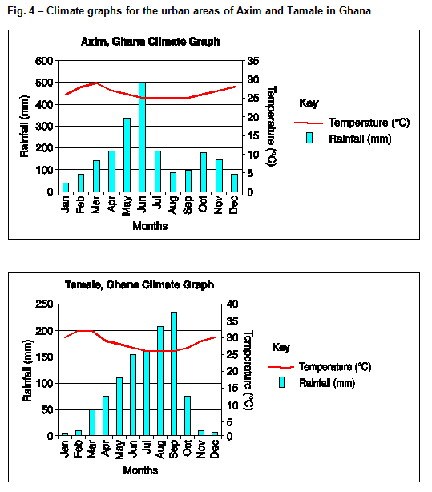
Question 2
Study Figs 4, 5a, 5b and 6 in the separate Resource Booklet, showing climate data, maps of Ghana and opinions on food security.
Questions will refer to the resources in Figs 4, 5a, 5b and 6 and could be on any aspect at the moment, students should read the questions first so they know what to focus on.

Slide 31
Question 2(a)(i) – 3 marks
Describe how the climate for Axim is different from Tamale. You should use data from Fig. 4 to support your answer.
This a 3 mark AO4 (skills) question targeting students ability to ‘extract, interpret, analyse and evaluate information’ in a graphical context – in this instance climate graphs.
There are three marks available, including the command to use data from Fig. 4 – therefore 1 mark is for using data (DEV) from the climate graphs. There are therefore 2 marks for describing how the climate is difference between Axim and Tamale – 1 mark (✓) for a point about the temperature trend and 1 mark (✓) for a point about the rainfall trend.
Any appropriate points would be fine but here are a selection of points included in the mark scheme:
Axim has a slightly lower average temperature than Tamale (✓)
Tamale had lower average rainfall than Axim (✓)
Tamale has a slightly higher average temperature than Axim (✓) with the average temperature in the first few months of the year in Tamale reaching over 30ºC (DEV)
For most of the year the average temperatures of Tamale and Axim are roughly the same (✓) but the average rainfall differs more significantly with Axim generally being higher (✓), although during August and September Tamale has roughly double the average rainfall of Axim at over 200mm in each month (DEV)
Axim has higher average rainfall than Tamale (✓) reaching over 500 mm for June compared to about 150 mm (DEV)

Slide 32
Question 2(a)(ii) – 2 marks
Using Fig. 5a, describe the differences in food security in Axim and Tamale.
This a 2 mark AO4 (skills) question targeting students ability to ‘extract, interpret, analyse and evaluate information’ in a cartographic context – in this instance the food security map of Ghana.
There are two marks available, and there is no command to use data so just appropriate descriptive or comparative points are necessary. There are marks associated to each place or for a comparative point between places.
Any appropriate points would be fine but here are a selection of points included in the mark scheme:
In Axim most people are food secure (✓)
In Axim there is a high percentage of food security (✓)
In Tamale, there is medium food security (✓) and people there are less food secure than in Axim (✓)
In Tamale there is more food security than in the North of Ghana (✓)

Slide 33
Question 2(b)* – 12 marks
‘The physical geography of Ghana causes its pattern of food security.’
To what extent do you agree with this statement? Give reasons for your answers and include references to the information in Figs 5a, 5b and 6.
This is a 12 mark question which is split between understanding (AO2) and application of knowledge and understanding to analyse and make judgements (AO3). Remember, both of the 12 mark questions on this exam are synoptic – drawing together two elements of content from different topics within the specification. In this instance, topic links include elements of physical geography (climate, ecosystems, landscape, soil type, relief) and food security.
An understanding (AO2) of the concept of food security is required and students must ensure they apply their understanding to analyse the information from the resources and make a judgement. The students judgement needs to show the extent to which the students agrees with the statement.
The asterisk (*) shows that ‘Quality of extended response’ will be assessed in this question – you can find out more about the Quality of Extended Response descriptors on slide 9.

Slide 34
Question 2(b)* – The mark scheme
Level 4 (10–12 marks)
An answer at this level demonstrates a comprehensive understanding of the concept of food security (AO2) and a thorough analysis of the information provided (AO3) to make a thorough judgement as to what extent the physical geography of Ghana causes its pattern of food security (AO3).
This will be shown by including well-developed ideas about the concept of food security and an analysis of the information to judge whether the physical geography of Ghana causes its pattern of food security.
There are clear and explicit attempts to make appropriate synoptic links between content from different parts of the course of study.
Level 3 (7–9 marks) looks for the same focuses in answers but with thorough understanding and reasonable analysis and judgement through well-developed ideas about either the concept of food security or an analysis of the information to judge whether the physical geography of Ghana causes its pattern of food security and developed ideas about the other question focus. There are clear attempts to make synoptic links between content from different parts of the course of study but these are not always appropriate.
Level 2 (4–6 marks) looks for the same focuses in answers but with reasonable understanding and basic analysis and judgement through developed ideas about either the concept of food security or an analysis of the information to judge whether the physical geography of Ghana causes its pattern of food security and simple ideas about the other question focus. There are limited attempts to make synoptic links between content from different parts of the course of study.
Level 1 (1–3 marks) looks for the same focuses in answers but with basic understanding and basic or no analysis and judgement through simple ideas about either the concept of food security or an analysis of the information to judge whether the physical geography of Ghana causes its pattern of food security. There are no synoptic links between content from different parts of the course of study.
‘Quality of extended response’ is assessed within each level – you can find out more about the Quality of Extended Response descriptors on slide 9.

Slide 35
Question 2(b)* – Indicative Content
Students could focus their answers in a number of ways but to reach the higher levels they must make clear and explicit attempts to make appropriate links between elements of physical geography (climate, ecosystems, landscape, soil type, relief) and food security in Ghana.
Students could link food security to information from various resources, especially Figs 5 and 6 but also potentially other resources, including:
  climate (with the north of the country having less rainfall and higher temperatures than the south)
  ecosystems (with rainforest being more productive than grasslands).
  the speech bubble opinions of Fig. 6.
  the landscape, with the Atlantic Ocean in the South and Lake Volta in the East.
Students should show a good awareness of the concept of food security and what this means in the context of Ghana, acknowledging that there are a range of different levels of food security.
Students may also reference other factors linked to food security, including human geography factors such as investment programmes, aid, transport links, mechanisation.

Slide 36
Question 2(b)* – Well-developed? Developed? Simple?
Examples of simple ideas:
There is some food security in Ghana. This can be seen by looking at the map areas in the south showing high food security. It is wetter in the Axim in the south as well.
Examples of developed ideas:
Food security in Ghana varies. The north west of the country has the lowest food security with 35% of the population being food insecure. This can be compared with the south west which has the least food insecure people at just 1%.This could be to do with the fact that people in the south have better weather for growing crops.
Examples of well-developed ideas:
In Ghana levels of food security vary, with the north of the country being less food secure than the south. This pattern could be due to the warm and wetter weather in the south, near Axim, which will allow communities to farm crops and raise cattle. Food security exists when all people, at all times, have physical and economic access to sufficient, safe and nutritious food that meets their dietary needs and food preferences for an active and healthy life.
This slide shows how ideas may progress from simple to developed and then well-developed. With the well-developed idea there is clear understanding of food security as well as discussion of the information in resources Figs 5a, 5b and 6.

Slide 37
Question 3(a)(i) – 3 marks
Using Fig. 5b, describe the location of Kakum National Park.
This a 3 mark AO4 (skills) question targeting students ability to ‘extract, interpret, analyse and evaluate information’ in a cartographic context – in this instance the ecosystem map of Ghana.
There are three marks available for making three separate and appropriate points regarding the location of Kakum National Park from the map.
Any appropriate answer should be credited and some examples include:
  South Ghana (✓)
  In the rainforest area (✓)
  West of Accra (✓)
  North-east of Axim (✓)
  South-west of Lake Volta (✓)

Slide 38
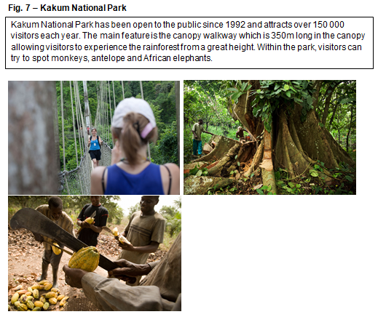
Question 3(a)(ii) – 4 marks
Using Fig. 7 and your own understanding, identify and explain two ways in which the rainforest in Kakum National Park could be a source of income for local people.
This is a 4 mark question with 2 marks for applying knowledge and understanding (AO3) to interpret from Fig. 7 ways in which the rainforest could be a source of income for local people (✓) and 2 marks for showing understanding (AO2) by explaining the ways interpreted from Fig. 7 (DEV).
Any appropriate answer should be credited, examples from the mark scheme include:
  Log trees (✓) so the trees can be sold for timber (DEV)
  Grow cocoa (✓) to sell to companies to make chocolate (DEV)
  Tourism in the NP (✓) generates work in the gift shops / cafes / hotels (DEV)

Slide 39
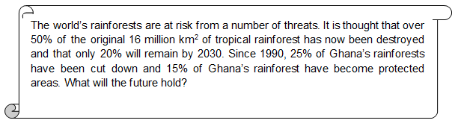
Question 3(b) – 6 marks
Using the newspaper extract above and your own understanding, evaluate the impacts of human activity on Ghana’s rainforest.
This question is split evenly between AO2 (understanding) and AO3 (application). Students need to show understanding (AO2) of the impact of human activity on tropical rainforests before applying this understanding to evaluate (AO3) how much impact human impact activity is having on Ghana’s rainforest, using the newspaper extract.
Human activity can impact tropical rainforests in a number of ways, both positively and negatively. These may include logging, mineral extraction, agriculture and tourism.
Evaluation of the impact of human activity may include the fact that 25% of Ghana’s rainforest has been cut down and that 15% of Ghana’s rainforest have become protected areas. The evaluation may focus on the potential use of the deforested areas to help drive Ghana’s economic development or the reasons behind the protection of the areas such as for tourism or environmental reasons.

Slide 40
Question 3(b) – The mark scheme
Level 3 (5–6 marks)
An answer at this level demonstrates a thorough understanding of the impact of human activity on tropical rainforests (AO2) and a thorough evaluation of how much impact human activity is having on Ghana’s rainforest (AO3).
This will be shown by including well-developed ideas about both the understanding of the impacts of human activity on tropical rainforests and the evaluation of how much human activity is having on Ghana’s rainforest.
Level 2 (3–4 marks) looks for the same focus in answers but with reasonable understanding and evaluation through developed ideas about the understanding of the impact of human activity on tropical rainforests and/or the evaluation of how much human activity is having on Ghana’s rainforest.
Level 1 (1–2 marks) looks for the same focus in answers but with basic understanding and evaluation through simple ideas about the understanding of the impact of human activity on tropical rainforests or the evaluation of how much human activity is having on Ghana’s rainforest.

Slide 41
Question 3(b) – Well-developed? Developed? Simple?
Examples of simple ideas:
The rainforest is being cut down to earn money. This has negative impacts.
Examples of developed ideas:
Ghana has destroyed 25% of its rainforest but it has also protected some. Logging trees means that they can sell it for timber and make money to develop economically, this would have a positive impact on the economy of Ghana but negative impact on the planet. The carbon store would be reduced and threatened species lose their habitat. These impacts are potentially the worst.
Examples of well-developed ideas:
Since 1990, Ghana has logged 25% of its rainforest; this could have had both positive and negative impacts. Some of the best benefits include economic growth such as the creation of jobs and trade. The logged areas could be used for growing crops such as cocoa and the trees could be sold for timber. Some of the worst impacts could be increased flood risk as trees intercept rainwaters. Also loss of the potential gene pool for medicinal value and protection of threatened species.
This slide shows how ideas may progress from simple to developed and then well-developed.

Slide 42
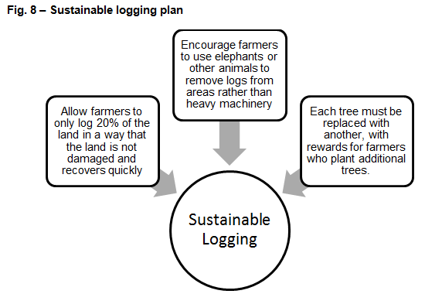
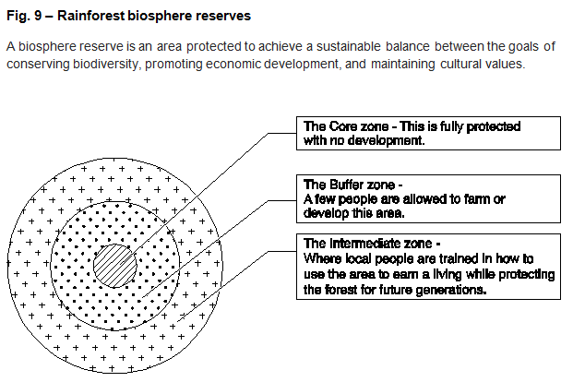
Question 4*
For the final question students can use any of the resources in the separate Resource Booklet – there are two more, new resources included which students have not had to interact with so far. It was intentional that students interacted with the majority of the resources before this question so they are familiar with the resources at their disposal. However, students should make sure they take the opportunity to familiarise themselves with any new resources.

Slide 43
Question 4* – 12 marks (+3 SPaG)
Ghana is an LIDC. Using information from the separate Resource Booklet and your own understanding, write a brief report on Ghana’s current economic development and decide on a strategy to help Ghana continue its development. In your report you must:
1 Outline Ghana’s current level of development including its successes and challenges.
2 Propose one strategy which would allow Ghana to develop further and justify how this strategy would be able to increase development.
This is a 12 mark question which is split between understanding (AO2) and application of knowledge and understanding to interpret, evaluate and make judgements (AO3). This is a synoptic question – drawing together elements of content from different topics within the specification. In this instance, various elements of the answer could draw from areas of Physical Geography (from Our Natural World) such as Sustaining Ecosystems, or Human Geography (from People and Society) such as Dynamic Development and Resource Reliance.
Students need to apply knowledge and understanding to interpret (AO3) the resources to outline Ghana’s level of development (including both successes and challenges) and then apply their knowledge and understanding to evaluate (AO3) the information to propose a strategy. Students must show understanding (AO2) of a development strategy and make a judgement (AO3) to justify how the strategy would be able to help Ghana develop further.
The asterisk (*) shows that ‘Quality of extended response’ will be assessed in this question – you can find out more about the Quality of Extended Response descriptors on slide 9.
There are marks for SPaG (Spelling, punctuation and grammar and the use of specialist terminology) you can find out more about the SPaG descriptors on slide 8.

Slide 44
Question 4* – The mark scheme
Level 4 (10–12 marks)
An answer at this level demonstrates a comprehensive interpretation of the information provided to outline Ghana’s level of development including both successes and challenges (AO3). It also shows a comprehensive evaluation of the information provided to propose a strategy (AO3) with a comprehensive understanding of a development strategy (AO2). The answer demonstrates a comprehensive judgement to justify how the strategy would be able to help Ghana develop further with a clear decision reached (AO3).
This will be shown by including well-developed ideas about Ghana’s current level of development and one strategy which would allow Ghana to develop further.
There are clear and explicit attempts to make appropriate synoptic links between content from different parts of the course of study.
Level 3 (7–9 marks) looks for the same focuses in answers but with thorough understanding, interpretation, evaluation and judgement through well-developed ideas about either Ghana’s current level of development or one strategy which would allow Ghana to develop further and developed ideas about the other question focus. There are clear attempts to make synoptic links between content from different parts of the course of study but these are not always appropriate.
Level 2 (4–6 marks) looks for the same focuses in answers but with reasonable understanding, interpretation, evaluation and judgement through developed ideas about either Ghana’s current level of development or one strategy which would allow Ghana to develop further and simple ideas about the other question focus. There are limited attempts to make synoptic links between content from different parts of the course of study.
Level 1 (1–3 marks) looks for the same focuses in answers but with basic understanding, interpretation, evaluation and judgement through simple ideas about either the Ghana’s current level of development or one strategy which would allow Ghana to develop further. There are no synoptic links between content from different parts of the course of study.
‘Quality of extended response’ is assessed within each level – you can find out more about the Quality of Extended Response descriptors on slide 9.

Slide 45
Question 4* – Indicative Content
Students could focus their answers in a number of ways and there is no single correct development strategy from which to choose. The important thing is that for whatever development strategy the student does choose they must show an understanding of that development strategy and justify it appropriately through the evaluation of the resources.
The interpretation of information to outline Ghana’s level of development could include reference to data from the development indicators’ table and the Ghana fact file, or any other resources the student wishes to draw from.
The development strategy the student proposes will determine what understanding and evaluation is shown. Their decision needs to be appropriate to Ghana and any of the Figures in the Resource Booklet can be used to help justify why the development strategy would be able to help Ghana increase development.

Slide 46
Question 4* – Well-developed? Developed? Simple?
Examples of simple ideas:
Ghana is a poor country which has a low level of development. This means that people do not have a lot to eat, cannot go to school and have no doctors.
The government should try to make more money to improve the country.
Examples of developed ideas:
Ghana has a range of successes and challenges. One success is that it has more GNI per capita than other LIDC countries at $1760. This could be partly because of ecotourism to bring in visitors.
In the future, Ghana should make more national parks so more people come to visit them and spend money in the area.
Examples of well-developed ideas:
Ghana currently has many successes in its development. One success is the increase in ecotourism, such as at Kakum National Park, which has increased its GNI per capita to $1760 which is well above other LIDC countries such as Kenya.
87% of Ghana’s people have access to clean drinking water; this is relatively high for an LIDC especially when compared to Mozambique at just 49%. However it has not been totally successful, for example in the north of the country 34% of people are food insecure.
In the future, I believe that Ghana should invest further in ecotourism through creating biosphere reserves. This would bring in more foreign direct investment while also protecting the rainforest therefore reducing the impacts of deforestation.
This slide shows how ideas may progress from simple to developed and then well-developed.

Slide 47
We’d like to know your view on the resources we produce. By clicking on ‘Like’ or ‘Dislike’ you can help us to ensure that our resources work for you. When the email template pops up please add additional comments if you wish and then just click ‘Send’. Thank you.
Whether you already offer OCR qualifications, are new to OCR, or are considering switching from your current provider/awarding organisation, you can request more information by completing the Expression of Interest form which can be found here: www.ocr.org.uk/expression-of-interest
Looking for a resource? There is now a quick and easy search tool to help find free resources for your qualification:
www.ocr.org.uk/i-want-to/find-resources/
OCR Resources: the small print
OCR’s resources are provided to support the delivery of OCR qualifications, but in no way constitute an endorsed teaching method that is required by the Board, and the decision to use them lies with the individual teacher. Whilst every effort is made to ensure the accuracy of the content, OCR cannot be held responsible for any errors or omissions within these resources.
© OCR 2016 - This resource may be freely copied and distributed, as long as the OCR logo and this message remain intact and OCR is acknowledged as the originator of this work.
OCR acknowledges the use of the following content: n/a
Please get in touch if you want to discuss the accessibility of resources we offer to support delivery of our qualifications: resources.feedback@ocr.org.uk

