Slide 1
The Boltzmann Distribution

Slide 2
Activation energy
Task 1: Write a definition of the term ‘activation energy’ in about 20 words
Task 2: Use the term activation energy to explain why chemical reactions happen at a faster rate at higher temperatures.

Slide 3
What does the Boltzmann distribution tell us?
What fraction of the reacting particles have enough energy to react?

Slide 4
Task: Measuring the height of the class
Make a table in your notes like the one opposite.
Go round the class and take a tally of the heights of all the students.
In your notes present the data as a bar chart.
Height in cm | Tally of students
Less than 160
160 – 164
165 – 169
170 – 174
175 – 179
180 – 184
More than 184

Slide 5
Why is this like the Boltzmann distribution?
Your bar chart shows the number of students in each height range.
The Boltzmann distribution shows the number of particles with each value of kinetic energy.

Slide 6
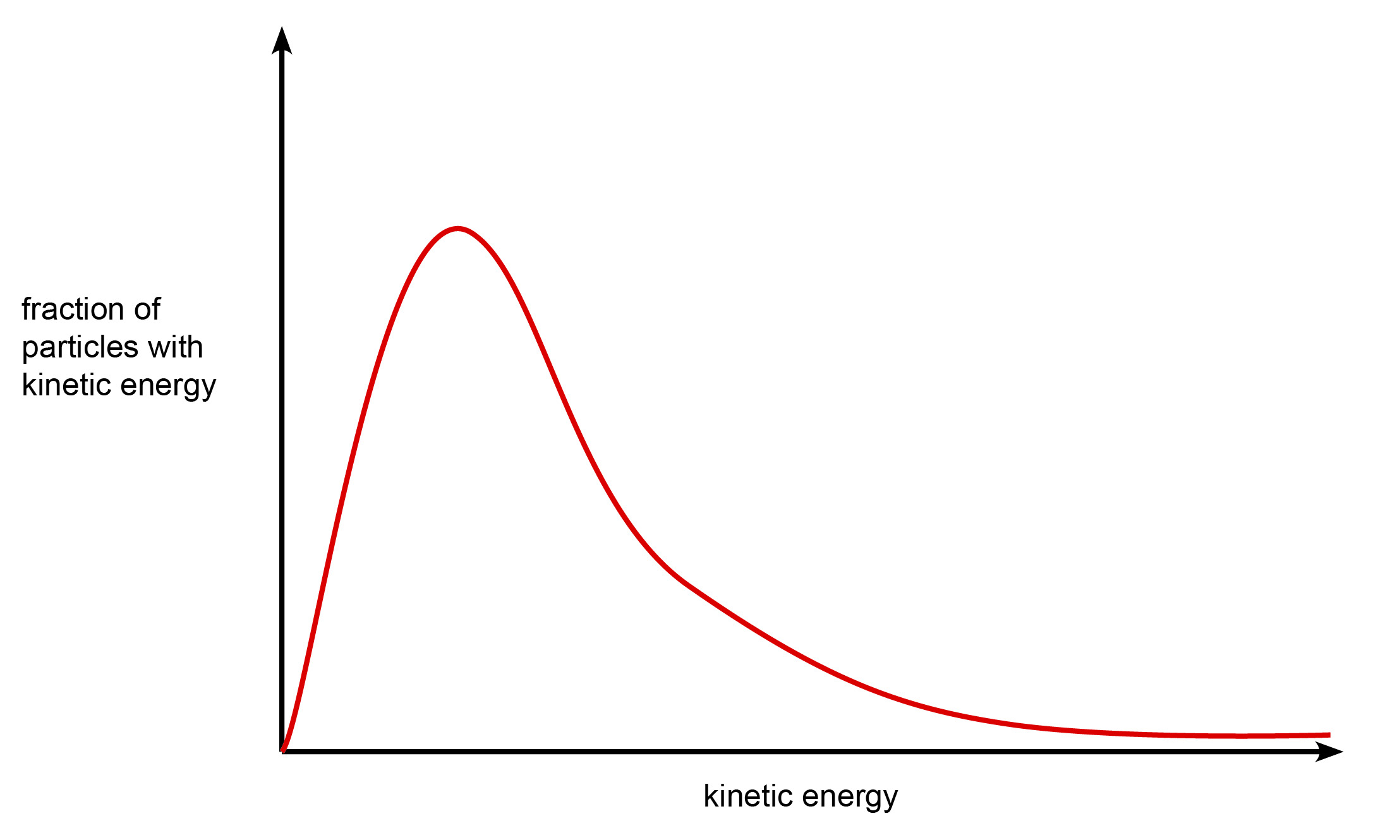
The Boltzmann Distribution

Slide 7
What are the key features of the distribution curve?
What features do you notice about this curve?
Is it very different from the ‘class height’ graph you made earlier?
What are the differences and similarities?

Slide 8
What did you notice?
There are NO molecules with ZERO energy.
There is a peak – an energy value with the greatest number of particles.
The graph ‘tails off’ at higher energies, but does not hit the x-axis.

Slide 9
How does it compare to the class height survey?
The height survey was probably more symmetrical around the middle peak.
The height graph tails off towards the maximum height and it DOES hit the x-axis.
Both graphs have a peak, which is the energy of the greatest number of particles or the height range of the greatest number of students.

Slide 10
Activation energy
Go back to the bar chart of the class height.
What if the class were to go on a trip to an amusement park and the minimum height for the rides was 175 cm?
Mark a line on the height chart to divide those students who cannot go on the ride from those who can.
Shade or colour the columns for those students who can go on the ride.
This is similar to activation energy.

Slide 11
Activation energy
Sketch the shape of the Boltzmann distribution in your notes.
Now add a line for the activation energy – the minimum energy required for the particles to react.
As with the previous graph, shade or colour in those particles with enough energy to react if they collide.

Slide 12
What happens to the distribution curve as the temperature changes?

Slide 13
Task
Go back to the sketch of the Boltzmann distribution.
Add two more curves:
One for a lower temperature
Another for a higher temperature.
Add them lightly in pencil if you are not sure.

Slide 14
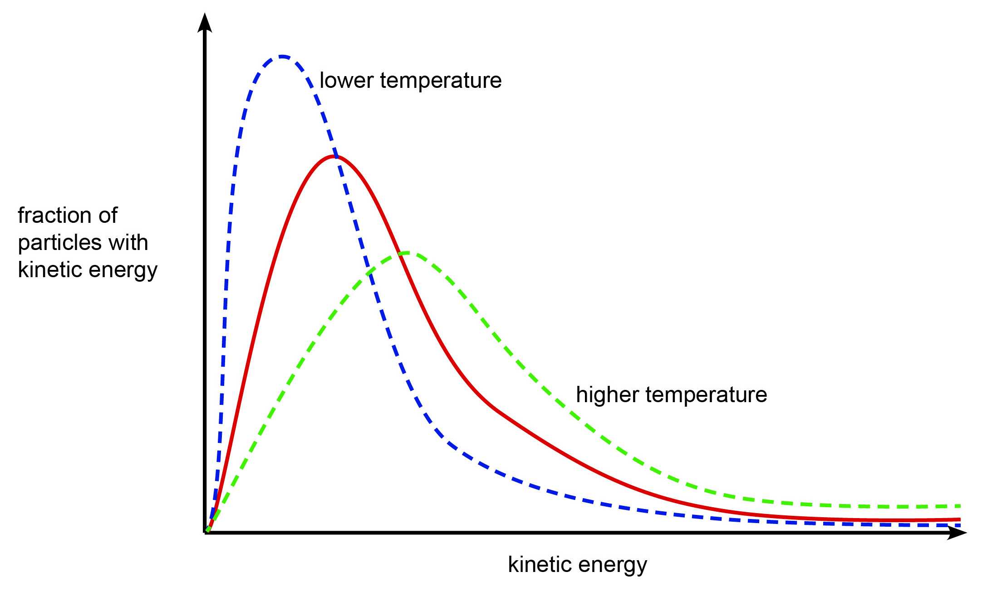
Temperature and Boltzmann

Slide 15
Activation energy
Now mark the activation energy on this graph with all three lines.
Shade the areas as before.
What do you notice about the proportion of molecules with enough energy to react at different temperatures?

Slide 16
Review
Return to the earlier writing task about the effect of temperature on rate of reaction:
Use the term activation energy to explain why chemical reactions happen at a faster rate at higher temperatures.
Using the key terms of ‘activation energy’ and ‘Boltzmann distribution’, reword your answer to improve the standard of chemistry.
Ensure that the answer is set out in a logical fashion and is easy to follow.

Slide 17
Review
Discuss the following example answers. How could each one be improved?

Slide 18
Example answer 1
Hotter chemicals are more able to overcome the activation energy, which stops them reacting normally. When the chemicals are hotter they have more activation energy so more collisions are successful. This means that the reaction will happen faster.

Slide 19
Example answer 2
At higher temperature the Boltzmann distribution shows that more molecules have enough energy to react when they collide. This means that more collisions will be successful and the reaction will happen faster.

Slide 20
Example answer 3
Molecules must have kinetic energy that is greater than the activation energy to react. When we heat up the chemicals, the molecules get more kinetic energy so more can react if they collide. This makes the reaction happen faster.

Slide 21
Example answer 4
When the chemicals are hotter, the particles collide more. This makes the reaction go faster and makes more product.

Slide 22
We’d like to know your view on the resources we produce. By clicking on ‘Like’ or ‘Dislike’ you can help us to ensure that our resources work for you. When the email template pops up please add additional comments if you wish and then just click ‘Send’. Thank you.
Whether you already offer OCR qualifications, are new to OCR, or are considering switching from your current provider/awarding organisation, you can request more information by completing the Expression of Interest form which can be found here: www.ocr.org.uk/expression-of-interest
Looking for a resource? There is now a quick and easy search tool to help find free resources for your qualification: www.ocr.org.uk/i-want-to/find-resources/
OCR Resources: the small print OCR’s resources are provided to support the delivery of OCR qualifications, but in no way constitute an endorsed teaching method that is required by the Board, and the decision to use them lies with the individual teacher. Whilst every effort is made to ensure the accuracy of the content, OCR cannot be held responsible for any errors or omissions within these resources. © OCR 2016 - This resource may be freely copied and distributed, as long as the OCR logo and this message remain intact and OCR is acknowledged as the originator of this work.
OCR acknowledges the use of the following content: n/a
Please get in touch if you want to discuss the accessibility of resources we offer to support delivery of our qualifications: resources.feedback@ocr.org.uk

