Slide 1

OCR Geography
‘Breaking down geographical barriers’
Shelley Monk & Chloë Nichols

Slide 2
Breaking down geographical ‘assessment’ barriers?
Removal of tiering from GCSE papers
Increased rigour
Higher tariff questions (6, 8 and 12 mark questions)
Accessibility of questions (lower ability and EAL)
Diverse nature of learners (ability, language, cultures)
Increasing popularity of Geography
Key aims of the workshop are:
Confidence building for EAL and lower ability learners
Accessibility of exam questions (deconstructing)
Strategies for success (focus on language)

Slide 3
Breaking down geographical language barriers
Ofsted (2012) suggested that Oral rehearsal, pre-teaching, visual clues, practical tasks and paired/group work best supports EAL children in class and can aid students in ‘developing highly advanced writing skills.’
Starter activity: Deconstructing language
Watch the first minute of the You Tube clip about Shanghai with NO sound:
https://www.youtube.com/watch?v=0KgXBpemWSs
Write a list of words to describe what you see in the clip.
Notes:
The words can be in students ‘home’ language and translated
https://www.naldic.org.uk/Resources/NALDIC/Teaching%20and%20Learning/sec_ks3_ge_access_engage_eal.pdf

Slide 4
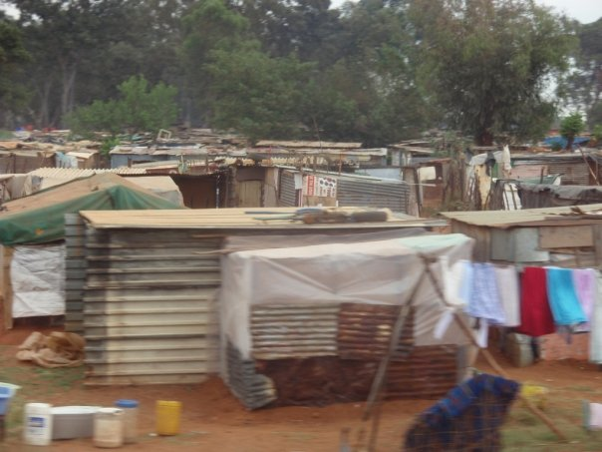

Shanghai is…...
Busy
Hot
High rise
Small streets
Bright lights
Densely packed
Modern
Congested
Historic
Key words | Image | Definition
Densely packed |  | Lots of buildings close together
High rise |  | Tall buildings with lots of floors
Congested |  | Too many people and cars
Historic |  | Old, built a long time ago
Notes:
Teacher follow up / additional activities:
List words on white board, explain their meaning
Encourage use of basic through to more complex vocabulary
Build a glossary together or use a template (on slide) and do a mix and match activity.
Encourage students to repeat words after you
Students to list unfamiliar words and look up their definitions
Students to write sentences using the key words

Slide 5
Making geographical language accessible
Aim: To use topic key terms in context
(1) Students in pairs sit back to back, with a small whiteboard and pens. One student picks a key term related to the topic and draws an image for the other student to guess the key term.
Follow up: the students write their own definitions of the key terms, the teacher could give them a basic prompt sheet.
(2) To help students build a glossary of key terms for a topic, this can be done throughout a topic or at the end. Start with more basic key terms, ask students working in pairs or small groups to match images, with key terms and their definitions. Ask students to say each key term and their definitions to each other.
Follow up: Students could use the key terms in a sentence and underline them so that they understand them in context of the topic.
Key points
Oral and repeat
Build knowledge (glossaries & use of images)
Context is key

Slide 6
Activity 1 – How can you break down exam questions?
GCSE B:
Evaluate the success of one technological strategy to sustainably improve food security. (6)
Evaluate the success of one technological strategy to sustainably improve food security. (6)
  Command word
  Key words
  Question focus
How would you get students to break down this question?
Notes:
Command word
Key words – link to what the students have been taught (topic / geographical content)
Question focus – what is it that you need to focus on that links to the question and the command word

Slide 7
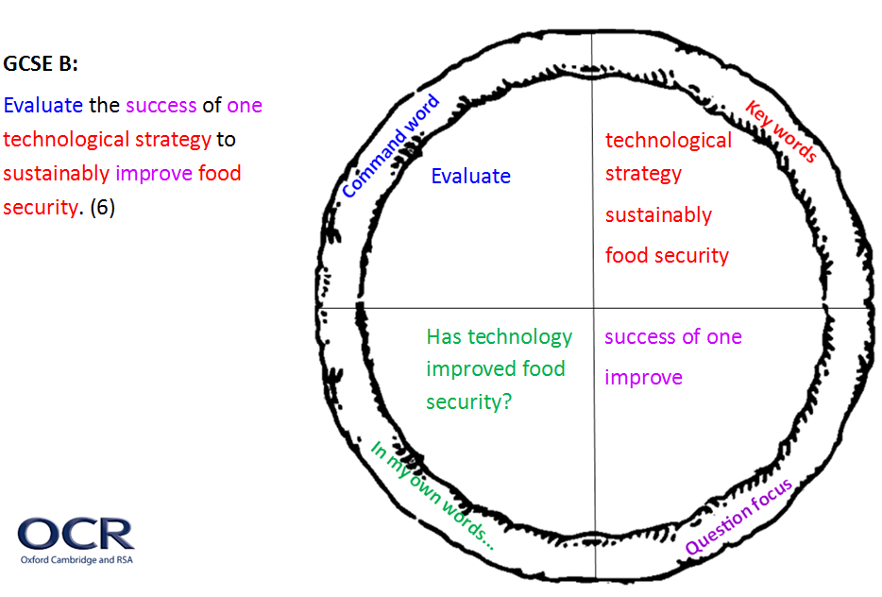
Pizza… to help break down exam questions
Notes:
Pizza rationale – engaging and memorable activity
Explain pizza – 4 key parts / slices to aid learners in visually deconstructing questions e.g. ‘slicing up the question’
First stage in supporting learners in breaking down complex questions
In an exam students could highlight the question ‘slicing it up’ (unlikely to use pizza)

Slide 8
Pizza…Over to you
GCSE A:
Examine how far migration influences the growth and character of cities in LIDCs or EDCs. Use case study knowledge in your answer. (12)
GCSE B:
CASE STUDY— a river basin in the UK.
Name of river basin in the UK __________
Explain how human activity has influenced geomorphic processes in this landscape. (6)
Notes:
For either the GCSE A or GCSE B question complete the pizza “slicing it up” activity template

Slide 9
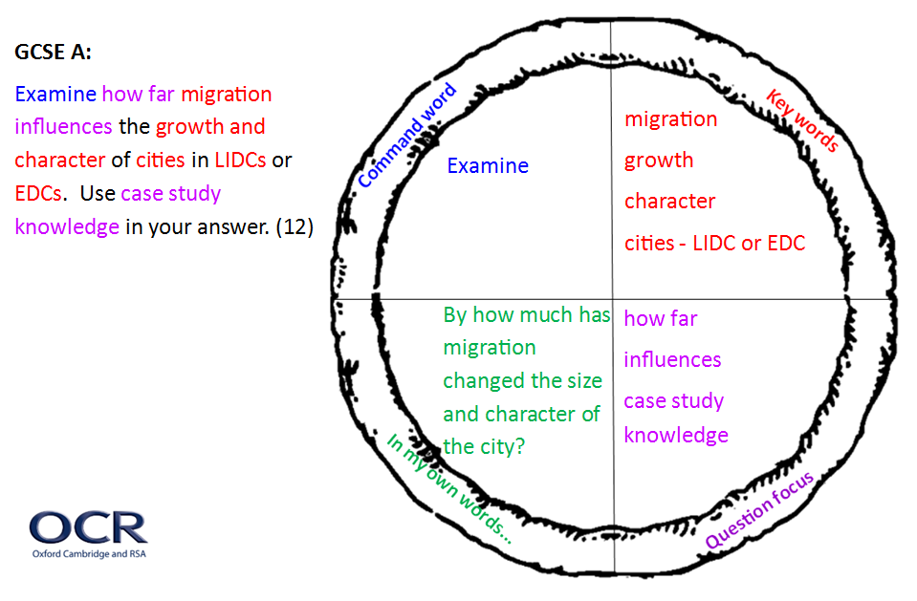
Notes:
What are the issues once this activity has been completed e.g. not understanding the key words, lack of topic knowledge, knowing how to start an answer, having the confidence to ‘get started’

Slide 10
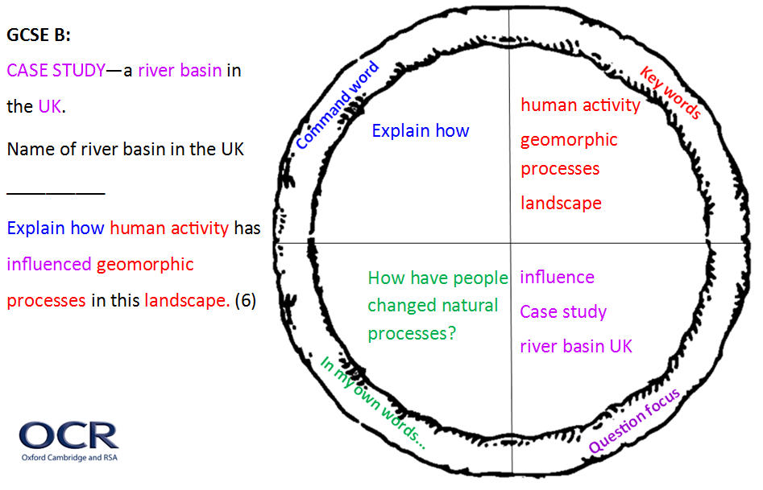

Slide 11
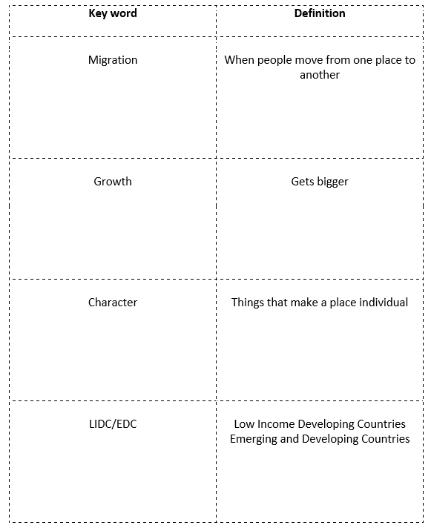
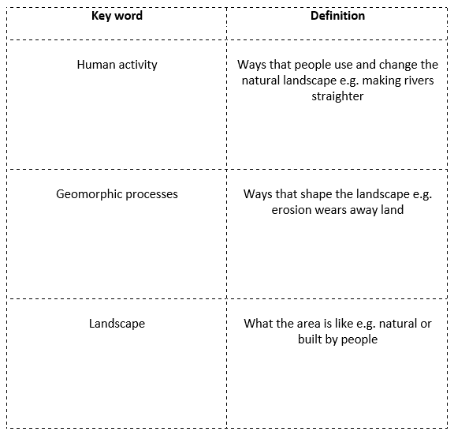
Supporting the pizza activity
Notes:
Understanding and supporting terminology used in questions – glossary activity and room for images (learners to draw)
Vocab building and embedding understanding
Recap EAL idea to go over terminology orally
Sentence building as definitions already completed – helping learners to ‘get started’

Slide 12
Getting learners writing…..
Ingredients for learners answers:
Key words in the question (flesh these out)
Topic knowledge and understanding (find things out / use notes)
How to put their ideas together (get planning)
Supporting learners
Talking things through – step by step guide
Working together (pairs / groups)
Modelling examples
Have a go! ☺
Notes:
Building up skills for tackling higher tariff questions

Slide 13
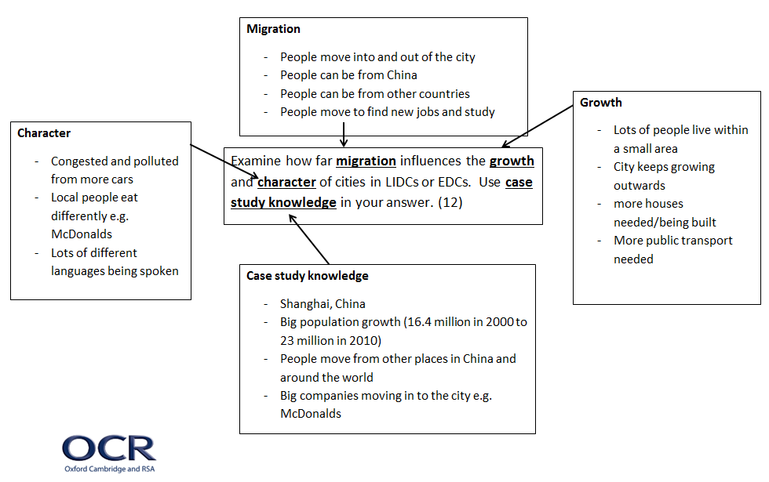
Activity 2 – Planning tool
Notes:
What do learners need to think about to answer the question? (This draws on the red section of the pizza)

Slide 14
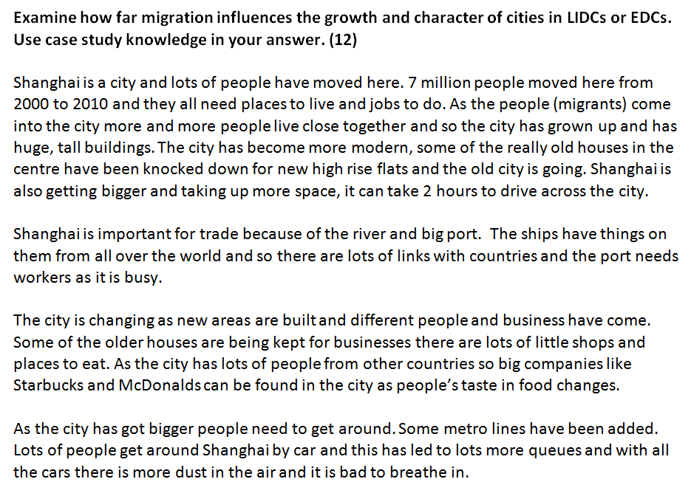
Activity 2 – Modelling an answer
Activities
Read through with learners
Talk through any unfamiliar words
Pick out / highlight the key words from the planning tool e.g.
  Migration
  Growth
  Character
  Case study knowledge
Extension: What else could be added? Improved? E.g. case study knowledge
N.B This answer has been written specifically for this workshop to use as a resource.

Slide 15
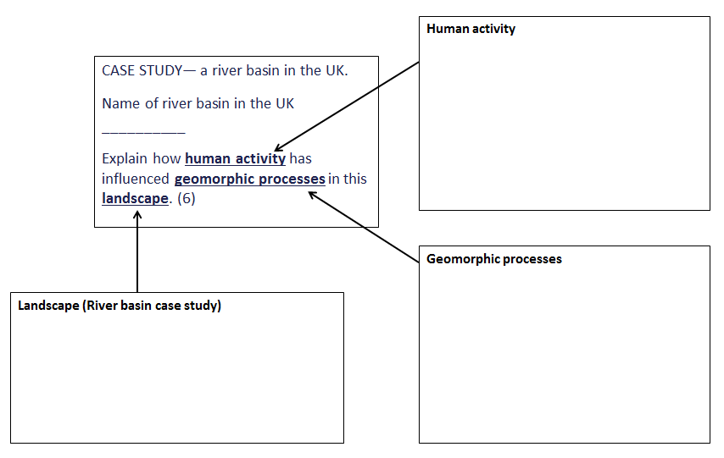
Activity 3 – Planning tool
Discussion – how can learners progress to writing an answer?
Notes:
Teachers to complete this individually / pairs
For the discussion – list ideas on WB / flip chart of strategies suggested to help learners write an answer.

Slide 16

Learners next steps
Other planning strategies
Plan together
Checklist of key content
Hexagons
Techniques to develop a ‘full’ answer
Gap filling
Mix and match answers
Writing frame – individual learners

