Slide 1
Reducing the IT Skills Gap
Alison Pearce, Senior Manager Skills Certification
apearce@comptia.org

Slide 2
Who are
The voice of the world’s information technology (IT) industry.
Non-profit trade association
We offer our partners:
Networking
Education
Thought leadership
Research
Certification
Advocacy
Philanthropy
CompTIA develops vendor-neutral IT exams
CompTIA certifications validate technical skills
Notes:
The Computer Technology Industry Association
Advance the global interests of the IT Sector

Slide 4
Recruitment Challenges – Sector Top 5
1. Competing with other tech firms for talent
2. Finding workers with the right soft skills
3. Finding workers with expertise in emerging tech fields
4. Rising salary expectations
5. Insufficient pool of talent in region / locale

Slide 5
Perceptions relating to the Skills Gap

Slide 6
Skills Gap – Research Findings

Slide 7
Skills Needed

Slide 8
CompTIA and Academic Partners
Free to join Academic Programme
Delivery Resources
E-book ITF
Presentations
Videos and webinars
Research
Instructor Networking Forum
Instructor vouchers
Discounted certification for students

Slide 9
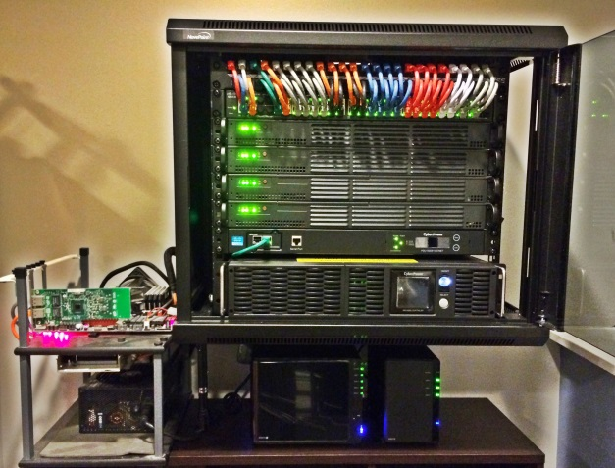
Recommendation for External Content
Wide range of third party materials
TV Online
This Photo by Unknown Author is licensed under CC BY-NC-SA
This Photo by Unknown Author is licensed under CC BY-SA
Notes:
Virtual labs
Online learning
Online TV
Books
Practice tests
Partner support through the training links to find authorised resources.
Talk to us for ideas, approaches and we can help to shortlist, request evaluation copies and demos

Slide 10
Ensures IT education programmes are up to date
Ensures programmes are benchmarked against industry standards
Enhances the student learning experience
Enhances student employment prospects
Offers another way of assuring the quality of the courses (as well as the internal and statutory external quality assurance frameworks in place)
Enhances the reputation of a educational organisation
Enhanced Employability and Differentiation
Improves understanding to potentially improve grades
Upskills teachers for CPD

Slide 11
Mapping
Benefits
Industry Standards
Support With Delivery
Job Role Relevant
History Of Vendor Content
Ease of Progression to HE, Apprenticeships and employment

Slide 12
COMPTIA CERTIFICATIONS
A skills-based look at the roadmap
We certify essential skills for the entire IT “ecosystem”
Help Desk
IT Support Technician
Field Technician
A+
Security+
CSA+
CASP
Security Engineer
Security Analyst
Security Architect
Cloud+
Operating system support
Data Centre Technician
Server+
Linux+
Cloud Systems Analyst
Cloud Engineer
Project+
CTT+
Project Manager / Officer
Technical Trainer
Learning Manager
Network Engineer
Systems Administrator
Network+
IT Fundamentals
Cloud Essentials
Nascent Digital Professionals
Technical Sales Professionals

Slide 13
Funded Qualifications and Mapping
Awarding Organisations
Funded, accredited vocational provision
Holistic and realistic learning
External assessment
Employer engagement and recognition

Slide 14
CompTIA and the Cambridge Technicals

Slide 16
Questions ? ? ?

