Slide 1
An overview of developments in vocational and technical education
Paul Steer, Head of Policy

Slide 2
Introduction
An overview of current and emerging developments in vocational and technical education
With particular emphasis on 16-19 qualifications
Show where OCR Cambridge Technicals fit into these developments, now, and in the future

Slide 3
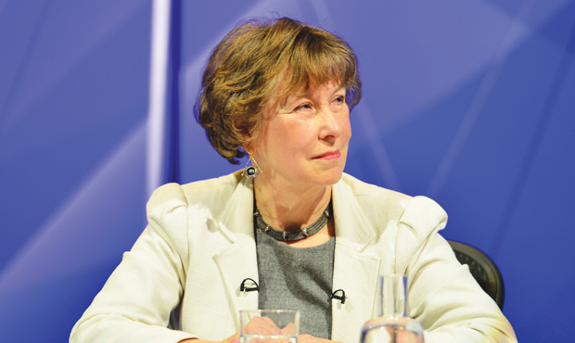
Review of Vocational Education
– The Wolf Report, March 2011
Where we are now…

Slide 4
Wolf recommendations
Maths and English GCSE resits
Limiting the size and amount of vocational qualifications to be taken at key stage 4
Organising vocational qualifications into coherent types, with prescribed features if they are to be recognised in performance measures

Slide 5
Those Wolf categories Key Stage 4
Technical Awards are Level 1 and level 2 qualifications designed for 14-16 year olds in schools and are normally studied alongside GCSEs.
[adapted from DfE guidance]

Slide 6
Those Wolf categories 16-19
Technical certificates are level 2 technical qualifications recognised by employers for students aged 16 plus who wish to specialise in a specific industry or prepare for a particular job.
Applied General Qualifications are level 3 qualifications for 16-19 year olds which aim to give students a strong but broad understanding of an occupational sector and to allow entry to a range of higher education courses.
Tech Levels are level 3 qualifications for students aged 16 plus which develop specialist knowledge and skills to help get an apprenticeship or job, for example in engineering, IT, accounting or professional cookery, or to progress to a higher level qualification.
[adapted from DfE guidance]

Slide 7
Typical ‘Wolf’ criteria
Grading requirements
Synoptic assessment
Employer support
HE support
Evidence of progression
External assessment requirements*
Notes:
To be recognised and included in one of these categories a qualification must meet the criteria for that category.

Slide 9
DfE recognised qualification types
A Levels and/or Applied General
GCSEs & Technical Awards
Higher education (undergraduate degree)
Higher Education (level 4&5 technical)
Degree & higher apprenticeships
Tech Level
or Technical Certificates
Employment-based technical (Apprenticeship)
GCSEs & Technical Awards
Academic option
Technical option

Slide 10
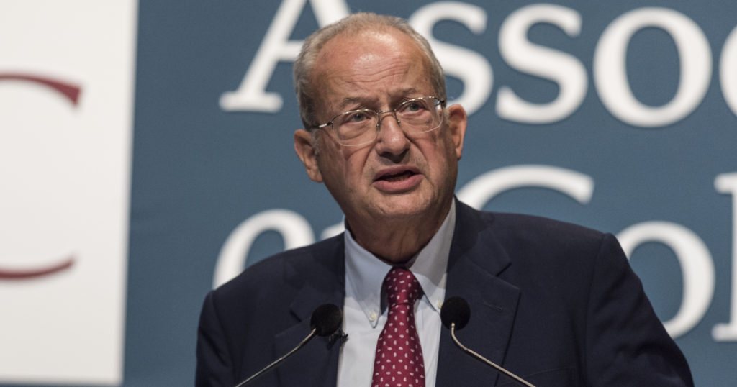
Sainsbury Review of Technical Education

Slide 11
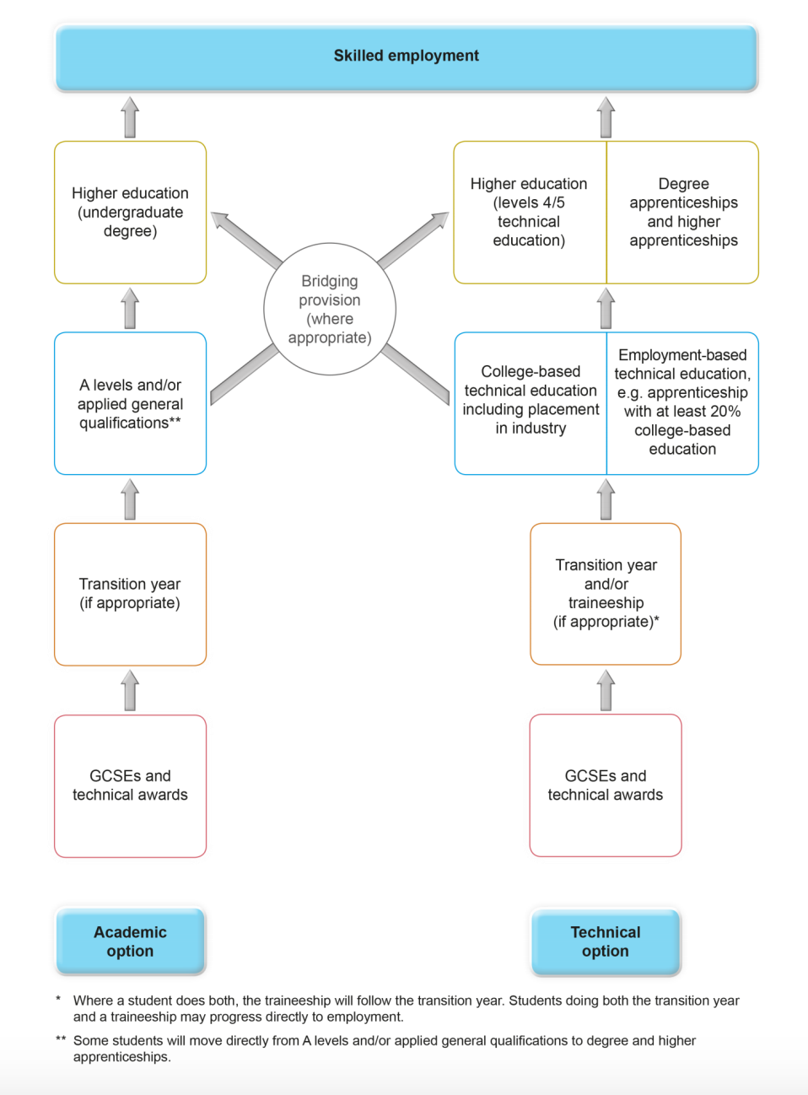

Slide 12
What do we mean by ‘technical’?
Origin
Early 17th century: from Greek tekhnē ‘art, craft’

Slide 13
Sainsbury defines ‘technical’ (1)
“The Government must be explicit that to be described as technical education, a programme must focus on progression into skilled employment and require the acquisition of both a substantial body of technical knowledge and a set of practical skills valued by industry.”

Slide 14
Sainsbury defines ‘technical’ (2)
“Technical education … differs from A levels and other academic options in that it draws its purpose from the workplace rather than an academic discipline…
“Ultimately, we must communicate consistently and more effectively the truth that technical education leads to rewarding, skilled jobs and opens doors for individuals to progress to the most senior of roles.”

Slide 15
T Levels - Who they are for
“[16 year olds] will be able to choose from an academic study programme (primarily through A levels), a technical option (primarily through a T level study programme or an apprenticeship).”
Implementation of T level Programmes, Government Consultation
30th November 2017

Slide 16
T Levels - What they are for
“A levels and T levels will exist as high quality, rigorous, level 3 study programmes.
A levels will continue to support entry to degree level higher education.
T levels will be designed primarily to support entry to skilled employment in technical occupations at level 3 and above.”
Implementation of T level Programmes, Government Consultation
30th November 2017

Slide 17
“T levels rejected by HE”
A spokesperson for Imperial College London said: “We need to ensure that students are academically able to cope with the rigours of an Imperial degree and we do not believe that T levels provide a suitable preparation for students.”
TES Online, T levels rejected by some of Britain’s top universities, Jonathan Owen, 9th February 2018

Slide 18
15 Technical routes
Agriculture, Environmental and Animal Care
Business and Administrative
Catering and Hospitality
Childcare and Education
Construction
Creative and Design
Digital
Engineering and Manufacturing
Hair and Beauty
Health and Science
Legal, Finance and Accounting
Protective Services (A)
Sales, Marketing and Procurement (A)
Social Care (A)
Transport & Logistics (A)

Slide 19
T Levels - Programme structure
Each programme will consist of 5 components:
an approved technical qualification
a work placement (45 days per learner)
maths, English and digital requirements
any other requirements/qualifications, as set out by the relevant panel
any employability, enrichment and pastoral provision (as required in all study programmes)

Slide 20
Threat to post 16 level 2 VQs?
“For a small number of students on taught programmes we recognise that achievement at level 2 by the age of 19 may be an appropriate aim.”
The DfE will work with providers to design programmes and decide what qualifications should continue
In the future all Level 2 qualifications must :
1. Be valued by employers and
2. Provide opportunities for re-engagement with education at a later date
From DfE consultation of T Level implementation

Slide 21
Threat to Level 3 Applied General Quals?
“It is my intention that AGQs should continue to provide pupils with a route to university, either in conjunction with A levels or on their own. They should equip pupils with the knowledge and skills to succeed at university. I expect the qualifications’ focus to remain as a route to higher education and with that in mind they should embody a sufficient and appropriate level of rigour…
“As you will know, the government is launching new T-levels for students undertaking a technical route. Whilst we think there is a valid place for AGQs, it is important that the qualifications are clearly differentiated...”
Nick Gibb to Sally Collier, April 2017

Slide 22
Ofqual Corporate Plan 2017-20
Objective 4
Regulate for the validity of vocational and technical qualifications
What we plan to do 2017–18
1. Review our regulatory approach to Applied General qualifications.

Slide 23
T-Level Timelines

Slide 24
Buyers’ market?
“Since 2014, the number of unconditional places handed out to sixth form pupils has surged from 2,985 to 51,615, up by more than 1,600 percent.
“Of the 259,230 sixth form students who applied to university this year, nearly one in five received an unconditional offer.”
Universities accused of making a 'mockery' of A-levels as the number of unconditional offers surges by more than 1,600 per cent - Harry Yorke, DAILY TELEGRAPH ON-LINE, 14 DECEMBER 2017

Slide 25
VQ applications to HE begin to taper
The proportion of UK 18 year olds who apply while studying Level 3 BTEC qualifications has decreased again this year, after strong growth between 2012 and 2015. In 2018, the proportion who applied while studying only BTECs was 3.4 per cent, a drop of 0.1 percentage points compared to last year, but still 41 per cent higher than in 2012.
UK application rates by the January deadline, 2018 Cycle, UCAS, 5th February 2018

Slide 26
Cambridge Technicals continue to grow

Slide 27
Conclusions
You decide…
What should be the main destinations of your learners?
Does your institution have a role in ‘technical education’?
Academic or Technical - Is it cut and dried..?

Slide 28
Questions and comments welcome
paul.steer@ocr.org.uk
Twitter: @ocr_policy
Web: www.ocr.org.uk/policy
Email: policy@ocr.org.uk

Slide 29
GCE AS subject decreases, 2017
Source: JCQ summer results data, 2017
Notes:
This gives us a pretty dramatic representation of the impact of decoupling (and funding issues) on the uptake of AS
The decline in reformed subjects is massive

Slide 30
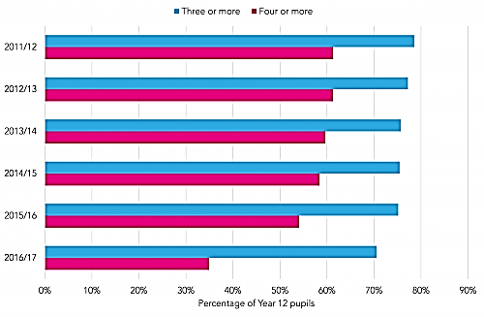
Number of A-Level learning aims, students in Year 12 in school sixth-forms in England
https://educationdatalab.org.uk/2017/05/young-people-are-taking-fewer-a-levels-as-qualification-reforms-kick-in-and-per-student-spending-falls/
Source: Education Datalab, Young people are taking fewer A-Levels, May, 2017

Slide 31
Level 3 Extended Project trend
Changes from 2016-2017
Subject | % change | 2016 Number of candidates | 2017 Number of candidates
Extended Project | 12.3 | 35608 | 40013
Source: JCQ summer results data, 2017

Slide 32
Applied General Qualifications - purpose
“Applied general qualifications are rigorous advanced (level 3) qualifications that allow 16 to 19 year old students to develop transferable knowledge and skills. They are for students that want to continue their education through applied learning.
“Applied general qualifications allow entry to a range of higher education courses, either by meeting the entry requirements in their own right or being accepted alongside and adding value to other qualifications at level 3 such as A levels.”
2017 16 to 19 performance tables: qualifications in the applied general category, DfE, February 2015

