Slide 1
Overview of CAMBRIDGE TeCHNICALs Qualifications
Spring Conference
Dean O’Donoghue
OCR Cambridge Technicals Product Manager
March 2018

Slide 2
What are Cambridge Technicals?

Slide 3
Cambridge Technicals
100% internal assessment
No longer eligible for DfE Key Stage 5 performance points
Funded as Section 96 qualifications
Some external assessment
Eligible for DfE Key Stage 5 performance points

Slide 4
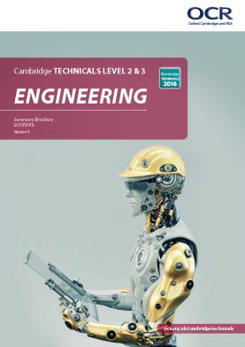
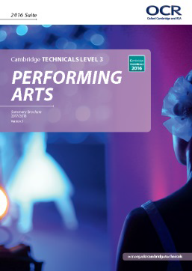
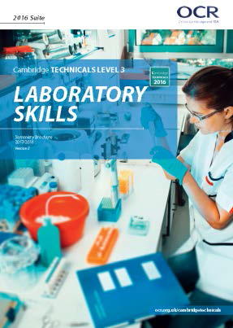
Cambridge Technicals L2/3 Subjects
Art and Design 2012 suite only

Slide 5
Cambridge Technicals
DfE 16-18 Performance Categories
Level 3 Applied General and Tech-Level
Level 2 Technical Certificate

Slide 6
Cambridge Technicals Qualifications
Level 2
Technical Certificate
Award (90GLH) – equivalent to ¾ of a GCSE
Certificate (180GLH) – equivalent to 1.5 GCSE’s
Diploma (360GLH) – equivalent to 3 GCSE’s
Level 3
Applied General
Certificate (180 GLH) – equivalent AS Level
Extended Certificate (360 GLH) equivalent to
1 A Level
Tech-Level
Foundation Diploma (540 GLH) equivalent to
1.5 A Levels
Diploma (720 GLH) equivalent to 2 A Levels
Extended Diploma (1080GLH) equivalent to
3 A Levels
Grading – Pass, Merit, Distinction, Distinction*

Slide 7
A Level v’s Cambridge Technicals Tariff Points
Grading – Pass, Merit, Distinction, Distinction*

Slide 8
Stakeholder Support
Examples of HEI’s supporting qualifications
University of Leeds
University of Brighton
London South Bank University
Coventry University
Birmingham University
Staffordshire University
Examples of employers supporting qualifications
IBM
UK Athletics
Alton Towers
Mencap Sport
JLR
Kings College Hospital
Siemens
Fujitsu
Cambridge TV

Slide 9
Where are centres doing Cambridge Technicals?

Slide 10
Who is doing Cambridge Technicals?
Cambridge Technicals are suitable for all your 16-19 year old students
Schools with sixth forms
Academies
Secondary and Middle Schools
Sixth Form Colleges
FE Colleges
UTC’s, Studio Schools and Free Schools
Independent schools
Training providers

Slide 11
Progression
Cambridge Assessment Research Division
Over 95% of applicants with a Cambridge Technical received an HEI offer
Over 86% students were accepted onto an HE course
46% of students with a mix of AS/A levels and Cambridge Technicals progressed onto HE
62% of students with A levels progress onto HE
15% of students with a Level 3 Cambridge Technical progressed onto FE based apprenticeships
Data based on Progression of Year 13 students 2014/15

Slide 12
PLAN, TEACH, ASSESS, RESULTS
Customer contact centre / subject advisors / customer support managers to
PLAN – Summary Guides, Subject Advisor Support, Customer Support Team, Parent and Student Guides
TEACH – Skills Guides, Delivery Guides, Endorsed Text Books, Get Started and Get Going face to face training, Advisory support webinars
ASSESS – Assessment materials, past papers, practice papers, exemplars and model assignments, visiting moderator
RESULTS - Reports to centres, moderator reports, past papers/combined reports

Slide 13
Resourcing Cambridge Technicals Qualifications
We’re here to support you and your students in choosing the right qualification pathway.

