Slide 1
Working in collaboration, with OCR, to achieve a sustainable workforce with the skills for our future
Brenda Yearsley: Siemens Global Social Innovation Team
UK School and Education Manager
siemens.co.uk
© Siemens plc 2016
Notes:
Brenda Yearsley:
I work with Siemens Global Social Innovation Team currently as the UK School and Education Manager

Slide 2
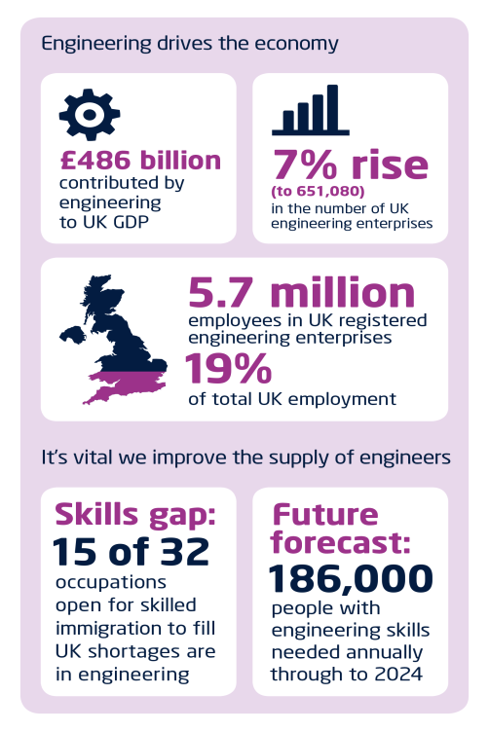
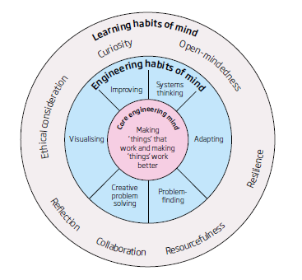
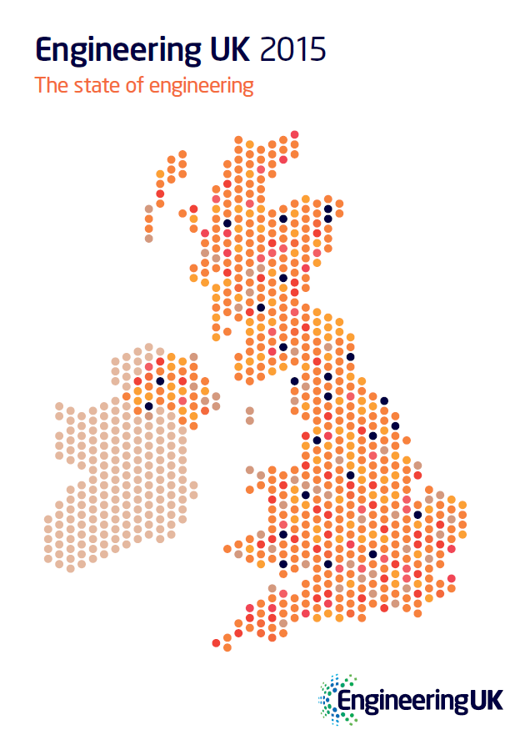

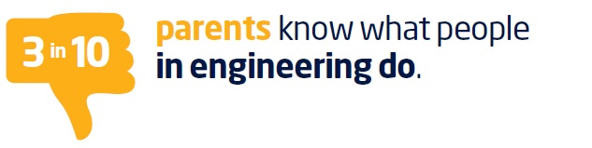


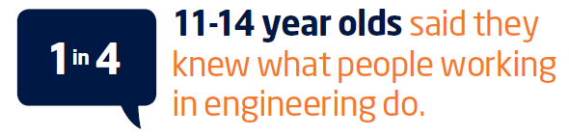
Our Challenge – Our Opportunity
The UK (and the World) needs more Engineers
Each year
87,000 engineers needed
51,000 coming on stream
Notes:
Skills gap: Anyone looking at this will not be shocked by the skills gap – this has been mentioned since I was an apprentice 30+ years ago
However there are new additional burdens in the detail
15 of the 32 occupations open for skilled immigration are Engineering so this may be further exacerbated by brexit
the demise of the connexions service -Parents are giving career guidance but only 3 in 10 know what people in engineering do
Lack of female applicants – they do well once in the application process but they need to apply
This is becoming a matter of urgency and this is why we were delighted to be approached by OCR to partner them in helping to address the skills gap through this unique project.
The Project provides students with an opportunity to engage in a series of learning tasks that facilitate vocational/ applied learning and helps them to experience not only academic rigor but the technical ability we need for today’s roles.

Slide 3



Siemens UK in numbers
1843
Siemens’ investment in the UK supply chain
Doing business since
£1.8bn
15,000
Employees
17,500
Securing over
jobs in the supply chain
600
Apprentices
250
Graduates
14
Manufacturing sites
£6bn
Revenue
30
Major Siemens sites
Siemens activity in the UK supports over
56,700
jobs
Figures FY16
Notes:
A little about Siemens in the UK we have a significant presence with 14 manufacturing sites and 30 major offices employing over 15,000 with 600apprentices/250 graduates
6 billion turnover
The skills and aspirations of young people leaving the UK education system and entering the world of work is therefore of vital importance to our business. Siemens will recruit and train hundreds of apprentices and graduate trainees over the next few years across nine business sectors.
So ensuring the calibre and experience of these young people is a challenge we do not face alone; research indicates that engineering companies will need 1.86 million people with engineering skills between 2010 and 2020. These statistics mean that the UK needs to double the numbers of engineering-related apprentices and graduates coming out of colleges and universities to fill the recruitment pipeline.

Slide 4
In the UK, for the UK
How we contribute to the social and economic prosperity of the UK
£3m
Responsible business
Nearly £300 per employee goes straight to community projects – a significant contribution to the livelihoods of UK people from all walks of life
donations
per year
10% of employees donate to charity through payroll giving
Equivalent £12m per year to participants in Siemens education projects
Productivity and innovation
Siemens firmly supports the UK’s scientific community, investing in more than
100 research projects, including the landmark smart city project, Triangulum
3,900
patents filed in the UK
Productive employees: £110k of GVA* per person, per year
Involved in £200m worth of UK research projects
Transforming the UK’s infrastructure
Recognising that rail is an integral part of the national daily commute, Siemens maintains more than 370 trains in the UK, and invested £300m in Thameslink depots
£310m
wind power facility investment
1,000 jobs created at Hull wind power facility
50% of UK wind energy is generated by Siemens turbines
Business to society report
In the UK for the UK info graphic and UK map
*GVA is the increase in the value of the economy due to the production of goods and services
Notes:
As we can see this isn’t just a nice to do it has a direct impact on the uK economy and our commitment to being a responsible business in the UK

Slide 5
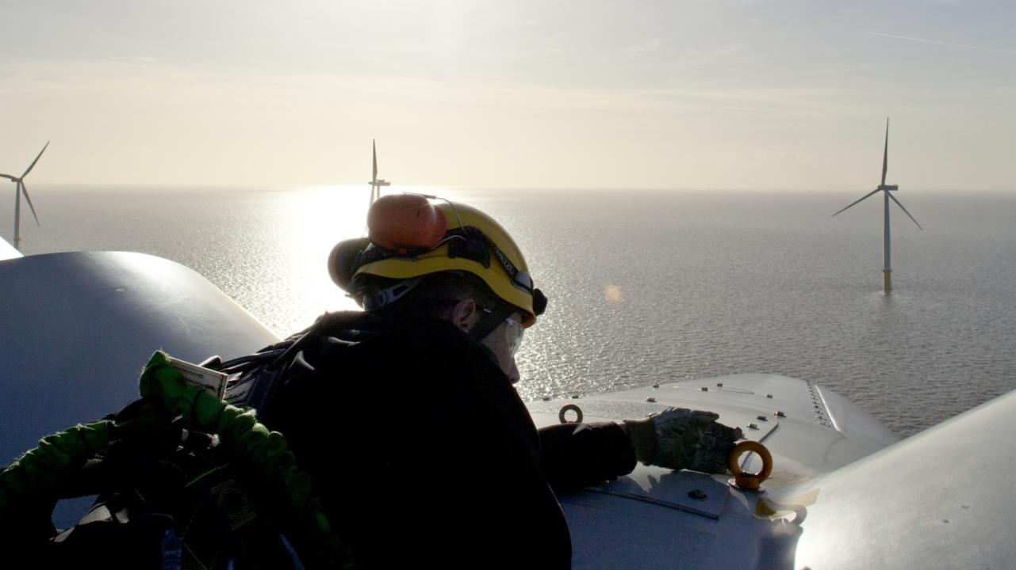
Notes:
I’m often asked what skills are needed at Siemens;
So I think it may be better to show you some of our roles - because Siemens is a business to business company you may not be aware of how we impact on your lives from traffic lights, to trains, to the energy you use to boil your kettle, the smart motorway monitoring to get here
Use the following slide images to tell a story of your journey to arrive at the venue – electricity, transport then link to jobs / health. All require engineers.

Slide 6
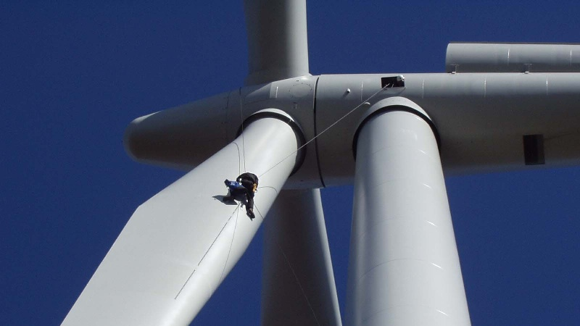
Notes:
Building Technologies (BT)
Energy Management (EM)
Digital Factory (DF)
Siemens Financial Services (SFS)
Siemens Healthineers
Mobility (MO)
Power Generation Services (PS)
Power & Gas (PG)
Energy Management (EM)
Process Industries and Drives (PD)
Siemens Gamesa Renewable Energy

Slide 7
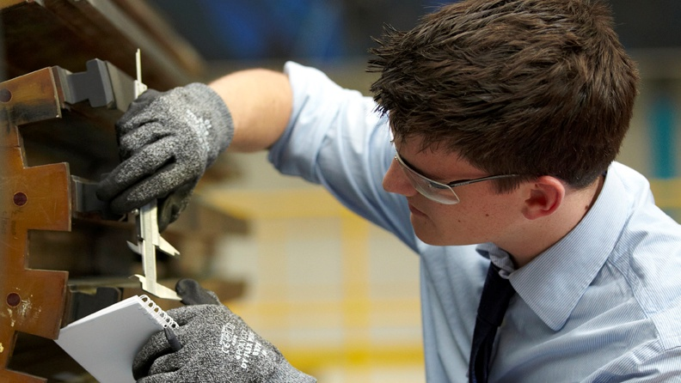

Slide 8
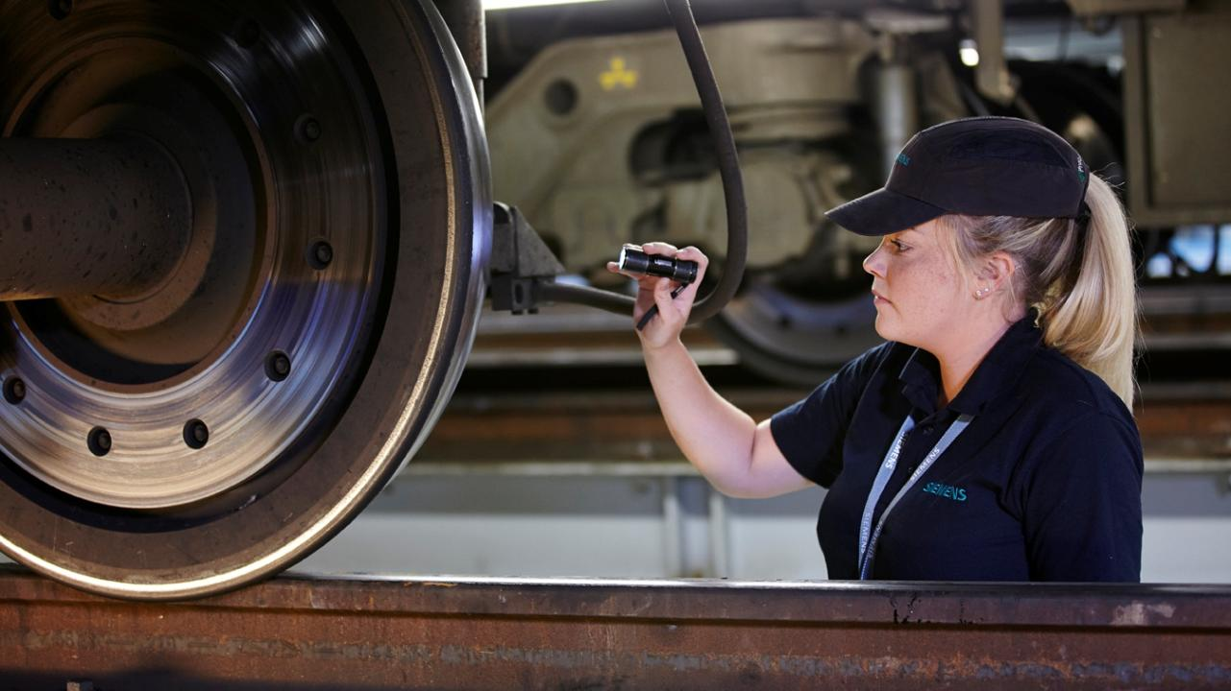

Slide 9
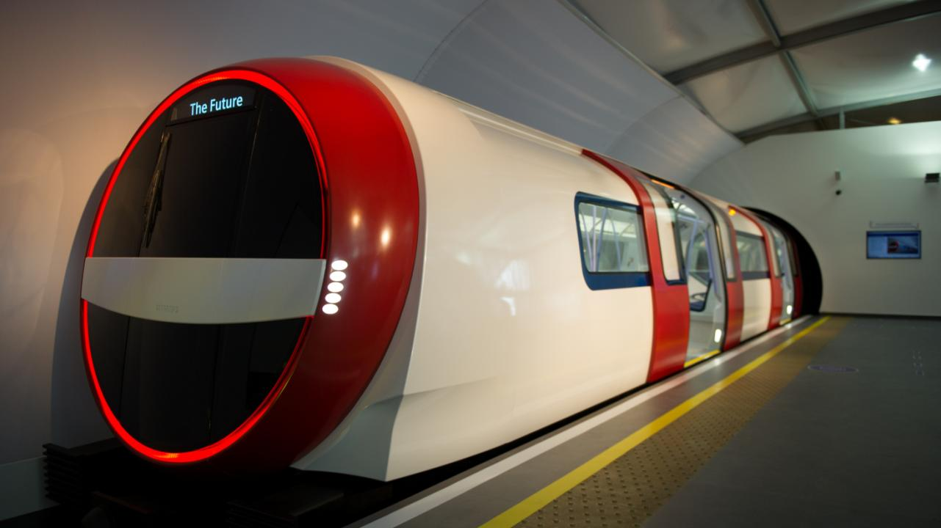

Slide 10
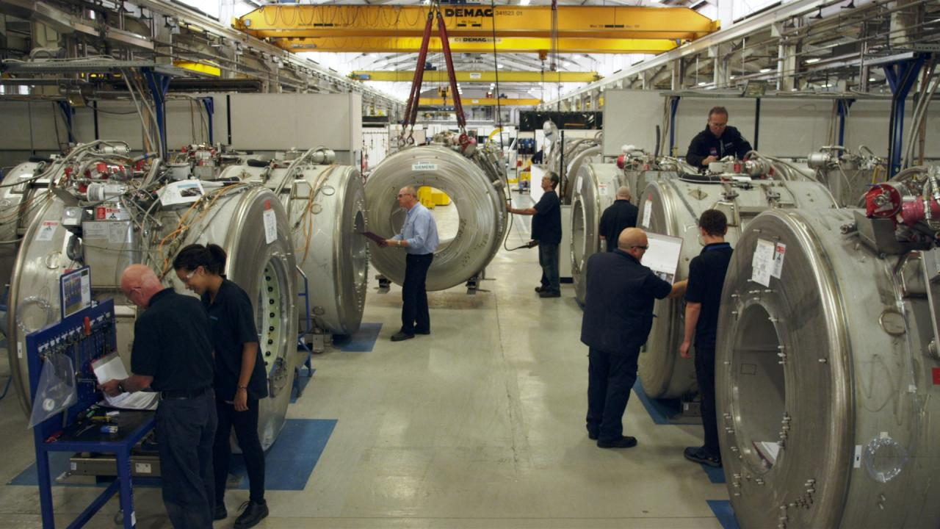

Slide 11
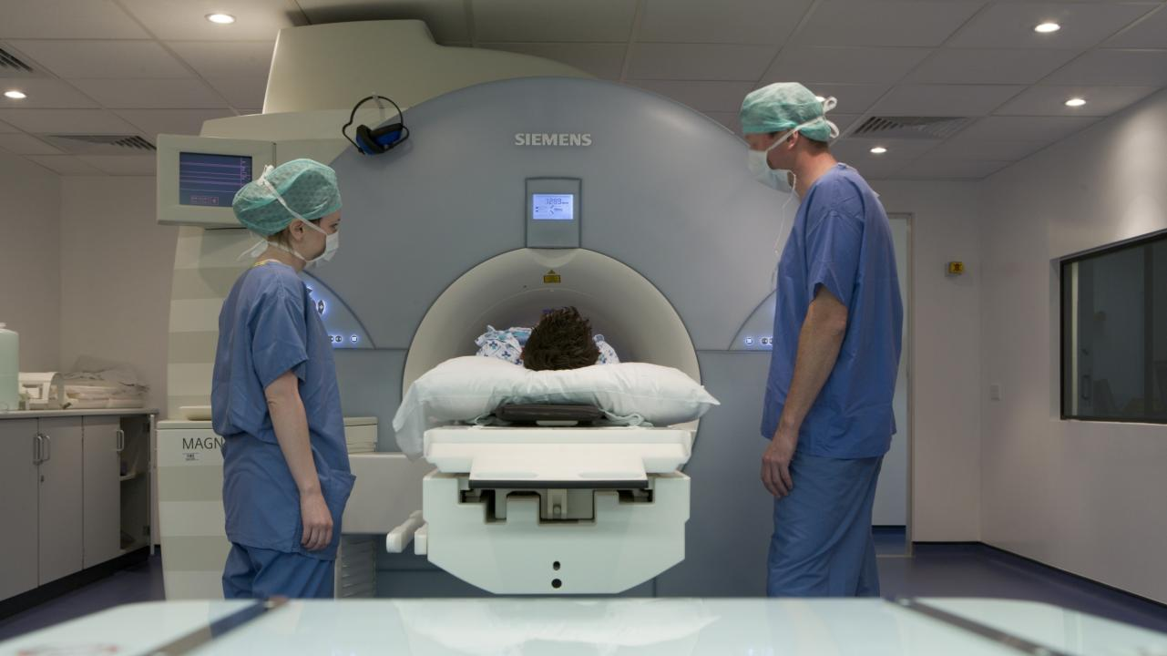

Slide 12
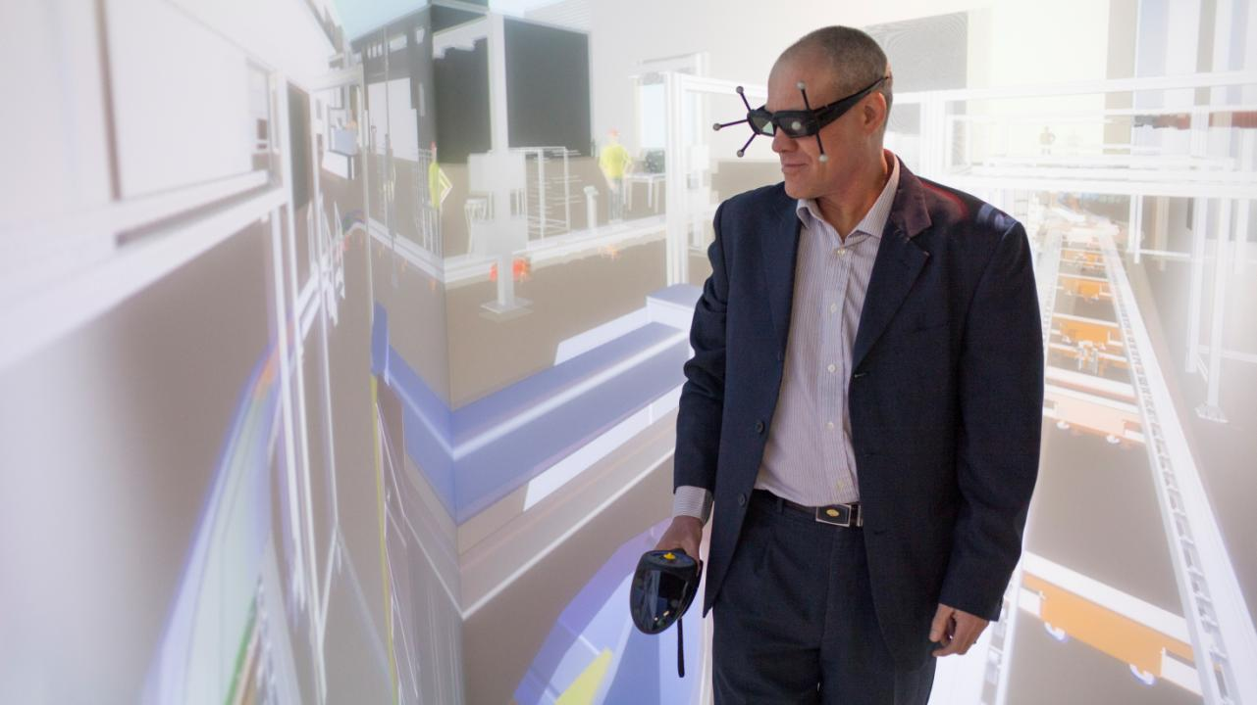

Slide 13


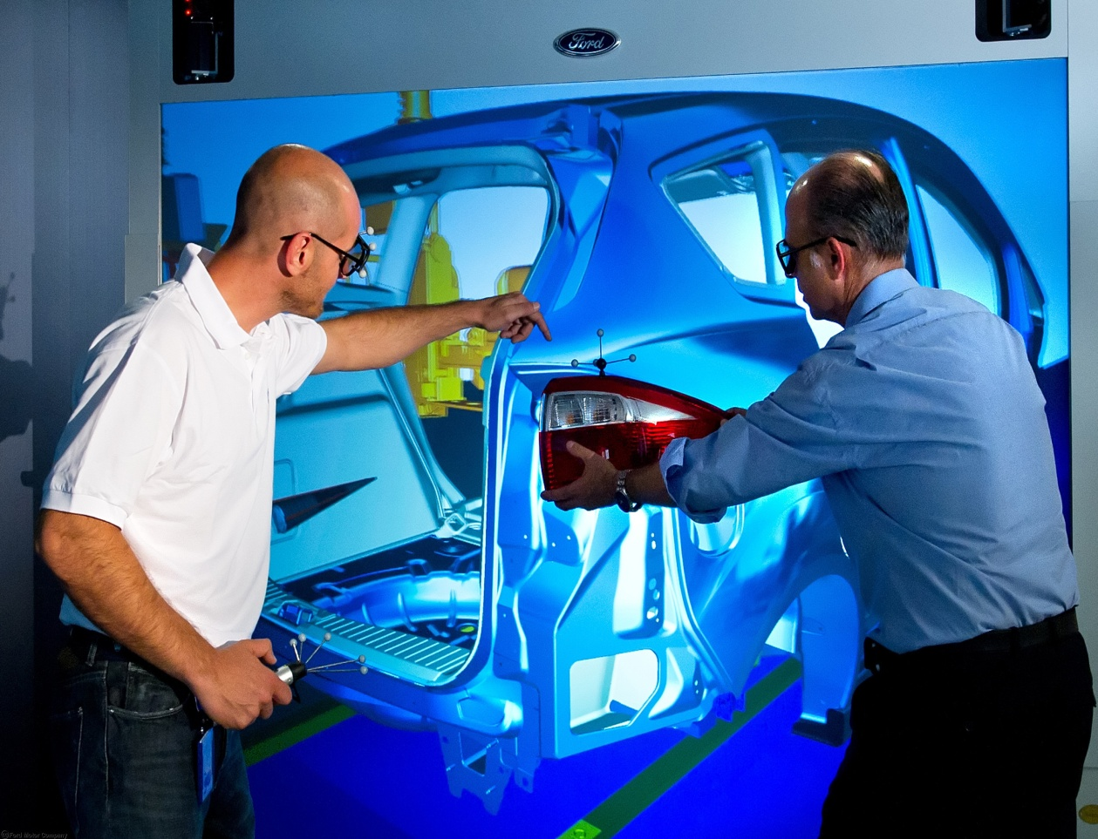
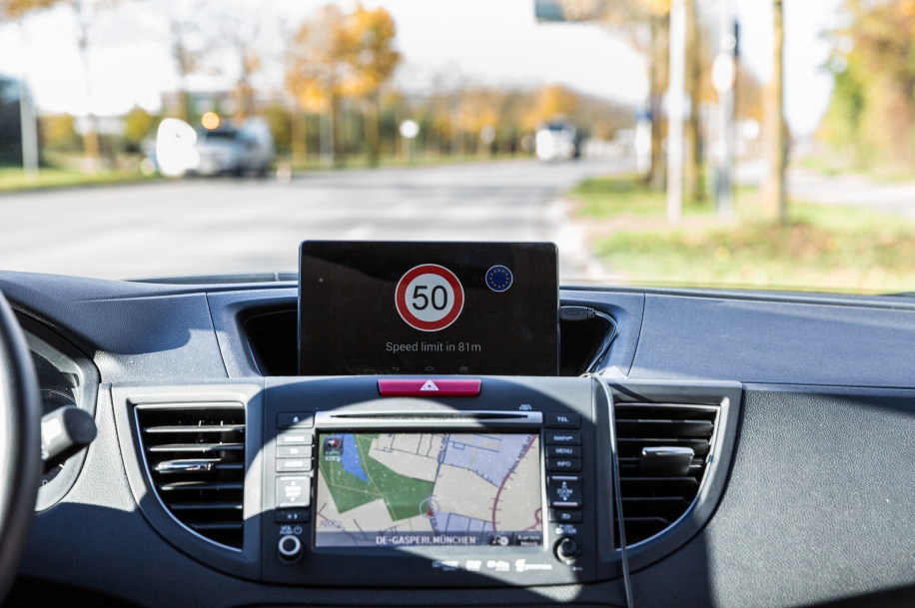
Two paradigm shifts which are reaching a tipping point for the world of work
From physical to virtual >>>>>>>>>>
Learning
Big Data
.>>>>>From managed to autonomous
Notes:
The working world is moving from physical to virtual
A mindsphere environment
Managed to autonomous
Artificial intelligence, augmented reality

Slide 14
What are the survival factors in a world like this ?
Networked
Complex
Volatile
Uncertain
Fast
?
Notes:
In terms of technology, society, demography globalisation,
a number of shifting trends have created new challenges and opportunities
Advanced Technologies: • the nature of work is more complex and technology-dependent, new technology platforms are facilitating greater collaboration and enabling new forms of virtual working. •
New Societal Values: • Autonomy and Choice is empowering
We have a changing Demographic: • increased longevity means companies need to accommodate an ageing workforce or face losing important knowledge and skills. •
Multiple Generations: up to five generations
Generation Y: new cohorts bring with them new values
Generation Y demanding more flexibility in their roles and a more social approach to work.
4.Rapid Globalisation: • Customer Expectations:
global market presents UK companies with new opportunities, but requires a 24/7 culture.
the needs of a low-carbon economy necessitating more agile ways of working.
In combination, these four forces are creating an urgent need for flexibility. And a more agile approach to work.

Slide 15

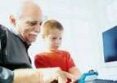








Siemens: Rounded, Grounded and Ready for Work?
Business and People Strategy is informed by megatrends
Megatrends
Electrification
Automation
Digitalization
Demographic change
Urbanization
…
Climate change
Technology
Road Maps
Globalization
Digitalisation
> 120%
45%
0%
-45%
> -90%
Siemens makes approx 20 inventions every working day.!!........................
C all rights reserved Siemens AG
Notes:
How can we ensure we have the right candidates for our roles and to fulfil the megatrends
Demographic change
Urbanization
Climate change
Globalization
Digitalisation – which is very important

Slide 16

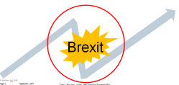
Strategy is no longer a static annual event
Geo shift to Asia
How to provide infrastructure and technology for mega cities and smart factories ?
Climate change
Digitalisation , AI, AR
Globalisation
Automation
Demographic change
E - Electrification
How can we improve the cost and quality of health care for an ageing growing population?
How to produce clean energy?
Urbanization
Notes:
Well Strategy is no longer a static event....
As a company we need to ask
how do we produce clean energy
How do we provide infrastructure and technology for mega cities and smart factories?
How do we prepare for our ageing populations healthcare needs

Slide 17
Strategy is no longer a static annual event – it must continue to evolve
Geo shift to Asia
How will the work place and the nature of work change ?
How to provide infrastructure and technology for mega cities and smart factories ?
Climate change
Digitalisation ,AI,AR
Globalisation
Automation
Demographic change
How can we harness technology to manage complexity?
E - Electrification
How can we close the skills gap ?
How can we improve the cost and quality of health care for an aging growing population?
How to produce clean energy?
Urbanization
20,000
Notes:
?
How can we close the skills gap of at least 20,000 per year
How will the workplace and nature of work change
How can we harness technology to manage complexity?
When we write software programmes how will we ensure they encompass all end use demographics

Slide 18
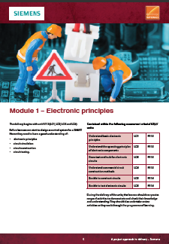
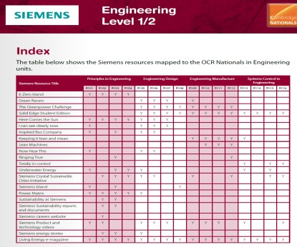


Our Partnership with OCR: Five SIEMENS inspired projects:
One for each of the Cambridge Nationals in Engineering L1/2
One Cambridge Technical L3
Utilising new and existing resources
Directly mapped to the curriculum
Industry-relevant to key sector requirements
Suit a broad range of learning styles and abilities
Contextualised
Authentic (created with Siemens staff)
Girls into STEM and Seewomen drive
Discrete single qualification delivery
Combined delivery
Holistic curriculum delivery
  Project approach
  Soft skills: Communication,
  Presentation & Team work
  Practical skills
  Mapping to other curriculum areas in Maths, Science, English & ICT
Notes:
True collaboration and team work to develop:
On the level 1 & 2 our apprentices worked on Cambridge Nationals and Level 3 our graduates.
OCR and Siemens have built specifications and resources using a clear and easy-to-understand format, making them straightforward to deliver.
Cambridge Nationals provide an ideal foundation for students to progress to more advanced studies and engineering-related careers.
You can enjoy teaching engineering through projects that have been authentically developed to help you inspire students of all abilities.
These resources provide learning for assessment and are clearly presented and sensibly structured for you and your students

Slide 19

SIEMENS and the project approach
A PROJECT APPROACH TO DELIVERY –
WIND TURBINE CONTROL – Technical Level 3
Powering the future Linked to
Principles in Engineering and Engineering Business
  Energy Transformation Linked to
  Engineering Manufacture
  Energy Recovery Linked to
  Engineering Design
  SMART Homes Linked to
  Systems Control in Engineering
Notes:
We worked collaboratively with OCR on each of the projects offered:, to give students the chance of quality academic study combined with real world activity, a grounding which equips students earlier with skills, experience, and enthusiasm to join a workforce and make a real contribution.
The Siemens project materials are adapted from a range of over 35 unique and engaging curriculum linked schemes of work, lesson plans, worksheets and practical activities on our web site developed by educationalists and based on ground-breaking projects and technologies Siemens is engaged with in the UK and around the world.
This partnership with OCR we believe will help to support the needs of students and the education sector to provide a talent pool of highly-skilled young people

Slide 20
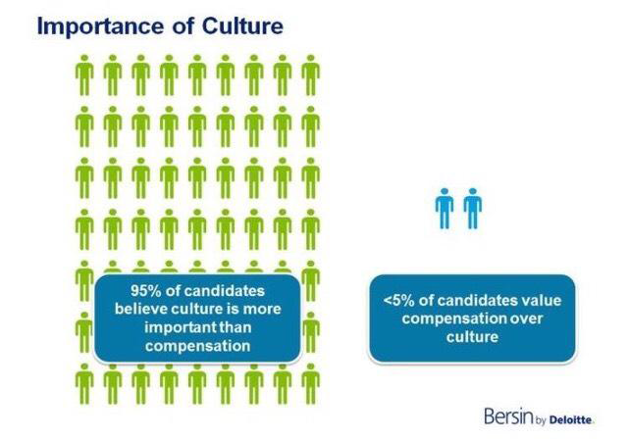
Emerging skills requirements for Entry Level Talent....
Beyond the traditional ‘engineering’ and ‘business’ skills....
Digitalisation – Engineering meets IT.
Innovation and Creativity – Inclusive culture and diversity of thinking.
The rise of the analytic – more systems generated data and management Information.
Problem solver
Inquisitive mindset
Characteristics
Collaborator
Ability to learn and adapt
….but it’s not just JOB Fit that is important – SIEMENS Fit is crucial.
Notes:
Well We need to look further than the traditional engineering and business skills
We need Problem solver, inquisitive minds, collaborators with the ability to learn & adapt
We are becoming more Digitalised where engineering meets IT
The rise of the analytics and big data

Slide 21

Engineering:
Electrical
Electronic
Mechanical
Field Service
Materials
Manufacturing
Production
Software
Systems Application
Business:
Business
Finance
Supply Chain & Procurement
Product Management
Siemens Global Graduate Programme (SGP)
Mechanical Engineering
Project
Management
Entry Level Talent Landscape
E3 Academy
Electrical/
Electronic Engineering
Finance
Railway Signalling Design
Power Academy
Working for Us
Engineering Maintenance
Technical Sales
Cambridge Bursary
IT
Electrical Power Engineering
Lincoln Bursary
Advanced manufacturing Engineering
Primary
Key Stage 3
Level 2 (GCSE/BTEC)
Level 3 (A Levels/Higher Diploma)
Degree
Post Graduate Qualification
Servicing Medical Equipment
Work Experience
Apprenticeships
Higher Apprenticeships
Degree Sponsorships
Post Graduate Opportunities
Internships
Graduate Opportunities
UK Education Pipeline
Education Portal (Core Curiosity Project)
Schemes of Work
Interactive Learning Tools and Games
Free Software for Schools UTC Support
Employee Working with Schools (Stem Ambassadors/ad hoc)
Sir William Siemens Certificate
Principal & Partner University Engagement
Employer Presentations & Career Fairs
SEMTA Skills Awards
Curriculum Engagement – E.g. Engineering You’re Hired
Events & Initiatives
GiSTEM Seewomen
National Student Challenge
Awarding bodies:Cambridge Nationals and Technicals,
Employability Skills Sessions
Curiosity Project Partners-eg. Big Bang , Primary Engineer, Arkwright Trust, Greenpower, PTI,Teach First , Rock Assembly, Digikids, Royal AcademyEtc
Sir William Siemens Medal
Internship Campaign
Notes:
How do we support on the education side with our ELT landscape:
As you can see we are not only looking for T skills but meta and soft skills
We see the cambridge national and technicals as part of our landscape
over 300 STEM ambassadors

Slide 22
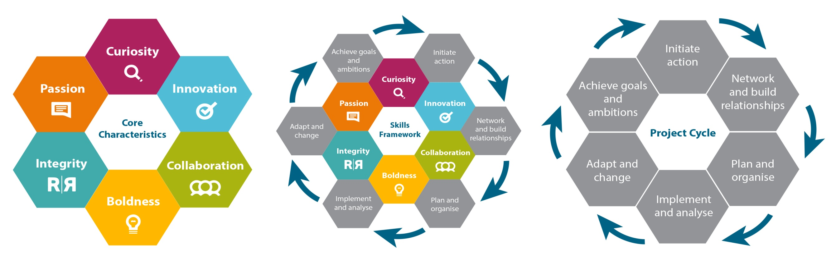
Link to our ‘Digital’ credentials
Content developed to link to Siemens Digital Badge Scheme and to evidence learning .
Digital badges are agile, responsive and a track-able means of showcasing soft or hard skills developed.
Siemens digital badges were developed based on a unique skills framework linked to core behavioural
characteristics and project cycle processes http://www.siemens.co.uk/education/en/digitalbadges.htm
Notes:
Content developed to link to Siemens Digital Badge Scheme and to evidence learning .
Digital badges are agile, responsive and a track-able means of showcasing soft or hard skills developed.
Siemens digital badges were developed based on a unique skills framework linked to core behavioural
characteristics and project cycle processes http://www.siemens.co.uk/education/en/digitalbadges.htm

Slide 23




Responding to the demands of business in many ways
Global transparency of talent
Global transparency of opportunities
Vertical boundary-less working
SUPPLY
DEMAND
Unemployment
Digital and Engineering
Skills
Women in Engineering & Technology
What has to change
Agile Ways of Working
Flexibility
Diversity
Digitalisation
Multigenerational
Digital Skills
Cross Disciplinary Experience
Project-based Flexible Workforce
Brexit Block
SPEED
INNOVATION
TECHNOLOGY
VOLATILITY
Notes:
.
So to sum up together education and business:
We need to Create Agility: flexible employees are measurably more productive than traditional ones - more profitable
We need to embrace new technologies to collaborate and communicate- an agile Infrastructure
Flexibility: we need high performing workers who can work in Virtual Teams independent of physical location
This encourages more Diversity,
Digitalisation. Meets global Customer Needs 24/7 allows continuous operation across locations and time zones, in turn means we can work when or where we need – but this means more global competition for jobs
Reduced Business Travel: virtual work reduces a costly dependence on face-to-face meetings and encourages a more environmentally conscious culture (more family time).
Creating Choice: staff are able to shape their working styles to fit their circumstances and exhibit greater levels of engagement and loyalty as a result.
.Generational Working Styles: a diverse offer allows different cohorts to express their own styles and reduces the potential for intergenerational conflict as a result

Slide 24
siemens.co.uk/education
Brenda.Yearsley@siemens.com
Notes:
Reward your students after they have attended a See Women session with a ‘See Women digital badge’. First, you need to register as a teacher to www.makewav.es/siemens or if your students are aged 13+ they can register themselves at www.openbadgeacademy.com/siemens. Once your students have created a profile, they need to enter the claim code (SEEWOMEN17) in their profile page to earn a See Women digital badge. For further instructions please refer to the digital badges starter pack.

