Slide 1
Path to success with Cambridge Technicals
Colin Smith, Curriculum Director Computing, UTC Sheffield

Slide 2
Background
UTC Sheffield Opened in September 2013, specialising in Creative Digital Media and Engineering
UTC Sheffield Olympic Legacy Park opened in September 2016, specialising in Computing and Health Sciences
Both schools run Cambridge Technicals in Post-16 studies.
Results for both sites are strong in technical areas
Progression to University, Employment and apprenticeships is higher than national figures
Both UTCs accept applications from year 10 and year 12 students (starting year 9 in September 2018)

Slide 3
Overview
Success with Cambridge Technicals
Working with Employers
Curriculum Design
Curriculum Delivery
Extra curricular Projects
Curricular Projects
Holistic
Extra-curricular
Projects across Units
Industry influenced

Slide 4
Structure and Curriculum delivery
Much like other schools, students can choose their studies when they join.
Because of the flexibility in the Cambridge technical qualifications, it can sit amongst other post 16 options like A Levels.
Lewis M:
Cambridge Technical Diploma in IT
A Level Mathematics
A Level Computer Science
David D:
Cambridge Technical Foundation Diploma in Engineering
Extended Project Qualfication
A Level Mathematics

Slide 5
Structure and Curriculum delivery
We use industry standards to enrich our curriculum, not just by the theory but the practice
Our curriculum is holistic rather than specification driven
Students complete projects rather than assignments
Additional study time (project time) is allocated within timetables to allow students time to complete project work using specialist equipment

Slide 6
Assessment by Project
Projects are effectively assignments
Work with a bank of ‘employers’ and local/national businesses that students will deliver aspects of the project to.
In it’s simplest form, taking the model assignment and dropping in a task from an employer partner (i.e modelling an F1 car canopy for Mercedes)
In a more complex form, curriculum is flexible to suit when employers would like project completed (i.e. Army Cadets and a VR/AR project using google cardboard).

Slide 7
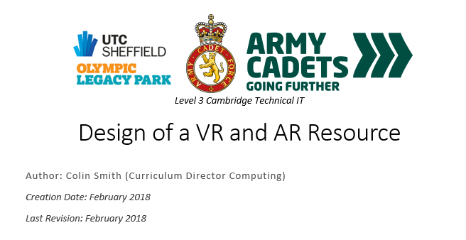
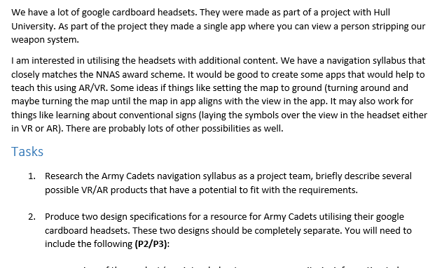
Assessment by Project (2)
Students complete set pieces of work
Tasks are a mixture of group/team and individual
Some tasks contribute to their qualification
Some project span multiple projects (in the case of IT Unit 8 and 9 sit well together)

Slide 8
Delivery – Modelling industry
All our students work in teams performing different roles
Students are also expected to deliver presentations to our employer partners, undertake work experience in a relevant work setting and take part in our employer mentor program to learn more about the industry.
Deadlines for projects are so they can be delivered to our partners, not so they can be delivered to us for marking!

Slide 9
Employer Engagement
Employers work with us for several reasons:
Positive PR
Corporate Social Responsibility
Recruitment stream
Individual Interests
Industry learning
And some sheer bloody mindedness.

Slide 10
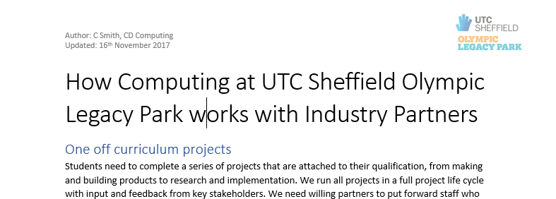
Employer Engagement
Getting the right person in the organisation is key.
Think about the HR/PR manager
the CEO who drinks in your local pub
The student’s uncle who runs a local business
Consider preparing something to hand to employers, the sections I have included are:
One off curriculum projects
One off visits
Projects off-curriculum
Work experience/placement
Employer Mentoring

Slide 11
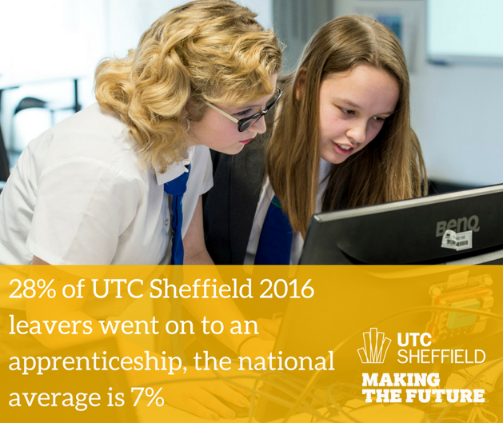
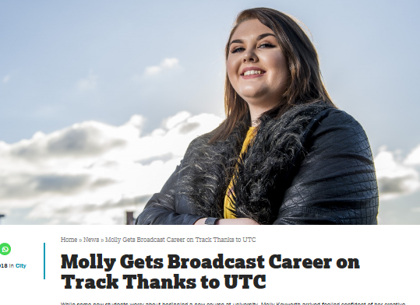
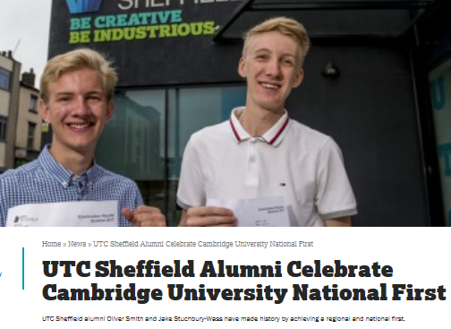
Progression
University still the highest progression route and a viable option for Cambridge Technical students
Employment, sometimes by our employer partners
Higher Apprenticeships

Slide 12
Summary
Success with Cambridge Technicals
Working with Employers
Curriculum Design
Curriculum Delivery
Extra curricular Projects
Curricular Projects
Holistic
Extra-curricular
Projects across Units
Industry influenced
At UTC Sheffield, progression is our primary goal
If you a curriculum that allows students to practice skills and knowledge from an industry they are interested in, and buy in from external employers and businesses, students will be motivated to achieve.
Success is dependent on many variables, however with the right model, students will achieve, progress with the skills and knowledge you have given them.

