Slide 1
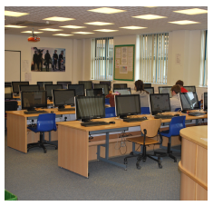
Vocational Education at Minsthorpe Community College

Slide 2
Context
11 – 18 Academy with 1500 OR in South East Wakefield
Ex-mining community
33% Pupil Premium / 24% identified SEND
Above average P8 at +0.09 (validated score for 2017)

Slide 3
Context
P16 is small/medium sized provision with 200 students combined
Upward trend of improving results academically
History of excellent vocational outcomes
A Level L3VA -0.19 average grade C- (2017)
Vocational L3VA +0.20 average grade D* (2017)
Over 50% of the cohort follow a vocational route

Slide 4
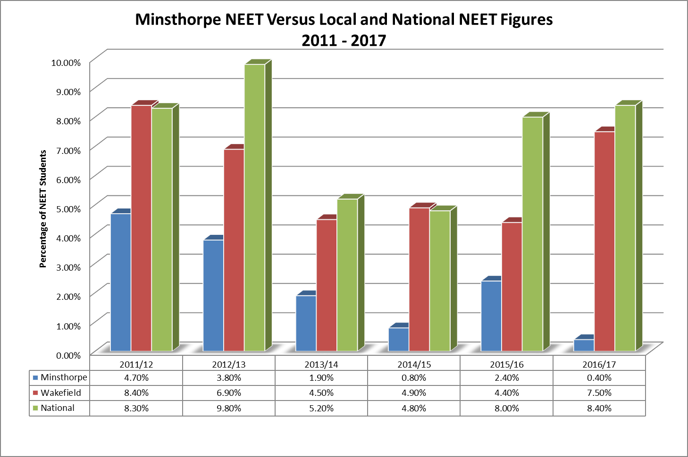

Slide 5
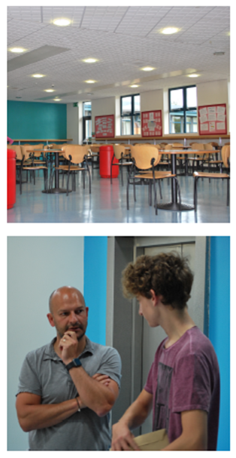
P16 Offer
Linear A Levels
Maths
English Language
English Literature
English Lit & Lang
Art
Photography
PE
History
Geography
Physics
Chemistry
Biology
Product Design
French
Psychology
Sociology
Vocational (Level 3)
BTEC Health & Social Care
BTEC Children’s Play, Learning & Development
Cambridge Technicals Sport (2 A Level & 1 A Level equivalent courses)
BTEC Business
BTEC Music
BTEC Applied Science
Cambridge Technicals in IT
Cambridge Technicals Digital Media
BTEC Performing Arts
Occupational
BTEC Children’s Play, Learning and Development (Extended Diploma – equiv. to 3 A Levels)
Cambridge Technicals Sport (Extended Diploma – not suitable for uni applicants)
BTEC Sport Level 2
BTEC Health and Social Care Level 2
BTEC Children’s Play, Learning and Development Level 2
Cambridge Technicals Creative iMedia Level 2
BTEC Pre-Apprenticeship Work Skills Diploma Level 2
BTEC Extended Certificate in Work Skills Level 1 (includes BTEC Level 2 Award in Fire & Rescue Services in the Community)
City & Guilds Beauty Therapy Level 2
Notes:
.

Slide 6
Need for Change
Changes in funding for P16
Competing with larger P16 providers in the area
Need to adapt to meet the needs of students with different levels of learning available (Level 1 – Level 3)
Linear A Levels – new specifications
Introduction of higher level of rigour following from Wolf Report (2011) – new specifications
Traditionally delivered BTEC ( however only draft specification was available Summer 2016)

Slide 7
Alternatives to BTEC?
Issues / Problems with BTEC
  Staff workload
  Limited assessment support
  Limited delivery support
  Staff felt under scrutiny rather than supported
  Postal Standards Verification
  Lack of communication with Standards Verifier
  Draft specifications

Slide 8
Cambridge Technicals
Met with some other colleagues from local schools and colleges and a Regional Account Manager
Explored the resources online (particularly the SAMS and assignments)
Looked carefully at the requirements for staff
IMPRESSED

Slide 9
Preparation for Teaching
Excellent resources on website
Easy to create a delivery plan and staffing for the two year courses
Looked at ways to maximise meaningful employer engagement – makes the course relevant for the learners
Clear and flexible procedures for staff – regular standards meetings

Slide 10
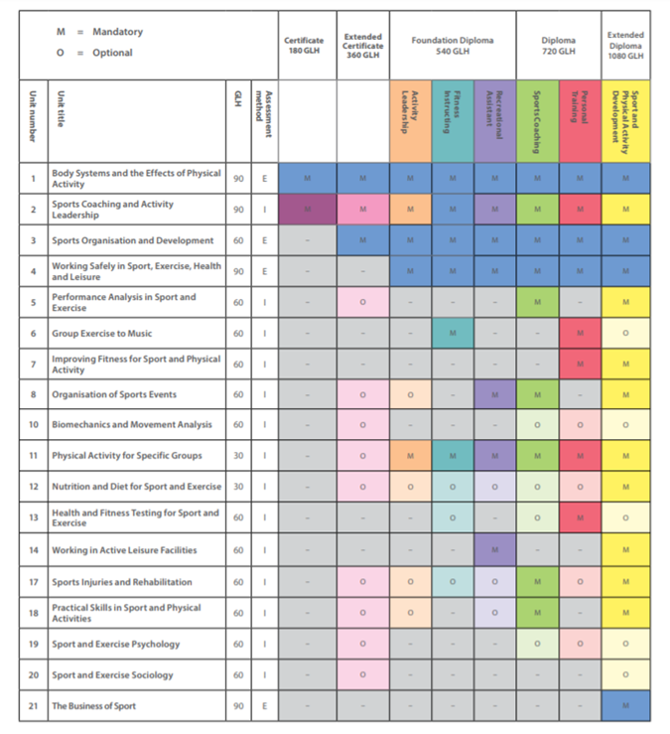
Structure and Timetable
Flexible
Tailor to staff strengths
External assessment (Jan/May)
Link units to College calendar
Run 2 course options in the same year:
Extended Certificate (1 A Level equivalent)
Diploma – Sports Coaching (2 A Level equivalent)

Slide 11
Moderation Process
Hold a series of standards meetings throughout the year and minute the discussions and outcomes.
Work together as a team to look at assessment decisions based on the specification and assignment.
Staff to follow up any actions from meeting.

Slide 12
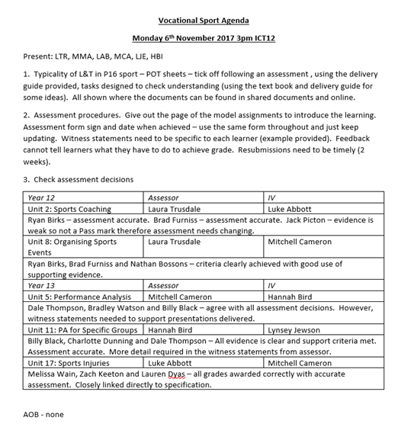

Slide 13
Moderation Process
Visiting moderator – great communication from the start of the course.
Emphasis on the standard of student evidence and the marks awarded
Supportive system – discussions with staff assessors to check understanding of specification, recommendations given to improve

Slide 14
 | Year 12 - 2018/19
 | A | B | C | D
Single Qualifications | Maths | Physics | Chemistry | Biology
 | English Language | Geography | English Literature | French
 | Art | Psychology | Performing Arts | English Lan/Lit
 | Physical Education | Product Design | Sociology | Photography
 | History | Cambridge Technicals Digital Media | Cambridge Technicals IT | BTEC Child Play, Learn & Dev
 | Cambridge Technicals Sport (Double A&C) | BTEC Music | Cambridge Technicals Sport (Single) | BTEC Business
 | BTEC Health & Social Care | BTEC Applied Science
Occupational | BTEC Children's Play, Learning & Development Level 3
 | BTEC Children's Play, Learning & Development Level 2
 | C&G Beauty Level 2
 | BTEC Sport Level 2
 | BTEC Health & Social Care Level 2
 | BTEC Business Level 2
 | Cambridge Technicals Creative I-Media Level 2
 | BTEC Work Skills Level 2
 | BTEC Key Skills Level 1

