Slide 1
H410/01
Film History
Annotated sample assessment materials
Version 3 (September 2021)

Slide 2
Guidance
This guide is designed to take you though the A Level Film Studies H410/01 exam paper. Its aim is to explain how candidates should approach each paper and how marks are awarded to the different questions.
The orange text boxes offer further explanation on the questions on the exam
paper. They offer guidance on the wording of questions and what candidates
should do in response to them.
The green text boxes focus on the awarding of marks for each question. They give
further information on the percentage of each assessment objective attributed
to each question. The percentage given is over the whole qualification.
This will always be a comparison of two primary sources requiring evaluation of the sources in their historical context.
AO3 (5%)

Slide 3
Assessment Objectives
AO1 – knowledge and understanding of elements of film.
AO2 – apply knowledge and understanding of elements of film to:
1a analyse films
1b compare films
1c use critical approaches
2 evaluate critical approaches.

Slide 4
Section A: Film Form in US Cinema from the Silent Era to 1990
You should have studied one US film from each of the lists below. Question 1-4 require you to write about the US films you have studied.
Silent Era | 1930–1960 | 1961–1990
Wings (1927). Directed by William A. Wellman. USA, PG* | Citizen Kane (1941). Directed by Orson Welles. USA | 2001: A Space Odyssey (1968). Directed by Stanley Kubrick. USA
The Gold Rush (1925). Directed by Charles Chaplin. USA | Singin’ in the Rain (1952). Directed by Gene Kelly/Stanley Donen. USA | Raging Bull (1980). Directed by Martin Scorsese. USA
The Mark of Zorro (1920). Directed by Fred Niblo and Theodore Reed. USA | Stagecoach (1939). Directed by John Ford. USA | E.T. (1982). Directed by Steven Spielberg. USA
The General (1926). Directed by Clyde Bruckman/Buster Keaton. USA | Vertigo (1958). Directed by Alfred Hitchcock. USA | Do the Right Thing (1989). Directed by Spike Lee. USA
Sunrise (1927). Directed by FW Murnau. USA | Double Indemnity (1944). Directed by Billy Wilder. USA | The Conversation (1974). Directed by Frances Ford Coppola. USA
The Wind (1928). Directed by Victor Sjostrom. USA | All that Heaven Allows (1955). Directed by Douglas Sirk. USA | West Side Story (1961). Directed by Jerome Robbins–Robert Wise. USA
*Birth of a Nation* (1915). Directed by DW Griffith. USA was replaced by Wings for first teach in September 2021. The last assessment for Birth of a Nation is June 2022.

Slide 5
Section A: Film Form in US Cinema from the Silent Era to 1990
There will always be two 10 ten mark questions in this section of the exam.
Answer Questions 1 and 2.
1 With reference to a sequence from the film made between 1930-1960 which you have studied, explain how diegetic and non-diegetic sound have been used to create meaning in the sequence. [10]
2 With reference to a sequence from the silent film you have studied, analyse how cinematography has been used to create aesthetic effects. [10]
Both questions target a specific micro-element of film form.
AO1 (3.3%) knowledge and understanding
AO2.1a (3.3%) analyse
Students should spend around 10 minutes on each 10 mark question.
Questions in this section will focus on micro-elements, aesthetics, spectatorship, and film poetics.

Slide 6
Section A: Film Form in US Cinema from the Silent Era to 1990
Students should spend roughly 40 minutes on this question.
There will always be a choice of two 35 mark questions.
Answer either Question 3 or Question 4.
3* ‘Film is just about spectacle; narrative resolution does not matter.’ Compare how this quotation applies to two films you have studied. You must refer to examples from one film from 1930-1960 and examples from one film from 1961-1990 in your answer. [35]
OR
4* With reference to examples from one film from the silent era and examples from one film from 1961-1990, compare how the use of sound and editing creates aesthetic effects for the spectator. [35]
* indicates an extended response.
This question will always involve the comparison of films from two of the three specified time periods.
AO1 (5%) knowledge and understanding
AO2.1b (3.3%) compare
AO2.1a (3.3%) analyse
Questions in this section will focus on micro-elements, aesthetics, spectatorship, and film poetics.

Slide 7
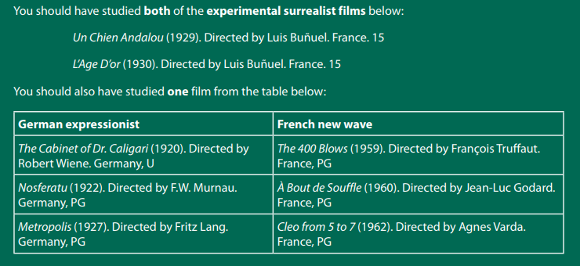
Section B – European Cinema History

Slide 8
Section B – European Cinema History
This question focuses on the use of micro-elements of film form.
There will always be a 15 mark question in this section. This question may assess either the experimental films or the other European film movements.
Answer Question 5
5 With reference to examples from both experimental surrealist films you have studied, explain how cinematography and editing have been used to challenge conventional narratives. [15]
AO1 (1.6%) knowledge and understanding
Questions in this section will focus on micro-elements and their relationship to meanings and aesthetics, European film movements and their stylistic developments and aesthetics, context, the experimental nature of film, film narrative, naturalism, realism and the expressive.
AO2.1a (3.3%) analyse
As a rough guide students should spend around 15 minutes on this question.

Slide 9
Section B – European Cinema History
Students should spend around 40 minutes on this question.
There will always be a choice of two 35 mark questions in this section. This question may assess either the experimental films or the other European film movements.
Answer either Question 6 or Question 7
EITHER
6* Analyse how the German expressionist or French new wave film you have studied approaches the concept of narrative. [35]
OR
7* ‘Realism in film is much more powerful for the spectator than the expressive’. Analyse how this quote applies to the German expressionist or French new wave film you have studied. [35]
* indicates an extended response.
AO1 (5%) knowledge and understanding
AO2.1a (3.3%) analyse
AO2.1c (3.3%) critical approaches

