Slide 1
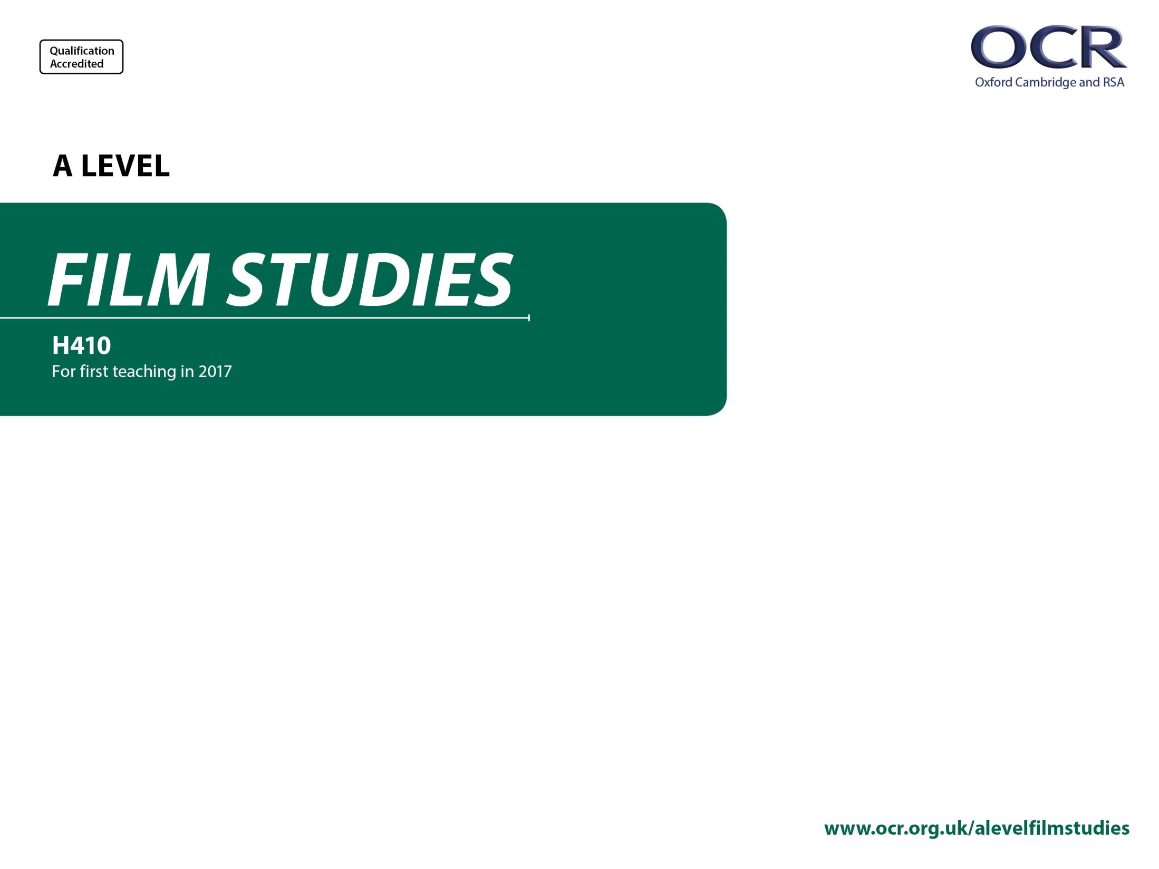
H410/02
Critical Approaches to Film
Annotated sample assessment materials

Slide 2
Guidance
This guide is designed to take you though the A Level Film Studies H410/02 exam paper. Its aim is to explain how candidates should approach each paper and how marks are awarded to the different questions.
The orange text boxes offer further explanation on the questions on the exam
paper. They offer guidance on the wording of questions and what candidates
should do in response to them.
The green text boxes focus on the awarding of marks for each question. They give
further information on the percentage of each assessment objective attributed
to each question. The percentage given is over the whole qualification.
This will always be a comparison of two primary sources requiring evaluation of the sources in their historical context.
AO3 (5%)

Slide 3
Assessment Objectives
AO1 – knowledge and understanding of elements of film.
AO2 – apply knowledge and understanding to:
  1a analyse films
  1b compare films
  1c use critical approaches
  2 evaluate critical approaches.

Slide 4
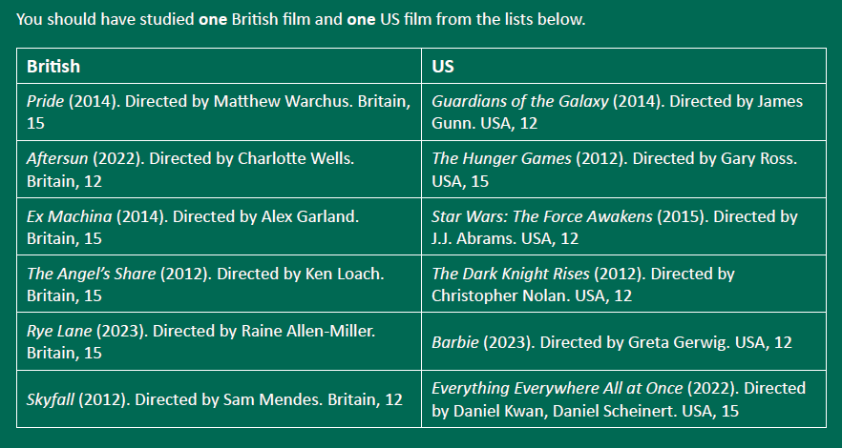
Section A: Contemporary British and US Film

Slide 5
Section A: Contemporary British and US Film
Questions in this section will focus on representations, contexts, viewing conditions for spectators.
There will always be a choice of two 35 mark questions in this section.
Answer either Question 1 or Question 2
EITHER
1* ‘There is no better way to watch a film than on the big screen in a cinema.’ Discuss how valid this view is in relation to examples from one British film and one US film you have studied. [35]
OR
2* ‘In the context of the film production process, it does not make sense to talk about the director as the film’s auteur.’ Discuss how valid this view is in relation to examples from one British film and one US film you have studied. [35]
AO1 (5%) knowledge and understanding
AO2.1a (1.6%) analyse
AO2.1c (1.6%) use critical approaches
AO2.2 (3.3%) evaluate critical approaches
Questions in this section will relate to critical debates on digital in film and auteurism.
* indicates an extended response question.
Students should spend around 40 minutes on this question.

Slide 6
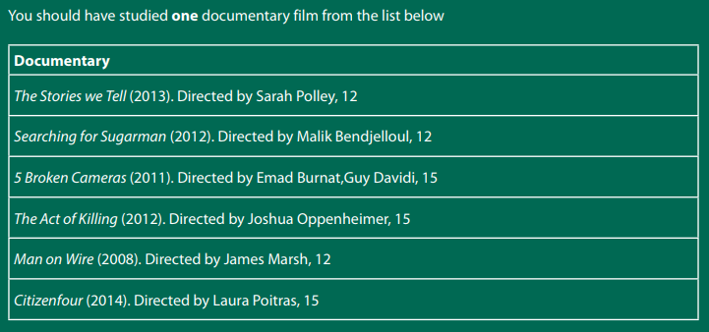
Section B: Documentary

Slide 7
Section B: Documentary
Students should spend around 40 minutes on this question.
There will always be a choice of two 35 mark questions in this section.
Questions in this section will focus on representations, contexts, spectatorship.
Answer either Question 3 or Question 4
EITHER
3* ‘Documentaries are unreliable narrators of past events’. Discuss this in relation to examples from the documentary film you have studied. [35]
OR
4* ‘The power of a documentary film relies on techniques that make it feel as real and as truthful as possible.’ Discuss this in relation to examples from the documentary film you have studied. [35]
Questions in this section will focus on critical debates in relation to realism, film narrative, filmmakers’ theories of film.
AO1 (5%) knowledge and understanding
AO2.1a (3.3%) analyse
AO2.1c (3.3%) critical approaches
* indicates an extended response question.

Slide 8
Section C: Ideology
Students answer one question in this section from a choice of two in relation to their chosen theme.
Answer one question from Questions 5 – 10
You should have studied films from one of the following themes:
Family and Home
Outsiders
Conflict
If you have studied films from the theme Family and Home, answer either Question 5 or Question 6.
If you have studied films from the theme Outsiders, answer either Question 7 or Question 8.
If you have studied films from the theme Conflict, answer either Question 9 or Question 10.

Slide 9
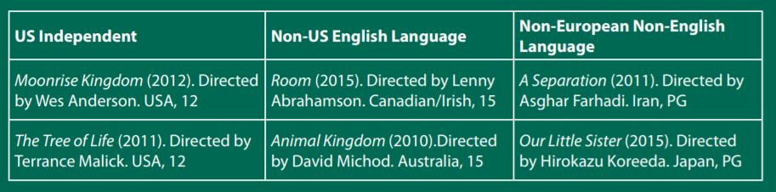
Section C: Ideology
Theme: Family and Home
You should have studied three films from your chosen theme. One film should be from the US Independent list, one film should be from the Non-US English Language list and one film should be from the Non-European Non-English Language list below.

Slide 10
Section C: Ideology
Students should spend around 40 minutes on this question.
* indicates an extended response question.
This question is synoptic
Questions will focus on learning from the whole course in order to evaluate the validity of ideology as a critical approach in film.
Theme: Family and Home
EITHER
5* ‘The idea of family and home is always presented as a safe place.’ Discuss how far this is true in the films you have studied. You must draw comparisons between the three films you have studied in your answer. [35]
OR
6* Discuss how the films you have studied use micro-elements of film to position the spectator and shape their responses to the idea of ‘family and home’. You must draw comparison between the three films you have studied in your answer. [35]
AO1 5% knowledge and understanding
AO2.1a 1.6% analyse
AO2.1b 1.6% compare
AO2.1c 1.6% use critical approaches
AO2.2 1.6% evaluate critical approaches
There will always be a choice of two 35 mark questions in this section in relation to the student’s chosen theme.

Slide 11
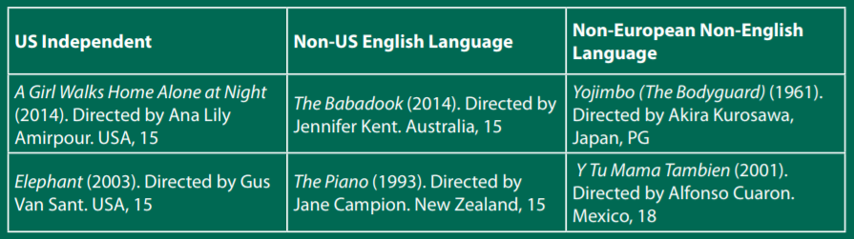
Section C: Ideology
Theme: Outsiders
You should have studied three films from your chosen theme. One film should be from the US Independent list, one film should be from the Non-US English Language list and one film should be from the Non-European Non-English Language list below.

Slide 12
Section C: Ideology
Students should spend around 40 minutes on this question.
* indicates an extended response question.
This question is synoptic
Questions will focus on learning from the whole course in order to evaluate the validity of ideology as a critical approach in film.
Theme: Outsiders
EITHER
7* Discuss how far the spectator is encouraged by the filmmaker to identify with the outsider(s) in the films you have studied. You must draw comparisons between the three films you have studied in your answer. [35]
OR
8* ‘Outsiders exist everywhere, regardless of social and political context, but their meaning and significance varies.’ Discuss this in relation to the films you have studied. You must draw comparisons between the three films you have studied in your answer. [35]
AO1 5% knowledge and understanding
AO2.1a 1.6% analyse
AO2.1b 1.6% compare
AO2.1c 1.6% use critical approaches
AO2.2 1.6% evaluate critical approaches
There will always be a choice of two 35 mark questions in this section in relation to the student’s chosen theme.

Slide 13
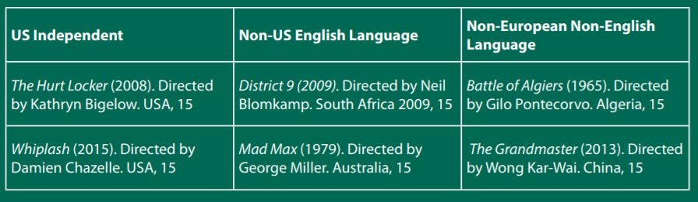
Section C: Ideology
Theme: Conflict
You should have studied three films from your chosen theme. One film should be from the US Independent list, one film should be from the Non-US English Language list and one film should be from the Non-European Non-English Language list below.

Slide 14
Section C: Ideology
Students should spend around 40 minutes on this question.
* indicates an extended response question.
This question is synoptic
Questions will focus on learning from the whole course in order to evaluate the validity of ideology as a critical approach in film.
Theme: Conflict
EITHER
9* ‘Fictional narratives in film can provide us with an understanding of the nature of real-life conflict.’ Discuss this in relation to the films you have studied. You must draw comparisons between the three films you have studied in your answer. [35]
OR
10* Discuss the ways micro-elements of film are used to represent conflict and shape spectator response in the films you have studied. You must draw comparisons between the three films you have studied in your answer. [35]
AO1 5% knowledge and understanding
AO2.1a 1.6% analyse
AO2.1b 1.6% compare
AO2.1c 1.6% use critical approaches
AO2.2 1.6% evaluate critical approaches
There will always be a choice of two 35 mark questions in this section in relation to the student’s chosen theme.

