Slide 1
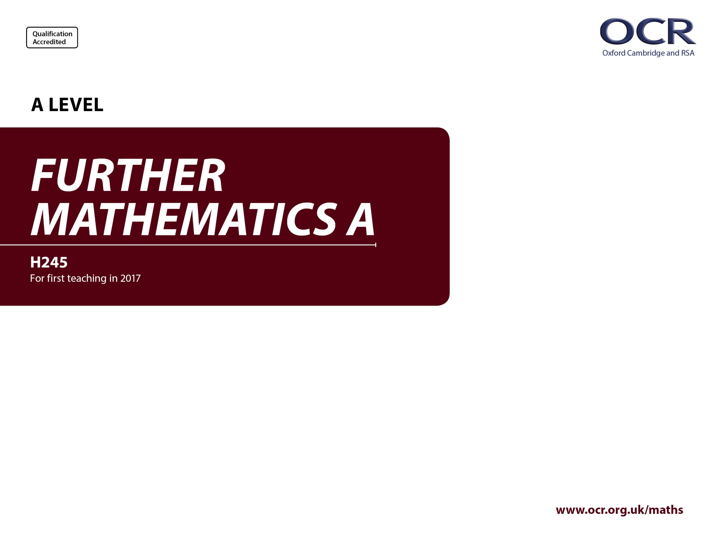
Y542
Statistics
Annotated sample assessment materials

Slide 2
Guidance
This guide is designed to take you though the A Level Further Mathematics H245 Statistics optional paper, Y542. Its aim is to explain how candidates should approach each paper and how marks are awarded to the different questions.
The orange text boxes offer further explanation on the questions on the exam
paper. They offer guidance on the wording of questions and what candidates
should do in response to them.
The green text boxes focus on the awarding of marks for each question.
This is a ‘show that’ question i.e. the answer has been given. A clear mathematical argument must be seen.
[this is an example]
The examiner is looking for a clear method for rationalising the denominator. [this is an example]

Slide 3
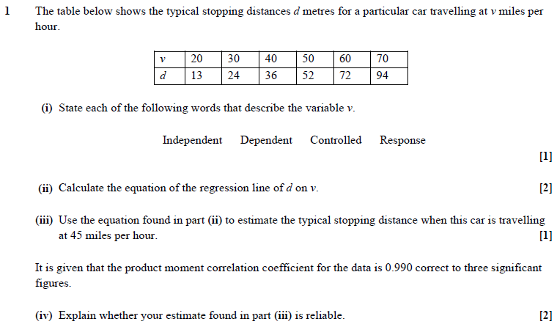
Specification content references covered: part (i) 5.09a, part (ii) 5.09c, part (iii) 5.09e and part (iv) 5.09e.

Slide 4
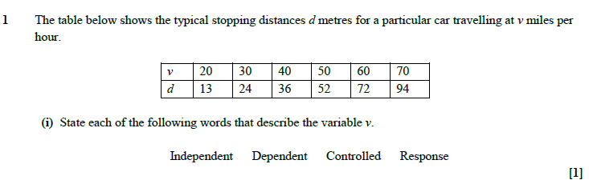
‘State’ means that the candidate needs to write down only the specific words that apply (in this case, ‘independent’ and ‘controlled’).
1 AO1 mark for accurately recalling facts, terminology and definitions.

Slide 5
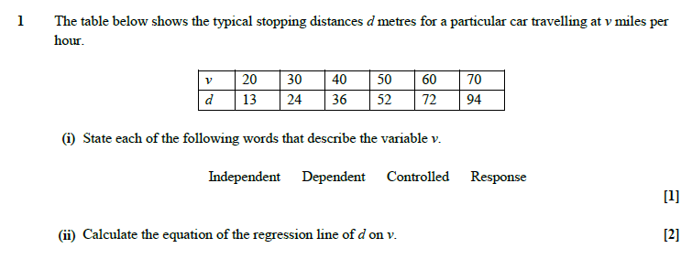
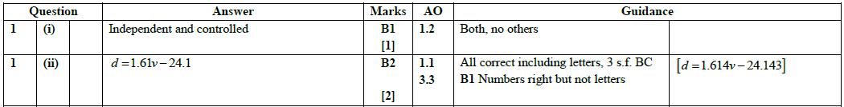
‘Calculate’ means that any valid method can be used. Candidates can write down the answer directly from their calculators with no working, but if they make any mistake they will not gain any credit. Candidates who demonstrate the use of the correct formulae can get partial credit even if they do not get the answer completely correct, though this may be a less efficient approach in terms of time and accuracy.
A fully correct answer must obviously use the correct letters in the equation.
The mark scheme has BC, by calculator, indicating that using the calculator to generate the answer is acceptable.
1 mark A03 for translating a problem given in context into a mathematical model and 1 mark AO1 for selecting and carrying out routine procedures.

Slide 6
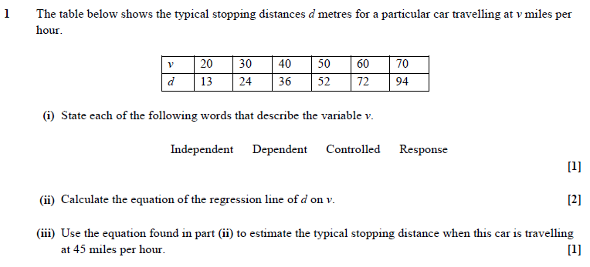
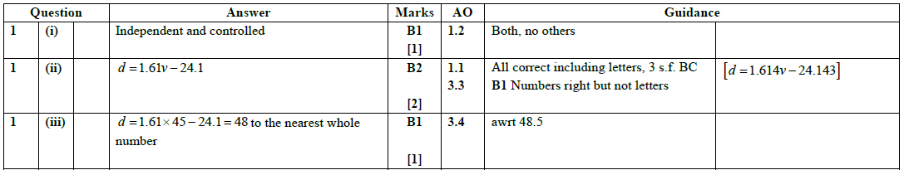
Only the correct answer is required, though a suitable degree of accuracy should be used, i.e. over-specification should be discouraged.
AO3.4 refers to using a mathematical model.

Slide 7
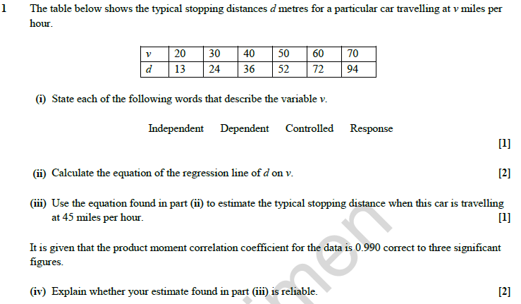
‘Explain’ means that a verbal answer giving reasons is needed. The fact that there are two marks available suggests that probably two reasons are needed.
AO3.5 refers to evaluating the outcomes of modelling in context and recognising the limitations of modelling.

Slide 8
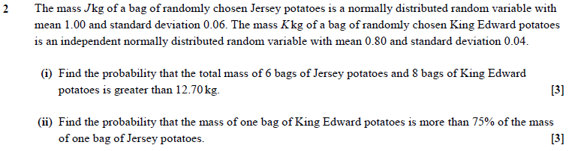
Specification content references covered: 5.04a and 5.04b.

Slide 9
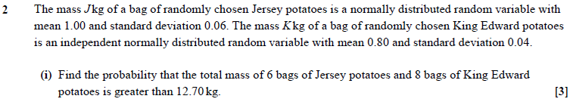
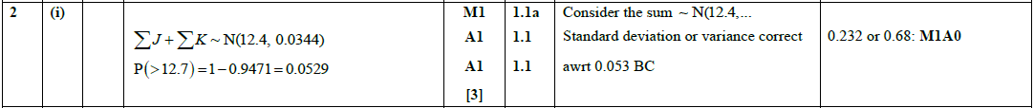
‘Find’ means that a correct answer will be given full credit. However, part marks can be scored only if correct working is seen, and candidates should indicate in particular the value of the standard deviation, using correct notation (calculator syntax such as ‘pdfnorm’ is not sufficient to obtain method marks if the answer is incorrect).
3 marks AO1 for selecting and carrying out a routine procedure.
In the reformed specification, candidates can use the calculator to find probabilities, hence BC, by calculator, in the mark scheme and the use of the command word ‘Find’ in this instance.

Slide 10
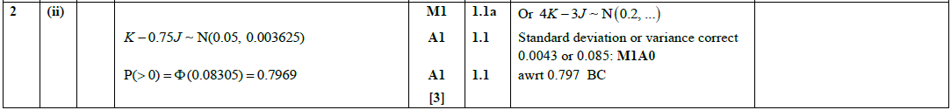
‘Find’ means that a correct answer will be given full credit. However, part marks can be scored only if correct working is seen, and candidates should indicate in particular the value of the standard deviation, using correct notation (calculator syntax such as ‘pdfnorm’ is not sufficient to obtain method marks if the answer is incorrect).
3 marks AO1 for selecting and carrying out a routine procedure.
In the reformed specification, candidates can use the calculator to find probabilities, hence BC, by calculator, in the mark scheme and the use of the command word ‘Find’ in this instance.

Slide 11
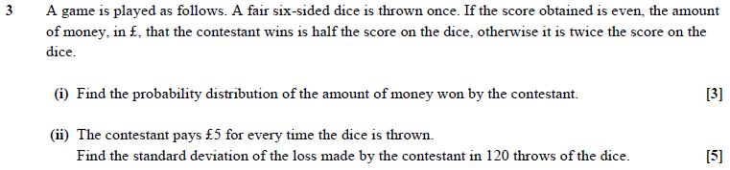
Specification content references covered: part (i) 5.02a and part (ii) 5.02b and 5.02c.

Slide 12
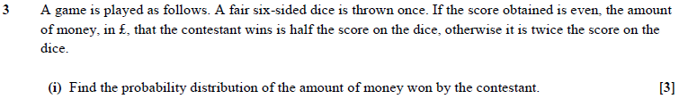
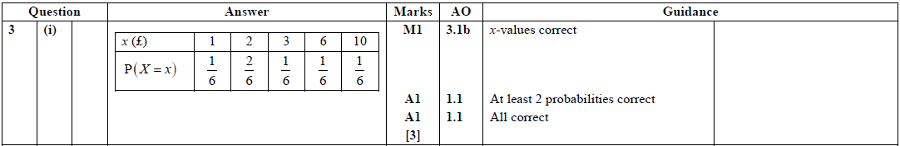
The probability distribution should be given as a table, showing clearly the possible values of the variable and the corresponding probabilities.
1 mark AO3 for translating a problem into a mathematical context, 2 marks AO1 for selecting and carrying out a routine procedure.

Slide 13
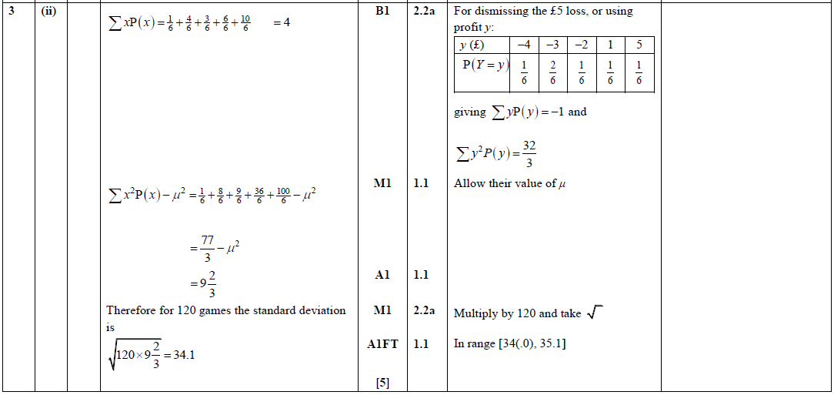
This question is intended to address AO2 and a properly worked solution is expected. Current questions addressing AO2 are more likely to use the command word ‘Determine’ rather than just ‘Find’.
3 marks AO1 for carrying out routine procedures and 2 marks AO2 for making deductions.

Slide 14
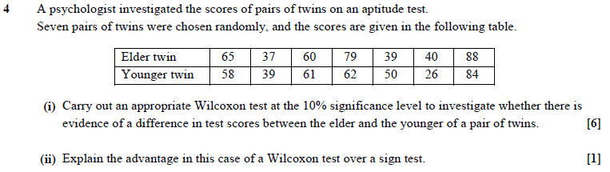
Specification content references covered: part (i) 5.07a, 5.07d, 5.07e and part (ii) 5.07b.

Slide 15
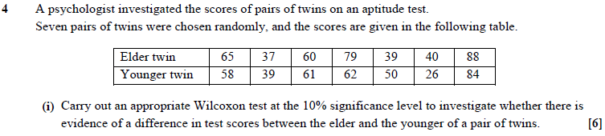
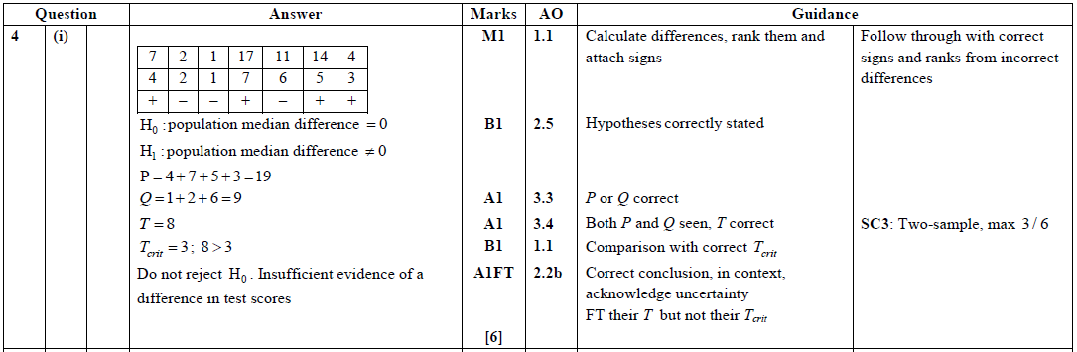
Questions that require a hypothesis test to be carried out should always include statements of the hypotheses, unless these are given explicitly in the question. Conclusions should be stated in the context of the test (hence AO2.2), so that merely ‘There is insufficient evidence that the median has changed’ would not gain the final mark. Nor should the conclusion be too assertive; ‘There is no difference in test scores’ would not gain the final mark either.
1 mark AO2 for for using mathematical language, 1 mark A03 for translating a problem given in context into a mathematical model, 1 mark AO3 for using a mathematical model, 1 mark AO2 for making inferences and 2 marks AO1 for carrying out routine procedures.

Slide 16
‘Explain’ means that a clear reason should be given.
AO3.5 refers to recognising the limitations of modelling.

Slide 17
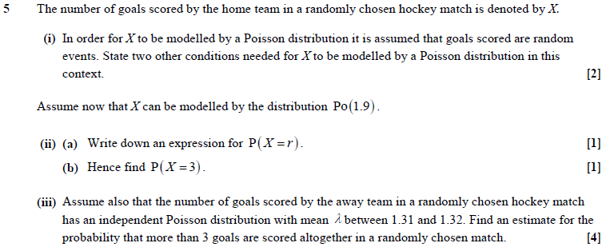
Specification content references covered: part (i) 5.02l, part (ii) 5.02j and part (iii) 5.02j.

Slide 18
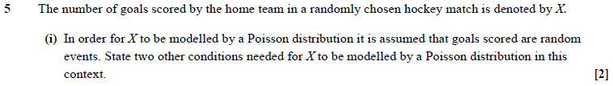
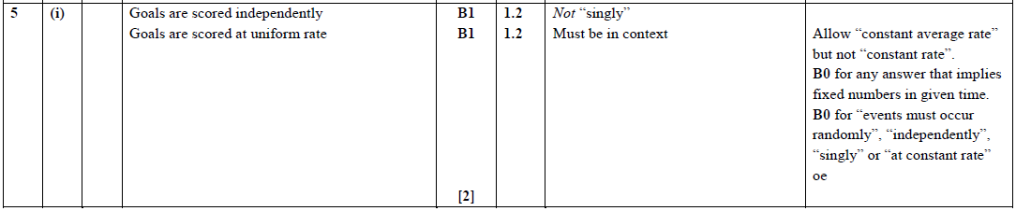
Candidates should state the two standard modelling assumptions for the Poisson distribution. Answers should refer to the context of the question (‘goals scored’), not just ‘events’. ‘Goals must be scored singly’ is not a correct assumption; as is almost always the case, the probability of two events happening simultaneously is zero (or at best vanishingly small). ‘Events occur singly’ is not a necessary modelling assumption for the Poisson distribution.
2 marks AO1 for accurately recalling facts, terminology and definitions.

Slide 19
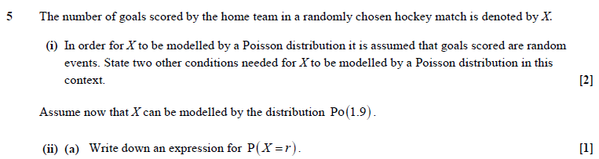
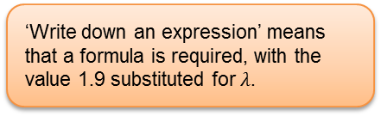
‘Write down an expression’ means that a formula is required, with the value 1.9 substituted for $λ$.
1 mark AO1 for selecting and carrying out routine procedures.

Slide 20
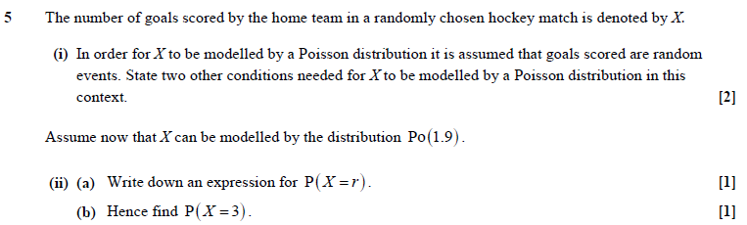
‘Find’ would usually require only the answer, but ‘Hence’ requires the use of the answer to the previous part, so that candidates need to show the use of the formula.
1 mark AO1 for selecting and carrying out routine procedures.

Slide 21
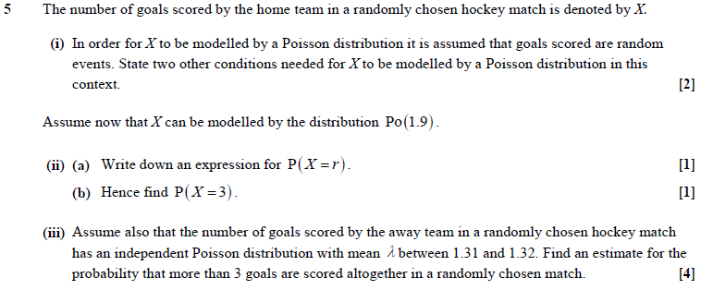
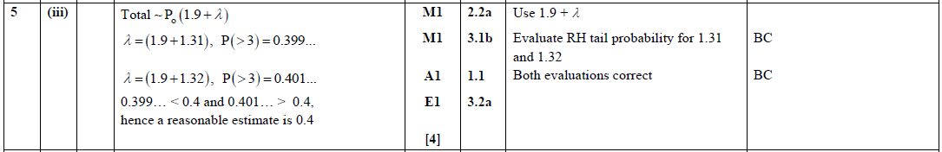
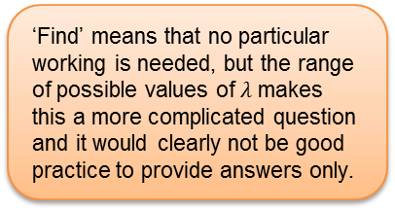
‘Find’ means that no particular working is needed, but the range of possible values of $λ$ makes this a more complicated question and it would clearly not be good practice to provide answers only.
The mark scheme has BC, by calculator, and the use of the command word ‘Find’ in this instance means that a solution could be obtained from the efficient use of a calculator.
1 mark AO2 for making deductions, 1 mark AO3 for translating a problem into a mathematical context, 1 mark AO1 for carrying out routine procedures and 1 mark AO3 for interpreting solutions to problems in their original context.

Slide 22
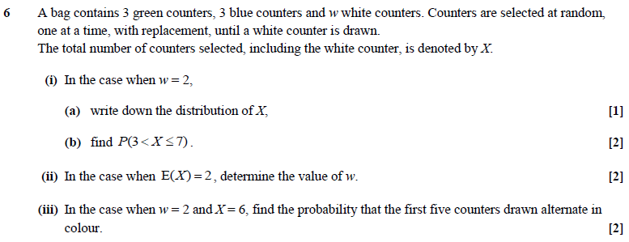
Specification content references covered: part (i) (a) 5.02f, part (i) (b) 5.02g, part (ii) 5.02a and part (iii) 5.02a and 5.02g.

Slide 23
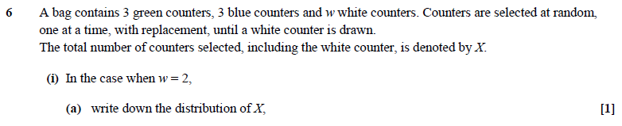
‘Write down’ means that no justification is required.
1 mark AO2 for using mathematical language and notation correctly.

Slide 24
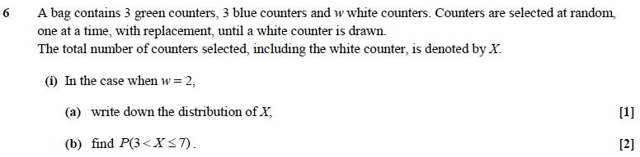
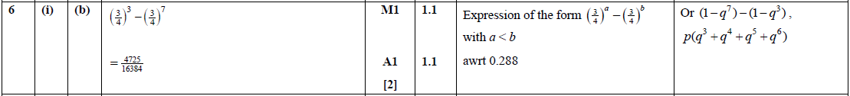
‘Find’ means that only an answer is needed, though, as usual when there is more than 1 mark available, it is in the candidates’ interests to show some working.
2 marks AO1 for selecting and carrying out a routine procedure.

Slide 25
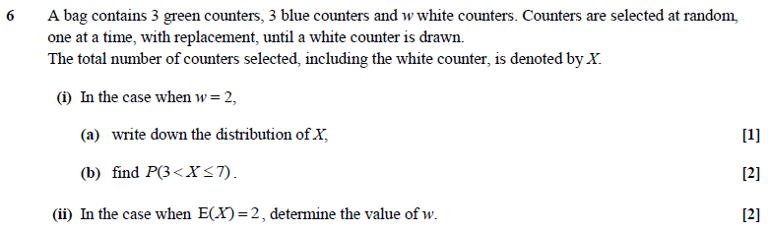
‘Determine’ means that a full mathematical argument is required for any results found.
2 marks AO2 for making deductions.

Slide 26
Although the command word is ‘Find’, it is clearly in the interests of candidates to give an indication of their method.
This is a synoptic question involving general ability to handle probabilities, in the context of problem-solving, so AO3 is addressed. Candidates need to find their own method.
1 mark AO3 for translating the problem into mathematical processes and 1 mark AO1 for carrying out a routine procedure.

Slide 27
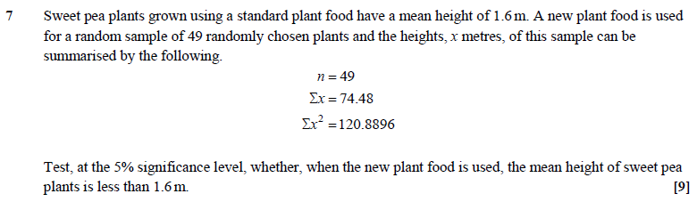
Specification content references covered: 5.05a, 5.05b and 5.05c.

Slide 28
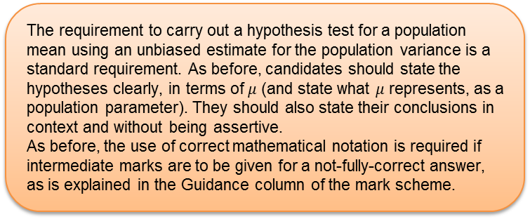
The requirement to carry out a hypothesis test for a population mean using an unbiased estimate for the population variance is a standard requirement. As before, candidates should state the hypotheses clearly, in terms of $μ$ (and state what $μ$ represents, as a population parameter). They should also state their conclusions in context and without being assertive.
As before, the use of correct mathematical notation is required if intermediate marks are to be given for a not-fully-correct answer, as is explained in the Guidance column of the mark scheme.

Slide 29
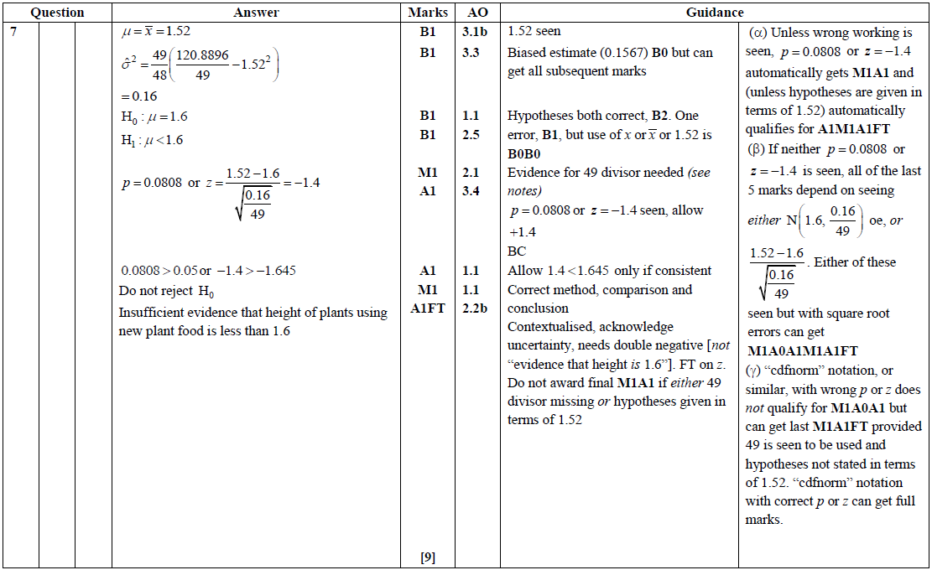
1 mark AO3 for translating a problem into a mathematical context and 1 mark A03 for translating a problem given in context into a mathematical model.
1 mark AO2 for using mathematical language and notation correctly and 1 mark AO2 for constructing a rigorous mathematical argument.
1 mark AO3 for using a mathematical model.
3 marks AO1 for selecting and carrying out routine procedures and 1 mark AO2 for making inferences.

Slide 30
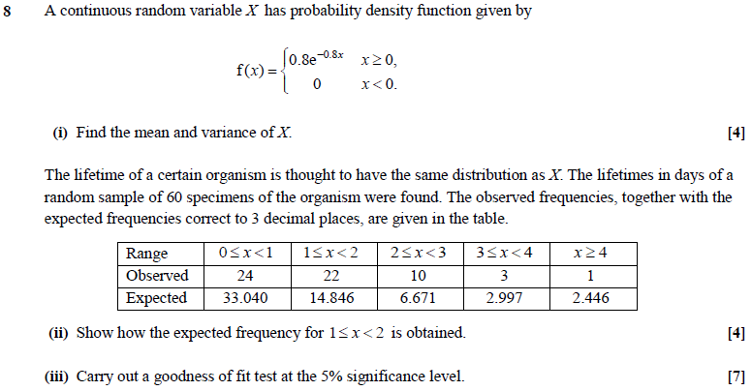
Specification content references covered: part (i) 5.03c, part (ii) 5.06c and part (iii) 5.06d.

Slide 31
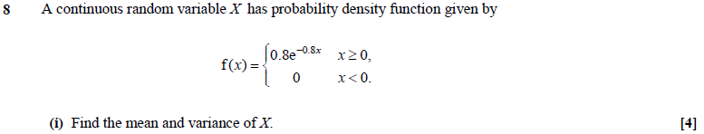
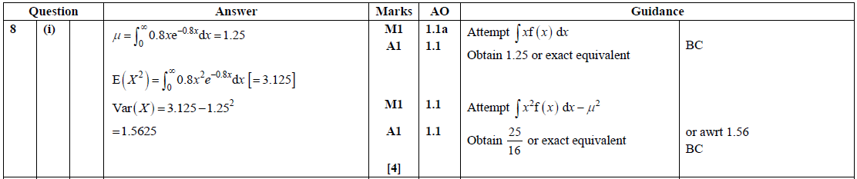
Here ‘Find’ means that the values of the definite integrals can be obtained directly from a calculator, although candidates would be well advised to write down the integrals they are evaluating.
The mark scheme has BC, by calculator, and the use of the command word ‘Find’ in this instance means that there is no requirement to justify answers.
4 marks AO1 for selecting and correctly carrying out routine procedures.

Slide 32
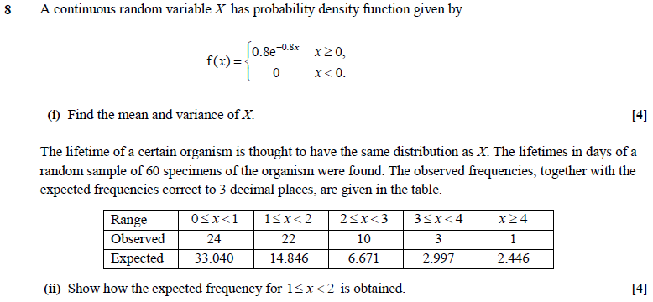
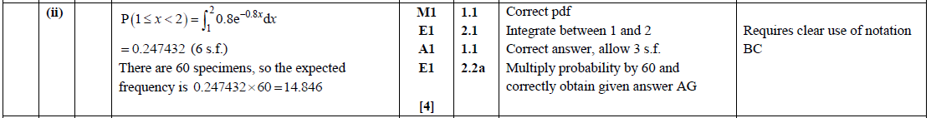
‘Show’ requires a clear mathematical argument with all necessary intermediate working. The result is given so the explanation has to be sufficiently detailed to cover every step of their working, although once again the value of the definite integral can be obtained directly from a calculator.
The mark scheme has BC, by calculator, indicating that using the calculator to generate the value of the definite integral acceptable.
1 mark AO2 for constructing a rigorous mathematical argument and 2 marks AO1 for selecting and correctly carrying out routine procedures.
1 mark AO2 for making deductions.

Slide 33
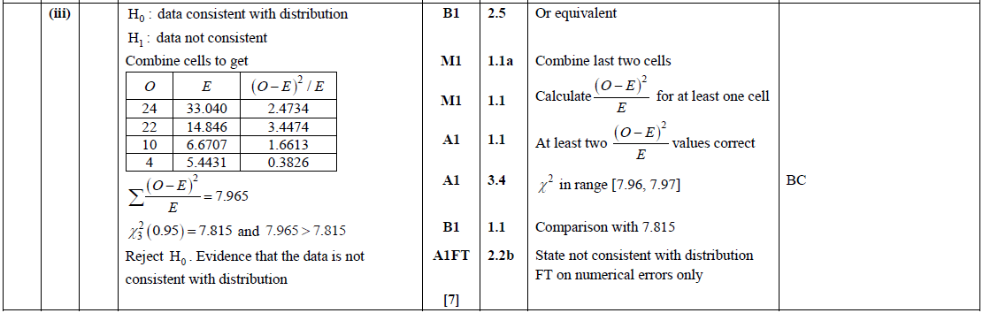
Again a hypothesis test question requires clear statement of hypotheses and conclusions in a correct form. It is not essential to show intermediate values such as those of (O – E)²/E but without them it would be impossible to award part marks for a wrong answer.
The mark scheme has BC, by calculator, indicating that using the calculator to generate the answer is acceptable. Although, as usual when there is more than 1 mark available, it is in the candidates’ interests to show some working.
1 mark AO2 for using mathematical language and notation correctly.
4 marks AO1 for selecting and carrying out routine procedures.
1 mark AO3 for using a mathematical model and 1 mark AO2 for making inferences.

Slide 34
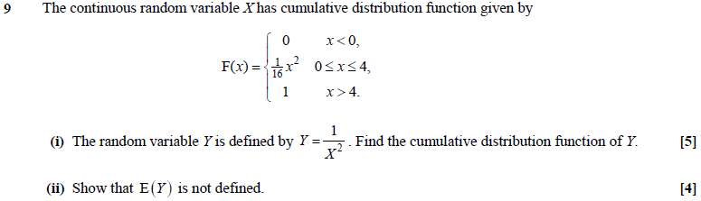
Specification content references covered: part (i) 5.03g, part (ii) 5.03c and 5.03f.

Slide 35
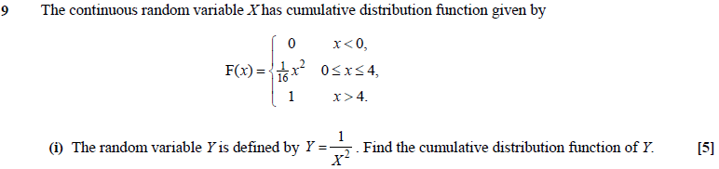
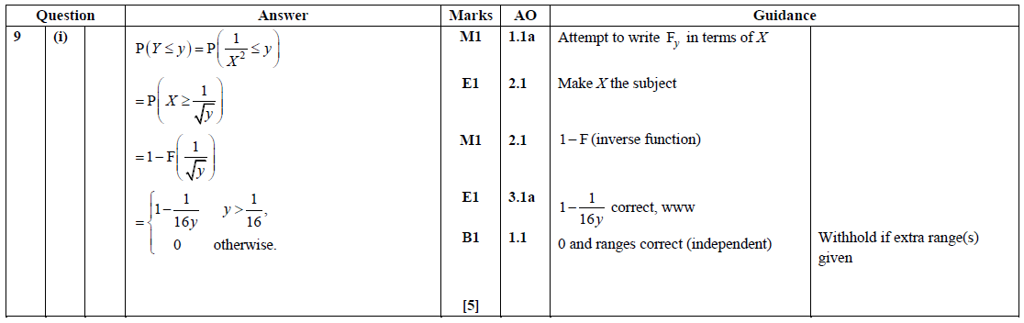
Y is a decreasing function of X, so it is necessary to take care with the inequalities defining the cumulative distribution functions.
This question could have involved the command word ‘determine’; it is clearly expected that the necessary algebra is shown, as required by AO2.
1 marks AO1 for selecting routine procedures and 2 marks AO2 for constructing rigorous mathematical arguments.
1 mark AO3 for translating problems into mathematical processes and 1 mark AO1 for carrying out routine procedures.

Slide 36
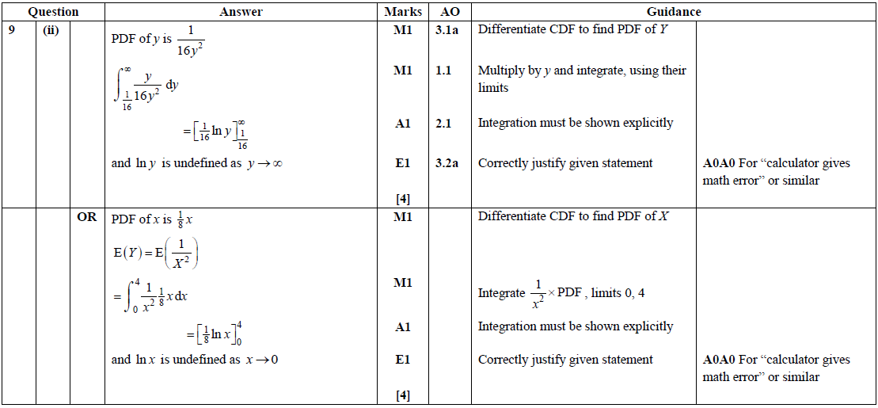
‘Show that’ requires a proper mathematical justification. The question has elements of both rigorous argument and problem-solving, so it addresses both AO2 and AO3.
1 mark AO3 for translating a problem into mathematical processes.
1 mark AO1 for selecting and carrying out routine procedures.
1 mark AO2 for constructing a rigorous mathematical argument and 1 mark AO3 for interpreting solutions to problems in their original context.

