Slide 1
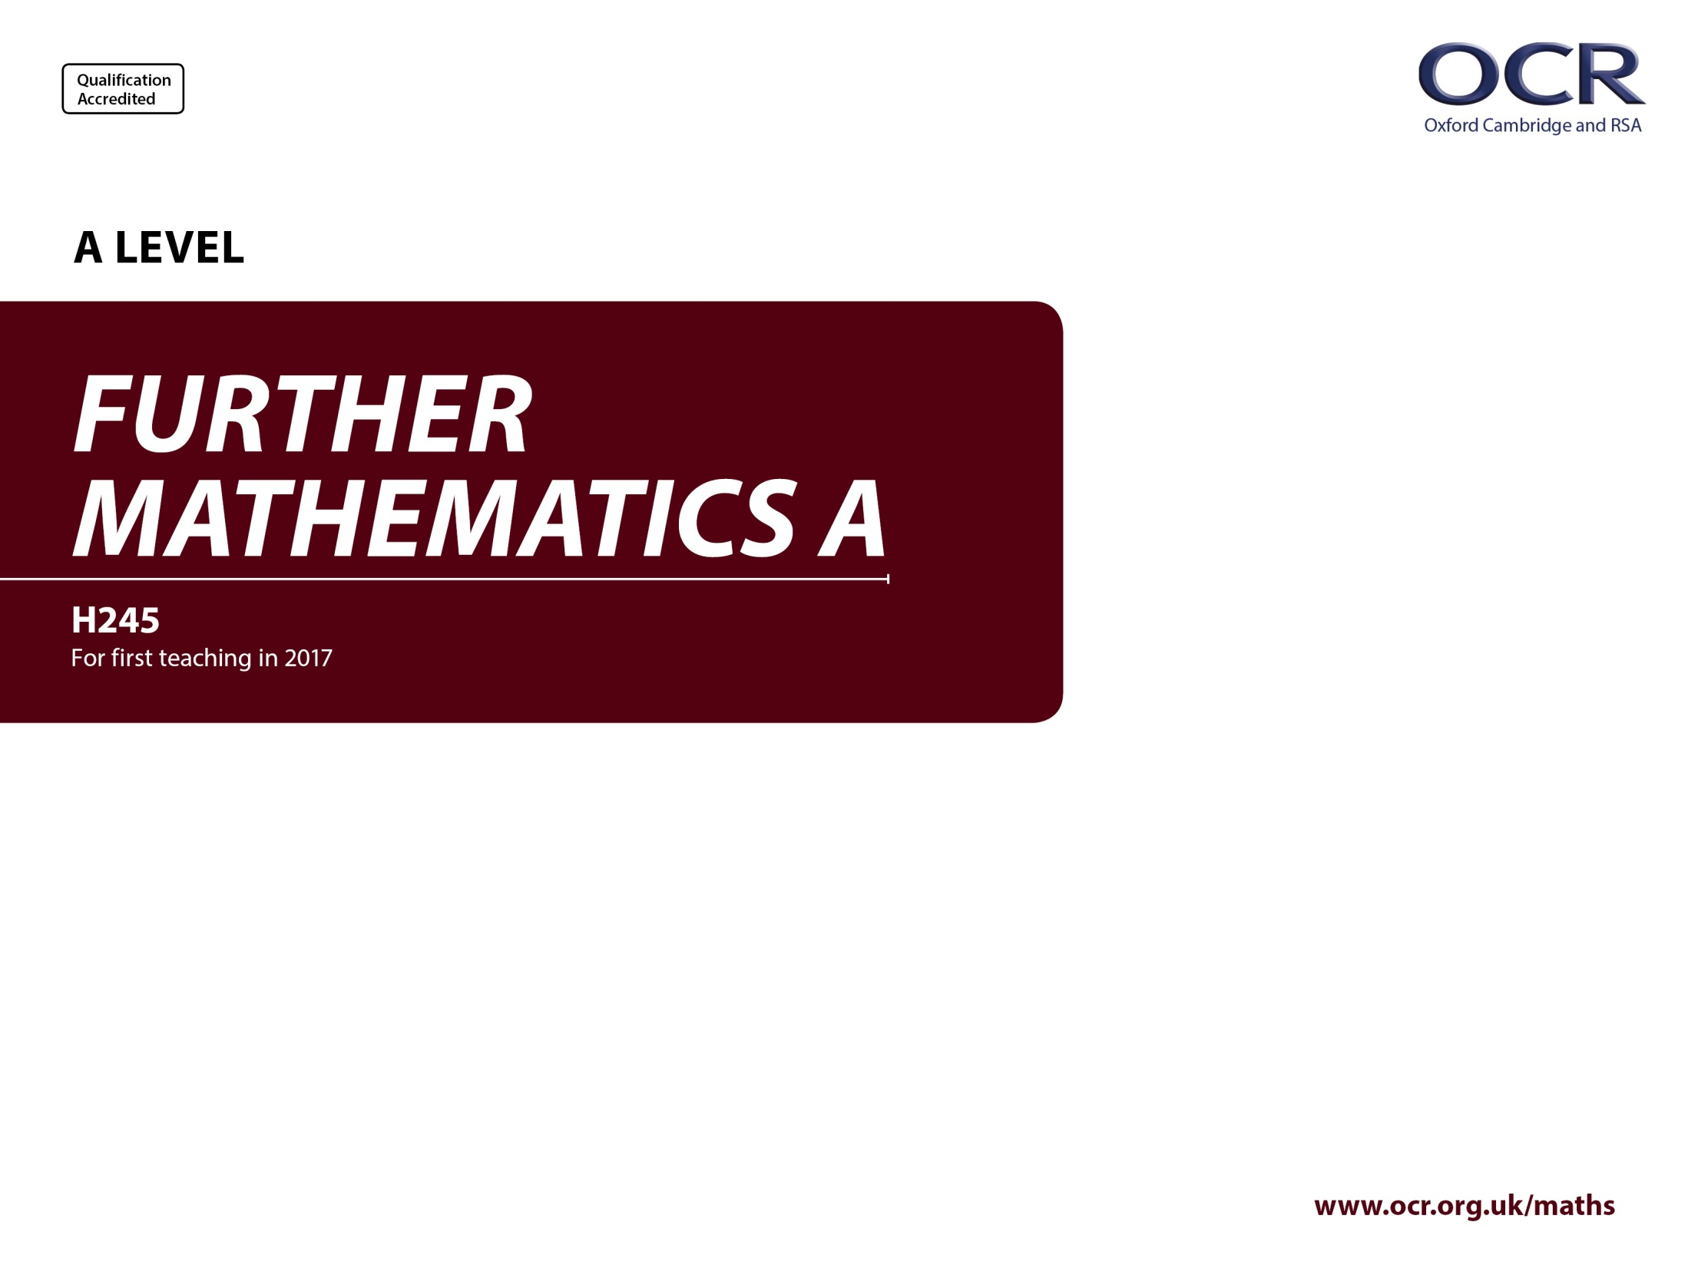
Y543
Mechanics
Annotated sample assessment materials

Slide 2
Guidance
This guide is designed to take you though the A Level Further Mathematics H245 Mechanics optional paper, Y543. Its aim is to explain how candidates should approach each paper and how marks are awarded to the different questions.
The orange text boxes offer further explanation on the questions on the exam
paper. They offer guidance on the wording of questions and what candidates
should do in response to them.
The green text boxes focus on the awarding of marks for each question.
This is a ‘show that’ question i.e. the answer has been given. A clear mathematical argument must be seen.
[this is an example]
The examiner is looking for a clear method for rationalising the denominator. [this is an example]

Slide 3
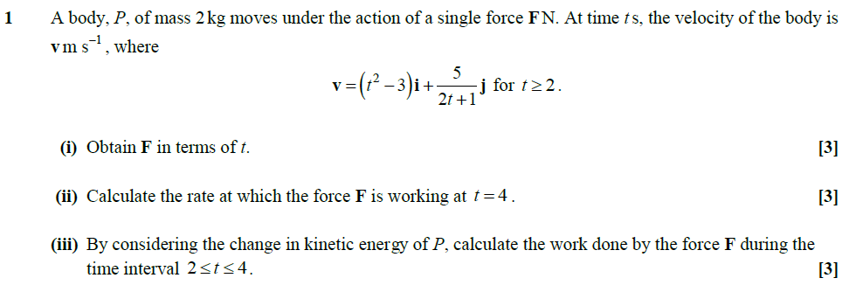
Question 1 is a vectors question. This is indicated by the use of i and j in the notation. The advantage of this is that each part of the equation can be dealt with separately.
It is an expression for velocity in terms of time and therefore indicates variable acceleration which implies the use of calculus to answer the question. Given that the initial equation is velocity then differentiation gives acceleration and integration gives distance.
Specification content references covered: part (ii) 6.02m and part (iii) 6.02f.
Part (i) is linked to A Level Mathematics (3.03).

Slide 4
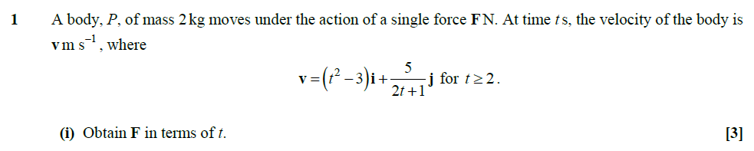
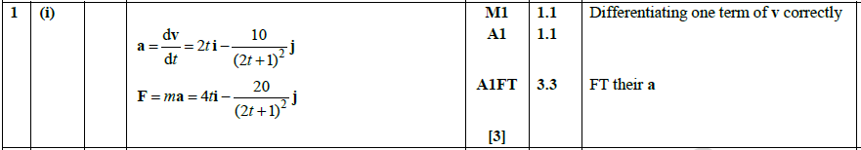
Within the opening sentence the mass is given and there is a reference to force so the equation F = ma becomes the obvious choice.
Given this information, part (i) requires differentiation to find the acceleration and then it is multiplied by the mass to give force.
AO3.3 refers to translating into a mathematical model.
2 AO1 marks for the routine application of calculus.

Slide 5
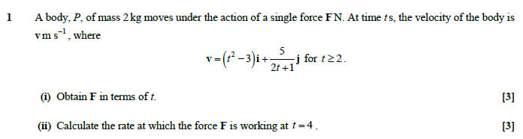
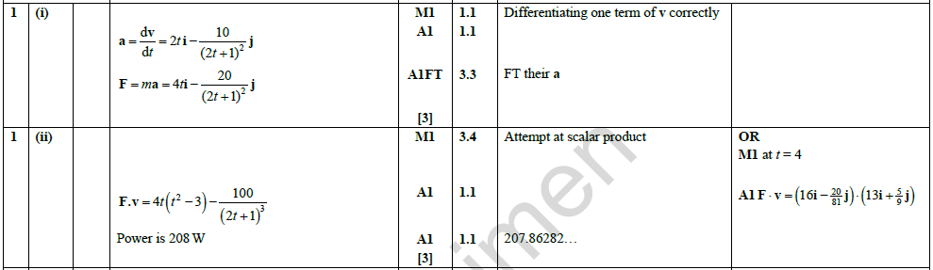
The rate of doing work is commonly known as power and the equation in this case is Fv. Given that this is a vector question this becomes F.v and so requires the scalar product.
Part (ii) then requires the input of t = 4 into both F and v and then the calculation of the scalar product.
AO3.4 refers to using a mathematical model.
The new calculators have a vector mode in which the scalar product can be calculated automatically.

Slide 6
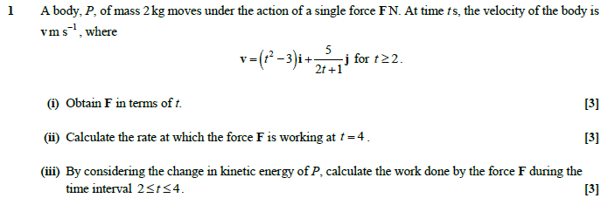
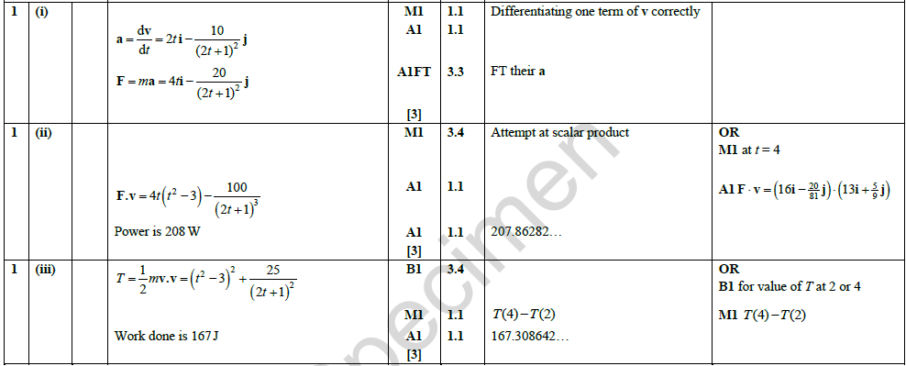
Kinetic energy requires the equation ½mv². In vector form this becomes ½mv.v
This requires no further alteration but the substituting in of values for t = 2 and t = 4. This can be done either algebraically first to find v.v and then substituting in the numbers or by substituting the numbers in first and then finding v.v.
As in part (ii), the dot product can be done on a calculator.
AO3.4 refers to using a mathematical model.

Slide 7
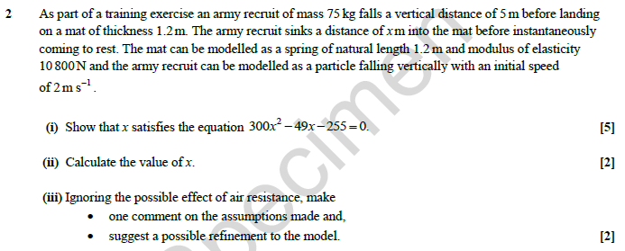
Modelling the mat as a spring leads to the work on Hooke's Law. The quadratics equation given in part (i) comes from the energy calculations. This means combining gravitational potential energy alongside kinetic energy.
Specification content references covered: 6.02d, 6.02e, 6.02h, 60.2i and 6.02j.
It is worth noting that much of this question is AS material.

Slide 8
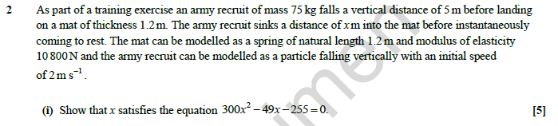
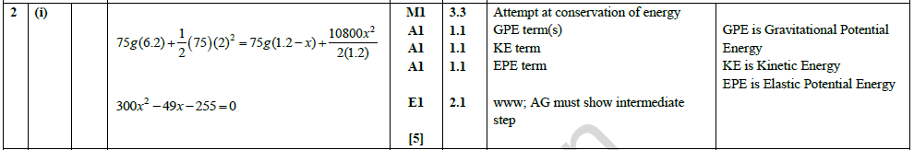
The quadratics equation given in part (i) comes from the energy calculations. This means combining gravitational potential energy (mgh) alongside kinetic energy
(½mv²) and finally elastic potential energy . The height fallen will be 5 + x
and this is combined with an initial velocity to give the starting energy. The final energy will all be elastic potential energy with distance x. Dividing all terms by 15 gives the correct solution.
The answer has been given in this ‘show that’ question so a clear argument must be seen. An AO2 mark for clear logical steps.
An AO3 mark for translation into a mathematical model.

Slide 9
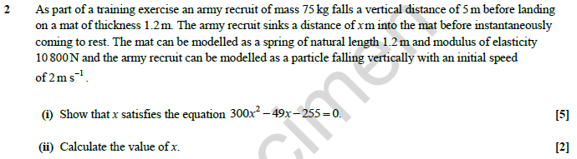
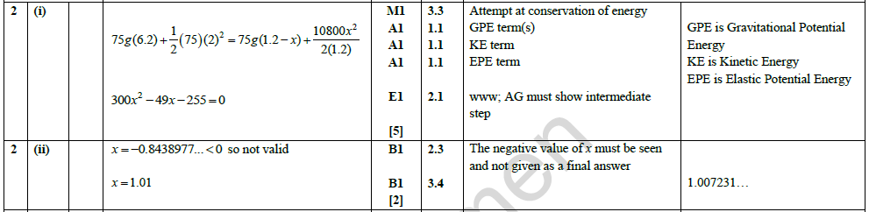
Part (ii) is for solving the quadratic.
The quadratic can be solved using the ‘Quadratic solve’ function on a calculator.
Important to always justify the discarding of roots.

Slide 10
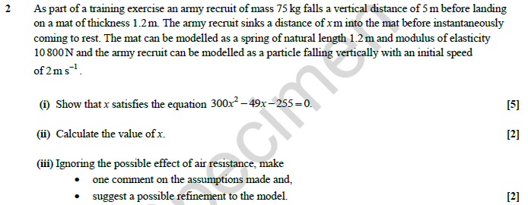
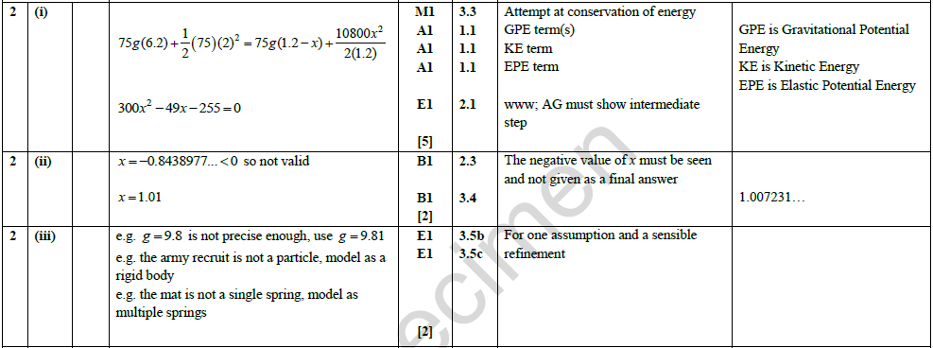
The last part of this question is a modelling exercise. This is looking at the factors that effect motion. The mat is not really a spring, the soldier is not a particle so air resistance and rotational motion come into play. Values given are rounded and not exact. Friction has been ignored as has the contact surface area. Energy has been assumed to be three types only with sound and heat being ignored.
This focuses on AO3, recognising the limitations of the model and suggesting a refinement.

Slide 11
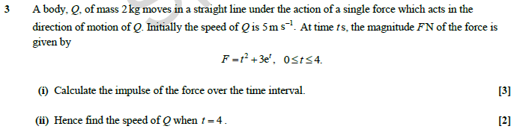
Specification content references covered: 6.03h and 6.06a for part (i) and 6.03f for part (ii).
The integral techniques here are taken from A Level Mathematics and are mostly covered at AS level so it is the understanding of its application to Mechanics that is being assessed here rather than specific mathematical skills.
Question 3 focuses on variable force.

Slide 12
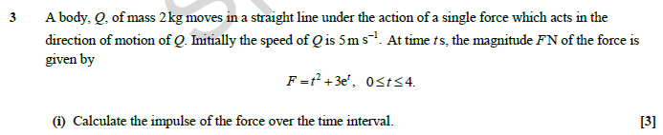
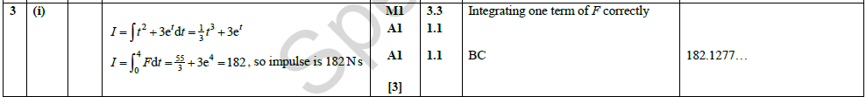
The impulse is calculated as force times time but in the case of variable force it is a summation process. This means the integral of force per unit time. The limits are given as 0 and 4.
Calculators have the definite integral function so once the integral is written down the calculator can do all the rest – use x instead of t and put in limits of 0 and 4.

Slide 13
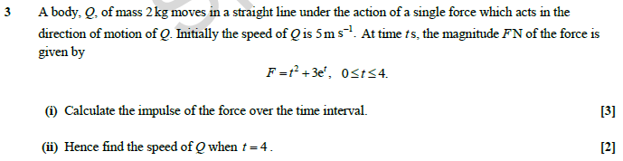
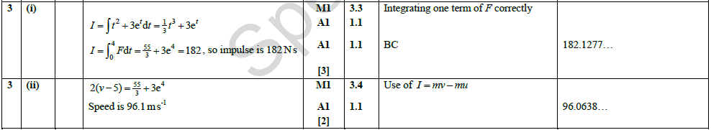
To find velocity it is necessary to integrate acceleration which is force divided by the mass of 2 kg. The constant C can be calculated using the initial conditions of t = 0 and v = 5. Then it is a case of substituting t = 4 into the equation.
It is possible to achieve this more easily as it is the same integral as part one. Halving this (dividing by the mass) answer and adding the five for initial velocity gives the same solution, this is the use of I = mv - mu.

Slide 14
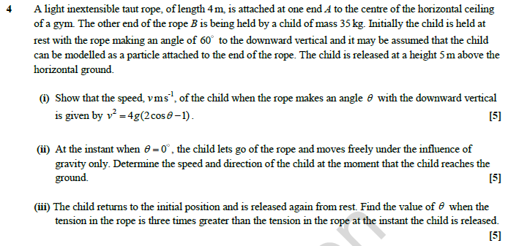
A light inextensible rope rules out elasticity in this case and given that it is motion with a fixed radius it is circular motion. It is also in a vertical plane and so two key aspects come into play. One is force and acceleration towards the centre and the other is the transfer between potential and kinetic energy as it moves around the circle. As the string is attached to the ceiling it will not be complete circular motion.
Specification content references covered: 6.02d, 6.02e, 6.02i, 6.05a, 6.05d and 6.05f.
These relate to energy and motion in a circle.
Note, it is only the latter objective that is not an AS level objective.

Slide 15
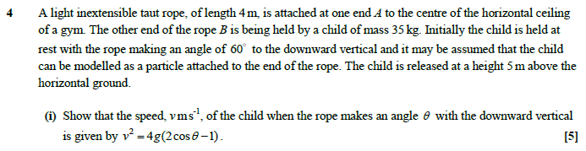
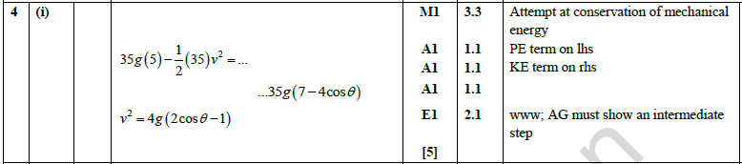
Calculating the height of the child at the start in terms of the angle gives the potential energy at the start and this is then equal to the potential energy at a general angle combined with its kinetic energy.
The ‘Show that’ command, with answer given signals a clear progression of ideas needs to be seen.

Slide 16
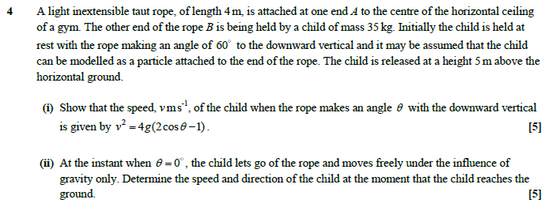
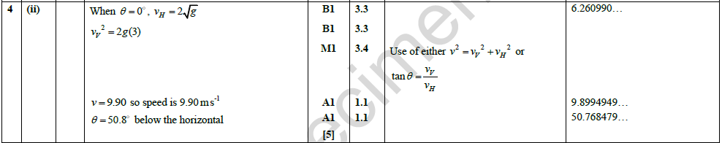
Part (ii) has the child letting go at the lowest point. This means that all the motion is horizontal. The child is still 1 m from the floor so this then becomes projectile motion.
AO3 marks are for use of a mathematical model.

Slide 17
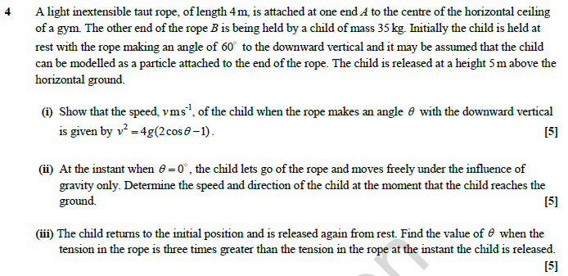
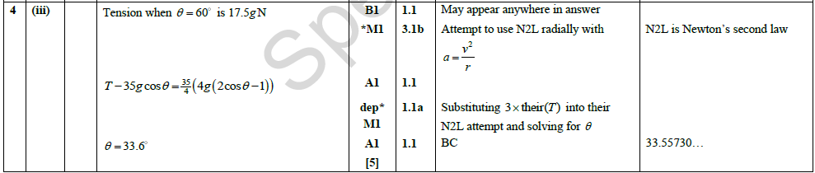
The final part of this question returns the system to its start point and repeats the process using the forces equation rather than the energy equation. Calculating the tension at the start then gives the value needed for the second part and the angle can then be found.

Slide 18
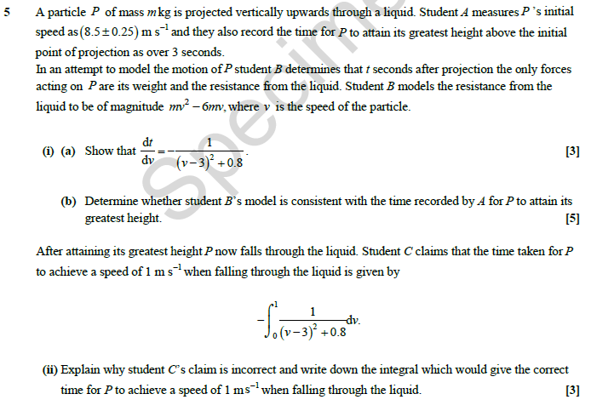
The differential equation in the first part points to variable acceleration and motion under a variable force.
Specification content reference covered is 6.06a. Most of the question is focused on the techniques of creating the equation through the understanding of the forces. The other aspect of the question is clearly the integration techniques from the Further Pure and completing the square from AS Mathematics.

Slide 19
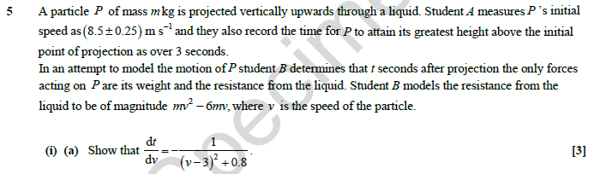
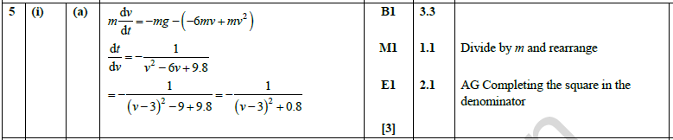
The resisting force is given as a function of v and this combined with the force due to gravity (its weight) gives the mass times acceleration. However, the differential needs inverting to get it the right way round for the integration. This leaves a quadratic in the denominator which can be tidied up by completing the square to give the desired formula.
An AO3 for modelling and an AO2 for clear argument.

Slide 20
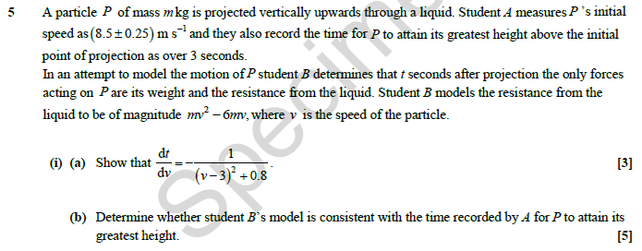
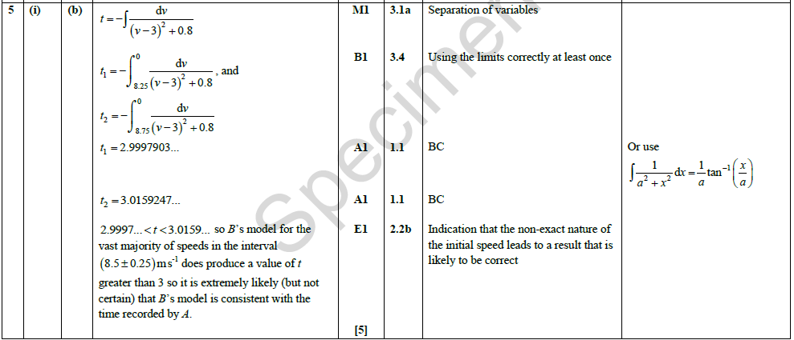
Conclusions drawn here suggest that it is probably a good model but with some values falling below the limit it is possible there is some error in the initial assumptions.
The second part of the question then requires the completion of this integral. This requires the use of Further Pure integration as it is an arctan integral. Two sets of limits are required as there is a range of error given in the question. The first calculation is 0 to 8.25 and the second, 0 to 8.75. The solution gives values either side of 3 with most of the values being greater than 3.
Numerical Integration by calculator.

Slide 21
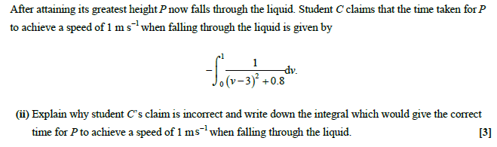
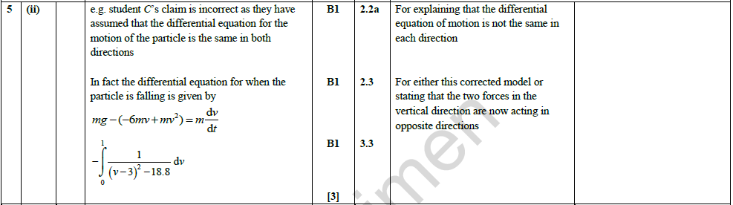
The last part of the question reverses the integral. However, as part of the initial work involved the force due to gravity, reversing the function would have gravity acting upwards. The integral should only reverse the resisting force and not the weight force. The adjustment then becomes straightforward to achieve. Start from the original equation and make the weight force positive, but leave the resisting force negative. Invert it and once again complete the square to give the correct integral.

Slide 22
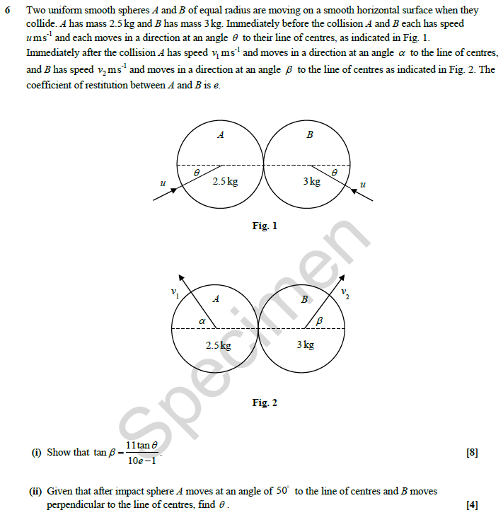
This questions focus is on oblique impact. This is indicated quite clearly through the diagrams that are given in the question.
It is advisable to annotate these with all the resolved velocities. Additionally, an arrow indicating which direction is positive can help to avoid any confusion in setting up the equations.
Specification content references covered: 6.03a, 6.03b, 6.03c, 6.03d, 6.03i, 6.03j, 6.03k and 6.03l.
This seems a lot of content coverage but half of them are the basic work and the others are the extension into two-dimensional motion so it is perhaps not as much as it seems.
Four equations can be set up here.

Slide 23
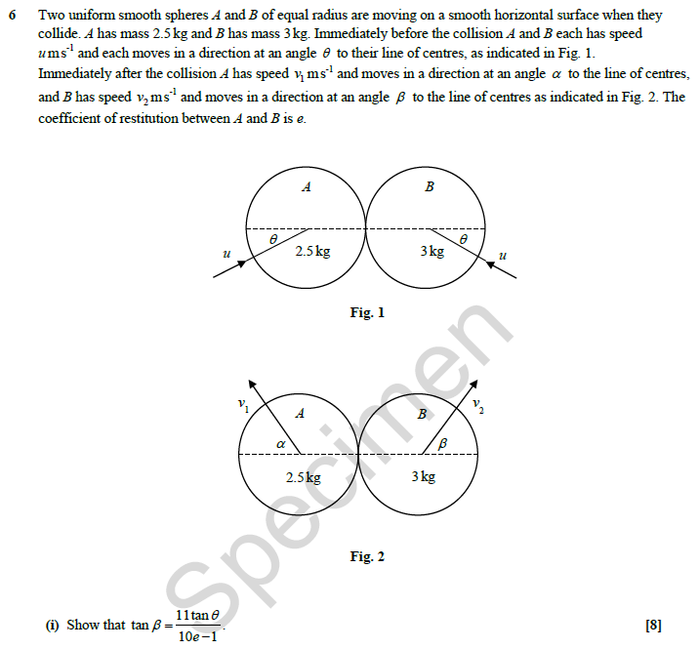
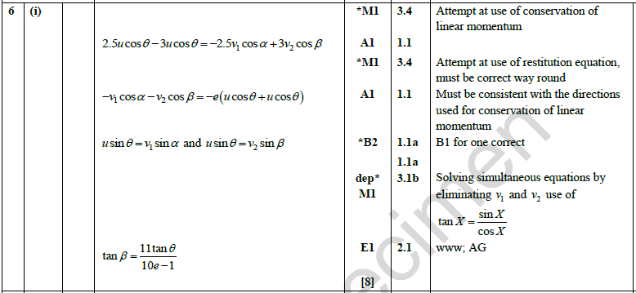
There is some use of mathematical modelling in this question (3 AO3 marks). As this is a ‘Show that’ question, with the answer given, there is an AO2 mark for a clear mathematical argument.
Usually the biggest problem with these questions is not being careful with the directions of motion which is why an arrow indicating the positive direction is really helpful.
Firstly, the conservation of momentum equation which uses the velocities along the line of impact (the dotted line on the diagram).
Secondly, Newton's Law of restitution which also uses the velocities along the line of impact.
Thirdly, the last two equations come from the fact that the velocity of each particle is unchanged perpendicular to the line of impact.
These four equations then need to be solved simultaneously to eliminate all but the unknown angles and e gives the required answer.

Slide 24
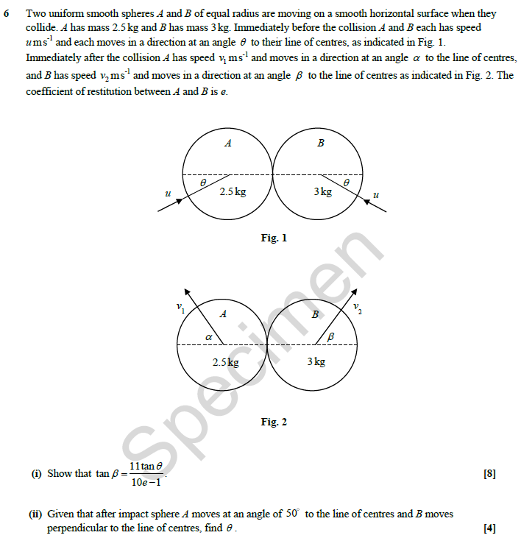
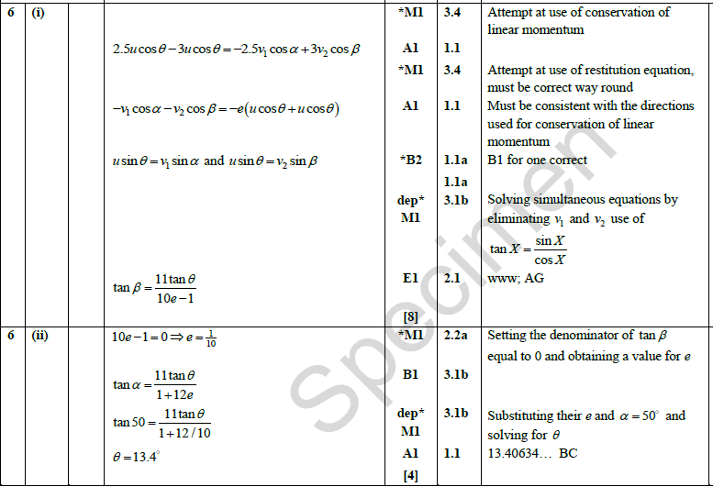
There is an AO2 mark for the deductive process of reasoning.
The second part of the question gives values for alpha and beta. If the latter is 90 then the denominator of the equation found in the first part is zero giving e as 0.1.
Finding theta from here should be relatively straightforward.

Slide 25
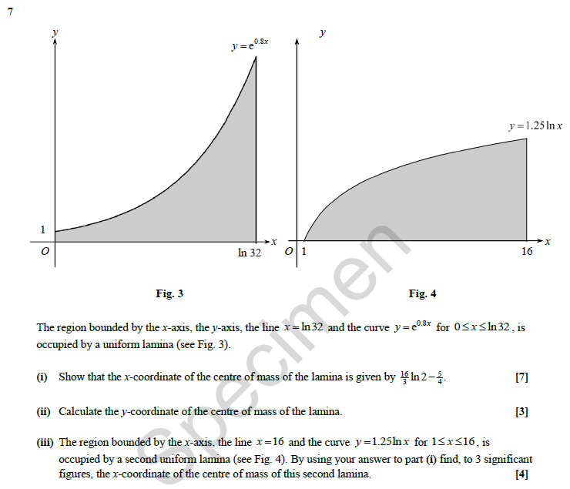
This question introduces, mathematically, a uniform lamina which quite clearly points to centres of mass. Indeed the two key parts of the question ask for the centre of mass with x and y coordinates. Although not explicit in the question, the key mathematical skill required here will be integration.
Specification content references covered: 6.04a, 6.04b, 6.04c and particularly 6.04d.
Alongside that are the techniques required for integration, specifically integration by parts.

Slide 26
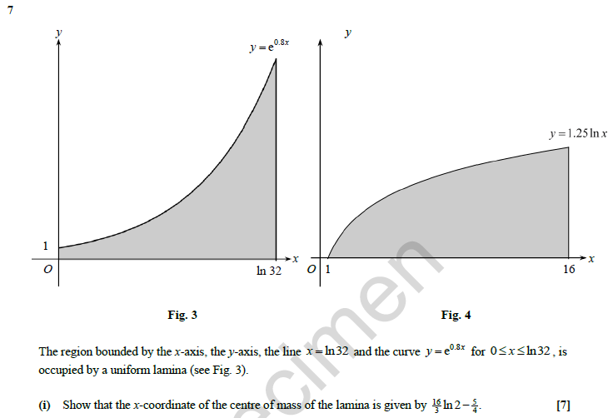
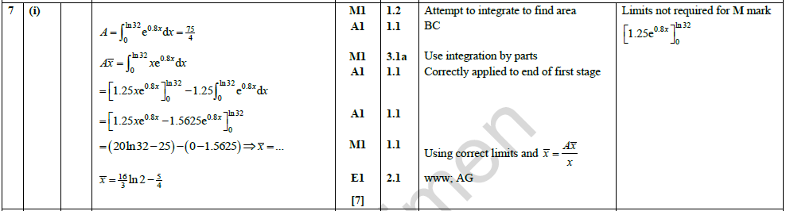
The first calculation will be the area of the lamina found by integrating the function between 0 and ln32.
New calculators have the definite integral function built into them so once the integral is written down the calculator could do all the rest. Although not always the case, for the values used in this question, the calculator will give an exact value for the answer which makes further calculations possible.
As a ‘Show that’ question, a clear mathematical argument is needed, even if the individual calculated steps have been performed on a calculator.

Slide 27
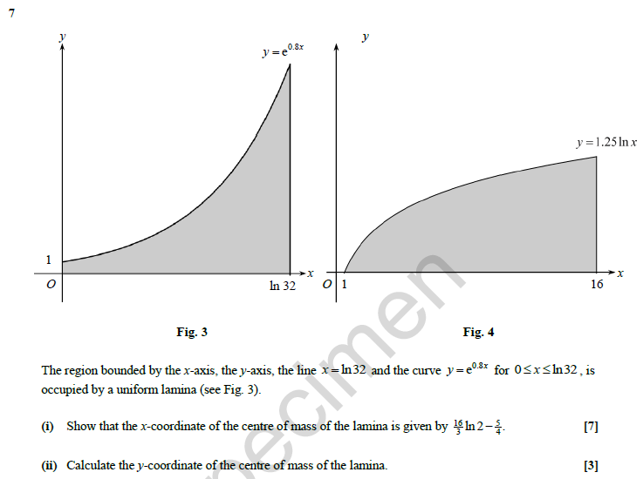
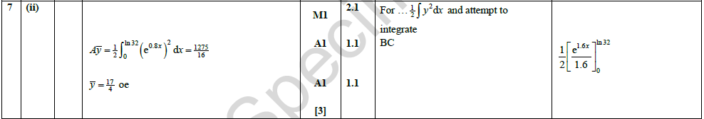
The second calculation is the moment whereby the original function is multiplied by x before integrating. This becomes an integration by parts exercise.

Slide 28
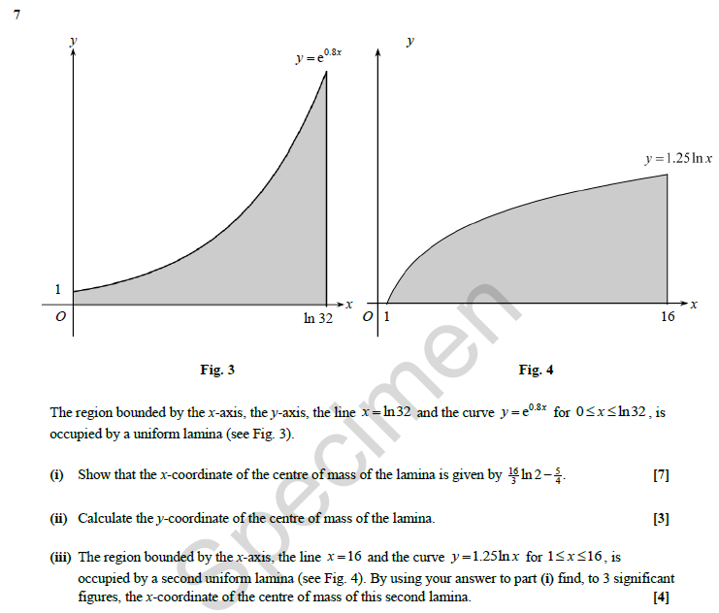
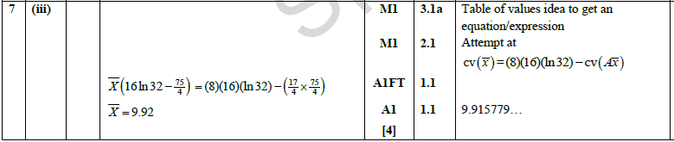
The final part of this question simply involves spotting that the second shape fits into the gap of the first one. This can then be treated as starting with a rectangle and removing the shape used in the first part. This does not involve any further integration although it could be done that way.

