Slide 1

Exploring higher order thinking skills in A level geography
Wednesday 10th April
Shelley Monk
OCR Geography Subject Advisor

Slide 2
Aims
This interactive session will explore techniques to develop higher-order thinking skills with in the context of case studies, fieldwork and extended writing. The main aim of the session is to support teachers in developing their learners; independence in preparation for higher education and employment.

Slide 3
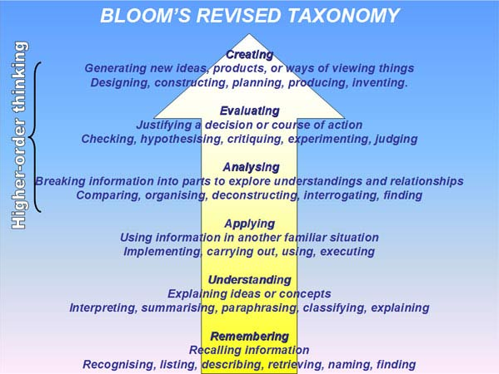
Notes:
Diagram from- Anderson, L. W., Krathwohl, D. R., & Bloom, B. S. (2001). A taxonomy for learning, teaching, and assessing: A revision of Bloom’s taxonomy of educational objectives. Allyn & Bacon.
https://tophat.com/blog/blooms-taxonomy-ultimate-guide/

Slide 4
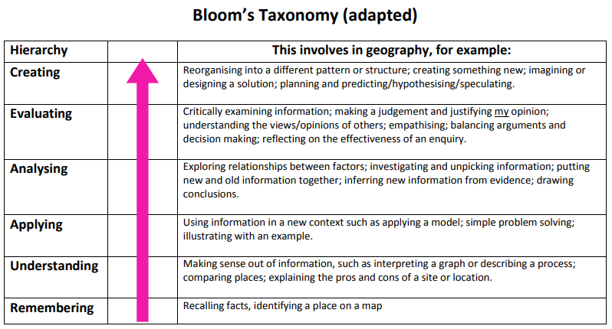
The relevance to geography
Blooms taxonomy revised by Anderson and Krathwohl
Notes:
Table from - https://www.geography.org.uk/write/mediauploads/teacher%20education/ga_ite_sft_learning_theories.pdf
Mastery learning in geography https://www.geography.org.uk/write/MediaUploads/Teacher%20education/GA_ITE_SFT_Mastery_learning.pdf

Slide 5
HOT – Higher Order Thinking
You know when students are engaged in HOT for example:
They visualise a problem by producing a diagram
Separate relevant and irrelevant information
Seek reasons and causes
Justify solutions
Look at different sides of a problem
Reveal assumptions in reasoning
Identify bias or inconsistencies, weigh up credibility of information / sources
Why teach HOT?
Students with deeper conceptual knowledge and understanding are better able to access that information for use in new contexts so therefore it is transferrable and can be applied to solve new problems.
Notes:
http://teachingasleadership.org/sites/default/files/Related-Readings/LT_Ch5_2011.pdf

Slide 6
Teaching HOT
Teach skills through real-world contexts
Vary the context in which students use a newly taught skills
Emphasise the ‘building blocks’ of HOT e.g.
  Build back ground knowledge
  Classify things into categories
  Arrange items along a dimension e.g. rank them
  Make hypotheses
  Draw inferences
  Analyse things into their components
  Solve problems
Encourage students to think about their own thinking (metacognition)

Slide 7
Opportunities for HOT in geography
Concepts
Case studies
Interaction with resources
Fieldwork / Independent Investigation
Synopticity
Essays – extended response
Activity 1 – Reflecting on your own teaching, how do you currently teach or provide opportunities for HOT?
Notes:
The concepts are listed in the specification (p2) and they are embedded in the content. The concepts include: causality, systems, equilibrium, feedback, inequality, representation, identity, globalisation, interdependence, mitigation and adaptation, sustainability, risk, resilience and thresholds.

Slide 8
Fieldwork & the Independent Investigation
Synthesis
Interpretation
The investigation process
What data can I collect and how?
Can I find a study or concept that fits?
What data is relevant? How can I process it & what does it show?
How valid and reliable are my findings?
Analysis
Evaluation
Activity 2: Where are there opportunities to develop HOT skills?

Slide 9
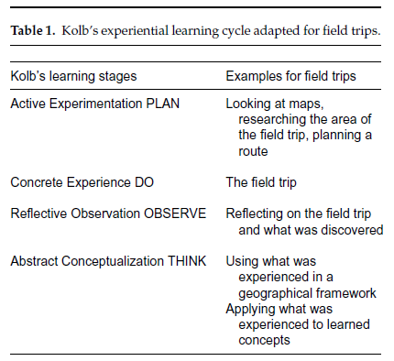
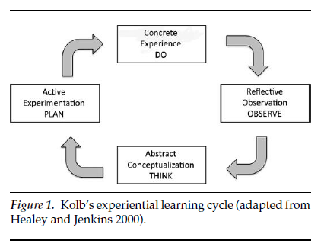
Experiential Learning - Kolb
‘Learning is the process whereby knowledge is created through the transformation of experience’ (Kolb 1984)
Notes:
Figure and table from –
Field Trips as Valuable Learning Experiences in Geography Courses (Amy Richmond Krakowka)
https://www.tandfonline.com/doi/pdf/10.1080/00221341.2012.707674
Promoting and Assessing ‘Deep Learning’ in geography fieldwork: An evaluation of reflective Fieldwork Diaries (Trevor J. B. Dummer , Ian G. Cook , Sara L. Parker , Giles A. Barrett & Andrew P. Hull)
https://www.tandfonline.com/doi/pdf/10.1080/03098260701728484

Slide 10
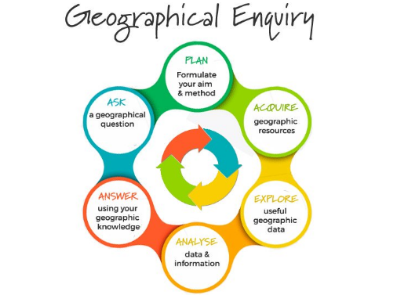
Fieldwork & HOT
For example
Teachers use of higher order questioning e.g. planning and data collection
Types of questions suitable for investigation
Build up knowledge ‘place knowledge’ through research (interpretation of resources)
Students to select and justify appropriate techniques for data collection
Small scale pilot study – opportunity to evaluate
Geographical enquiry encourages learners to be analytical and evaluative throughout the process.
Notes:
Field Studies Council
https://www.geography-fieldwork.org/media/16632/geographical-investigations-hi-res.pdf
https://www.geography-fieldwork.org/a-level/before-starting/
Diagram from NST education travel experts
https://www.nstgroup.co.uk/?gclid=Cj0KCQjw4qvlBRDiARIsAHme6ouaoBjoGg1zGzQGqJ3-Gzn__pNitTf2A6LPV5oMh22jKesHbkXwxucaAugeEALw_wcB

Slide 11
Activity 3(a) Synopticity & GIS
Topics
Global migration and Climate Change
Geog. Skills
4.1 (c) Understand the nature and use of different types of geographical information
4.1 (e) Informed and critical questioning of data sources
4.3 (b) Qualitative skills – interpret analyse and evaluate a range of source material including textual and visual sources
http://storymaps.esri.com/stories/2017/climate-migrants/index.html
Design an activity which encourages students to make connections between the topic areas and develops a skill/s.

Slide 12
Activity 3(b) Essays
To what extent is it possible to manage hazards arising from earthquakes? (33 marks)
Plan an activity to develop HOT which includes at least one of the following:
Collaboration
Interpretation (resources)
Language development (evaluation)
Application (Case studies and examples)
e.g. Activity - Silent debate (developing arguments, drawing inferences, applying examples etc)

Slide 13

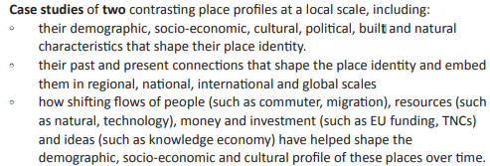
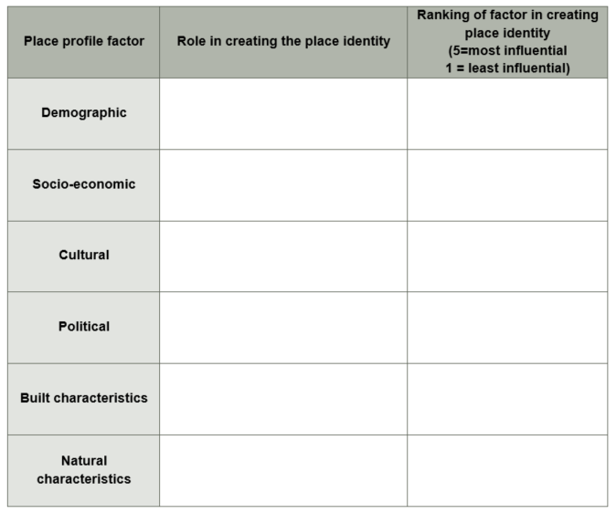
Activity 3(c) Case studies
Specification content:
How can HOT be developed from this activity?
Use resource 3(c) about Mill Road - Cambridge as ‘stimulus material’. (and the two websites in the notes below)
Notes:
OCR Delivery Guide for the Changing Spaces: Making Places topic. This includes teaching and learning ideas as well as resources: https://www.ocr.org.uk/qualifications/as-a-level-gce-geography-h081-h481-from-2016/delivery-guide/component-ge001-01-landscape-and-place/delivery-guide-asgedg003-changing-spaces-making-places-as
Mill Road Cambridge
https://www.cambridge-news.co.uk/news/cambridge-news/ridgeons-cromwell-road-cambridge-housing-14871229
‘Take me home, Mill Road’ https://www.varsity.co.uk/features/16803

Slide 14
Activity 3 - feedback and reflections
Each group to feedback ideas
Nature of the activities?
Which aspects of HOT are being developed?
Reflection
What will you try with your own students?

Slide 15
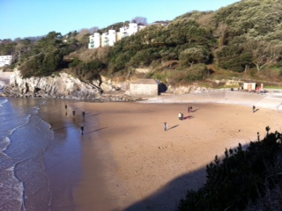
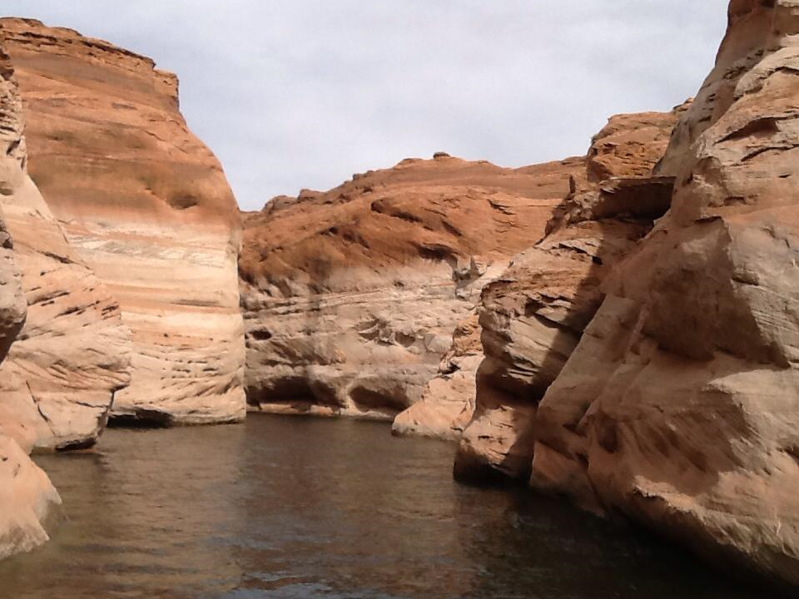
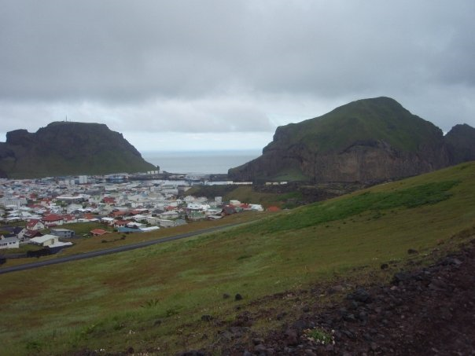
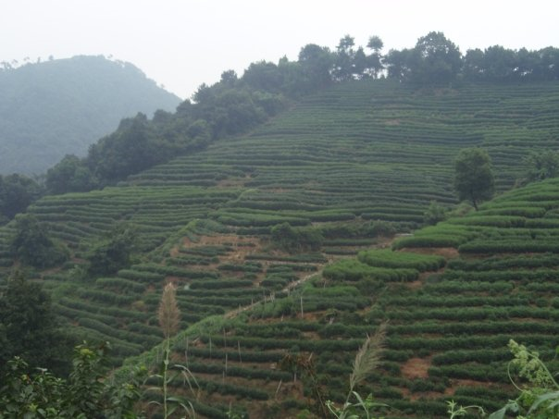
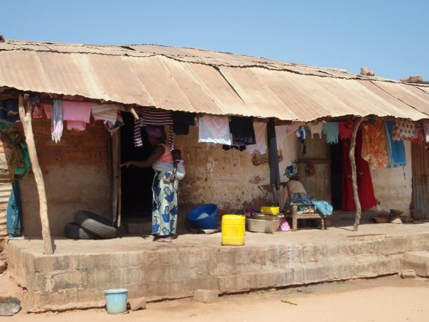
Case studies and examples
For the teacher …….
Authenticity and excitement
Distant places – challenging ideas
Enhance students understanding
Fieldwork opportunities
‘Real life’ V ‘the textbook’
To include:
Range in scale
Country variations
Case study v example
For the assessment …….
Exemplifies a point
Relevance to the question asked (application)
Demonstrates knowledge and understanding
Help develop arguments
Adds complexity to arguments
Explain and validate / disagree with concepts
How many is too many?

Slide 16
The assessment – AO2
Application of knowledge and understanding to
Interpret
Analyse
Evaluate
Discussion: How do we develop these skills or provide opportunities for students to develop these skills?
Context: Synoptic questions & essays
Geographical information and issues
Notes:
Handling the 33 mark essay questions – ‘top tips’
Question is usually a contentious statement; it has a ‘twist’ in it.
Students needs to answer the question in front of them, not the one prepared in class.
The introduction should state the general argument – to give direction
Ongoing evaluation is important because it prevents wandering away from the focus.
Use evaluative / comparative language - strongly, significance, importance, most vulnerable, relative importance etc
‘Come to a view‘ about the question - try and avoid sitting on the fence.

Slide 17
Essay writing
How do you prepare your students to write essays?
What do these require students to do?
Command terms – discuss, assess, to what extent
In the beginning!
Exam ready…..
Deconstructing the question
Writing frames – the structure
List of topic words to include
Case study summaries
A quick plan
Command words
Working out the ‘twist’
Key arguments
Relevant case studies (range of scales)
Come to a view
Evaluative ‘style’ language e.g.
However, despite, whereas, on the other hand, the most (significant), compared with, but, yet, although, nevertheless, therefore or overall.
Answers that are ‘more’ evaluative - explore several sides of an argument, demonstrate complexity and can potentially reach the higher levels.
Its all about timing!
Notes:
PEEL (Point, Explanation, Example , Link back to question)

Slide 18

Higher order thinking within the context of developing ‘critical thinkers’.
OECD and Harvard discuss important 21st century skills for students in the global economy.
Harvard – ‘global competencies’
Notes:
Diagram from – Mentoring Minds https://www.mentoringminds.com/
https://www.oecd.org/site/educeri21st/40756908.pdf
https://www.gse.harvard.edu/news/uk/16/11/how-thrive-21st-century

Slide 19
Do get in touch……..
Geography Subject Advisor – Shelley Monk
Email us at geography@ocr.org.uk
or tweet us at @OCR_Geography

