Slide 1
Fieldwork to develop deeper geographical understanding
Thursday 11th April
Shelley Monk
OCR geography Subject Advisor

Slide 2
Aims – GCSE focus
This interactive session will look at developing geographical understanding through actively using key terminology and exploring the fieldwork location to enable learners to make experiential connections to place. It will explore fieldwork in relation to the enquiry approach, effective geographical questions, embedding knowledge and understanding 'in the field' and encouraging learners to 'critically reflect'.

Slide 3
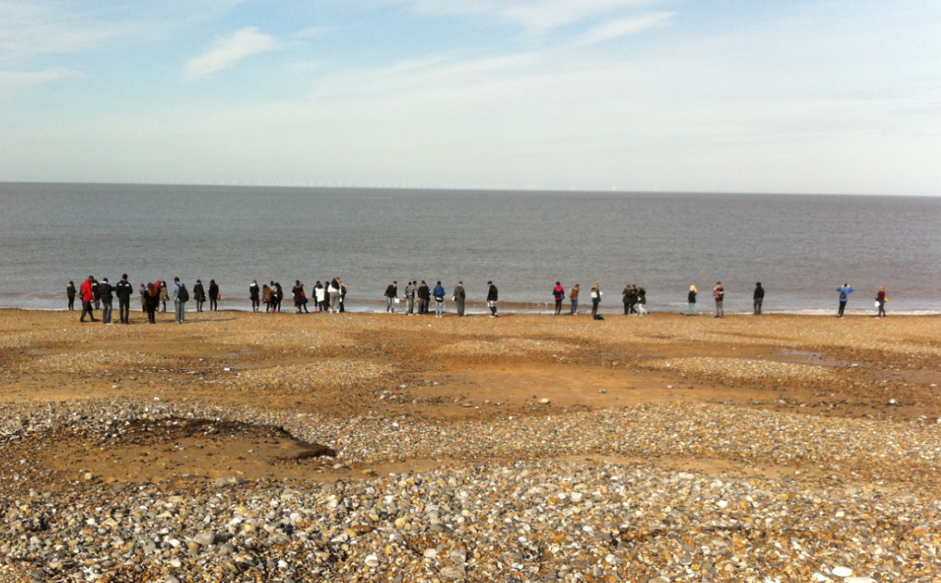
Fieldwork reflections
Activity 1
How do you design your fieldwork – what factors do you consider?
How much do you embed fieldwork into the curriculum / topic areas?
What do you do prior to the fieldwork visit? How do you prepare students?

Slide 4
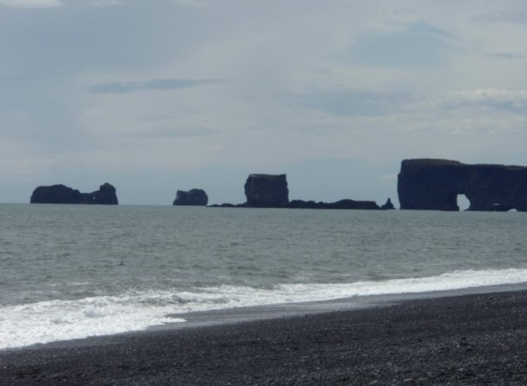
What does fieldwork offer?
Explore and contextualise topic areas and case studies to develop a deeper understanding
Go in search of evidence to answer geographical questions
Challenge ‘expected’ outcomes
Use geographical terminology in context
Engage with a ‘place’ / geographical location
‘Real life’ geography interrogating questions, concepts, processes, data …..
Consolidating or learning ‘new’ skills
Lots of fun and opportunities for skill development.
Notes:
Caton, D. (2006). Real world learning through geographical fieldwork. In D. Balderstone (Ed.),
http://uir.ulster.ac.uk/12617/1/JGHE_May_2009.pdf
Usefully enhance the causal link between student affective response (emotions, feelings and values) and deep learning
A number of other claims have also been made about the pedagogical benefits of fieldwork:
Fieldwork gives students the opportunity to develop a range of subject-specific skills (mapping, data collection and analysis) and transferable skills, such as independent learning and problem-solving (Andrews et al., 2003; Shah & Treby, 2006). In addition fieldwork can usefully encourage the development of interpersonal skills (Boyle et al., 2003).
2. Fieldwork lends itself to the promotion of active rather than passive modes of learning (Haigh, 1996; Kent et al., 1997). Healey & Jenkins (2000) for example have drawn attention to the role of active experimentation in Kolb’s experiential learning cycle and note how this “has a ready connection ... with students learning directly from the environment, particularly in fieldwork” (Healey & Jenkins, 2000, p. 193).
3. Fieldwork can create opportunities to “connect theory with real experience” (Kent et al., 1997, p. 319). This reinforces classroom-based learning by following it through in particular ‘real world’ situations. Theory and practice interrelate in a spiral of learning (Fuller et al., 2006).

Slide 5
What does research say?
Remmen and Frøyland (2014)
Evidence suggests that ‘students who actively engage with phenomena outdoors develop deeper cognitive and affective learning’
‘being actively involved in one’s own learning process can promote inquiry-based learning’
Oost et al. (2011)
Proposed that inquiry-driven fieldwork can potentially lead to a deep approach to learning: ‘A deep approach to learning is recognized when students are motivated and try to understand the meaning of the content by connecting new ideas to prior learning and by connecting specific examples to theoretical ideas and everyday life.’
Notes:
http://www.tandfonline.com/doi/pdf/10.1080/10382046.2014.891424 (Remmen & Frøyland, 2014)
http://www.tandfonline.com/doi/pdf/10.1080/10382046.2011.619808 (Oost et al. 2011)
http://deeperlearning4all.org/about-deeper-learning
https://www.academia.edu/1715153/Student-led_learning_and_engagement_with_place_on_international_fieldwork

Slide 6
Enquiry approach
Why use an enquiry approach?
Encourages exploration, discovery, thinking, questioning, reflection and analysis
Encourages learners to take ownership of their learning and understanding
Encourages learners to engage, collaborate and problem solve
Fieldwork skill from the GCSE specifications:
‘Reflecting critically on fieldwork data, methods used, conclusions drawn and knowledge gained’
This goes beyond students simply writing about what they did ….. (AO3 – application of knowledge and understanding)
http://galileo.org/wp-content/uploads/2012/10/inquiry_lc.png
Notes:
Questioning – critical attitude towards geographical knowledge
Learn to use reasoning and argument to reach evidence based conclusions
Critical understanding of complex geographical concepts
http://galileo.org/wp-content/uploads/2012/10/inquiry_lc.png
http://www.geography.hunter.cuny.edu/~jochen/GTECH361/lectures/lecture02/concepts/12%20The%20geographic%20inquiry%20process.html
https://intranet.birmingham.ac.uk/as/cladls/edudev/documents/public/ebl/finding-out/ebl-characteristics-fundamentals-approaches.pdf
http://www.thinkingschoolsinternational.com/site/wp-content/uploads/2012/09/Pgs-45-461.pdf

Slide 7
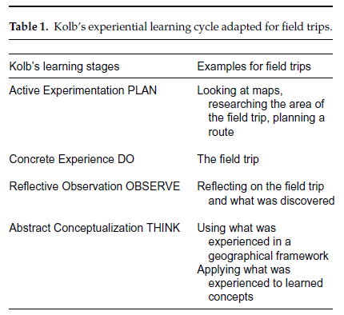
Experiential Learning - Kolb
‘Learning is the process whereby knowledge is created through the transformation of experience’ (Kolb 1984)
Notes:
Images on the slide from –
Field Trips as Valuable Learning Experiences in Geography Courses (Amy Richmond Krakowka)
https://www.tandfonline.com/doi/abs/10.1080/00221341.2012.707674
Promoting and Assessing ‘Deep Learning’ in geography fieldwork: An evaluation of reflective Fieldwork Diaries (Trevor J. B. Dummer , Ian G. Cook , Sara L. Parker , Giles A. Barrett & Andrew P. Hull)
https://www.tandfonline.com/doi/pdf/10.1080/03098260701728484

Slide 8
Role of the teacher and student in fieldwork
Notes:
Graph resource - Oost, K., De Vries, B. & Van der Schee (2011). Enquiry-driven fieldwork as a rich and powerful teaching strategy – school practices in secondary geography education in the Netherlands. International Research in Geographical and Environmental Education, (20)4, 309-325, p. 311.

Slide 9
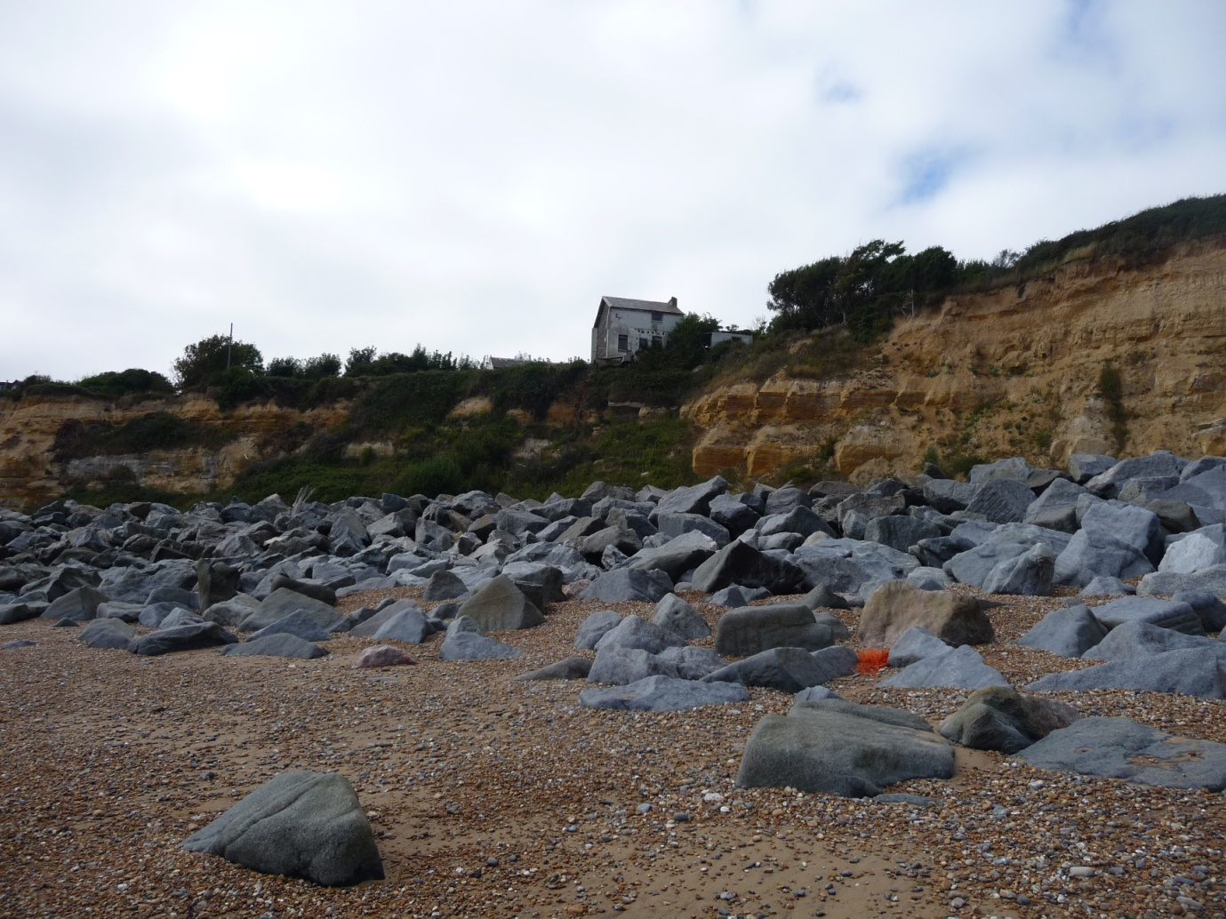
‘Examining’ Fieldwork
Activity 2
Let’s start here!
How can we create opportunities for
student’s to do this?
Notes:
If planning fieldwork… Work way through each of the criteria.
Cliffs at Fairlight (Hastings) East Sussex (J Lyon)
What makes a good geographical question?
3 rules e.g. Spatial (where/scale), Measurable (qual/quant/mixed), Geographical hook (link to the Spec/Geographical underpinning. Can you think of anymore?
Student questions to engage in the environment.
The basic ones e.g. How strong at the rocks? How did the rocks get here? Why are they a different colour from the cliffs? Better still – when will the house fall over the cliff? How long will the rocks be resistant to erosion? How long will the rocks protect the cliff?

Slide 10
GCSE B – Distinctive Landscapes
How can we embed and create a deeper understanding of this topic through fieldwork?

Slide 11
Coasts case study - ‘flipping fieldwork’
Virtual fieldwork (before you go!)
Awe and wonder, developing a ‘sense of place’, real world geography
Holderness coastal erosion – GIS opportunities
What do you notice about the shape of the coastline?
What landforms can you identify?
Which direction do you think long shore drift is travelling in?
3D map
Why is the coastline not straight?
Why do you think the grey stones are on the beach?
Historic map
Why is the coastline not in the same place?
How much has the coastline ‘moved’?
Can you work out where this is?
Notes:
https://esriukeducation.maps.arcgis.com/home/webscene/viewer.html?webscene=e34b02ba5315431a83a542f9162739e8
Impact
Teaching the topic content ‘in the field’
Geographical language in context - geomorphic processes, landform development & management techniques
Opportunity to engage with geographical skills e.g. OS map, GIS images, coastal erosion data
Higher order thinking – developing a question, data analysis, critical reflection of data collection and quality of data collected (validity and reliability) e.g. what did you expect to find & what did you actually find?
How can you ‘test’ impact e.g. use of exam questions?
Activities
Geography detectives - Developing a sense of place e.g. Where? What? When? How? (OS map, satellite imagery, photos, coastal retreat GIS). Primary versus secondary data?
What do we want to find out and how? In the students own words! Get planning ………..
2 sites (landforms) e.g. beach, sand dunes, cliffs?
Why protect some areas and not others? Management of the coast e.g. hard and soft engineering

Slide 12
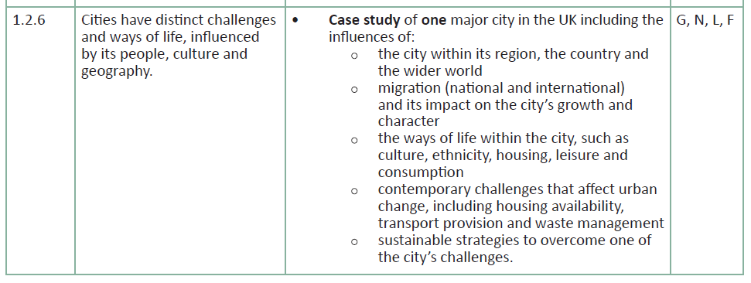
Embedding fieldwork learning and skills
Activity 3
Where are the opportunities for fieldwork?
What can you ‘facilitate’ to bring ‘this place to life’?
How can you develop geographical language?
GCSE A Topic: People of the UK

Slide 13
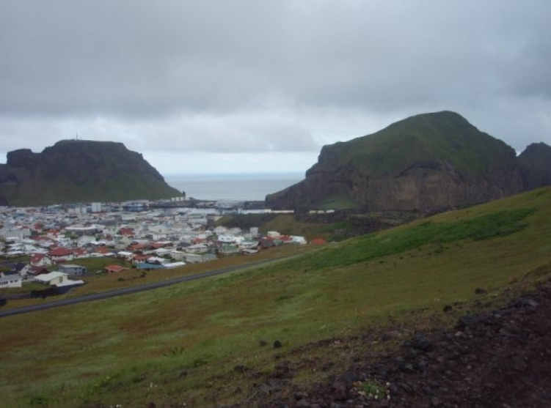
Fieldwork: points for reflection
Choosing a fieldwork experience with potential to support topic content:
Embed key terms in context
Develop and extend understanding
Depth and place specific detail developed for case studies
Learner ownership of the fieldwork experience e.g. choice of title, data collection (design) and sampling
Flexibility of approaches to data presentation and analysis techniques – what works well for the ‘data’ gathered? Why choose those approaches over others?
Being an ‘evaluative geographer’ – wording within questions e.g. ‘most’ successful, ‘most’ effective, to what extent, justifications / reasoning (for choices).

Slide 14
Do get in touch……..
Geography Subject Advisor – Shelley Monk

