Slide 1

Tree diagrams lesson element

Slide 2
Level 3 Certificate in Quantitative Problem Solving (MEI) and Level 3 Certificate in Quantitative Reasoning (MEI)
Using frequencies in tree diagrams to calculate probabilities

Slide 3
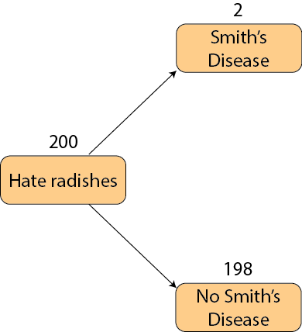
Using frequencies to find probabilities
Use frequencies with tree diagrams and other forms of representation to calculate or estimate probabilities, including conditional probabilities:

Slide 4
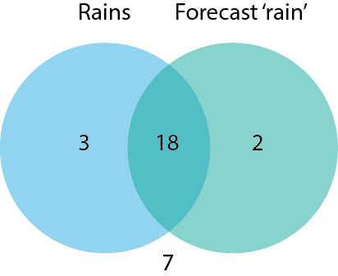
Using frequencies to find probabilities
Use frequencies with tree diagrams and other forms of representation to calculate or estimate probabilities, including conditional probabilities:

Slide 5
Using frequencies to find probabilities
Use frequencies with tree diagrams and other forms of representation to calculate or estimate probabilities, including conditional probabilities:
 | Forecast ‘rain’ | Forecast ‘no rain’
Rains | 18 | 3 | 21
Does not rain | 2 | 7 | 9
 | 20 | 10 | 30

Slide 6
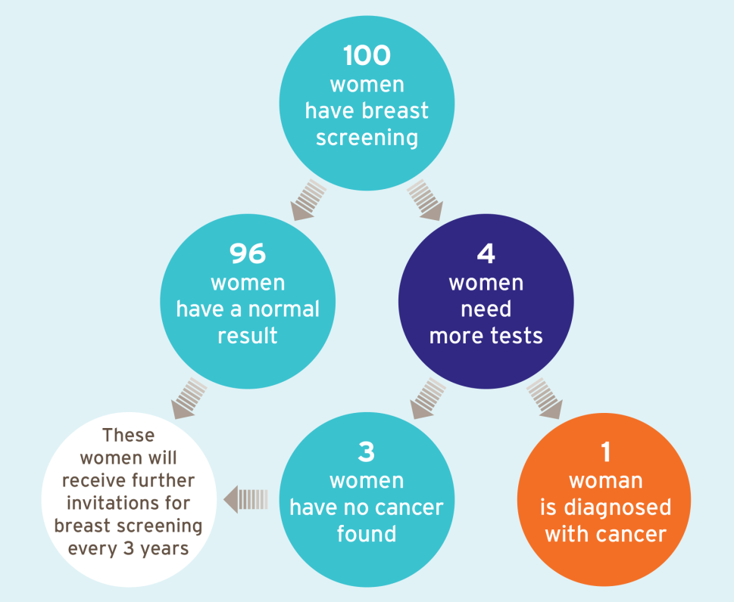
Using frequencies to find probabilities
An image from an NHS Screening programme leaflet which uses expected frequencies to communicate the chances of different events following a mammogram:
What is the chance that someone referred for more tests is diagnosed with cancer?
Image from http://www.cancerscreening.nhs.uk/breastscreen/publications/ia-02.html

Slide 7
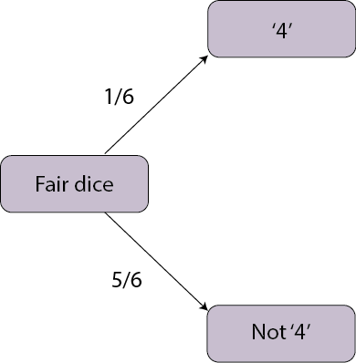
Using frequencies to find probabilities
Some balanced dice have probability 1/6 of coming up ‘4’.
Out of 60 throws, how many ‘4’s would we expect to come up?

Slide 8
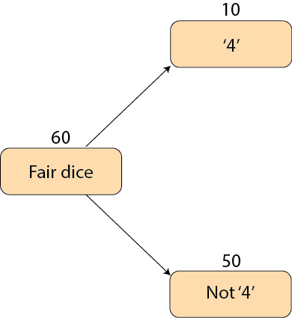
Using frequencies to find probabilities
Some balanced dice have probability 1/6 of coming up ‘4’.
Out of 60 throws, how many ‘4’s would we expect to come up?

Slide 9
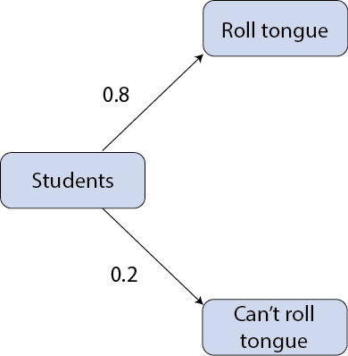
Using frequencies to find probabilities
80% of the school students can roll their tongues.
If I pick 1000 students at random, how many do you expect will NOT be able to roll their tongues?

Slide 10
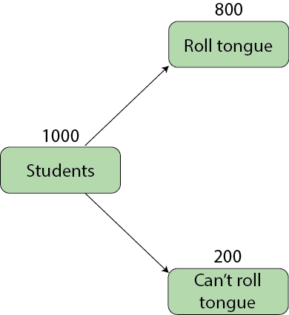
Using frequencies to find probabilities
80% of the school students can roll their tongues.
If I pick 1000 students at random, how many do you expect will NOT be able to roll their tongues?

Slide 11

Using frequencies to find probabilities
In a typical school with 80 Year 10 students, 64 of them will have a profile on the social media site Face-ache.
What is the probability that if we pick a Year 10 student at random, they will not have a profile?

Slide 12
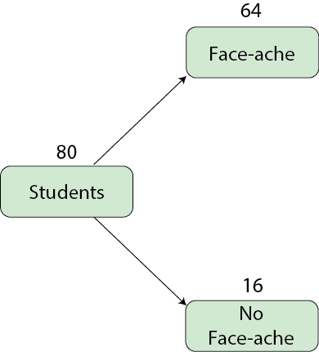
Using frequencies to find probabilities
In a typical school with 80 Year 10 students, 64 of them will have a profile on the social media site Face-ache.
What is the probability that if we pick a Year 10 student at random, they will not have a profile?

Slide 13
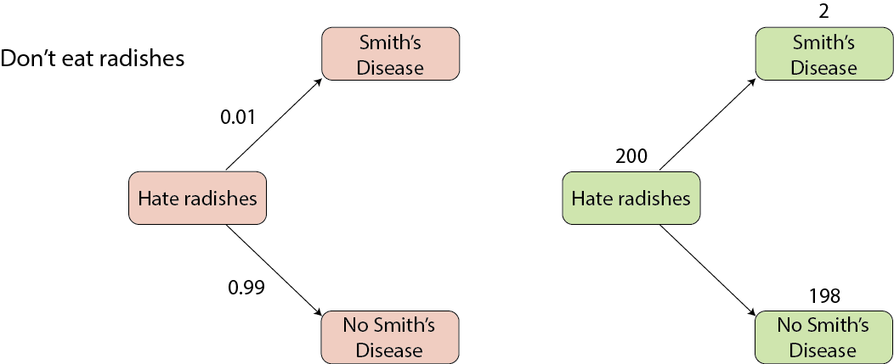
Using frequencies to find probabilities
A newspaper headline says that eating radishes doubles your chance of getting Smith’s Disease. 1% of people who don’t eat radishes get Smith’s Disease anyway.

Slide 14
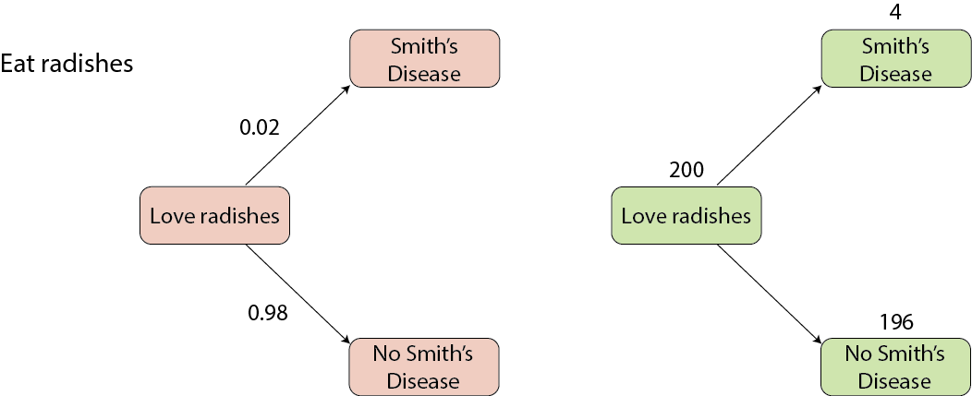
Using frequencies to find probabilities
A newspaper headline says that eating radishes doubles your chance of getting Smith’s Disease. 1% of people who don’t eat radishes get Smith’s Disease anyway.

Slide 15
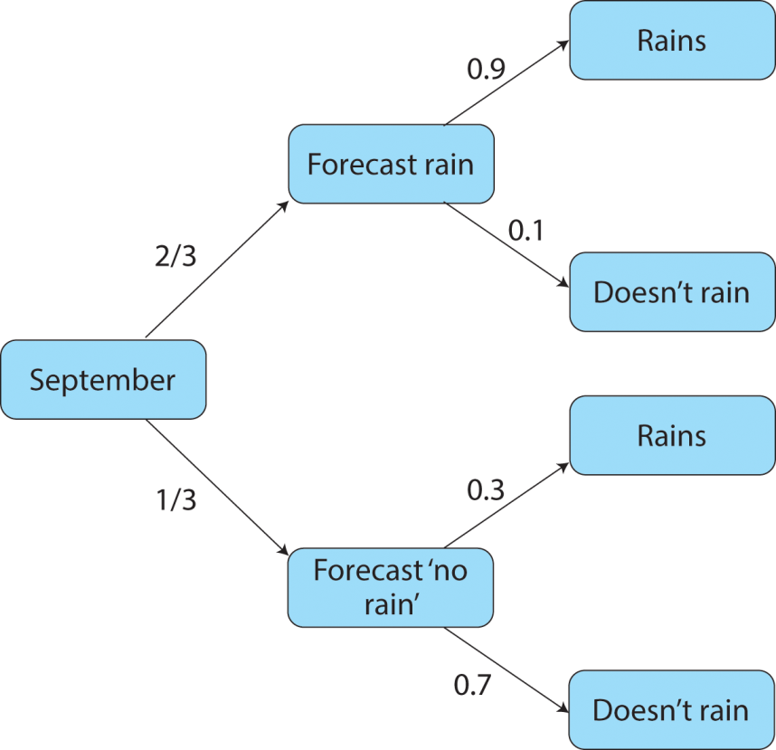
Using frequencies to find probabilities
A weather forecast is generally right. When it forecasts ‘rain’, 90% of the time it rains. When it forecasts ‘no rain’, 70% of the time it does not rain.
In a typical September they forecast rain on two-thirds days and no rain on one-third of days.

Slide 16
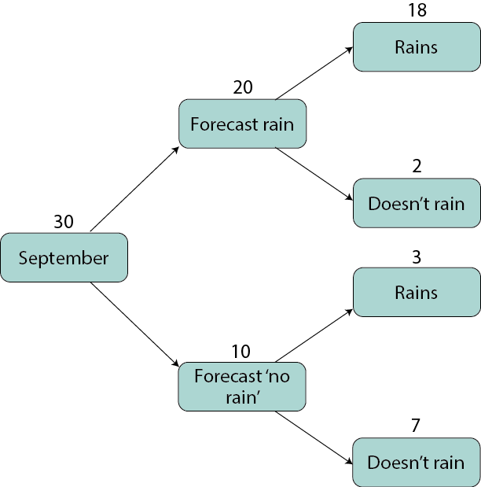
Using frequencies to find probabilities
A weather forecast is generally right. When it forecasts ‘rain’, 90% of the time it rains. When it forecasts ‘no rain’, 70% of the time it does not rain.
In a typical September they forecast rain on two-thirds days and no rain on one-third of days.

Slide 17
Thank you for using
this OCR resource
Other OCR resources are available at www.ocr.org.uk

Slide 18
