Slide 2
Contents
Aims
Learning outcome 1 – understand the issues which affect participation in sport
Learning outcome 2 – know about the role of sport in promoting values
Learning outcome 3 – understand the importance of hosting major sporting events
Learning outcome 4 – know about the role of national governing bodies in sport.

Slide 3
Learning outcome 1 – understand the issues which affect participation in sport
Different user groups
Ethnic minorities
Retired people / people over 50
Families with young children
Single parents
Children
Teenagers
Disabled
Unemployed / economically disadvantaged
Working singles and couples

Slide 4
Learning outcome 1 – understand the issues which affect participation in sport
Barriers that can affect participation
Employment / time (e.g. not much free time)
Work restrictions / family commitments
Disposable income (lack of)
Accessibility of facilities / equipment
Lack of role models
Provision of activities
Awareness of activity provision
Portrayal of gender issues by the media

Slide 5
Learning outcome 1 – understand the issues which affect participation in sport
Barriers and user groups
TASK: Identify up to three barriers for each user group. The first one has been completed as an example.
User group | Barrier 1 | Barrier 2 | Barrier 3
Families with young children | Lack of free time | Family commitments | Lack of disposable income
Retired people/people over 50
Single parents
Children
Disabled
Ethnic minorities
Teenagers
Working singles and couples
Unemployed/economically disadvantaged

Slide 6
Learning outcome 1 – understand the issues which affect participation in sport
Solutions to barriers
Provision
Programme specific sessions to cater for different user groups – e.g. evening activities for working singles
Provide appropriate activity options
Plan times to suit different user groups.
Promotion
Use role models specific for different groups
Targeted promotion – advertise in appropriate places
Initiatives aimed at increasing participation – under 16’s free swimming.

Slide 7
Learning outcome 1 – understand the issues which affect participation in sport
Solutions to barriers
Access
Access to facilities – wheelchair ramps, transport in rural areas
Access to equipment
Sensible pricing – offer concessions / discounts
In your groups link a solution to the barriers you identified

Slide 8
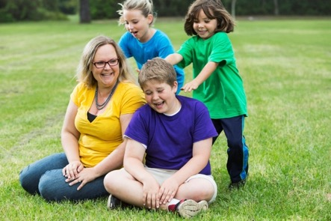
Learning outcome 1 – understand the issues which affect participation in sport
Exam question focus
Jane is a single parent with three young children. She is currently unemployed. Jane is keen to try a new sport. Identify three barriers that might prevent Jane from taking part regularly in sport.
1.
2.
3.

Slide 9
Learning outcome 1 – understand the issues which affect participation in sport
Exam question focus
Lack of childcare/lack of sports activities where she can also take the children to participate
Lack of time
Lack of disposable income/money/can’t afford transport
Lack of role models
Lack of awareness
Activities not at a suitable time
Family commitments/taking children to their leisure activities

Slide 10
Learning outcome 1 – understand the issues which affect participation in sport
Exam question focus
What wasn’t accepted as an answer and why
Do not accept – she is a single parent, or she is unemployed = this is in the question so is a repeat.
Give benefit of doubt – taking care of children
Do not accept – lack of transport on its own, must relate to cost

Slide 11
Learning outcome 1 – understand the issues which affect participation in sport
Exam question focus
Now try these two:
John is a single parent with young children who works full-time. He is interested in participating in more sport.
Identify four barriers that might prevent John from regular participation in sport
Suggest two solutions that could help John to participate in more sport.

Slide 12
Learning outcome 1 – understand the issues which affect participation in sport
Exam question focus – answers
Lack of childcare / no childcare
Lack of transport / no transport
Expense of equipment / participation charge
No suitable programmed sessions / suitable activities
Lack of awareness of facility / activity provision
Lack of free time (due to family commitments)
Work restrictions / unsuitable timing of activities (due to work commitments)
Lack of role models.
Do not accept – he is a single parent.
Do not accept – lack of income or cannot afford it.
BOD lack of time.
Do not accept – the word time on own.
Do not accept – works full time.

Slide 13
Learning outcome 1 – understand the issues which affect participation in sport
Exam question focus
Providing appropriate activity options/family-based activities
Programming/appropriate timing of sessions
Reduction in cost/subsidized sessions
Providing childcare/crèche (BOD ‘get someone to look after the children’)

Slide 14
Learning outcome 1 – understand the issues which affect participation in sport
Exam question focus
In your groups/pairs write a question about a user group.
Set the scene – who is the user group, is there anything about them we need to know (work, money, time, family)?
What do they want to take part in?
The first part should have between three and four marks available to identify barriers.
The second part should require the answer to identify two or three solutions.
Make sure you have written a mark scheme with what you will and will not accept in the answer.

Slide 15
Learning outcome 1 – understand the issues which affect participation in sport
What else can affect popularity of sport?
Levels of participation – how many people already do the sport?
Provision – how many facilities there are for people to access
Environment/climate – is it suitable for the sport?
Spectatorship – how easy is it to watch the sport, how many people watch the sport?
Media coverage
Success of teams and individuals – cycling in the Olympics
Role models
Acceptability – e.g. sports perceived as violent.

Slide 16
Learning outcome 1 – understand the issues which affect participation in sport
What else can affect popularity of sport?
TASK: For each of the eight factors, give an example that helps increase popularity and an example that would have a negative effect on popularity. The first one has been completed as an example.
Factors | Increase popularity | Negative effect on popularity
Level of participation | Football has a well-developed infrastructure, which means that there are a lot of participants as there are lots of places/clubs/leagues. | Rowing is not as developed as football as there are not as many participants due to less rowing clubs
Provision
Environment/climate
Spectatorship
Media coverage
Success of teams/individuals
Role models
Acceptability

Slide 17
Learning outcome 1 – understand the issues which affect participation in sport
What else can affect popularity of sport?
Think of the area that you live in
Think of the user group you are in
What barriers might you face
What solutions could be put in place
What factors affect the popularity of two sports that you would consider taking part in
What factors affected your choice of sport to take part in
Write a short paragraph answering each of the areas above

Slide 18
Learning outcome 1 – understand the issues which affect participation in sport
Trends in the popularity of sport
TASK: Complete some research on the internet to show what trends there are in the popularity of sports.
For example, studies and statistics in recent years have suggested that recreational walking, fishing/angling, cycling and swimming are the most popular sports in the UK in terms of numbers participating.
Here are some links to websites to get you started:
Sport England – Active Lives
Statista – Sports in the United Kingdom
See what you can find and write a short report/presentation of some of your findings – try and link it to the factors that affect popularity and user groups.

Slide 19
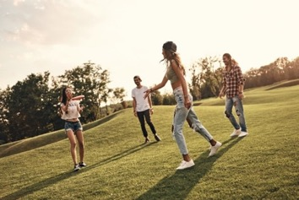
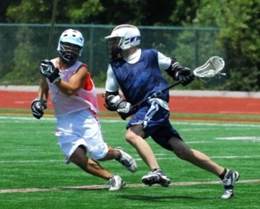
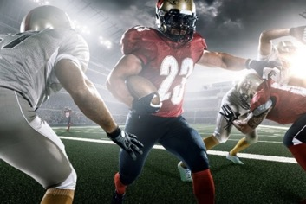
Learning outcome 1 – understand the issues which affect participation in sport
Emerging sports
TASK:
What is an emerging sport?
In your pairs / groups think of as many emerging sports in the UK as you can
Think of the factors that affect popularity of sport and for one of the emerging sports you have found think of how those factors could affect the growth and popularity of that emerging sport.

Slide 20
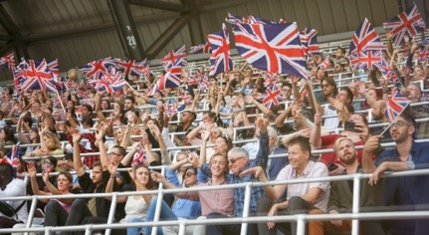
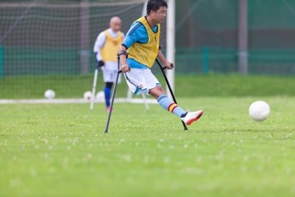
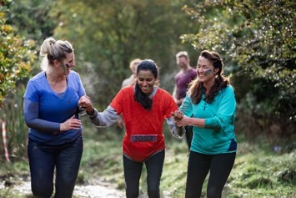
Learning outcome 2 – know about the role of sport in promoting values
Sport can promote the following values:
Team Spirit
Fair Play
Citizenship
Tolerance and Respect
Inclusion
National Pride
Excellence.
TASK: What do each of these mean in sport – give an example of how each of these are shown.

Slide 21
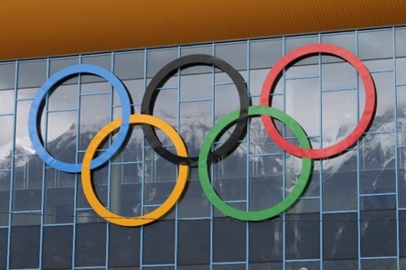
Learning outcome 2 – know about the role of sport in promoting values
Olympics and Paralympics
There are seven Olympic and Paralympic values:
Friendship
Respect
Excellence
Determination
Inspiration
Courage
Equality.

Slide 22
Learning outcome 2 – know about the role of sport in promoting values
Olympics and Paralympics
The Olympic motto:
Faster, higher, stronger
The Olympic creed:
“The most important thing in the Olympic games is not to win but to take part, just as the most important thing in life is not the triumph but the struggle. The essential thing is not to have conquered but to have fought well”.
Pierre de Coubertain (founder of the Modern Olympics).

Slide 23
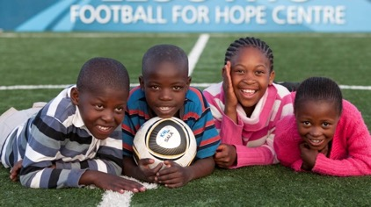
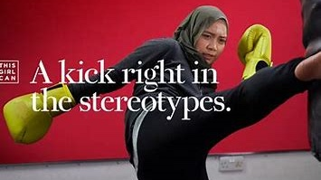
Learning outcome 2 – know about the role of sport in promoting values
Initiatives to break barriers
Football – Football for hope (watch the video here)
ECB – Chance to shine
Sport Relief
Premier League – Creating chances
Sport England – This girl can (watch the video here)
TASK: Research one of these or one of your own and write a list of how values are promoted.

Slide 24
Learning outcome 2 – know about the role of sport in promoting values
Initiatives and events that promote vales
Kick It Out (watch the video here)
Respect
Transforming British Tennis Together
Back To Netball (watch the video here)
TASK: What barriers are these trying to break? Can you think of any other initiatives?

Slide 25
Learning outcome 2 – know about the role of sport in promoting values
Etiquette and sporting behaviour
Performer etiquette and sporting behaviour
Perform in fair way
Promotes values
Safety
Positive role model

Slide 26
Learning outcome 2 – know about the role of sport in promoting values
Etiquette and sporting behaviour
Spectator etiquette and sporting behaviour
Being quiet during rallies at wimbledon
Quiet during play in snooker
Quiet during national anthems
What other examples can you think of?

Slide 27
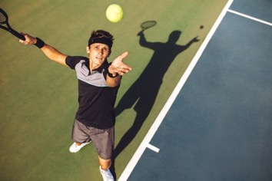
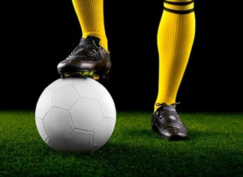
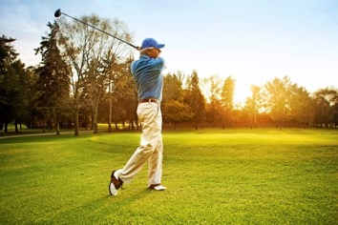
Learning outcome 2 – know about the role of sport in promoting values
Gamesmanship
TASK: What is gamesmanship?
Make a list of examples of gamesmanship from different sports.

Slide 28
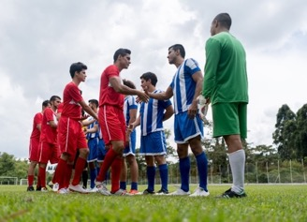
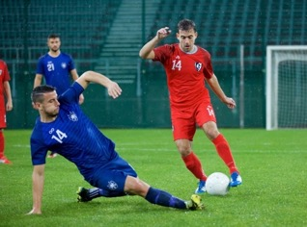
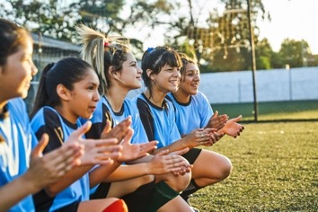
Learning outcome 2 – know about the role of sport in promoting values
Sportsmanship
TASK: What is sportsmanship?
Make a list of examples of sportsmanship.

Slide 29
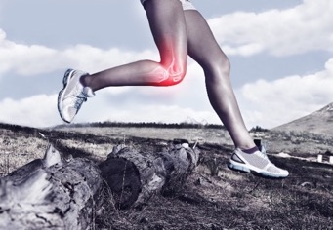
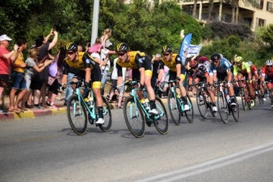
Learning outcome 2 – know about the role of sport in promoting values
Drugs in sport
TASK: Why might a performer use drugs?
Why shouldn’t performers use drugs in sport?

Slide 30
Learning outcome 2 – know about the role of sport in promoting values
Drugs in sport
How do we prevent / reduce drug taking?
WADA Whereabouts rule
Drugs test – sample blood, urine, hair, nails
Sanctions
Education

Slide 31
Learning outcome 2 – know about the role of sport in promoting values
Drugs in sport
Research:
Drug offences by elite performers
Impact of drug taking on the reputation of sport
Ethical issues related to drug taking.
TASK: Identify an athlete, what substance they were caught using and what were the implications – bans/fines, etc.

Slide 32
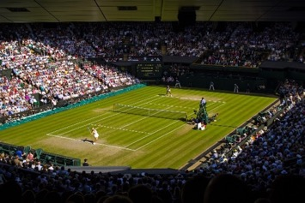
Learning outcome 3 – understand the importance of hosting major sporting events
Importance of hosting major sporting events
Features of events
One-off – Only happen once in a generation in any certain city e.g. the Olympics
Regular – Annual event, different cities e.g. UEFA Champions League Final
Regular and recurring – Annual and in same venue e.g. Wimbledon.

Slide 33
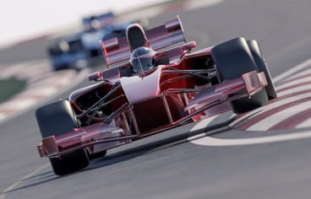
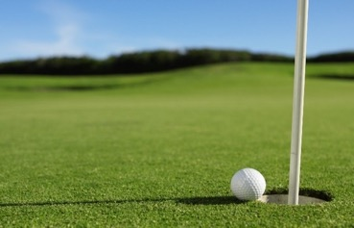
Learning outcome 3 – understand the importance of hosting major sporting events
Importance of hosting major sporting events
TASK: Features of events – write some more examples of each type of event (remember to check how often they happen and if the venue changes).
One-off –
Regular –
Regular and Recurring –

Slide 34
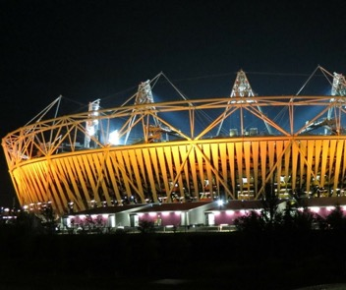
Learning outcome 3 – understand the importance of hosting major sporting events
Hosting major sporting events
TASK: What else needs to be considered?
Investment
Legacy
Sporting
Social
Economic
Sports facilities left after the event have both a sporting and social legacy.
What other legacies are left – look at the points above to guide you.

Slide 35
Learning outcome 3 – understand the importance of hosting major sporting events
Hosting major sporting events
Benefits of hosting
Investment in developing/improving transport system
Increased direct and indirect tourism
Commercial benefits (e.g. money from sponsors, external investment which would not otherwise have been attracted)
Participation may increase in some sports
Infrastructure/social facilities built can be used by people who live in the area where the events have been held
Sports facilities will be improved, or new facilities built
Raise the status of the country/’shop window effect’
Morale of the country is raised.

Slide 36
Learning outcome 3 – understand the importance of hosting major sporting events
Hosting major sporting events
Drawbacks of hosting
Bidding to host can be expensive and you may not be awarded the event
Event can cost hosts more than it raises in revenue
Facilities can end up not being used after the event if not planned properly
Can have negative impact on the status of the country if event runs poorly/is disorganised
While hosting the event will help to promote one area of sport, others may suffer as a consequence
Can cause divisions in the country if the specific area which hosted (e.g. one city) is perceived to have been the only beneficiary
Increased risk of terrorism/crime
Increase population – traffic, overcrowding, litter.

Slide 37
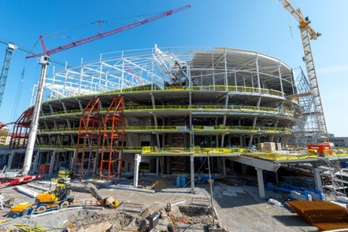
Learning outcome 3 – understand the importance of hosting major sporting events
Hosting major sporting events
TASK: Think of a recent major sporting event.
Write a report or a presentation about what the benefits and drawbacks were for the host city. Include:
Before hosting
During the event
After the event.

Slide 38
Learning outcome 4 – know about the role of national governing bodies in sport
The role of national governing bodies
TASK: Make a list of between 10–15 sports and name the national governing body for each sport.

Slide 39
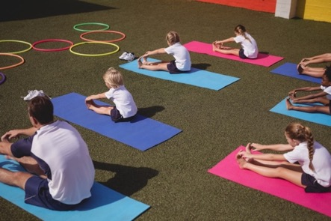
Learning outcome 4 – know about the role of national governing bodies in sport
The role of national governing bodies
Promotion
Promoting participation e.g. equal opportunities policies
Increasing the popularity of the sport e.g. schemes for schools
Exposure in the media e.g. press releases, public relations.

Slide 40
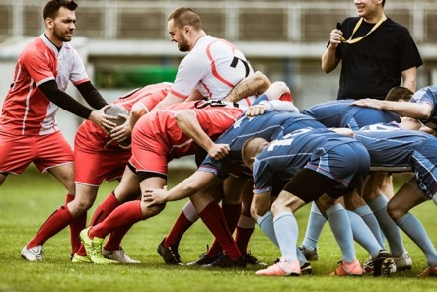
Learning outcome 4 – know about the role of national governing bodies in sport
The role of national governing bodies
Development
Elite training – national performance squads and national teams in many sports
Coaching awards – England Netball UK coaching certificate
Training officials – Rugby Football Union has a young officials award which can be used as a starting point to becoming an official.

Slide 41
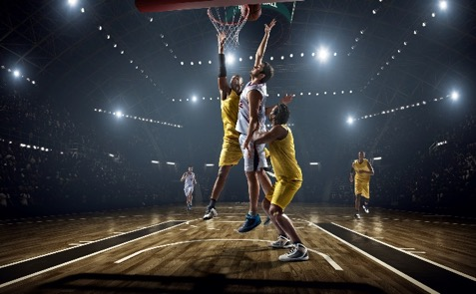
Learning outcome 4 – know about the role of national governing bodies in sport
The role of national governing bodies
Infrastructure
Competitions and tournaments e.g. England Basketball organize national competitions for over 500 teams from senior to under-13 level
Rule-making and disciplinary procedures e.g. the Football Association has a disciplinary procedure for any individual or team connected with the sport
Providing a national and directive and vision
Providing guidelines, support and insurance to members
Assist with facility developments.

Slide 42
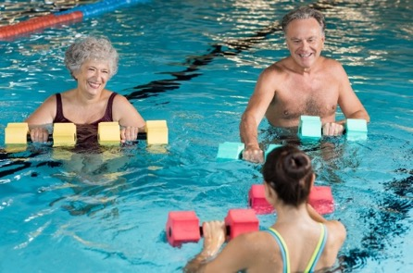
Learning outcome 4 – know about the role of national governing bodies in sport
The role of national governing bodies
Policies and initiatives
Anti-doping policies e.g. the England and Wales Cricket Board has an anti-doping policy and has a list of all substances which are permitted and those that are banned
Promoting etiquette and fair play e.g. the Football Association’s ‘Respect’ campaign
Community programmes e.g. Amateur Swimming Association’s ‘Swimfit’
Information and guidance on safeguarding.

Slide 43
Learning outcome 4 – know about the role of national governing bodies in sport
The role of national governing bodies
Funding
Lobby for and receive funding
Distribution of funds e.g. grants, membership, subscriptions/match fees, lottery funding, merchandising, income from media/sponsorship/advertising, private investment and donations
Provide members with advice about funding.

Slide 44
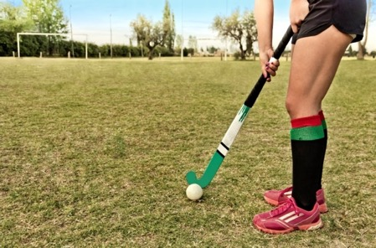
Learning outcome 4 – know about the role of national governing bodies in sport
The role of national governing bodies
Support
Providing technical advice e.g. England Hockey provide information about playing surfaces
Providing location and contact details for local clubs, how to get started in the sport, etc.

Slide 45
Learning outcome 4 – know about the role of national governing bodies in sport
National governing bodies
Types of funding – lobby for, receive and distribute
Grants
Government, non-government
Membership
Subscriptions/match fees
Lottery funding
Income from media/sponsorship/advertising
Private investment and donations
Merchandising
Admission charges
Fundraising events.

Slide 46
Learning outcome 4 – know about the role of national governing bodies in sport
National governing bodies
TASK: Think about your local area and sports.
Choose one sport and research how the national governing body has helped that sport in your area.
Think about the main areas:
Promotion
Support
Funding.
You can write a report, prepare a presentation or design a leaflet to show your research.

Slide 47
We’d like to know your view on the resources we produce. Click ‘Like’ or ‘Dislike’ to send us an auto generated email about this resource. Add comments if you want to. Let us know how we can improve this resource or what else you need. Your email will not be used or shared for any marketing purposes.
Looking for another resource? There is now a quick and easy search tool to help find free resources for your qualification.
OCR is part of Cambridge Assessment, a department of the University of Cambridge. For staff training purposes and as part of our quality assurance programme your call may be recorded or monitored. Oxford Cambridge and RSA Examinations is a Company Limited by Guarantee. Registered in England. Registered office The Triangle Building, Shaftesbury Road, Cambridge, CB2 8EA. Registered company number 3484466. OCR is an exempt charity.
OCR operates academic and vocational qualifications regulated by Ofqual, Qualifications Wales and CCEA as listed in their qualifications registers including A Levels, GCSEs, Cambridge Technicals and Cambridge Nationals.
OCR provides resources to help you deliver our qualifications. These resources do not represent any particular teaching method we expect you to use. We update our resources regularly and aim to make sure content is accurate but please check the OCR website so that you have the most up to date version. OCR cannot be held responsible for any errors or omissions in these resources.
Though we make every effort to check our resources, there may be contradictions between published support and the specification, so it is important that you always use information in the latest specification. We indicate any specification changes within the document itself, change the version number and provide a summary of the changes. If you do notice a discrepancy between the specification and a resource, please contact us.
© OCR 2020 You can copy and distribute this resource freely if you keep the OCR logo and this small print intact and you acknowledge OCR as the originator of the resource.
OCR acknowledges the use of the following content: Slide 8: Woman with 3 kids, kali9/Getty Images; Slide 11: Man reading to two kids, monkeybusinessimages/Getty Images; Slide 19: Playing with a frisbee, g-stockstudio/Getty Images: Playing lacrosse, CDH_Design/Getty Images: American football, Dmytro Aksonovo/Getty Images; Slide 20: Waving flags in a stadium, tomazi/Getty Images: Amputee playing football, tecep-bg/Getty images: Muddy runners, SolStock/Getty Images; Slide 27: Tennis player, jacoblund/Getty Images: Footballer, Georgijevic/Getty Images: Playing golf, Orbon Alija/Getty Images; Slide 28: Footballers shaking hands, andreser/Getty Images: Football tackle, simonkr/Getty Images: Girls football team clapping, Portra/Getty Images; Slide 29: Knee pain, Yuri_Arcus/Getty Images: Medals and drugs, Valerii Evlakhov/Getty Images: Man sprinting, sportpoint/Getty Images; Slide 30: Footballer, AaronAmat/Getty Images: Wellness and Illness, gustavofrazo/Getty Images: Cycle race, Larissa Goffman/Getty Images; Slide 31: Drugs test fail, KHL49/Getty Images; Slide 33: UEFA Champions league flag, Oleksii Liskonih/Getty Images; Slide 34: Motor racing, mevans/Getty Images: Golf ball, sculpies/Getty Images; Slide 38: Stadium construction, Blurra/Getty Images; Slide 40: School kids stretching, Wavebreakmedia/Getty Images; Slide 41: Rugby scrum, skynesher/Getty Images; Slide 42: Basketball players, Dmytro Aksonov/Getty Images; Slide 43: Seniors doing aqua aerobics, Ridfranz/Getty Images; Slide 44: Charity donations, Scar1984/Getty Images; Slide 45: Hockey player, EAQ/Getty Images.
Whether you already offer OCR qualifications, are new to OCR or are thinking about switching, you can request more information using our Expression of Interest form.
Please get in touch if you want to discuss the accessibility of resources we offer to support you in delivering our qualifications.

