Slide 1

The role of markets and money

Slide 2
Learners should be able to
2.1 The role of markets
Explain what is meant by a market
explain the features of the primary, secondary and tertiary sectors, including the difference between the production of goods and services
explain the difference between factor and product markets, including their interdependence
evaluate the costs and benefits of specialisation and exchange in markets including for producers, workers, regions and countries.

Slide 3
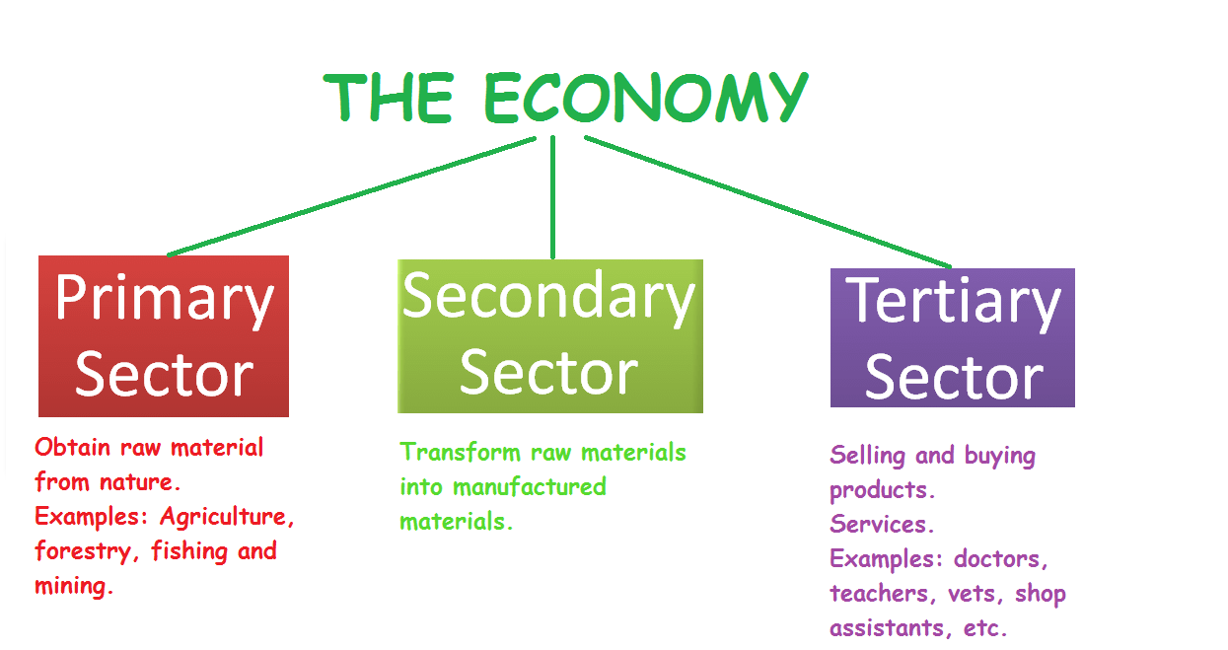
Activity
Use the information below to sort the next slide into each sector

Slide 4

Activity

Slide 5
Key terms
Market
Where buyers and sellers come together in order to buy or sell goods and services.
Primary sector
Direct use of natural resources such as extracting oil from the land.
Secondary sector
Manufacturing or construction activities.
Tertiary sectors
Industries that provide a service, such as transport or finance.
Goods
Physical products/tangible.
Services
Intangible.

Slide 6
Key terms
Factor market
Where the services of the factors of production are sold.
Product markets
Where final goods and services are offered to consumers businesses and the public sector.
Specialisation
The process whereby individuals, firms, regions or countries focus on producing what they are best at.
Exchange
Giving up of something you have in return for something you do not have.

Slide 7
Activity
Below are general advantages and disadvantages of specialisation. Use the textbook pages 27-30 to outline them for producers, workers regions and countries
Advantages | Disadvantages
Reduced movement between tasks, saves time, increases efficiency | Same task, leads to boredom, leads to reduced productivity
Repetition increases skill, more productive | Loss of range of skills
Tasks broken down, become efficient to use specialist machinery | Strikes/breakdown can lead to all production being stopped
Workers can be designated according to their strengths/expertise | Can lead to overuse of scarce resources and limit choice
Leads to greater use of scarce resources

Slide 8
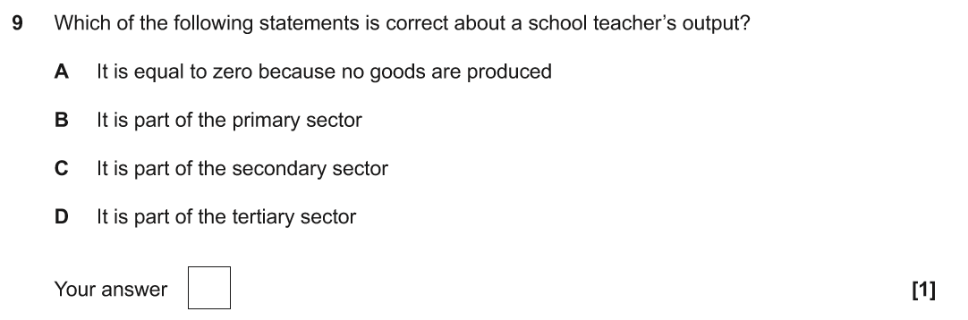
Practice examination questions J205/01
Notes:
Answer: D

Slide 9
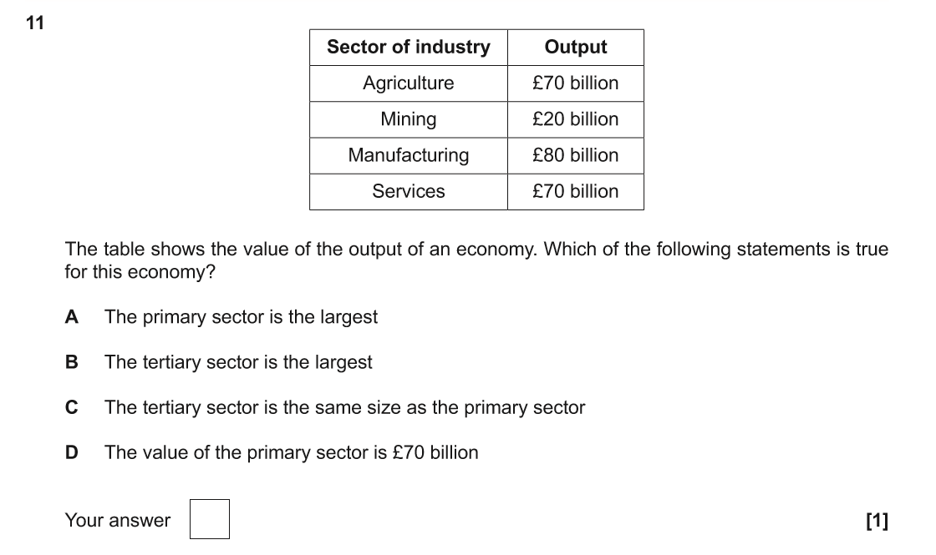
Practice examination questions J205/01
Notes:
Answer: A

Slide 10
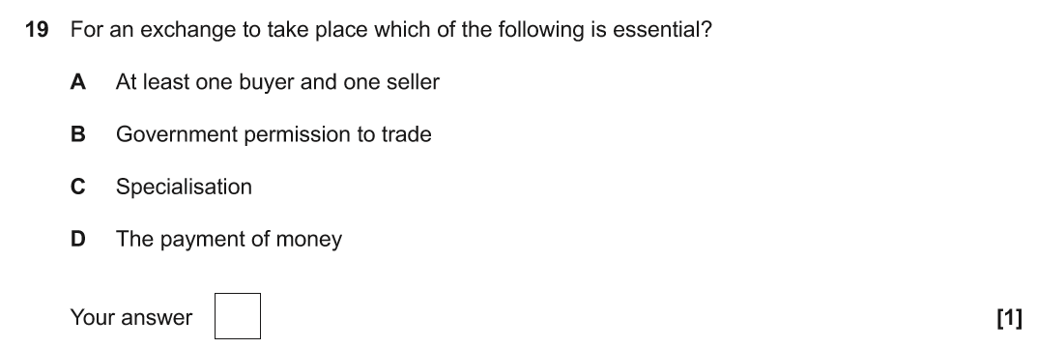
Practice examination questions J205/01
Notes:
Answer: A

Slide 11
Learners should be able to
2.2 Demand
explain what is meant by demand
draw and explain a demand curve using data, including individual and market demand
draw shifts of, and movements along, the demand curve
analyse the causes and consequences for consumers and producers, of shifts of, and movements along, the demand curve
explain price elasticity of demand
draw demand curves of different elasticity
evaluate the importance of price elasticity of demand for consumers and producers.

Slide 12
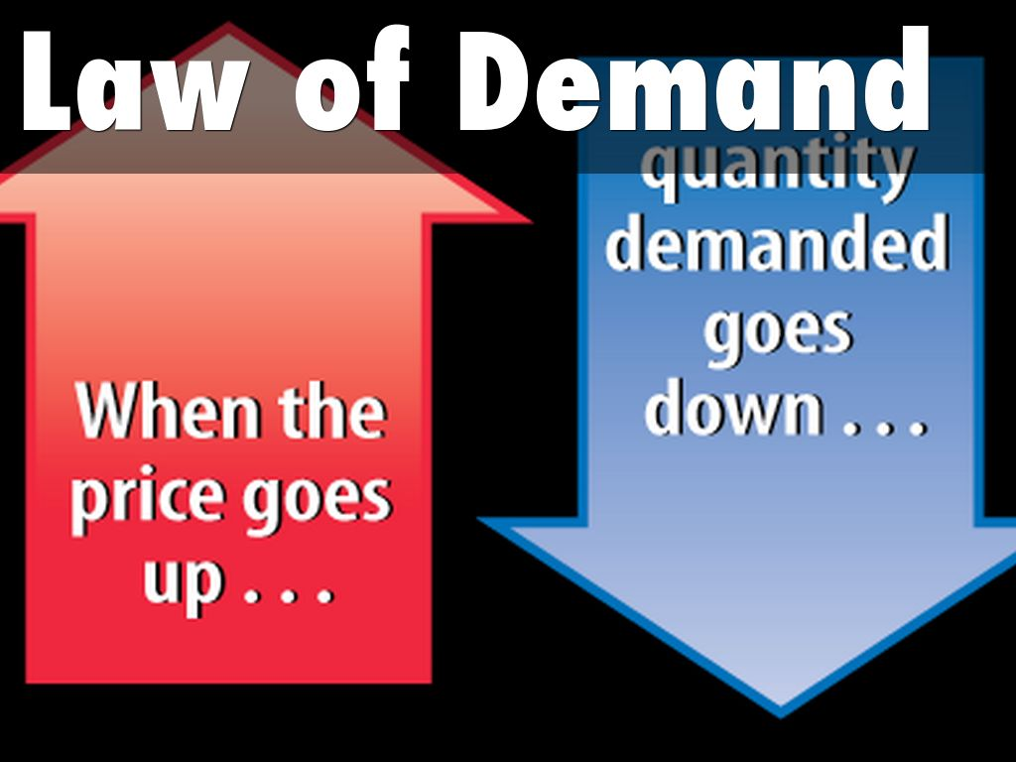
The relationship between demand and price

Slide 13
Key terms
Demand
The quantity of goods/services that consumers are willing and able to buy at a given price, at a given time.
Individual demand
The demand for a product by a consumer/individual.
Market demand
The demand for a product by all consumers/individuals in a market.

Slide 14
Key terms
Movements along the demand curve (extension/contraction):
Caused by changes in price; movement along the demand curve (fall=extension/rise =contraction).
Shifts of the demand curve (increase/decrease):
Caused by changes in; income, tastes and fashions, the price of other goods (complimentary goods, substitute goods), population, advertising, legislation.
Price elasticity of demand (PED)
The responsiveness of quantity demanded to a change in price.

Slide 15
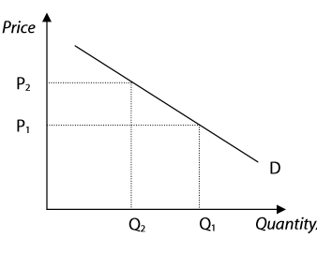
Diagrams
A change in price causes a movement along the demand curve. An increase in price from P1 to P2 leads to a decrease in quantity demanded (or contraction in demand) from Q1 to Q2.

Slide 16
Activity
Use graph paper and draw a demand curve from the demand schedule/table below. Show what happens when the price goes up from £20 to £30. Explain the relationship between price and demand.
£ Price | Quantity demanded
10 | 40
20 | 30
30 | 20
40 | 10

Slide 17
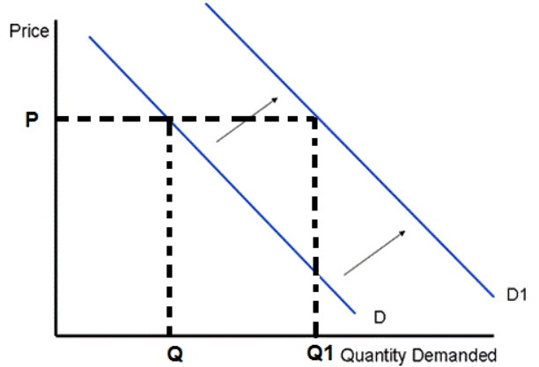
Activity
Shifts of the demand curve (increase/decrease) are caused by other factors than price. For example and increase in income would shift the demand curve from D to D1 leading to an increase in quantity from Q to Q1.
TASK: Use the textbook (pages 36-37) or other resources to explain other reasons that would cause a shift in demand.

Slide 18
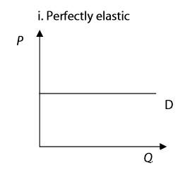
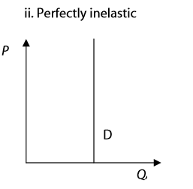
P.E.D and diagrams
PED = %change in quantity demanded
% change in price
P
In each of the above diagrams, what would happen to quantity if price increased?

Slide 19
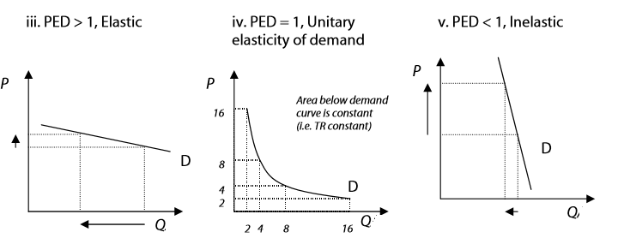
P.E.D and diagrams
Give examples of products that could be associated with each elasticity diagram.

Slide 20
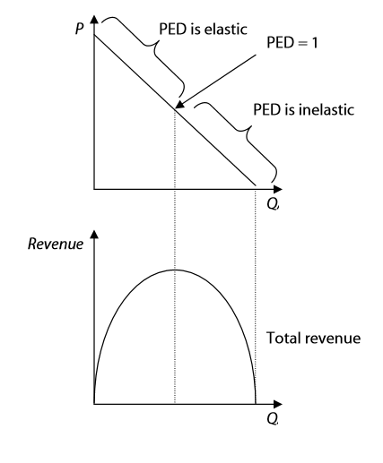
P.E.D and diagrams
If PED is elastic: An increase in price causes a decrease in total revenue. A decrease in price causes an increase in total revenue. If PED is inelastic: An increase in price causes an increase in total revenue. A decrease in price causes a decrease in total revenue. Revenue is therefore maximised when PED = 1.

Slide 21
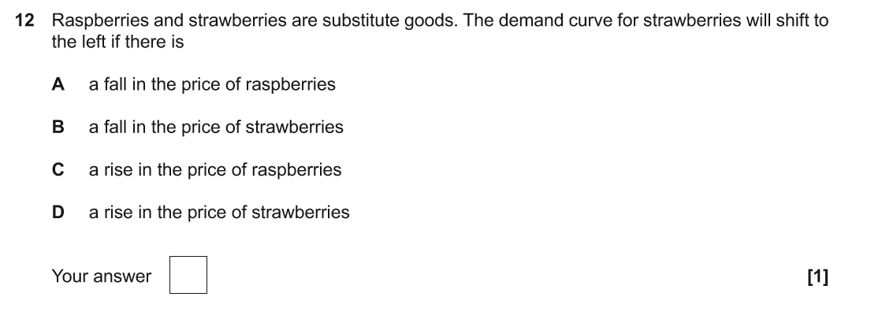
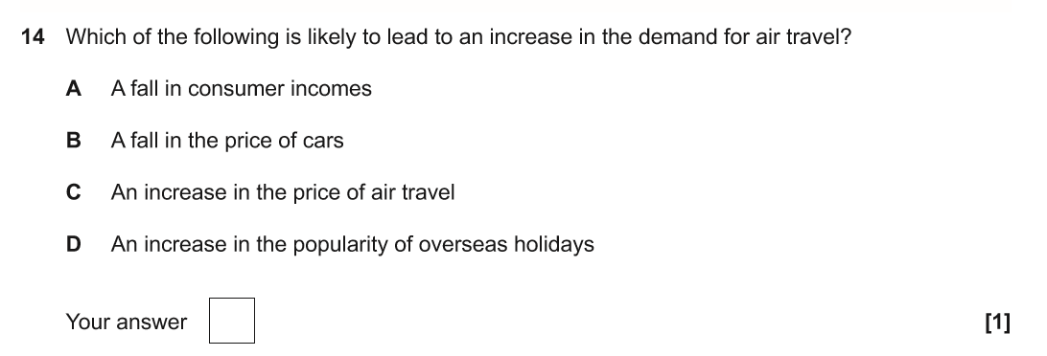
Practice examination questions J205/01
Notes:
Answer Q12: A
Answer Q14: D

Slide 22
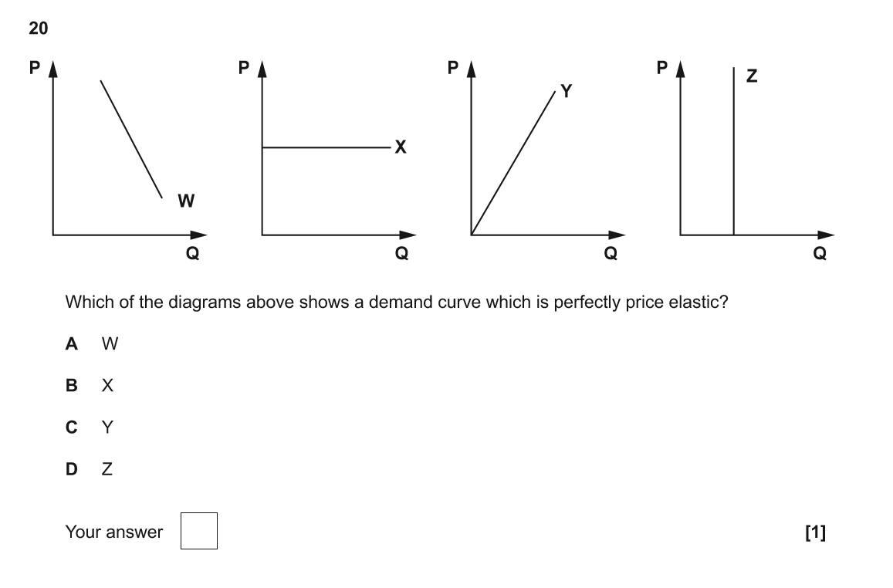
Practice examination questions J205/01

Slide 23
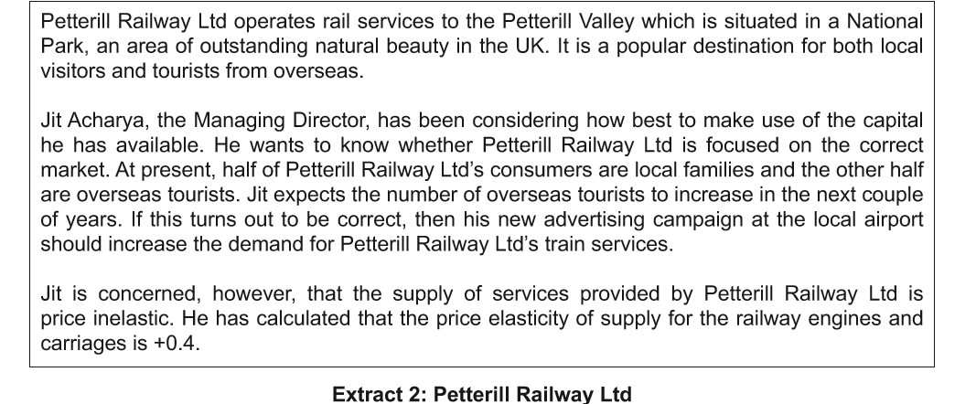
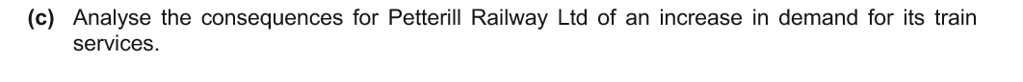
Practice examination questions J205/01
Notes:
Greater revenue leading to higher profits.
Able to afford more staff and equipment and/or improve facilities.
More pressure on staff and capital equipment leading to stress for employees and breakdown of engines etc.
Need to find the money to purchase more trains/carriages etc.
Consumer dissatisfaction if trains breakdown or there is overcrowding. This could lead to lower profits

Slide 24

Video – P.E.D

Slide 25
2.3 Supply
Learners should be able to
Explain what is meant by supply
draw and explain a supply curve using data, including individual and market supply
draw shifts of, and movements along, the supply curve
analyse the causes and consequences for consumers and producers, of shifts of, and movements along, the supply curve
explain price elasticity of supply
draw supply curves of different elasticity
evaluate the importance of price elasticity of supply for consumers and producers.

Slide 26
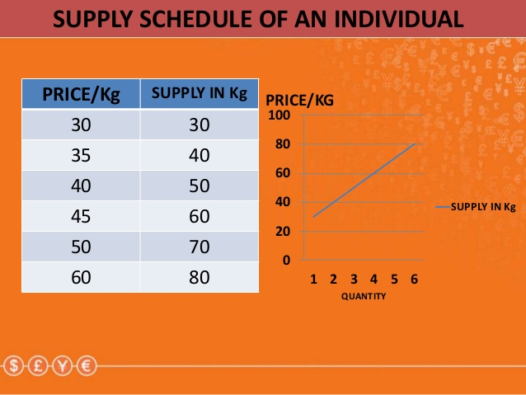
Supply

Slide 27
Key terms
Supply
The quantity of goods/services that producers are willing and able to supply to the market at a given price, at a given time.
Individual supply
The supply of a product by one producer.
PES
The responsiveness of supply to a change in price.

Slide 28
Key terms
Market supply
The supply of a product by all producers in a market.
Movements along the supply curve
Caused by changes in price (extension/contraction).
Shifts of the supply curve
Caused by changes to the costs of production/ technology/productivity/weather (increase/decrease).
PES
The responsiveness of supply to a change in price.

Slide 29
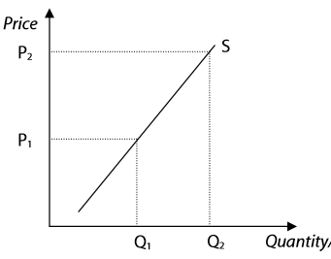
Diagrams
A change in price causes a movement along the supply curve, an increase in price from P1 to P2 leads to an increase in quantity supplied from Q1 to Q2.
Task: Draw a supply graph based on the information from the supply schedule/table below. Explain what will happen if the price increases from £20 to £30 also state what the relationship is between price and supply
Price £ | Quantity supplied
10 | 0
20 | 20
30 | 40
40 | 60

Slide 30
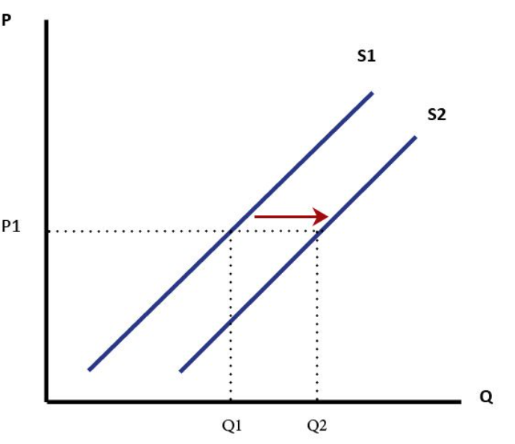
Diagrams
Shifts of the supply curve: caused by changes to the costs of production/technology/productivity/weather (increase/decrease)
Task: Draw further diagrams to illustrate:
An increase in the costs of production
An improvement in technology
The impact of recent floods on agricultural products

Slide 31


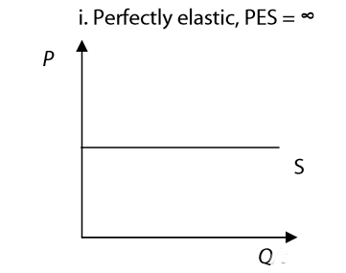
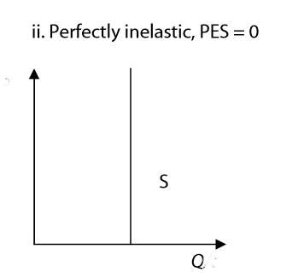
P.E.S Price elasticity of supply
=
Differing PES curves:

Slide 32
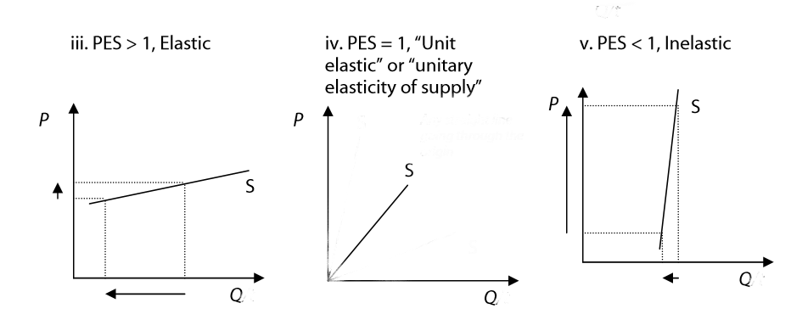
Differing P.E.S curves
Task: Complete the axis and try to think of products that would match the diagrams.

Slide 33
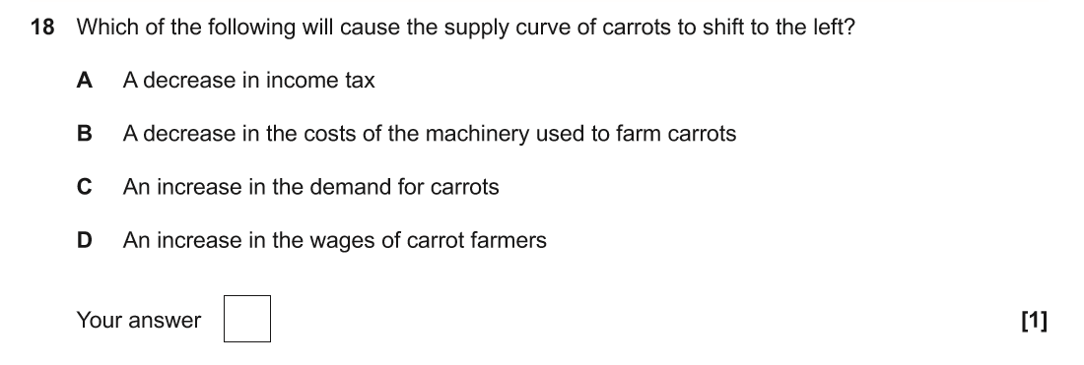
Practice examination questions J205/01
Notes:
Answer: D

Slide 34
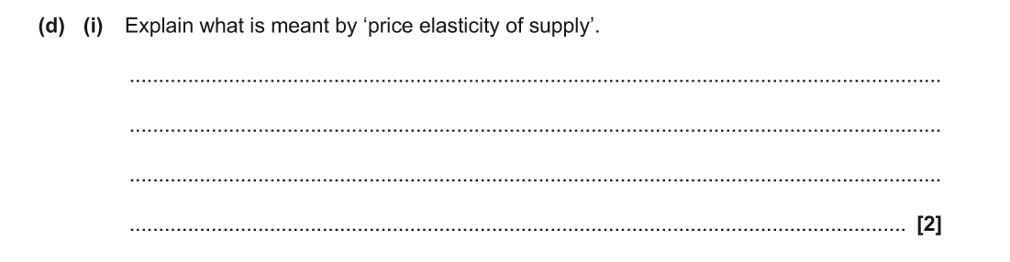

Practice examination questions J205/01
Notes:
Explain what is meant by ‘price elasticity of supply’.
Answers may include:
The responsiveness of quantity supplied to a change in price.
The percentage change in quantity supplied relative to a percentage change in price.

Slide 35
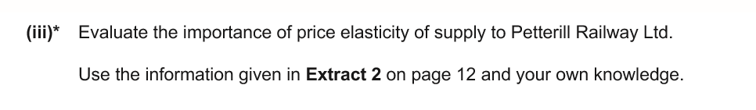
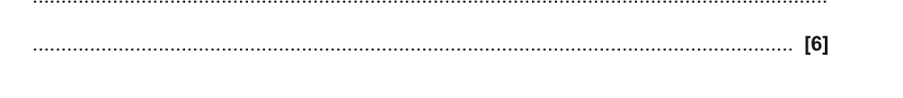
Practice examination questions J205/01
Notes:
Answers may include:
Inelastic supply means that the firm will have difficulty responding to increased demand in the short run thus restricting the number of customer.
This means that although revenue/profits are likely to rise there may be problems with customers.
It might be better to try and make PES more elastic by having more trains/carriages so they can respond quicker to demand changes.
Knowing PES allows the firm to predict the effects of changes in demand.
Knowing PES allows the firm to decide how best to try and meet demand changes.
PES is difficult to change, or even to calculate.
Changes in consumer demand may be more important. The success or otherwise of the advertising will depend on whether Jit’s forecast about future consumption is correct or not.
More important could be factors such as: providing better facilities; better marketing, focusing on innovative ideas, being aware of competitors, linking with other transport operators and/or the National Park authorities, etc.

Slide 36

Video P.E.S.

Slide 37
Price
Learners should be able to
Explain price as a reflection of worth and its role in determining an efficient distribution of resources
explain what is meant by equilibrium price and quantity
draw and analyse the interaction of demand and supply
explain the role of markets in the determination of price and the allocation of resources
analyse how the market forces of demand and supply affect equilibrium price and quantity.

Slide 38
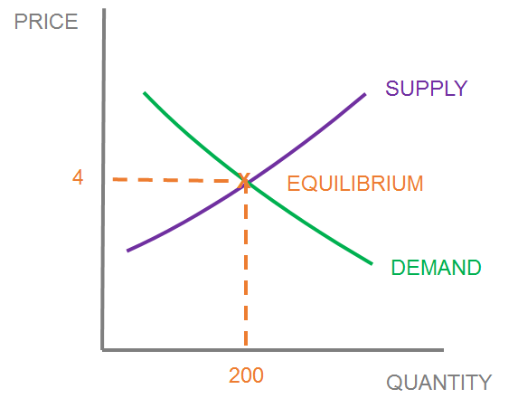

Price determination and equilibrium price

Slide 39
Key terms
Price
How much you pay for a good or service, determined by demand and supply.
Equilibrium
Where demand equals supply.
Price determination
Interaction of demand and supply.
Allocation of resources
How scarce resources are distributed to producers and allocated to consumers.
Market forces
The forces of demand and supply.

Slide 40
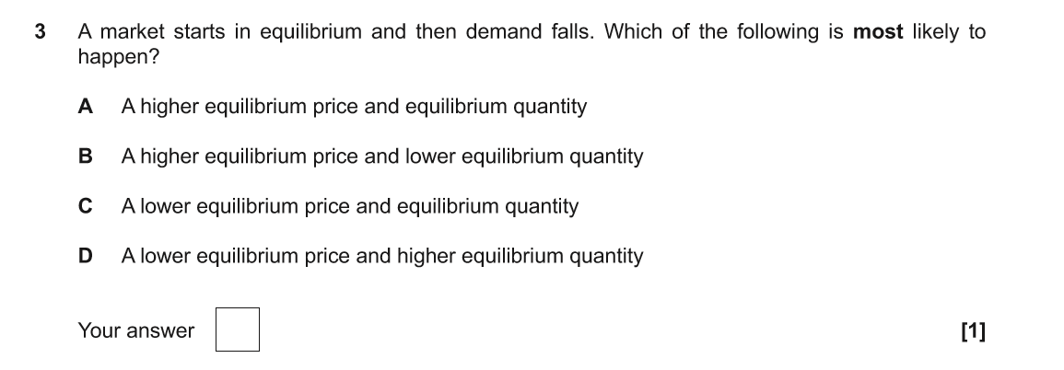
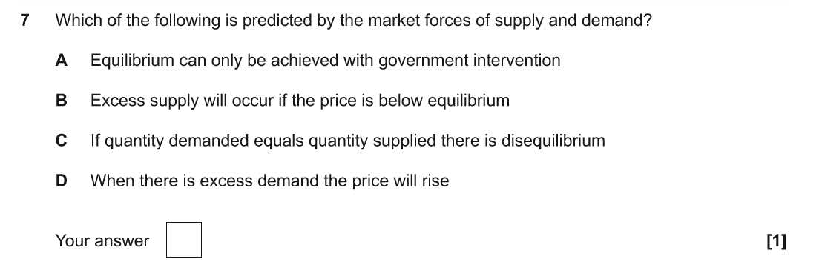
Practice examination questions J205/01
Notes:
Answer Q3: C
Answer Q7: D

Slide 41

Price and the allocation of resources

Slide 42
2.5 Competition
Learners should be able to
Explain competition between producers in a market economy, including the reasons why producers compete
analyse how competition affects price
evaluate the economic impact of competition on producers and consumers
explain the meaning of monopoly and oligopoly and how they differ from competitive markets.

Slide 43

Market structure: Monopoly

Slide 44
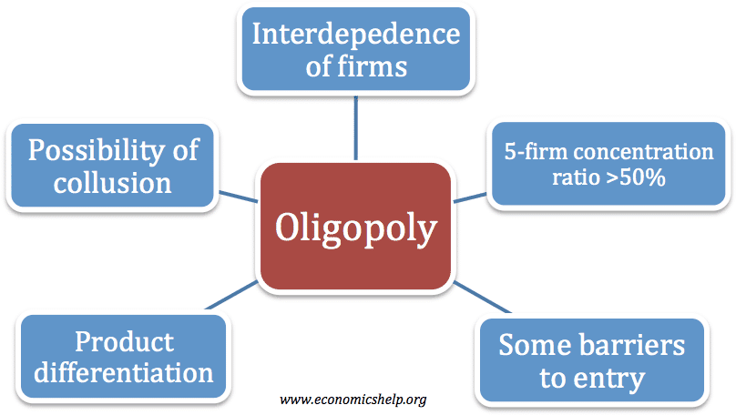
Market structure: Oligopoly

Slide 45
Key terms
Competition
Where different firms in a market are trying to sell similar products to consumers.
Market economy
Where the forces of demand and supply determine the allocation of resources.
Monopoly
A sole seller or producer in a market.
Oligopoly
A few large firms control the majority market share.

Slide 46
Outline the advantages and disadvantages to
Consumers and producers in the table below
 | Consumers | Producers
Advantages
Disadvantages

Slide 47
Task: Fill in the following table
(page 75 of the textbook will help you)
Characteristic | Competition | Oligopoly | Monopoly
Size
Number of firms
Barriers to entry
Price making power
Level of price and output
Efficiency
Examples

Slide 48
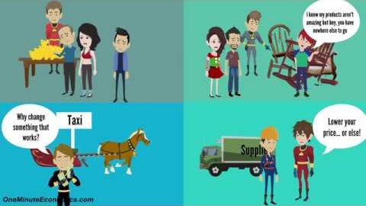
Video: Monopolies, Oligopolies and competition

Slide 49
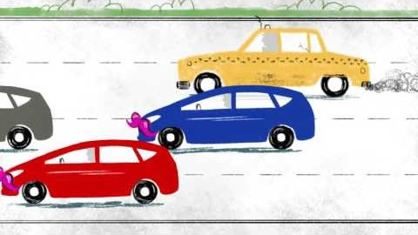
How competition affects prices

Slide 50

Video: Competition

Slide 51
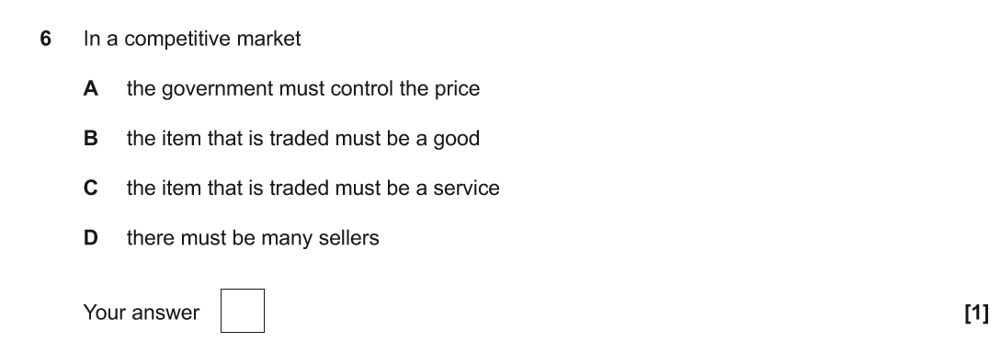
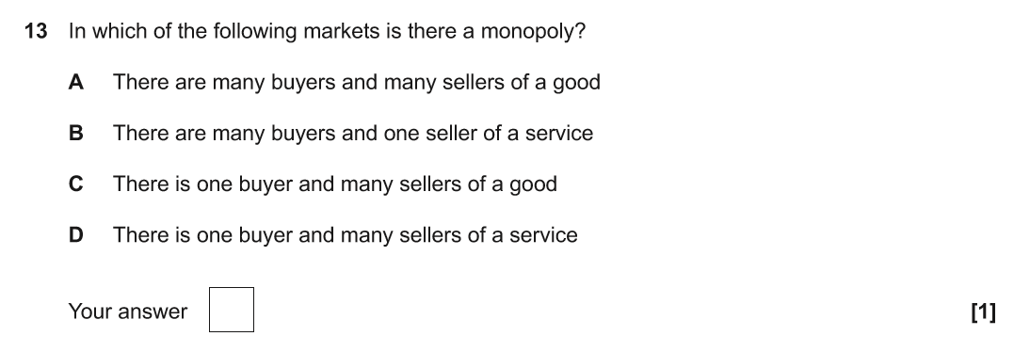
Practice examination questions J205/01
Notes:
Answer Q6: D
Answer Q13: B

Slide 52
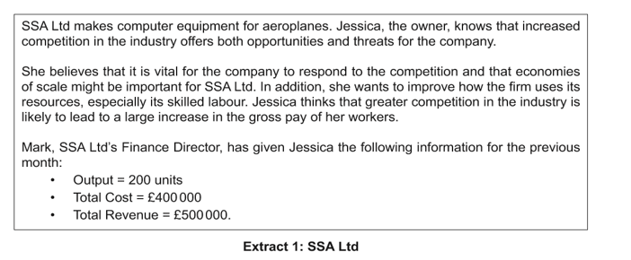
Practice examination questions J205/01
Notes:
Positive points may include:
Lower prices.
Improved quality (if this is a way of responding to competition).
Greater technological innovation.
Improved customer service.
Increased standard of living.
Negative points may include:
Decrease in quality (if competition encourages cost-cutting).
Consumers persuaded to buy products they do not need.
May purchase goods which are harmful either to themselves and/or the environment.
Have to pay for ‘extras’ which were included when prices were higher.

Slide 53
Production
Learners should be able to
Explain the role of producers, including individuals, firms and the government
evaluate the importance of production and productivity for the economy
calculate and explain total cost, average cost, total revenue, average revenue, profit and loss
evaluate the importance of cost, revenue, profit and loss for producers, including how costs and revenues affect profit and supply
explain what is meant by economies of scale.

Slide 54
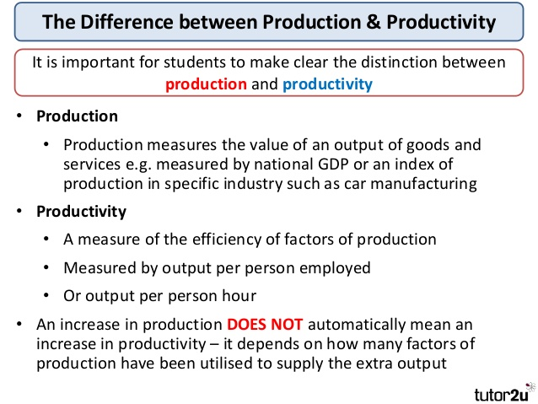
Production and productivity

Slide 55
Key terms
Production
Total goods or services produced per period of time.
Productivity
Output per unit of input, how efficient a firm is.
Total cost (TC)
All costs added together.
Average cost (AC)
Total costs divided by total output. Unit cost of production.

Slide 56
Key terms
Total revenue
Total income from the sale of its goods and services.
Average revenue
Total revenue divided by total output Revenue per unit sold.
Profit
Total revenue minus total costs. Money left over after all costs have been paid.
Loss
When total revenue is less than total cost.
Economies of scale
Fall in long run average costs due to an increase in the scale of production.

Slide 57
Complete the tables below using the formula
Total revenue = quantity X price per unit.
Average revenue = Total revenue
Quantity
Profit = Total revenue- total costs
Average cost = Total cost
Quantity
Quantity | Price per unit | Total revenue | Profit | Total cost | Average revenue | Average cost
0 | 10 |  |  | 0
10 | 10 |  |  | 80
20 | 10 |  |  | 160
30 | 10 |  |  | 240
40 | 10 |  |  | 320

Slide 58
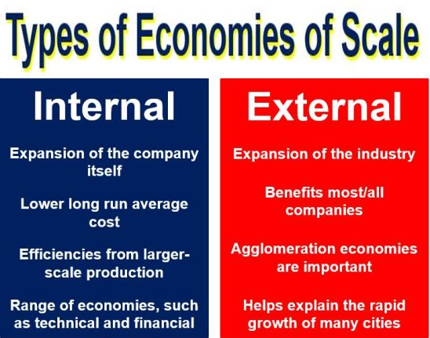
Economies of scale

Slide 59
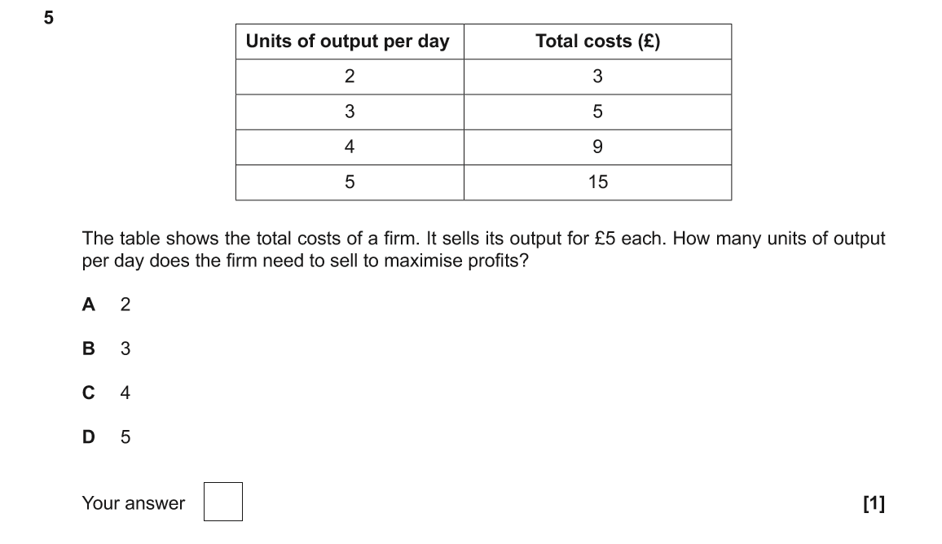
Practice examination questions J205/01
Notes:
Answer: C

Slide 60
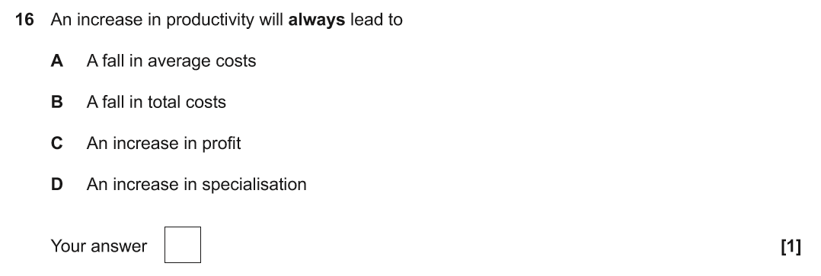
Practice examination questions J205/01
Notes:
Answer: A

Slide 61
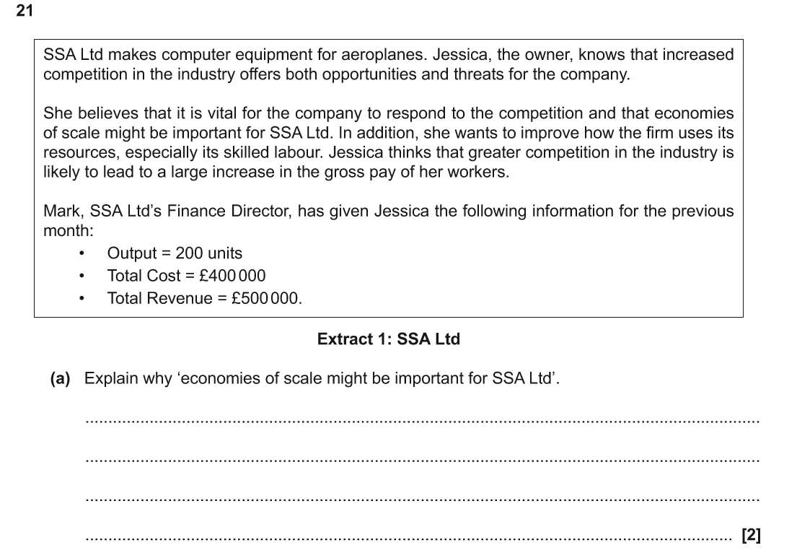
Practice examination questions J205/01
Notes:
Answers may include:
Economies of scale are the cost advantages a firm can gain by increasing the scale of production.
This can allow a business to cut its prices and/or increase profits.
Examples could include marketing, purchasing, technical, financial, managerial, risk bearing.

Slide 62
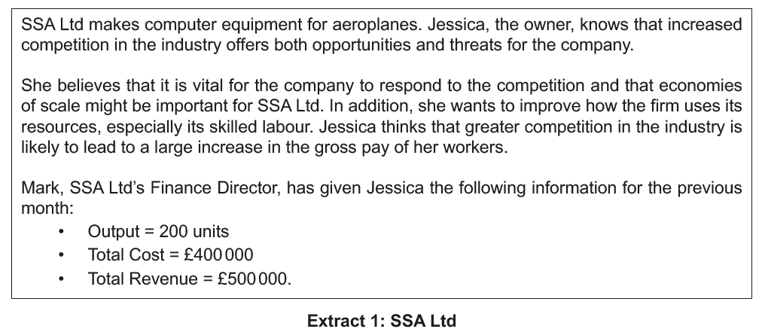
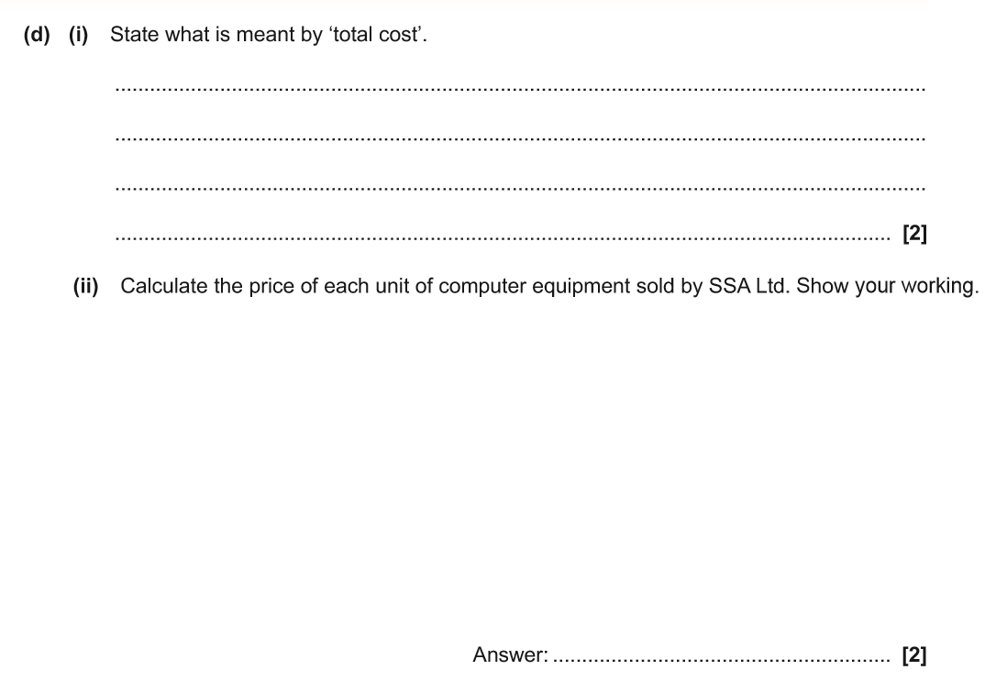
Practice examination questions J205/01
Use SSA Ltd Extract 1

Slide 63

Video: Productivity

Slide 64

Economies of scale

Slide 65

Watch the video on economies of scale
and make revision notes on the types

Slide 66
2.7 The labour market
Learners should be able to
Explain the role and operation of the labour market, including the interaction between workers and employers
analyse the determination of wages through supply and demand, including factors affecting the supply and demand of labour
explain and calculate gross and net pay, including deductions through income tax, national insurance and pension contributions.

Slide 67
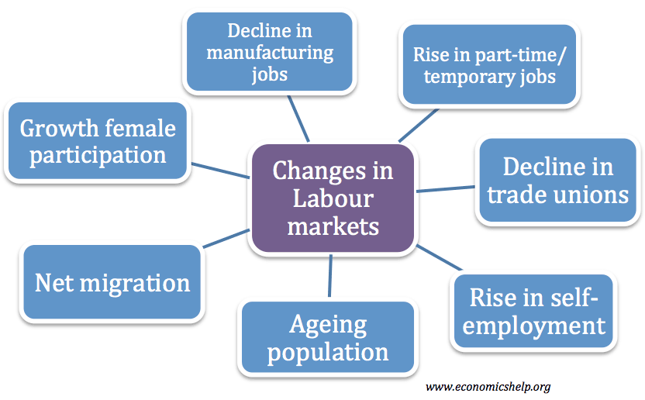
Labour markets

Slide 68
Key terms
Labour market
Workers sell their labour and firms buy their labour.
Determination of wages
Interaction of supply of labour and demand for labour.
Supply of labour
The amount of workers willing and able to supply their labour (including the unemployed).
Demand for labour
Is derived demand- demand for labour due to demand for the good or service the labour produces e.g. demand for construction workers when there is a demand for building work.

Slide 69
Key terms
Gross pay
Earnings before any deductions are taken.
Net pay
Earnings after all deductions have been taken.
Income tax
A direct tax levied on income.
National insurance contributions
Contributions paid by employee and employer to pay towards state benefits.
Pension contributions
Contributions paid by employee and employer towards future pension payments.

Slide 70
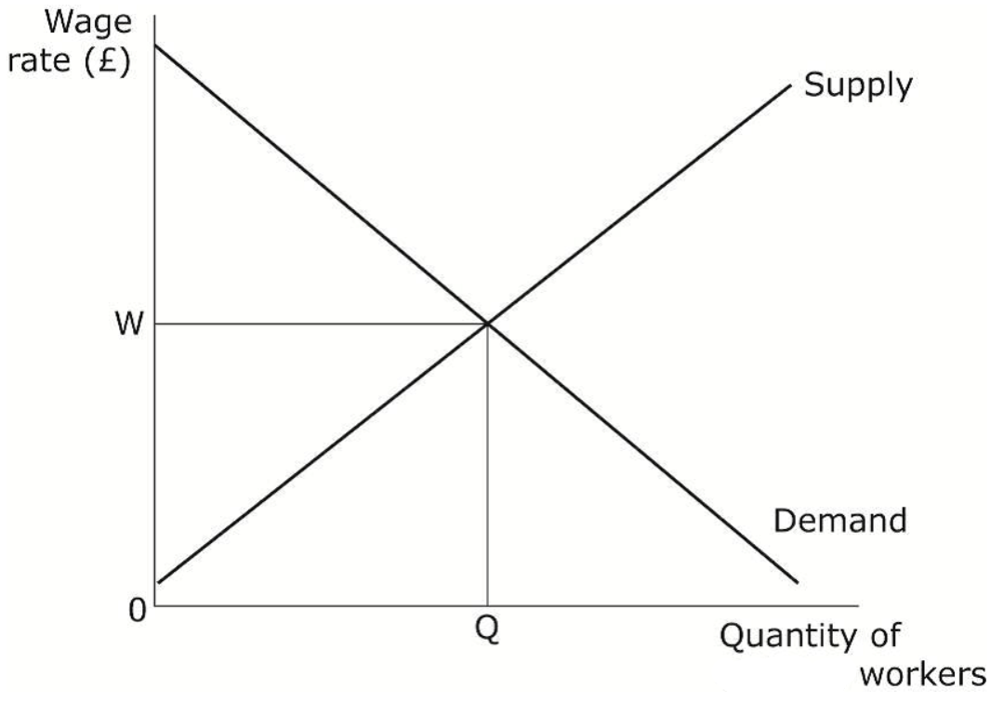
Interaction of workers and firms
Task: Make a list to complete each title below.
Factors affecting the supply of labour
Factors affecting the demand for labour

Slide 71
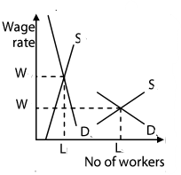
Wage determination
Task: 1.Complete the labels below to show which is elastic and which is inelastic
2. Explain why this makes a difference to wage rates
3. Give examples of occupations which would fit each situation

Slide 72
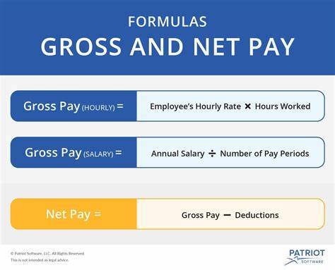
Gross and net pay

Slide 73

Basic introduction to gross and net pay

Slide 74
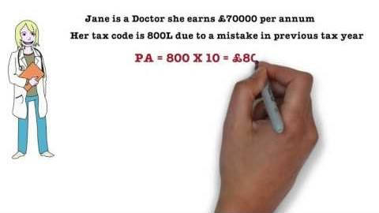
Gross and net pay and deductions from pay
Task: Watch the following video and make notes, then look up the latest tax bands, what difference would they make to Jane’s pay?
Use the following link:
https://www.gov.uk/income-tax-rates

Slide 75
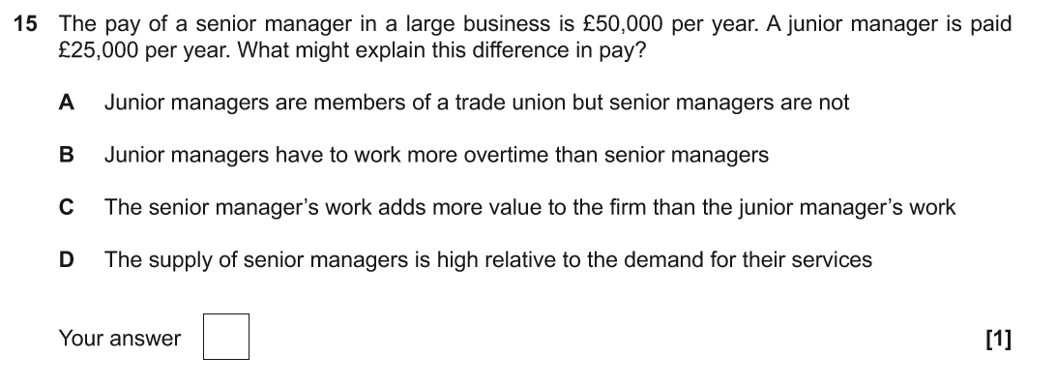
Practice examination questions J205/01
Notes:
Answer: C

Slide 76
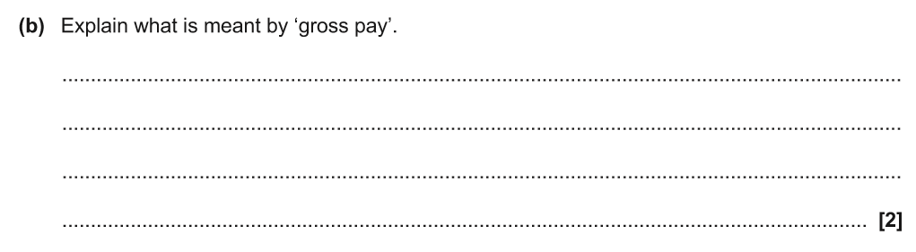
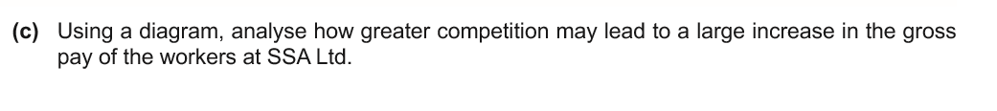
Practice examination questions J205/01
Notes:
Answer:
Question from Extract 1 SSA Ltd Answer Gross pay is the amount of money which an employee earns before any deductions are made.
Takes time to increase supply of [especially skilled] labour so supply remains the same • Supply of labour to the firm may actually fall if competitors attract available staff • Competition indicates increased demand for the product which will lead to increased demand for labour A rise in wages due to higher demand and/or lower supply of labour (see mark scheme for diagram).

Slide 77
2.8 The role of money and the financial sector
Learners should be able to
Explain the role of money as a medium of exchange
explain the role of the financial sector for the economy, including financial institutions such as banks, building societies and insurance companies
evaluate the importance of the financial sector for consumers, producers and government
analyse how different interest rates affect the levels of saving, borrowing and investment
calculate the effect on savings and borrowings of changes in the rate of interest.

Slide 78

Role of money

Slide 79
Key terms
Money
Anything that is accepted as a means of payment.
Medium of exchange
Anything that sets the standard for exchange of goods and services that is acceptable to all parties.
Financial sector
Firms that provide financial services.
Interest rates
The cost for borrowing and the reward for saving.
Investment
The purchase of capital goods.

Slide 80
Key terms
Financial sector
Firms that provide financial services.
Financial institutions - Banks
Central bank
The institution responsible for issuing a country’s banknotes, acting as a lender of last resort for other banks, and implementing monetary policy (e.g. setting interest rates).
Commercial (retail) Bank
Take deposits from customers individuals and firms and turn them into assets for the bank.
Building societies
Mutual financial institution owned by its members.
Insurance company
Institution that guarantees to cover for losses in return for a premium.

Slide 81

Money as a medium of exchange

Slide 82

The Bank of England

Slide 83

Watch the following video.
Task: Using the textbook or your own research make summary notes showing the key differences between banks building societies and insurance companies.

Slide 84
Task: summarise the importance of the financial sector to consumers, producers and the government in the following table.
Importance | Consumers | Producers | Government
Credit provision
Liquidity provision
Risk management

Slide 85

Interest rates

Slide 86

Video: Interest rates – return for saving,
payment for borrowing

Slide 87
Interest rates: Task
If you had £1000 of savings what would you have at the end of the year at a 2% interest rate?
Now calculate again if the interest rate was 5%.
How would that make you feel as a saver?
Also discuss how it may make a borrower feel and a business taking out a loan for investment and what impact it may make on their decisions to borrow or invest.

Slide 88

Practice examination questions J205/01
Notes:
Answer: B

Slide 89

Practice examination questions J205/01
Notes:
Answer: C

Slide 90

Practice examination questions J205/01
Notes:
Answer: D

Slide 91

OCR Resources: the small print
OCR’s resources are provided to support the delivery of OCR qualifications, but in no way constitute an endorsed teaching method that is required by the Board, and the decision to use them lies with the individual teacher. Whilst every effort is made to ensure the accuracy of the content, OCR cannot be held responsible for any errors or omissions within these resources.
Our documents are updated over time. Whilst every effort is made to check all documents, there may be contradictions between published support and the specification, therefore please use the information on the latest specification at all times. Where changes are made to specifications these will be indicated within the document, there will be a new version number indicated, and a summary of the changes. If you do notice a discrepancy between the specification and a resource please contact us at:
resources.feedback@ocr.org.uk.
© OCR 2020 - This resource may be freely copied and distributed, as long as the OCR logo and this message remain intact and OCR is acknowledged as the originator of this work. OCR acknowledges the use of the following content: n/a
Please get in touch if you want to discuss the accessibility of resources we offer to support delivery of our qualifications: resources.feedback@ocr.org.uk

