Slide 1


GCSE
DESIGN AND TECHNOLOGY
Getting ready to start your GCSE NEA
J310
For first teaching in 2017
www.ocr.org.uk
Notes:
Hi – I’m Chris Rowe and I’m the Principal Moderator for the GCSE Non Examination Assessment - otherwise known as the NEA. What most of you and your teachers will refer to as ‘coursework’

Slide 2
A quick guide to the NEA?
What is the NEA?
Why do you do an NEA?
Example NEA Portfolio
GCSE Design and Technology
© OCR 2020
Notes:
I’m here to give you a brief overview of the NEA. What it is, Why you need to do it as well as a quick look at what a typical NEA portfolio might look like?

Slide 3
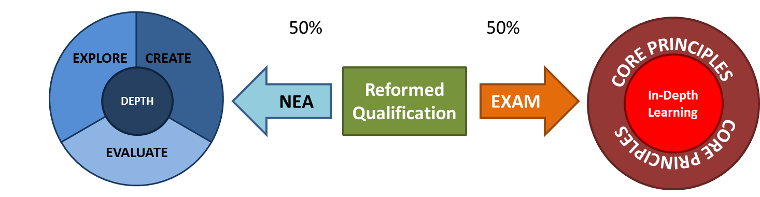
What is the NEA?
Portfolio
Chronological
Contexts
50% of your GCSE
GCSE D&T
Qualification
Approx. 40 hours
100 marks
GCSE Design and Technology
© OCR 2020
Notes:
The NEA is a portfolio of work that will show your teachers how you investigated a specific need, problem or opportunity and how you developed and test a prototype that would solve that specific need.
It must reflect how things happened in REAL TIME – what your teachers will refer to as a ‘chronological portfolio’
It must also respond to one of THREE contexts (or themes) that are set by OCR each year
The portfolio of work that you produce accounts for 50% of your total GCSE.

Slide 4

Why do the NEA?
Knowledge and understanding
Creative thinking skills
Problem solving
GCSE Design and Technology
© OCR 2020
Notes:
The NEA helps you to demonstrate your knowledge, understanding and skills through an iterative process that ‘explores’ needs, ‘creates’ solutions and ‘evaluates’ how well the needs have been met.
It helps you to develop the critical-creative thinking skills that are required to manage and organise this process.
It will equip you with life-long skills of problem spotting and problem solving and enable you to apply this to lots of different areas.

Slide 5
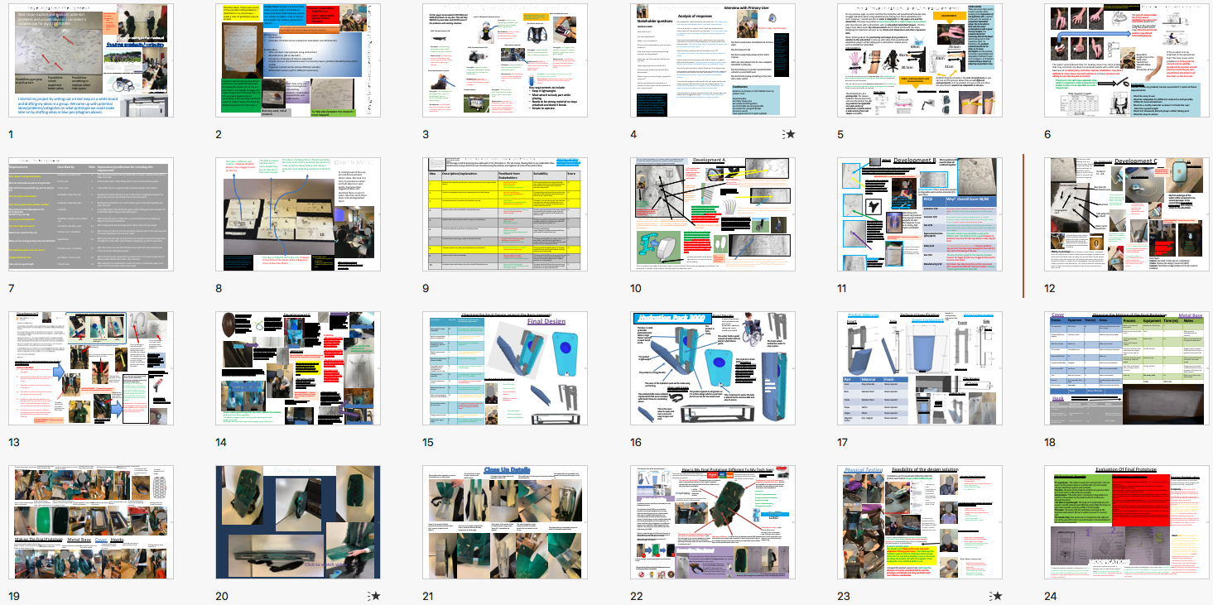
NEA portfolio
© OCR 2020
Notes:
EXAMPLE PORTFOLIO
The following example shows a concise approach to the NEA clocking in at only 24 slides and I’m going to very quickly talk you through each page
To comply with copyright restrictions and privacy laws we have redacted some images and media in this presentation.

Slide 6
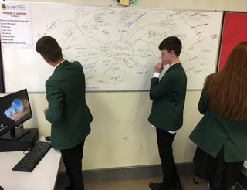
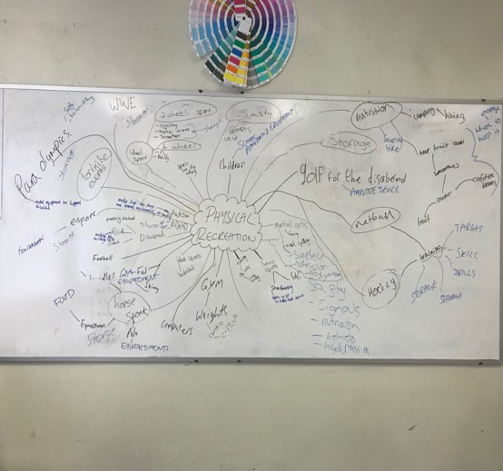
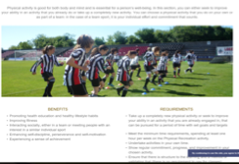
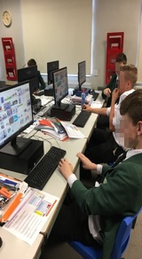
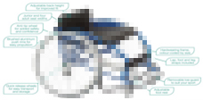
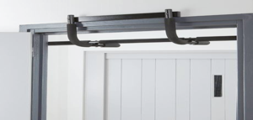
Investigating the context
Next steps: Explore and evaluate potential problems and project ideas so I can select a suitable one for my DESIGN BRIEF.
Possible issues that need considering-
Size
Function
Aesthetics
Ergonomics
Cost
My group working on the whiteboard
Existing products/websites
Website on google that helped
Existing product to help
Possibilities-gym-grips on pull up bars
Possibilities-school equipment better safety
Possibilities-something to improve wheel chair sports
Images on google to help
I started my project by setting out a mind map on a white board and drafting my ideas in a group. We came up with potential ideas/problems/categories on what prototype we could make later on by drafting ideas in blue pen (diagram above).
Existing product to help
Notes:
The student started by exploring the context set by OCR using the internet for some initial research and a mind map to explore potential needs

Slide 7
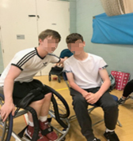
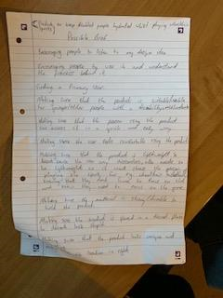
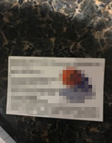
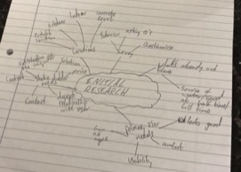
Potential Ideas- These were some of the possible briefs/problems I identified on my mind maps. I made a note of good/bad aspects of each.
Design Brief- Design a product that helps people with a disability to keep hydrated whilst playing sports in a indoor/outdoor area. It should be suitable for various wheel chair players.
Potential stakeholders-
Staff/Owners
Sport coordinators
Special schools
Hospitals
I am a member of a local wheelchair basketball club group so I asked them if they thought it was and were happy to help with my project.
Primary User
Oscar Kemp
(member of Featherstone wheelchair basketball club Whirlwinds)
Stakeholders
Other product users (people using wheelchair)
Manufactures (UK or abroad?)
Insurance companies (if claim is required)
People who are interested but don’t necessarily have a problem/disability (may find it useful)
Organizer's (tried out by various different people)
Wheelchair owners (sell to different customers)
Design Brief And Identifying Stakeholders
Hydration whilst playing wheelchair sports was one potential idea that immediately jumped out at me as I don’t like to see people struggle and I want people less fortunate than me to have every opportunity of succeeding in the sporting world and I want to make it easier for them by adding my product to there sport.
Next step- carry out initial investigations into existing products, stakeholder requirements and wider issues.
Business card, initial research
To help plan/prepare my research I mind mapped.
Notes:
They suggested several suitable design briefs before settling on designing a product to help wheelchair users stay hydrated during sporting activities

Slide 8
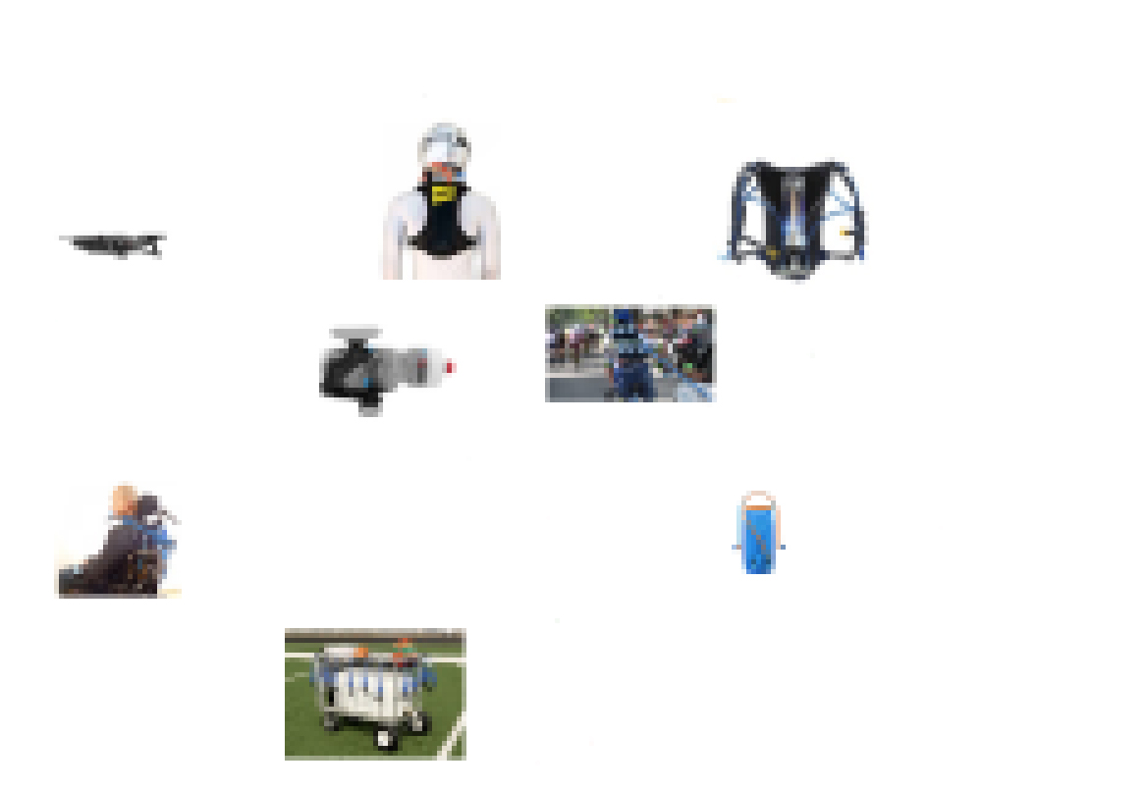
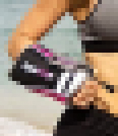
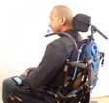
What is already out there? – Existing products
On this page I have looked at EXISTING and SIMILAR products to my idea. This will help INSPIRE my own ideas and AVOID some of the problems with existing solutions.
Next steps-Visit leisure center, and discuss user/stakeholder needs with someone.
Aqua Arm Hydration pack
Leatt H-2 Backpack Hydration System
Strengths- Easy to use, Lightweight product, well organised user friendly, quick release hose.
Weaknesses- hose not very discrete, material of backpack is comfortable, has a modern look.
Hydration backpack
XLAB Torpedo Kompact 500
Strengths- Hardwearing, lightweight, quite small, attaches with the seat well.
Weaknesses- material may not be comfortable, may not be easy to access, water tube may not be long enough.
XLAB Torpedo Kompact 500
Water bottle backpack
Strengths- Ample storage, stable and comfortable to ride in, robust construction.
Weaknesses-bladder is difficult to insert when full, straps may not be the right size, material is comfortable.
Strengths- has a good look, comes in a range of colours, product is good size, tube is good length.
Weaknesses- may distract while running, can only hold a certain amount of water, Material is itchy after a while.
Strengths- Good storage for water bottles, material of backpack is light.
Weaknesses- May be heavy on back while cycling, not easy to access, looks a bit odd.
Strengths- compact, good durability, lightweight, doesn't easily come out to what its attached to.
Weaknesses- not very appealing, may be hard to access, limited water storage available.
Camel back hydration system
Strengths- Good tubing, functions very well, lightweight, quite small
Weaknesses- limited water space, very basic, tubing is not discrete, may not be easy to access.
Strengths- functions very well, materials are simple, easy to use, has a unique look.
Weaknesses- not able to footballers at all time, may not provide for all people involved who what water at the same time, quite big that a very discrete product.
Key requirements to include:
Keep it lightweight.
Must attach to body part while playing.
Needs to be strong material so stays attached and doesn't break.
Simple to operate.
Strengths- Well attached to the wheelchair, tube is a good length, easy to access,, provides a good water supply.
Weaknesses- not discrete, looks a bit strange, may get in the way while your doing something.
Football pumper
Notes:
Their initial investigation started with some analysis of existing designs

Slide 9


User/Stakeholder Needs
Interview with Primary User
Analysis of responses
Audio content removed due to Data Protection Act
Stakeholder questions
My stakeholder is 68 years old. This means that Steve has good knowledge about the game and problems.
He is a male who is a sport coach, has worked across various parts of the world for e.g. America. This means that Steve is qualified and has worked with different types of people over the years.
works independently as he retired some years ago and volunteers to run the club whirlwinds as he enjoys sports and helping others. This means that is a good person who cares for his players and loves sport.
has been working with the disabled since 1977.
This means that is very experienced and knows what he's doing.
conducts his training sessions with his players in sports halls and indoor areas. This means that the players train in good facilities where there basketball nets are equipped for them.
One of the main questions I asked was if his players had any problems with dehydration and he said yes so this suggests my product may come in use with the players. This means that my product would come in use for the players while there playing.
Currently the players at whirlwinds only use water bottles and water spray at half time and at the end of there games. This means that the players will struggle to play throughout a full game and wont be able to reach there full potential.
believes my product would interest the younger ages and people who struggle massively. This means that my product would be valuable and successful to a range of people.
Questions asked
How old are you?
Are you male/female?
What is your occupation?
Do you work independently or do you have a partner?
How long have you been doing sporting activities for the disabled?
Where do you train and what facilities do you use?
What age groups do you work with?
Have you ever faced any problems with dehydration?
What are you currently using for hydration purposes?
Would you/players be interested in a hydration device which can be attached to arm, leg and waist?
My primary user wants a hydration system which fulfills his needs of keeping hydrated throughout a full game. He would like something that is good quality and adds sustainability. Oscar would like something which is different but also something which is easy to access and use.
My client usually trains at Featherstone 3 times a week.
My client plays for GB.
My client usually helps people at the club to improve.
When my client plays/trains he uses a adapted wheelchair to him play.
My client believes my product would be better suited at a junior/adult level.
My client thinks having something on the chair and a water sachet.
Conclusions
Based on my Analysis on User Market Issues my product must:
Be good quality
Be a fairly cheap price
Be suitable for both genders
Be comfortable also strong/durable
Be suitable for young/old people
Be easy to access
Have a good amount of water available
My stakeholder wants a source of hydration. In which allows his players to reach there highest potential. Steve wants something which can put his players at ease whilst playing and something which will give them remaining water so they aren't struggling.
Notes:
Then interviews with their primary user and a stakeholder

Slide 10
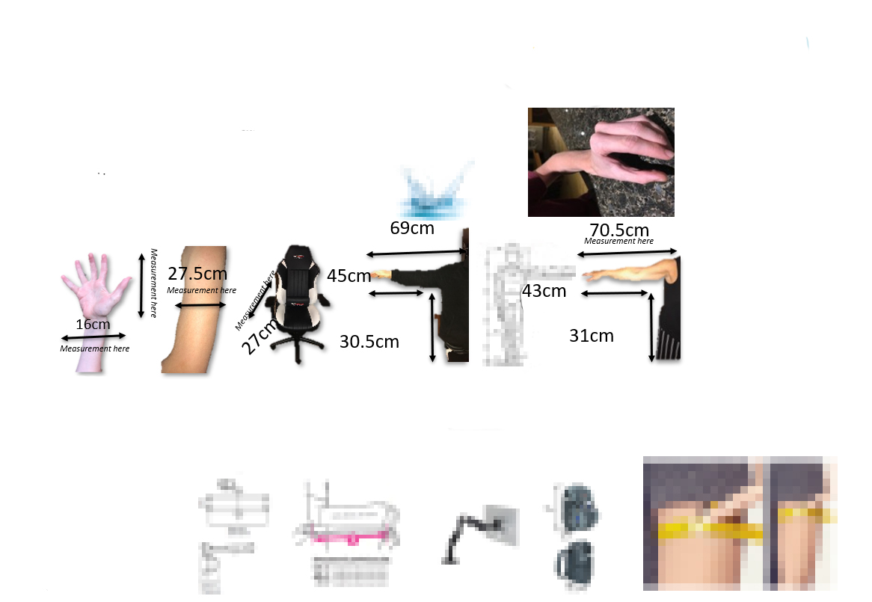
Initial Investigation: Useful measurements
CONCLUSIONS
There are some major points I had to consider when looking at the Ergonomics of the hydration aid in relation to the user, for example, a wheelchair basketball player has to be able to deal with the water system/device with a good level of comfort, the product should not massively disturb the player whilst taking part in their respective sport. So therefore, the products material should not be itchy, as to cause discomfort and the product should be a good length and adaptable to different sized arms of players, so therefore implementing a means of adjusting my product is key.
On my previous page my client said that the hydration aid would benefit people who struggle hydration when using wheelchairs by having it on there wheelchair arm rests. However, I would also like to make it adaptable for the upper arm and the wheelchair, this way my product is more accessible for a wider ranger of consumers who may interact with a wheelchair such as wheelchair basketball players . On this page I have taken some key measurements which I think will benefit me when designing the hydration aid such as my clients arm dimensions and other ergonomic data.
ERGONOMICS
When thinking about the positioning and usage of my product in relation to the wheelchair I came up with ideas that would benefit wheelchair players whilst taking part in wheelchair related sports, such as wheelchair basketball.
FOR EXAMPLE:
Measurement here
On the left is the measurements of my own wrist, this is useful as it can help me design my product to easily fit in a users hand if it needs to be detached from the wheelchair.
Then the second picture is the dimensions of my arm, this is useful as my product is also going to be able to attach to the upper arm so a wider variety of upper arm widths are required.
Other useful products and measurements
Another thing to consider is the arm circumference as you can see on the pictures above they are all different measurements so if my product is to go on the arm then the attachment needs to be adaptable to all sizes.
Bag strap
Door closer
Arm sling
Adjustable monitor
The third picture is of a gaming chair, the reason I looked at this was due to the arm rests the product has, for my product to be applicable to a wide variety of wheelchairs I need to look at a wide variety of arm rest shapes and widths.
Notes:
And the gathering of important technical information such as anthropometric data

Slide 11
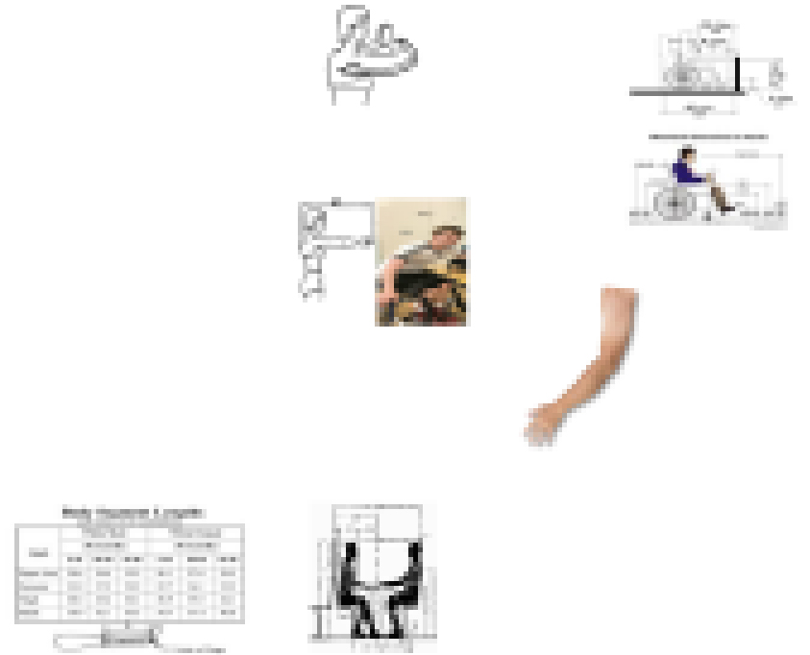
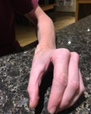
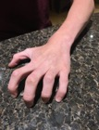

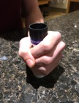
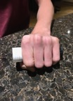

Next Steps- Start gathering Stakeholder Requirements by having discussions with various people.
Ergonomics and other useful sizes
The grip of someone who has a very severe disability may cause a lot of problems aswell as it may get in the way when using this product and it may stress the person out and this may disturb them whilst playing.
Bicep-30cm
Length of arm-77cm
Wrist-17cm
Hand-19.5cm
Shoulder-elbow-30cm
Arm pit-hip- 42.5cm
If the product is to be attached to the wheelchair then this may cause some problems as it may not be easy to access and the length of the product would have to reach the persons mouth from the bottom of the chair or the arm rest.
The water system/device that I'm making cause may some problems that may constrain my ideas for example people who suffer with a bad case of cerebral palsy and other inferior disabilities may find it difficult to move there stomach and arms so there function and ability to use this may be restricted.
The picture to the right shows adjustable strap which is a mechanism I shall incorporate into my product to allow it to be adjustable to a wide range of users.
Conclusions-
Overall I think my product can be successful if I reach all these requirements:
Must be easy to use
Must be adaptable for different sized arms and possibly different sized wheelchairs
Must be a comfy material so doesn't irritate the user
Must be a good length
Must not massively disturb player whilst taking part
Must be easy to access
Notes:
and the dimensions of wheelchairs

Slide 12
Stakeholder Requirements
Requirements | Identified by | Slide | Explanation/justification for including this requirement
Must appeal to all ages and genders | Candidate and stakeholder | 4 | After having discussions with my stakeholder he thinks I should try doing this to make more sales.
Must be comfortable as well as strong/durable | Primary user | 4 | If the product wasn’t these things then it may not work and be a failure.
Must be fairly cheap shouldn't go past the price of £15 | Primary user | 4 | To fit within the price range of similar products already on the market.
Must be easy to access and use | Candidate and primary user | 3 | By doing this people will want to use it when there struggling throughout the game and wont just wait till half time or end of the game.
Must have a good amount of water available | Candidate and primary user | 4 | By doing this wheelchair users will be able to play to there full capability and enjoy the more.
The product must be lightweight on the arm/wheelchair shouldn't’t go over 3kg | Candidate | 3 | If not lightweight it may disturb the player whilst taking part and it wouldn’t be comfortable which may put them off buying it.
The strap must be adjustable | Candidate, possible users, primary user | 6 | After having discussions I think this is a good idea because everybody has different sized arms/ wheelchair.
The cover needs to be secure | Candidate, possible users | 13 | After analysing the first prototype and it doesn't seem strong enough
Needs to be away from the user | Primary user, Candidate | 12 | After testing it is clear to see that the tubing is going to get in the users way and this needs adjusting to suit customer needs
Make sure the strap goes fully across the wheelchair | Stakeholder | 14 | After testing the first type of straps they were separate and weak showing there not effective so the straps need change or adapting to go all the way across.
The metal base needs to be more secure | Possible users, Candidate | 13 | After discussions it is clear that the base may need to be more powerful and secure to survive a full intense game.
Change material of cover | Candidate, Primary User | 14 | After various testing it shows that my initial cover isn’t strong enough due to it being a weak material alternative- poly carbonate.
Tube must be a good length | Stakeholder | 10 | After talking to my stakeholder he thinks the tube is a important aspect so its needs to be long enough and the right length.
Notes:
This helped them to establish some stakeholder requirements that they continued to refine as he developed his idea

Slide 13
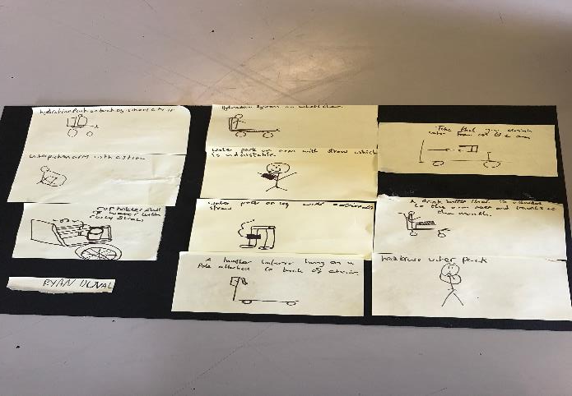
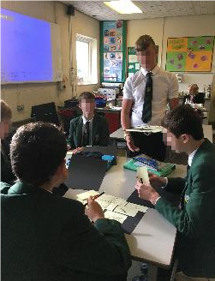
This idea is different and creative, however disabled players may struggle to pick up the cup.
This idea is unique and discrete so more people may buy as they don’t feel embarrassed
This idea is my favourite as I think it would be the most useful and it would be the easiest to make as well as being unique and I think it looks the most appealing product out of them all.
Rough Ideas
In small groups of four we sat and discussed each others ideas. We took it in turns to present our brief and talk about our spec points. Everyone then suggested ideas and sketched them on post it notes. We then stuck these down and photographed them.
4.
1.
5.
8.
2.
3.
6.
9.
7.
10.
The group work helped as it allowed me to branch out to various opportunities and ideas were available which I just didn't’t think about myself, the opinion of others also helped as it gave me some initiative moving forward.
This idea is different and looks cool, however it may distract the player whilst taking part more so than the others.
The best ideas were:
1 have system on pack of wheelchair.
6 place the system on leg.
5 place the system on the arm.
Me and my group discussing ideas for our products.
Notes:
They collaborated with classmates to generate some initial ideas

Slide 14
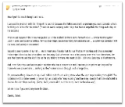
Me discussing with Steve over email over possible options.
Assessing Initial ideas/Stakeholder Feedback
Next steps: I will make a clearer sketch of number 1 and make my first model.
On this page I shall be assessing how viable each of my initial ideas is. This will involve showing them to my stakeholder Steve Greatorex by having a brief chat over email discussing the positives and negatives of some of the product ideas.
Idea | Description/explanation | Feedback from Stakeholders | Suitability | Score
1 | Based on a basic hydration pack but with a sleeve/cover but this can be wrapped around the arm. | May irritate the player Not easy to access Secure to the arm Can be adjustable to other users | Quite suitable helps the user having a adjustable strap. Could irritate the user whilst playing and may find it difficult to use which adds to the minor weakness of the product. | 18
2 | A holder in the wheelchair where a cup is placed and can use it whilst playing. | High risk of cup falling out Inconvenient to drink mid game Easy to access | This product may cause stress the user stress as can easily fall out whilst playing. However when in the holder the cup is easy to access. | 16
3 | A hydration pack which is attached to the wheelchair users leg. | Unique design Doesn't get in the way whilst playing. Would be hard to attach to leg | This design is new and current, you’ll also find that it wont get in your way whilst playing so the user is more likely to buy it. However it would be hard to attach to the leg for the user. | 17
4 | Hydration system under the wheelchair with adjustable straw. | Discrete design wont embarrass the user Very similar to existing designs Not easy to refill | This idea is discrete and doesn't look stupid. However the overall idea of this product is poor as its very similar to the other products and it would be very difficult to refill. | 14
5 | Hydration bottle with metal tube attached to upper part of wheelchair. | Highly unsuitable Easy to refill Can fit a lot of water in | This idea in my opinion is the worse as its just highly unsuitable. However it would be easy to refill and can fit a large capacity of water in it. | 11
6 | A neck brace hydration system that can easily be accessed. | Will distract the player Easiest to drink from Securely attached not going to come of wheelchair | This design would distract player. However it would be easiest to drink from and it wouldn't’t come off your neck. | 12
7 | A hamster water system hung on a pole at the back of the chair | Hamster system is difficult to modify Would drop of the pole easily Would have a good amount of water | This design would be difficult to make as its not very sustainable. It would be hard to get hold off a hamster hydration pack and the idea of having a pole wouldn’t work as it would easily fall off. | 9
8 | Tube that is placed a on a holder device which the user can drink from | Would be easy for the user to reach Tube may not be long enough | This design would be viable however it is very basic and the user may not be bothered about it, also the tube may not be long enough. | 14
9 | Hydration system under the wheelchair | May get caught in the wheel Would be difficult to maintain Would be less risk of it getting damaged | This design would be difficult as it may cause the user stress as they are worrying about it breaking at the bottom, this ultimately making the floor slippery. However it is a unique design | 13
10 | A hydration system which allows you to clip on and off the wheelchair arm | Clip may not be strong enough Wheel chair arm may not be able to hold This design is unique | This design would be different but may cause some difficulties as the clip would need extreme strength and the chair arm may not be able to fit | 12
Notes:
Which were then evaluated against their stakeholder’s requirements

Slide 15
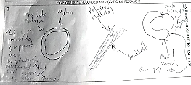
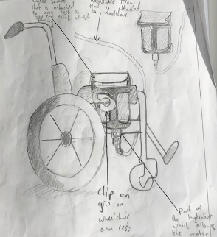

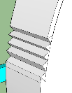

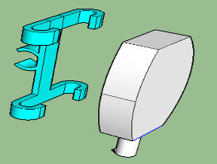

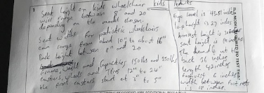
This is an idea of my design. It is a water sachet on a wheelchair that provides the wheelchair player/user hydration whilst playing there chosen sport so they don’t struggle and get dehydrated.
Development A
1. The water sachet may not be big enough to keep the user hydrated throughout the whole game.
Materials to consider when designing
6. The tube may split, so water may get let out this may be dangerous
This solution suggests that I need to make some adaptations to my grip as I need it to stay on the wheelchair which can be achieved by sticky gel or Velcro, also the other images imply that the grip needs to be made out of something strong and durable so it doesn't break easily an can last a long time.
2. The grip needs attachments for e.g. sticky material and polyester so it stays attached to the wheelchair arm without any issues.
Picture of adjustable bendy straw to give me an idea of what is required i.e. look and material.
Oscar thinks the overall idea is good he likes the idea of the grip and the use of the Velcro.
I made this idea on sketch up to ensure that the grip would comfortably detach from the wheelchair arm. However this idea may cause the user stress or another problem as the product may be spikey and not smooth.
This solution shows me that the tube must be long enough so the water can smoothly run through it so it doesn't disturb or cause any difficulties to the user.
However he's unsure about the amount of stress it may cause the user and whether the tube will stay in tact for along period of time.
4. Make sure the tube is big enough so the water comes through the straw with no problem so doesn't cause e user any stress.
Wheelchairs on sketch up to help me fulfill the ergonomics issues that may occur when designing, also to show all the parts of the wheelchair mainly the arm rest as that’s the important when making my prototype of the water sachet and the other required parts in the model.
3. The straw must be adjustable and bendy so it is available for all ages and is user friendly so it doesn't cause the user any problems whilst taking part.
5.The tube could get caught in the wheel.
I made this idea due to the fact that there may be issues with the amount of water stored in the sachet. However this may cause problems as it may be to big for the user and may not fit on the arm rest. This idea could maybe be available in different sizes.
A bendy adjustable straw will be attached here so user can drink whilst playing
NEW REQUIREMENT- Tube has to be a good length.
This solution tells me that I need to be careful when designing my model as I need to consider the ergonomic issues and the anthropometric data, so the straw that comes out of the sachet is suited to the 5th, 50th and 95th percentile if all goes well and if this can be achieved.
This is my sketch up model of the water sachet. I will use this as a basis when designing my prototype, The green grip is the part of the product that clips onto the wheelchair arm.
Notes:
The strongest idea was initially modelled using CAD, problems were highlighted and solutions explored.

Slide 16
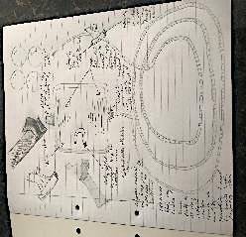
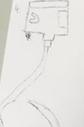

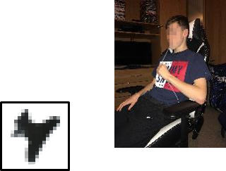
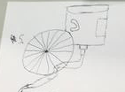
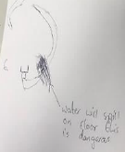
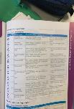

Development B
Sticky gel
This is a picture of the new the ideas all combined together
This sketch shows that the tube and the parts connected to the tube must be long enough so the water can run through smoothly so the user can comfortably drink from it.
NEW REQUIREMENT! – Needs to be secured away from the wheel
This sketch shows that the tube may get caught in the wheel. This would cause the user stress and would prevent them from playing.
EXTRA RESEARCH This is some extra research on disposable water sachets and when/if to reuse them
This is a picture of me holding a piece of straw to see a good length for the tube I will be using the length was 57 inches.
REQS | Why? Overall Score 58/80
Aesthetics 7/10 | My product doesn't look that aesthetically pleasing as its not bright. However it has various adaptations to make it stand out.
Customer 7/10 | My product has various good adaptations to it seatbelt material to keep it attached, butterfly clip attached to straw and etc. However improvements can be made.
Cost 9/10 | My product is very cost efficient as it will be fairly cheap as well it comes with various different parts which are cheap and easy useable.
Ergonomics/Function (9/10) (8/10) | The water sachet is easy recyclable as well as the different parts. The function of this is good however so problems may occur for tube may break or tube may get stuck.
Safety 6/10 | The safety with this product is ok however problems may occur for the tube may trail along the floor and this may restrict the playing of the user
Size 7/10 | The size of sachet is good for the majority of people however the bigger people may struggle as they need to consume more water.
Manufacturing 5/10 | My product may take along time as there are various parts required and different materials needed. However I've got a good outline to work with.
After doing some research ive found out that polyvinyl chloride would be the best thermpolymer to use as its strong, high impact and flexible.
This sketch shows that the tube may split, which would mean that water would spill out, suggesting danger and this issue may result in pausing the game.
NEW REQUIREMENT! – Needs to be secured away from the wheel
A picture of materials in the textbook this helped them choose what material to use
ADDED INFO This is some added information about the water sachet
Notes:
The idea was periodically checked against the requirements to check they were on track

Slide 17
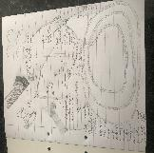
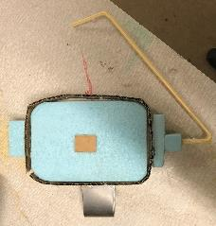

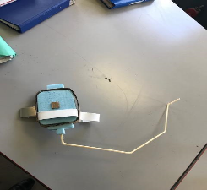
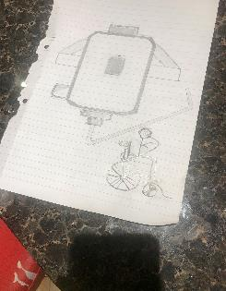

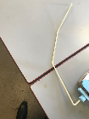
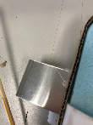
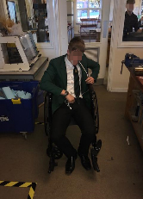
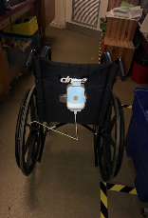



This was my initial drawing from my previous page, however it didn't look like my actual prototype so I decided to draw it again to make it more clear so it would help me whilst designing.
Development C
E1- Testing in the workshop
1st prototype
Iteration E1- 3/6
NEW REQUIREMENT! – Needs to be secured away from the wheel
2nd prototype
Stainless steel hook
Blue foam for both filters/screws
The size of the hole which attaches was a good size as the straw fitted comfortably inside without any risks of falling out.
My first prototype of the water sachet compared to my second porotype. In the second design I've added a longer straw and a strap to attach to the wheelchair.
Blue foam
The length of the strap was a bit too big I felt I was squeezing it together to reduce the size of it.
Congregated card
Tube going into the mouth
User Testing
NEW REQUIREMENT! – Needs to be secured away from the wheel
Water sachet placed here
The straw was a good length for a teenager as it comfortably went into the mouth without much issues.
In the workshop I used a elastic band to create my clip but the photo to the right is actually the kind of object that would be attached to the hook however I was limited to materials/objects I could use.
Additional research
Jacob said that the straw may need to be a bit longer for it to be comfortable plus change to style of straw as it needs to be more flexible.
However he did say that the hole where the tube fits in is a good size.
The size of the hook could be smaller, however the material is suitable and the hook needs to be a bit wider it was a bit squeezed together.
Making my prototype- My prototype is quite simple. I used blue foam to create a sort of square shape with the edges rounded for my sachet and used blue foam to design my screws/filters which allows the water to go into the sachet. My attach mechanism and my base around the sachet is made out of congregated card with allows the straps to attach to the wheelchair. My hook is made of stainless steel and I've used a art straw to implement the straw coming out the filter/screw.
The size of the filter is good, however the hole is way to small for the extensive amount of water that I want to put in the sachet.
Next Steps:
Explore: See what it looks like on a wheelchair
Create: Improve the design (move into CAD?)
Evaluate: Send these images/videos to Primary User for feedback
Notes:
Before starting to model using quick modelling materials that could be tested out on an actual wheelchair

Slide 18

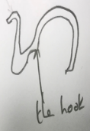
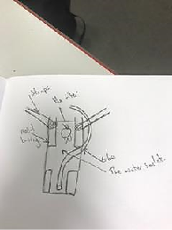
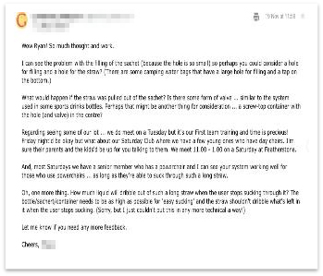
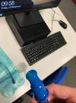




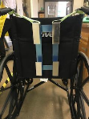

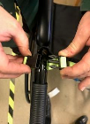
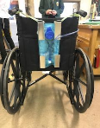




Development D
Hydration pack i will be using throughout testing my product.
Nozzle
The filter which allows the water to go in
The tube.
This is a drawing of my water sachet and some of the adaptations I have made to it.
This shows how it fits on the back using the metal basing.
This is a drawing of my hook which is attached to the inner tubing which helps the tube stay in good position when not in use I thought this was an ideal place to put it as there's a high chance it wont fall on the floor and disturb the game
This is the clip on mechanism that is attached to the inner tube.
Next steps: Start thinking about materials that I could use to upgrade my product, and add more security to metal basing.
Email from coach of disabled basketball club.
Areas to develop:
hole where water goes through needs to be bigger.
Two valves are needed one at the end of the sachet and the other at the top of straw.
Consider screw top opener for putting the water in.
The sachet needs to be higher up on the wheelchair so easier to use.
Straw may need making smaller as its going to hard for the user to access the water as they will struggle sucking so much to get the water out of the straw.
Consider the amount which is able to come through the straw and how much will dribble out when the user stops drinking.
Bite valve research this could attach onto the top of straw and go into the mouth.
The strap that attaches are the metal basing to keep it secure
This is my next prototype tested on the schools wheelchair. Overall the prototype works very well with limited errors.
Advantages: The straps stay attached and don’t come apart, the hook provides a sustainable source for the straw to rest in when not in use, The metal base and hook keeps the hydration pack inside and it fall out as the hooks keep the sachet in a good position.
Improvements: The straps need to be of a stronger material, the hook needs upgrading and needs to be more secure, the metal basing needs to have more to it.
NEW REQUIREMENT! – The metal basing needs to have more security possibly add more metal to it.
The hook that is used to keep the straw in place when not in use.
A valve which is processed by the squeezing of something.
The water sachet once the recent prototype has been made
NEW REQUIREMENT- The cover needs to be more secure
User Testing with Mr
Notes:
Along the way they sought further feedback from stakeholders as they continued to refine their model

Slide 19












Additional research on the type of shape I am going for when designing my shield. This I needed to add variety and shape this is needed to give me a better idea of what kind of shape my cover is going to be.
Development E
Additional research on a different type of hook I could use as its more user friendly. This is needed as it needs to look appealing to the user and needs to be comfortable.
This is the metal hook that I've made to allow the tube to have something to rest whilst not in use, this has been upgraded from the last prototype hook. This needed to keep the straw away from user when not in use.
I have designed this see through cover to add protection to the sachet whilst the user is playing and it also makes the product look better. When going into further advancements I will vac form my cover and possibly make a turtle shield to upgrade my product. This is needed to give the cover protection and security.
Metal hook
Problems-
the outer part of the hook on the inner tubing may cause user problems
the hook around the inner tubing didn’t fit on properly
the strap needs to go across the wheelchair as one strap
the cover is not exactly measured correctly and its not completely high impact resistant.
Strap
Cover
This is the strap that I've decided to use at this stage instead of the previous idea to upgrade it to make it more sustainable. This is needed to keep the product attached to the chair.
This is a sketch of the sachet once all adaptations were made.
sketch of cover
NEW REQUIREMENT! – make sure that the strap does fully across back of wheelchair in the next design.
Next steps: Upgrade my product even more start to think of new and better materials to use.
I have designed this for my product to give it more freedom and I considered other this as well when designing this ergonomics, better usability, more aesthetically pleasing. This is needed to give the tube freedom and it helps the tube reach the mouth better.
Gap for straw to feed through
User testing with Mr.
when the upgraded adaptations were made.
NEW REQUIREMENT! – Move the hook to be at the bottom of inner tube and change the material of cover.
I have decided to add a magnetic catch to keep the cover attached to the metal, this enables the cover to stay down when in use. This is needed so the cover can attach to metal base..
I have added hinges to my product so it is easy to remove and put on when using the product.
Magnetic catch
Before
After
Improvements/good things that have been added to the product-
both hooks have been upgraded.
I've added a magnetic catch to the product which works well.
Hinges work well
the straps work well but need to be changed to go fully across
I have decided replace my hooks to be more curved as it helps the usability as the sachet stays on better. This is needed to smoothly keep the pack inside.
hinges
Curved hooks
Notes:
Their development continued as they experimented with more specific materials and processes

Slide 20






Checking the Final Design against the Requirements
Requirement | Score /10 | Explanation/ justification for including this requirement
Must appeal to all ages and genders | 6.5 | This requirement is needed to add more sales and give the product some variety.
Must be comfortable as well as strong/durable | 7 | This is needed so the user is at ease whilst and is not in pain.
Must be fairly cheap shouldn't’t go past the price of £15 | 8 | Must be cheap so its affordable so people buy it.
Must be easy to access and use | 8 | This is needed so it doesn't cause the user any difficulty or distress.
Must have a good amount of water available | 9 | So it can last the whole game.
The product must be lightweight on the arm/wheelchair shouldn't’t go over 3kg | 8 | So its easy to carry and doesn't weigh a lot whilst playing.
The strap must be adjustable | 10 | This requirement is needed so it fulfils the 5th, 50th, 95th percentile.
The cover needs to be secure | 6.5 | This is needed so it is impact resistant and doesn't break.
Needs to be away from the user | 8.5 | This is required so it doesn't stop the calm and cause the user problems.
Make sure the strap goes fully across the wheelchair | 9.5 | So the product doesn't de attach/ fall off during the game and to keep it secure.
The metal base needs to be more secure | 7 | This is needed due to there being a high possibility it gets badly damaged throughout the game with all the impact.
Change material of cover | 7 | So its more sustainable and more appealing.
Tube must be a good length | 9 | This is needed so it fits into the persons mouth without any difficulties.
Final Design
Feedback from Stakeholders
Works efficiently
Hooks work well
Cover needs to be stronger
Metal base needs to be stronger
Tube is good length
Good amount of water
Needs to be more efficient
Notes:
Leading to a final design that was checked against the requirements

Slide 21



Hydration Pack 3000
Final Design
A photo shop picture of the product on the back of the wheelchair, obviously tubing and straps would be provided.
The base is made of durable galvanized steel which is high impact resistant so wont break easily.
The product is fairly cheap.
The sachet holds a good amount of water and can last for a full intense game.
The hooks which enable the sachet to stay in place.
The product is lightweight
The Hydration Pack 3000 provides a sustainable hydration source which puts the user at ease whilst playing and it gives the user a more efficient performance whilst taking part.
The product is strong/durable
The product when in use.
The cover of the hydration pack will be made using vac forming.
Straps used to keep the sachet in place.
The product appeals to all genders as it’s a basic design which is used more for the use not for the ascetic look.
This product fulfils many stakeholder requirements that were considered a while back, these are annotating above.
This component is where the tube is placed and its unscrew able and easy to access.
This is the cover when its open and not in use as its easy to open and shut.
Notes:
Before producing a presentation that fully explained their design idea to their stakeholders

Slide 22













Product Overview
Technical Specification
Bought in Components: Hydration Pack
Tube
Base Component
Front
Side
Cover Component
Hooks
Metal Base
Cover
Whole Unit
Part | Material | Finish
Cover | Poly carbonate | None required
Base | Stainless Steel | None required
Hooks | Stainless Steel | None required
Straps | Velcro | None required
Hinges | Plastic | None required
Magnetic Circles | Iron, magnet | None required
Thickness of base
Shaded x-ray view
Metal cut out to keep it secure
The length of the top of the base
Pivot holder
Notes:
Based on his CAD model they were able to produce a series of dimensioned drawings

Slide 23

Cover
Planning the Making of the Final Prototype
Metal Base
Process | Equipment | Time (m) | Notes
Cut two pieces | MDF Wood | 10 | Make sure the pieces are the same length
Stick two MDF pieces together. | Super glue, screws | 5 | Make sure they don’t fall apart.
Mark out cut/shape | Marker pen | 1 | Make sure its curved
Cut out shape | Fret saw/band saw | 5 | Make sure the shape looks clean
Shape the MDF Wood | File | 6 | Make sure
Smooth the MDF Wood | Sandpaper | 8 | Make sure it looks clean/tidy
Vac form over MDF | Vac Former | 15 | Make sure to watch carefully
Trim | Band saw, hand saw | 15 | Make sure its kept flat
Clean up | File, emery cloth, Sand Paper | 5 | Use Radius guides, needs to look tidy
Laser cut cover | Laser cutter | 10 | Make sure it looks neat and tidy
Process | Equipment | Time (m) | Notes
Mark out 4 pieces of aluminium | Marker Pen, Aluminium | 5
Measure the size of metal strips | Ruler | 3 | Make sure the measurements are accurate
Cut 2 large strips by 360mm Cut 2 small strips by 150mm | Metal Cutter | 10 | Make sure that the pieces are equal for both parts
Drill holes needed on the small pieces by roughly 20mm in each side on both | Drill Bit, Pill Drill | 5 | Roughly mark out where to put the holes and try to get them to the same size
Bend the two large pieces of metal by 120mm in length | Mental Bender | 10 | Make sure that the pieces are bend to the same length
Drill holes at the bend point so hinges can fit and work | Drill bit, Pill Drill | 5 | Roughly mark out where to put the holes and try to get them to the same size and fill them in
Clean up | File, emery cloth | 10 | Make sure it looks clean and finished
 | Total | 48 mins
 | Total | 1hour 20 mins
Hook
To the right is a rough production plan, for lessons and any after school sessions
Process | Equipment | Time (m) | Notes
Mark out aluminium sheet at 25-30mm | Marker pen, aluminium | 3
Bend the aluminium to roughly a 45 degree angle. | Maybe metal bender or hand | 5 | Make sure the tube fits in the hole and wraps around
Add magnetic circles to aluminium hook. | Magnetic circles | 2 | Total- 10 mins
Notes:
That helped them to plan how they would make their idea in the school workshop

Slide 24

The piece of metal I used to cut with markings on it.
Me putting the nuts and bolts into the holes
Using the metal cutter to cut the pieces of metal.
Drilling hole for straw to be easy accessible
Drilling holes to allows nuts and bolts to fit in.
Screwing the hooks in and image of hooks fit in
This strap is used to attach the straw to when its not in use
The cover designed on 2D design
Step 1 I tried a see through plastic prototype
Step 2 then I tried a prototype in cardboard with a green basin over it
Step 3 I used the vac former to create a hard prototype and I'm using this one
Using the gerbil to trim outside the first prototype
The cardboard porotype in vac former
The hard prototype in vac former
The hard prototype in thermo forming being softened
Drilling holes into hinges for screws
Making The Final Prototype
Metal Base
Cover
Hooks
Strap
Using the mental bender to bend the pieces of metal at the front of the base to give it some shape/variety.
Using the blow torch and hammer to bend the hook.
Trimming the metal to allow a cleaner finish
Marking out the lines in which I would place the holes.
Using a hammer to pinpoint holes.
Cleaning the holes once they were drilled.
Drilling holes to allow hooks fit in
Notes:
Their making diary demonstrated the use of an appropriate range of tools, machines and processes

Slide 25

The Hydro Drive
Video content removed due to Data Protection Act
Notes:
The final prototype was clearly photographed along with a video to demonstrate it working

Slide 26
Close Up Details
The product when opened to see how the metal base is constructed.
The metal base is bent to give a secure unit whilst in use.
The middle parts of the metal connected to the base to add security
The hooks that are attached to the metal base so hydration pack can fit in.
A hexagon type shape where the magnetic circles fit in.
Some of the metal drilled to connect the top parts using a 3mm drill, screws, screwdriver to tighten.
A cut out arch shape using the fret saw to allow the bottom of tube component to fit through.
Other parts of the metal drilled to bottom parts using screws, 3mm drill, screwdriver to tighten.
The metal magnetic circles attached to laser cut cover which stick to it whilst its not in use.
The hinges that are attached to metal to make it removable (open/close).
Notes:
Along with some Close-up photos that helped the teacher to see all the work that had gone into the making

Slide 27

















Tech spec on one of the previous pages
How Is My Final Prototype Different To My Tech Spec
There will be a opportunity to buy different coloured shells to add more sales and to give more variety to the product.
My product would be sold in these kind of stores as it meets the criteria out these stores sell.
Advert of product in magazine
The cover isn't as rounded- The reason for this is because it take a considerable amount of time to get it properly rounded ad I was dealing with limited time, however the fits perfectly to metal base.
Screws weren’t used in the tech spec to keep hooks connected to base- I felt this was needed as its more sustainable and the hooks are less likely to come out as there more securely fitted in.
I will be sponsored by Hydration Station
It’s a good size
The product is environmentally friendly
The straps go all the across the wheelchair
The tube is a good length
The cover is aesthetically pleasing
The magnetic circles work well
Marketability
Trying my final prototype on the back of the wheelchair where it will be placed.
I think my product would be marketable for the following reasons:
The Hydration Pack 3000 is a sustainable
product that allows disabled users to stay hydrated whilst playing there chosen wheel chair sport. It follows the footsteps of a environmentally friendly product which is similar to just having a water bottle holder with you whilst playing but its more advanced. Its name could be easily changed to suit different versions as it could be a Mini Hydration Pack 3000 or a Pro Hydration Pack 3000 or the Elite Hydration pack 3000.
Due to a cover being one of the main factors of this product it could be easily manufactured in different colours or finishes as its easy adjustable and would look good with all different types of finishes.
LOGO
£12.00
The cover isn’t blue- I felt that a blue cover wouldn’t be as suitable and that this dark green colour with hexagon type shapes on it looked more appealing.
There wasn’t a cut out oval shape for bottom of tube device to fit through on tech spec- I felt that this type of cut out was needed as it adds some variety to the cover and it looks more pleasing on the eye when the end of tube device is coming out of it.
The name is different- I realised that the Hydration pack 3000 seemed a bit to basic and simple and it wouldn't’t really lure people to buy it as it sounds boring and the new name in the hydration driver relates more to the product made and its use.
Expanding The Brand
In my early sketches I drew a design for my cover and base. This would be quite useful for transportation and could be a buy on product for some users.
I went through several prototypes to find the best finish.
A more developed component for the tube holder would have be made if it was to become popular product. Either a circular stainless steel item with a screw or a versatile clip on mechanism
The cover will also allow to make further advancements as you are able to put stickers on the product.
Direct Comparison with Drawing- As I did some hand drawn working drawings I placed against my prototype and it looked pretty similar!
Notes:
They then discussed the viability of their idea – checking against their technical specification whilst thinking about its marketability

Slide 28

Physical Testing
Feasibility of the design solution
I checked to see if it would work efficiently when the product was finished and yes it did it fulfilled its job.
Product Design Teacher
Cover needs to stronger
Stronger Straps
Need stronger clips to keep it attached
Bag is high capacity
Looks good/nice design
It’s a good size
I posted my final prototype on a facebook wheelchair sports group chat and they were uncertain of what it was.
has a family member who would be interested in my product.
Water needs to stay cold
Buckles shouldn't’t hurt user
Need more straps to keep it more secure
Protective casing
Its nice and simple
The handle strap is useful
I tried out my product inside a backpack and on the frame of a bed to see if it could exceed other uses.
Video content removed due to Data Protection Act
Stakeholder
I tried its impact resistance and fortunately it didn't’t break as the cover is quite durable but if it was a greater impact it may break so maybe something to look at in the expanding the brand section of the marketability
Hinges aren't strong enough
Metal base needs to be stronger
Cover needs to be stronger
The hooks keep the sachet in place
The handle strap is efficient
Straps do there job
So does it actually work?
The answer is yes however the cover may need adaptation if facing great impact. The hooks keep the hydration pack on and the metal base doesn't break easily as it has two pieces keeping it secure, the straps also keep the product still with the magnetic circles keeping the cover attached whilst in use.
Primary User
Needs to be more efficient
Straps may not work on every wheelchair
Water needs to stay cold
The handle strap works well
Good amount of water
The tube is a good length
I dropped the product several times and it was fine. However it must be considered that its only the prototype and that the real thing would be much more effective and durable.
Notes:
The final prototype was tested on a wheelchair and they received final feedback from their users and stakeholders

Slide 29




Evaluation Of Final Prototype
My Prototype’s Strengths
It’s a good size- This makes it easier for transportation. The size aspect of the product helps as it will be able to fit into maybe storage wheelchair systems and rucksacks.
The price- The price of this product would be very good as there isn’t much items in the product to consider.
Catchy Name- “The hydro drive” is instantly recognisable as it relates to the purpose of the product which is to drive you through the game.
The tube is a good length- This helps as it comfortably fits into peoples mouths without much difficulty and it fulfils the range of ages that would be using this product 10-30 roughly.
The hooks- The hooks into the metal base work well as the hydration pack doesn't fall out in whilst in use as it’s a secure unit.
The handle strap- This works well as it keeps the tube safe and out of the way whilst not in use and it keeps it stored and doesn't fall out of the component.
My Prototype’s Weaknesses
The cover isn’t completely impact resistance- This may be due to the strength of the cut out.
The metal base is sharp at some points- This is because the sides aren’t rounded/smoothed out well enough.
The metal base could be made stronger- This could be adapted be changing to metal or adding more pieces to keep it more secure.
The ease of removing and putting the hydration pack inside is limited- This is due to the cover not having anything to keep it up whilst taking the pack out so it just falls down.
The cut out oval shape doesn't really work – This is due to there being too much space when end of tube component tries to fit through so it just falls back down into the base.
There isn't a hook to wrap the tube in the base when its finished- This is a weaknesses as there isn't anything to keep the tube out of the way and it just dangles down otherwise.
Hinges aren't strong enough- This is due to the cover not being able to go all the way back so the cover just falls down relates to ease of removing.
Its not bright enough- This was due to the lack of time however if havi9ng more time to create a final product I would add more patterns/colours to make it more pleasing on the eye.
Design Optimisation
Certain modifications would affect various elements of my product and would have to be considered.
Complexity- Mod 2 and 3 will require significant development as providing a glow in the strap would be difficult to manufacture as the idea would be hard to modify due to it maybe not meeting the requirements as it may not be bright enough. It all depends on how you would manufacture the adaptation to it as it may be challenging to bend the exact shape needed for the prototype. Another problem that needs considering during the manufacture process is that you still need the strap to work efficiently so this addition cant affect it as its purpose will not be fulfilled.
1
2
3
Retail Cost- All would add to the overall retail cost expect maybe Mod 1. Mod 2 would increase the price as cotton is a expensive material and the getting it to modify to the shape with both the sponge insert and cotton cover over the original cover would be difficult to manufacture. Mod 3 would affect the price as the addition would be hard to manufacture as the service is limited and it may not be bright enough so it may have to self made. However you would have to cautious of price as users/buys may not want to buy it if its too pricey.
MODIFICATIONS
If added a hook to the back of the metal base- it would give the user something to store the tube once finished so it make there life much easier. However it may drop down too much so it would still get in the way.
Providing a cotton cover with a sponge insert on top of the original cover would make it stronger and impact resistance. However it may be costly and add extra weight.
Adding a possible colored/glow in the dark strap would provide a additional source to be added on to the product which will make it more sustainable and more appealing to the user. However it may be difficult to find this service and adapt it to the strap.
Notes:
All this testing helped them to conclude their portfolio with a list of strengths and weaknesses and some suggestions as to what they could improve further.

Slide 30
Top tips
Talk to others, get their opinions.
Be clear about who you have talked to and how you have taken on board their feedback and opinions.
Document everything as it happens.
Focus on describing WHAT you did WHY you did it and HOW it affects your project.
GCSE Design and Technology
© OCR 2020
Notes:
And that’s it… 24 well presented, easy to follow slides that document what they did in real time to solve the problem they found.
So, some tops tips for you to remember when developing your own NEA project:
Talk to others, get their opinions.
Be clear about who you have talked to and how you have taken on board their feedback and opinions.
Document everything as it happens.
Focus on describing WHAT you did WHY you did it and HOW it affects your project

Slide 31
OCR Resources: the small print
OCR’s resources are provided to support the delivery of OCR qualifications, but in no way constitute an endorsed teaching method that is required by the Board, and the decision
to use them lies with the individual teacher. Whilst every effort is made to ensure the accuracy of the content, OCR cannot be held responsible for any errors or omissions within
these resources.
Our documents are updated over time. Whilst every effort is made to check all documents, there may be contradictions between published support and the specification, therefore please use the information on the latest specification at all times. Where changes are made to specifications these will be indicated within the document, there will be a new version number indicated, and a summary of the changes. If you do notice a discrepancy between the specification and a resource please contact us at: resources.feedback@ocr.org.uk.
© OCR 2020 - This resource may be freely copied and distributed, as long as the OCR logo and this message remain intact and OCR is acknowledged as the originator of this work.
OCR acknowledges the use of the following content:
Please get in touch if you want to discuss the accessibility of resources we offer to support delivery of our qualifications: resources.feedback@ocr.org.uk
Notes:
Please look out for further support videos on how to handle your own NEA.
Bye for now…

