Slide 2
LO1 – Understand the principles and importance of a balanced diet.
1.1 Meaning of a ‘balanced diet’
1.2 The importance of a balanced diet, i.e.
weight control
chronic diseases
health and wellbeing
1.3 Components of a balanced diet, i.e.
macronutrients (e.g. carbohydrates, proteins, fats)
micronutrients (e.g. vitamins, minerals, fibre)
water

Slide 3
LO1 – Understand the principles and importance of a balanced diet.
1.4 Nutritional advice, i.e.
Current recommended guidelines from public health sources
Associated with nutrition (e.g. the Eatwell plate, the food pyramid, food traffic lights)
Common terminology (e.g. Recommended Daily Allowance (RDA), Optimum Level (OL), Safe Intake (SI), Estimated Average Requirement (EAR)) Food labelling (e.g. legal requirements, different ways information is displayed)
Current healthy eating initiatives (e.g. Change4Life, Healthy Schools, Ministry of Food)

Slide 4
LO1 – Understand the principles and importance of a balanced diet.
1.5 Nutritional requirements for different groups, i.e.
children
young people
adults
older people
athletes
physically inactive people
By the end of this section, you will be able to outline the components of a healthy balanced diet, including recommended guidelines from public health sources.
In addition, you should also be able to describe the nutritional requirements for different groups of people.

Slide 5
Timings
Topic | Allocated Time
1.1 Balanced diet | 1 hour
1.2 Importance of a balanced diet | 2 hours
1.3 Components of a balanced diet | 3-4 hours
1.4 Nutritional advice | 2 hours
1.5 Nutritional requirements for different groups | 2 hours
Total hours for LO1 | 10-11 Hours

Slide 6
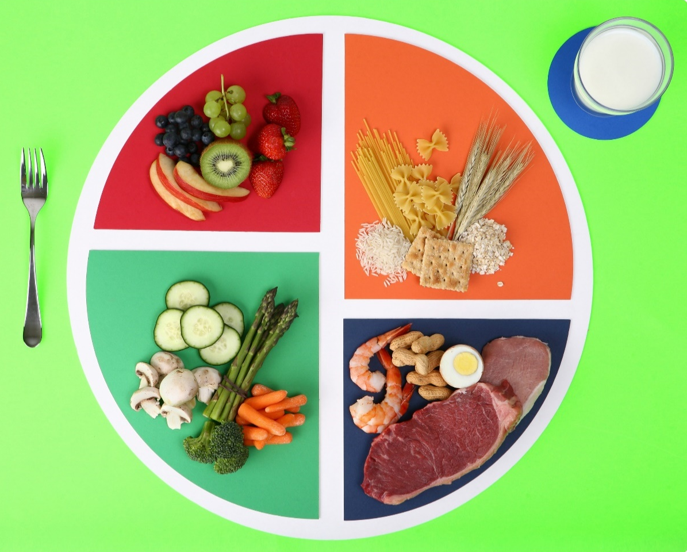
LO1 – Understand the principles and importance of a balanced diet.
1.1 Meaning of a ‘balanced diet’
What is a balanced diet?
Learner activity – Write down all the foods you think make up a balanced diet
Now make a poster to represent all the food types you think you need in a balanced diet.

Slide 7
LO1 – Understand the principles and importance of a balanced diet.
1.1 Balanced diet
A balanced diet is one that gives a person all their nutritional needs.
A balanced diet provides all the nutrients a person requires, without going over the recommended daily calorie intake
The NHS has developed the Eatwell Plate to demonstrate the correct proportions of each food group to maintain a healthy body weight. They suggest that individuals should:
eat at least 5 portions of a variety of fruit and vegetables every day (see 5 A Day)
base meals on higher fibre starchy foods like potatoes, bread, rice or pasta
have some dairy or dairy alternatives (such as soya drinks)
eat some beans, pulses, fish, eggs, meat and other protein
choose unsaturated oils and spreads, and eat them in small amounts
drink plenty of fluids (at least 6 to 8 glasses a day)
https://www.nhs.uk/live-well/eat-well/

Slide 8
LO1 – Understand the principles and importance of a balanced diet.
1.1 Balanced diet
Learner Activity:
Watch the video on this website and think about what you ate/drank yesterday, did you hit all the food groups and in the correct proportion.
Discuss with a partner.
https://www.nutrition.org.uk/healthyliving/healthydiet/healthybalanceddiet.html

Slide 9
LO1 – Understand the principles and importance of a balanced diet.
1.1 Balanced diet
A balanced diet should contain around
15% protein
30% fat
55% carbohydrates.
For athletes in training, the percentage should be changed to reflect the need for more instant energy.
Sports nutritionists recommend:
10-15% Proteins
20-25% Fats
60-75% Carbohydrates

Slide 10
LO1 – Understand the principles and importance of a balanced diet.
1.2 The importance of a balanced diet.
Weight control
For body weight to remain constant, energy input via food must equal energy expenditure.
This is the basis of weight control and is known as the ENERGY EQUATION.
Input 2000Kcal – output 2000Kcal = no change in weight.
Input 3000Kcal – Output 2000Kcal = increase in body weight
Input 2000Kcal – Output 3000Kcal = decrease in body weight

Slide 11
LO1 – Understand the principles and importance of a balanced diet.
1.2 The importance of a balanced diet.
Weight control
It is important that you eat the right amount of calories per day to maintain a healthy weight, too many calories can lead to weight gain, whilst to little can lead to weight loss.
A simple way of calculating your basic energy needs is:
1.3 (Kcal per hour) x 24 (hours in a day) x weight in KGS
For example:
1.3 X 24 X 60Kg = 1872kcal
Energy requirement then increase when you exercise, you would need to add the extra calories you burn off during exercise on top of your daily requirements.
Learner Activity
Research how many extra calories you will require to participate in a sport of your choice for one hour.
You could use your smart watch or an app such as My Fitness Pal to help you calculate how many calories you burn off during exercise.

Slide 12
LO1 – Understand the principles and importance of a balanced diet.
1.2 The importance of a balanced diet. - Learner Activity
Task 1 – Using the previous slide, calculate your basic energy needs per day, include any exercise you might have done/have planned for each day.
Task 2 – Choose a sport/activity of your choice and fill in the table to take into account the age/duration of training/intensity of training etc. You could use a famous sport person, if required.
Day | Basic Energy | Extra Energy | Total Kcal
1
2
3
4
5
6
7

Slide 13
LO1 – Understand the principles and importance of a balanced diet.
1.2 The importance of a balanced diet.
Chronic diseases
There are many disease that can be caused from an unbalanced diet.
Diseases related to overeating are:
Obesity
Diabetes
Cardiovascular disease
Cancer
Osteoporosis
Learner activity: Choose 1 of the diseases above and research how an unbalanced diet can have an impact on the chances of developing the diseases.
Produce a report on your chosen disease and share with your class.

Slide 14
LO1 – Understand the principles and importance of a balanced diet.
1.2 The importance of a balanced diet.
Health and wellbeing
A well-balanced diet provides all the energy you need to keep active throughout the day.
It also gives you the nutrients you need for growth and repair, helping you to stay strong and healthy and help to prevent diet-related illness, such as some cancers.
Deficiencies in key nutrients, can lead to a weakened immune system and therefore more chance of developing illnesses and disease.

Slide 15
LO1 – Understand the principles and importance of a balanced diet.
1.3 Components of a balanced diet
macronutrients - carbohydrates, proteins, fats
micronutrients - vitamins, minerals, fibre
water
Learner activity – Write down on piece of paper (and stick them on the board), different foods that belong to each group:
Carbohydrates
Protein
Fats
Vitamins
Minerals
Fibre
Water

Slide 16
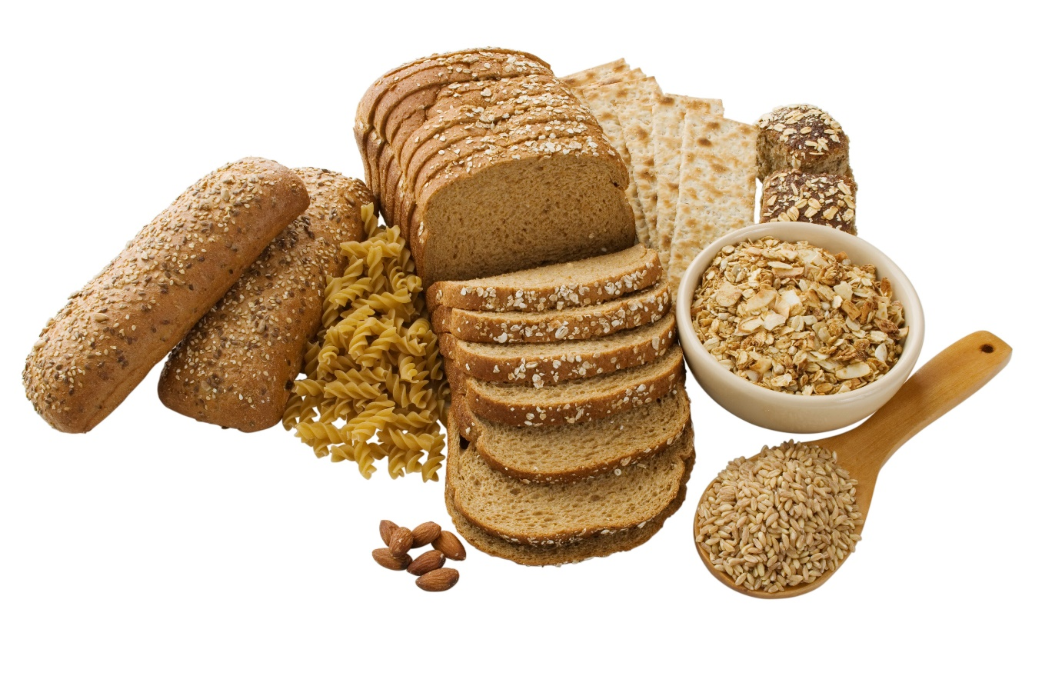
LO1 – Understand the principles and importance of a balanced diet.
Macronutrients - Carbohydrates
There are two types of carbs; Simple & Complex.
Simple carbs are found in fruits and are easily digestible. They are also present in many processed foods & anything with refined sugar added.
Complex carbs are found in nearly all plant-based foods, and usually take longer for the body to digest. They are commonly found in bread, pasta, rice & vegetables.

Slide 17
LO1 – Understand the principles and importance of a balanced diet.
Macronutrients - Carbohydrates
Carbohydrates are an important energy source during activity, it is the predominant source of energy during high-intensity exercise or anaerobic work.
Carbohydrates are stored in the muscle & liver as glycogen & transported in the form of glucose. They contain the elements carbon, hydrogen & oxygen, and store a lot of energy.
Due to their limited supply, it is important that carbs are consumed before, during & after exercise as the body has limited stores.
Learner Activity
Watch the following video- https://www.youtube.com/watch?v=wxzc_2c6GMg
Discuss with a partner the different types of carbohydrates and how they impact on your health.

Slide 18
LO1 – Understand the principles and importance of a balanced diet.
Macronutrients - Fats
Fats are the secondary energy fuel for low-intensity, aerobic work such as jogging. Fats are made from glycerol and fatty acids.
Fat is an important energy fuel during low-intensity exercise
Fats are stored in the muscle as triglycerides & transported as fatty acids.

Slide 19
LO1 – Understand the principles and importance of a balanced diet.
Macronutrients - Fats
We have two types of fats, high density lipoproteins (HDLs) and low-density lipoproteins (LDLs)
HDLs are also know as the good fats, which we get from fish, nuts, avocado etc. they help move cholesterol to the liver to be disposed of.
LDLs are our bad fats, we get from doughnuts, chips, crisps etc. LDLs create deposits in the arteries and lead to heart disease.
Watch this video, to learn more about different types of fat -https://www.youtube.com/watch?v=QhUrc4BnPgg
Learner activity:
Make a poster to show people the good and bad fats.

Slide 20
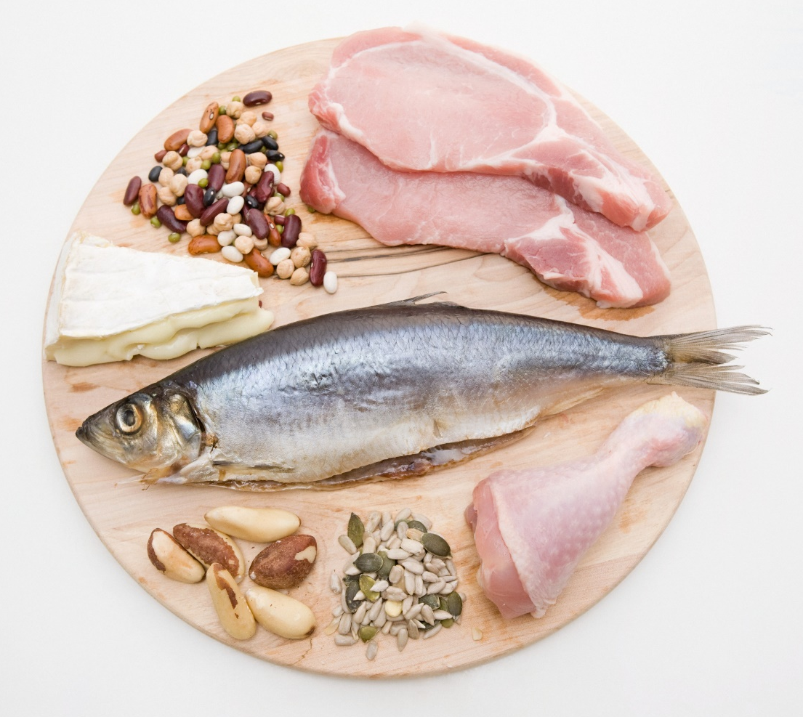
LO1 – Understand the principles and importance of a balanced diet.
Macronutrients – Protein
Proteins are important for tissue growth and repair and to make enzymes, hormones and haemoglobin. - https://www.youtube.com/watch?v=2tM1LFFxeKg
Generally, proteins provide energy when glycogen and fat stores are low. However, during strenuous activity or sustained periods of exercise, proteins in the muscles may start to be broken down to provide energy
Protein can be found in fish, seafood, white-meat poultry, beef, milk, nuts, yoghurt, cheese and eggs.
Protein is key when carrying out strength training or high intensity training, as it is needed to help muscle repair.
Without protein our muscles won’t recover so quickly, leaving us with sore muscles (DOMS)

Slide 21
LO1 – Understand the principles and importance of a balanced diet.
Micronutrients – Vitamins
Vitamins are needed for muscle and nerve functioning, tissue growth and the release of energy from foods.
Fat soluble vitamins – A, D, E & K. Your body stores these in liver & fatty tissue for use later.
Water soluble vitamins – B & C. Found in fruit, vegetables & dairy products. Your body cannot store these, and excessive amounts would just be excreted through urine
Watch this video to learn more about each vitamin- https://www.youtube.com/watch?v=ISZLTJH5lYg

Slide 22
LO1 – Understand the principles and importance of a balanced diet.
Micronutrients – Vitamins
Learner activity: Make yourself a table with all the different groups of vitamins as the titles and then place the foods listed below under the correct vitamin group (hint, some can be found in more than one group).
A | B | C | D | E | K
Cheese, yoghurt, milk, lemons, spinach, nuts, oily fish, eggs, brussel sprouts, olive oil, breakfast cereals and mushrooms

Slide 23
LO1 – Understand the principles and importance of a balanced diet.
Vitamin | Sources | Function
A | Cheese, eggs, oily fish, milk and yoghurt | Helps build the immune system. Vision in dim light and healthy skin.
B (1-12) | Milk, eggs, fortified breakfast cereals, mushrooms, meat, chicken, liver, avocado | Keeping the nervous system healthy the body release energy from food
 | Citrus fruit, peppers, strawberries, blackcurrants, broccoli, brussels sprouts | Helps to protect cells Maintains healthy skin, blood vessels, bones and cartilage and with wound healing
D | Oily fish, red meat, liver, egg yolks, breakfast cereals, sunlight | Needed to keep bones, teeth and muscles healthy and helps regulate the amount of calcium and phosphate in the body
E | Plant oils – such as rapeseed (vegetable oil), sunflower, soya, corn and olive oil, nuts and seeds, wheatgerm – found in cereals | Helps maintain healthy skin and eyes, and strengthen the body's natural defence against illness and infection (the immune system).
K | Green leafy vegetables – such as broccoli and spinach vegetable oils, cereal grain | the body needs for blood clotting, helping wounds to heal.

Slide 24
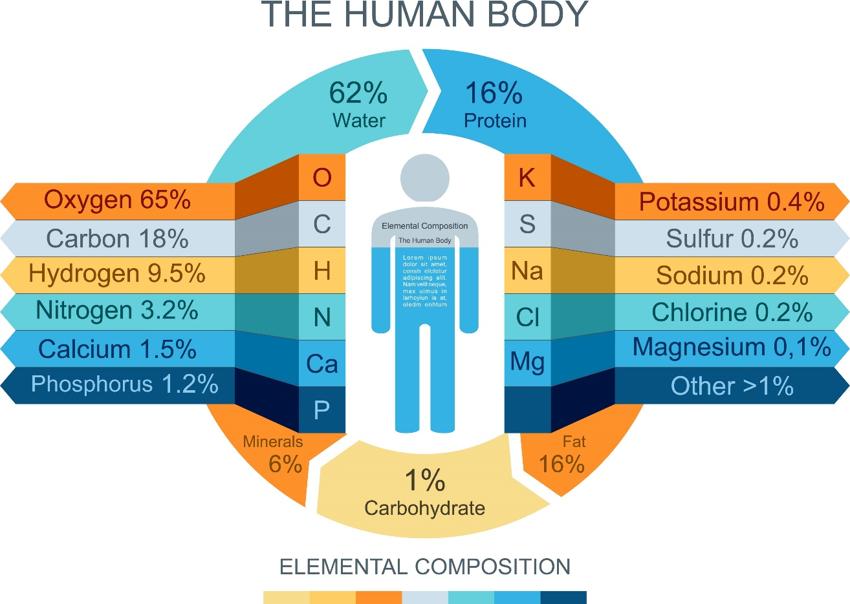
LO1 – Understand the principles and importance of a balanced diet.
Micronutrients – Minerals
The body is made up of a variety of minerals.
Minerals assist in bodily functions:
Calcium is important for strong bones and teeth.
Iron helps form haemoglobin, which is needed for the transport of oxygen and therefore to improve stamina levels.
Sodium helps maintain the balance of water in and around your cells. It's important for proper muscle and nerve function
Iodine helps make thyroid hormones, which help keep cells and the metabolic rate (the speed at which chemical reactions take place in the body) healthy.

Slide 25
LO1 – Understand the principles and importance of a balanced diet.
Micronutrients – Minerals
Minerals tend to be dissolved by the body as ions and are called electrolytes.
It is important to get the right balance of minerals as too much of one can cause issues, for example to much sodium (salt) can result in high blood pressure.
Summary of minerals - https://www.youtube.com/watch?v=q4BRJMFYokI
Learner activity:
Research the different minerals our body needs and find out what they do and what could happen if you consume too much.
Now make a presentation about the different minerals and present it to your class.

Slide 26
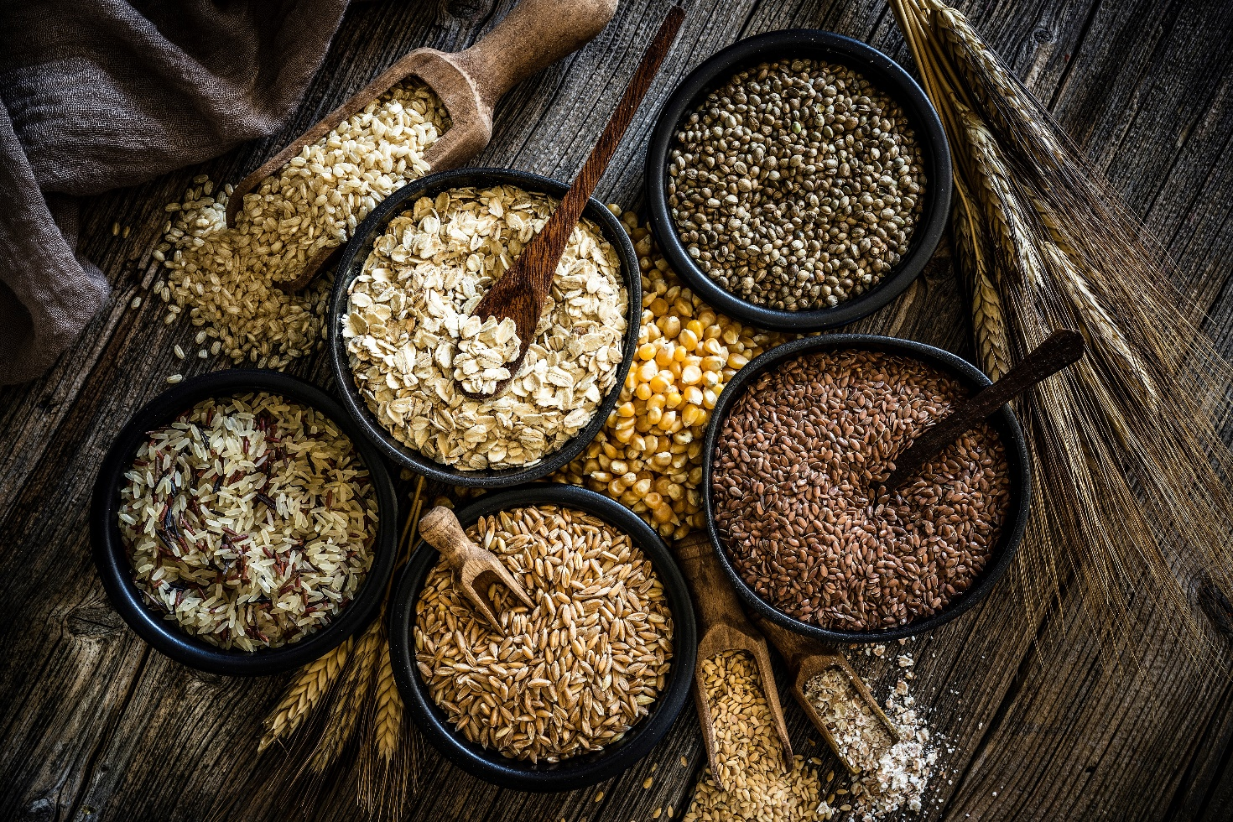
LO1 – Understand the principles and importance of a balanced diet.
Micronutrients – Fibre
The main role of fibre is to keep the digestive system healthy
Fibre is important during exercise as it can slow down the time it takes the body to break down food, which results in a slower, more sustained, release of energy.
Good sources of fibre include wholemeal bread and pasta, nuts, seeds, fruit, vegetables and pulses.

Slide 27
LO1 – Understand the principles and importance of a balanced diet.
Water
Water constitutes up to 60% of a person’s body weight and is essential for good health.
It carries nutrients to cells in the body and removes waste products.
Helps maximize physical performance.
Significantly affects energy levels and brain function.
May help prevent and treat headaches.
It also helps to control body temperature.
Learner activity: How many glasses of water do you think you need to drink per day to keep healthy?
Now watch this video to see how much water you should drink per day. https://www.youtube.com/watch?v=oW6UI_d98Yw

Slide 28
LO1 – Understand the principles and importance of a balanced diet.
1.4 Nutritional advice.
Current recommended guidelines from public health sources
Recommended guidelines will give us information on the RDA (recommended daily allowance) for each food group.
There are many different public health sources that can give us recommended guidelines of each food group.
It is important when researching that you ensure you are using websites based in the UK
Learner activity:
Make a list of UK based websites you can use to gain information on the RDA for each food group.
One to get you started is:
https://www.nhs.uk/live-well/eat-well/

Slide 29
LO1 – Understand the principles and importance of a balanced diet.
1.4 Nutritional advice.
It is recommended the following amount of each nutrient per day for an adult.
Food Group | RDA
Carbohydrates | Just over a third of your diet – around 252g for men and 198g for women
Fats | 44 to 78 grams a day, with no more than 20g coming from saturated fats (bad fats)
Protein | 0.8 grams per kg of body weight, so a 60KG person would need 48g per day.
Fibre | Adults are advised to eat an average of 30g a day
Water | 6-8 glasses.

Slide 30
LO1 – Understand the principles and importance of a balanced diet.
1.4 Nutritional advice.
Learner activity:
Using the NHS website, fill out the table below https://www.nhs.uk/conditions/vitamins-and-minerals/
Vitamin/Minerals | RDA
A
B (choose 3)
C
D
E
K
Iron
Calcium
Iodine

Slide 31
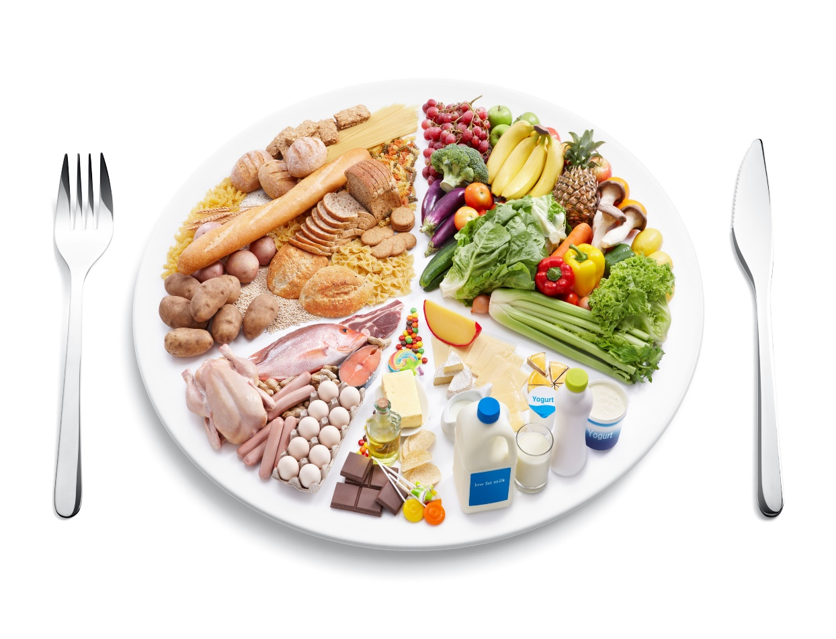
LO1 – Understand the principles and importance of a balanced diet.
1.4 Nutritional advice.
Current recommended guidelines from public health sources
The government have developed different ways to demonstrate the amount of food we should consume each day.
These are designed to make it easy to understand and to encourage everyone to eat a balanced diet.
The Eatwell plate
Developed by the NHS to show the proportion of each food group that should be eaten. – https://www.nhs.uk/live-well/eat-well/the-eatwell-guide/

Slide 32
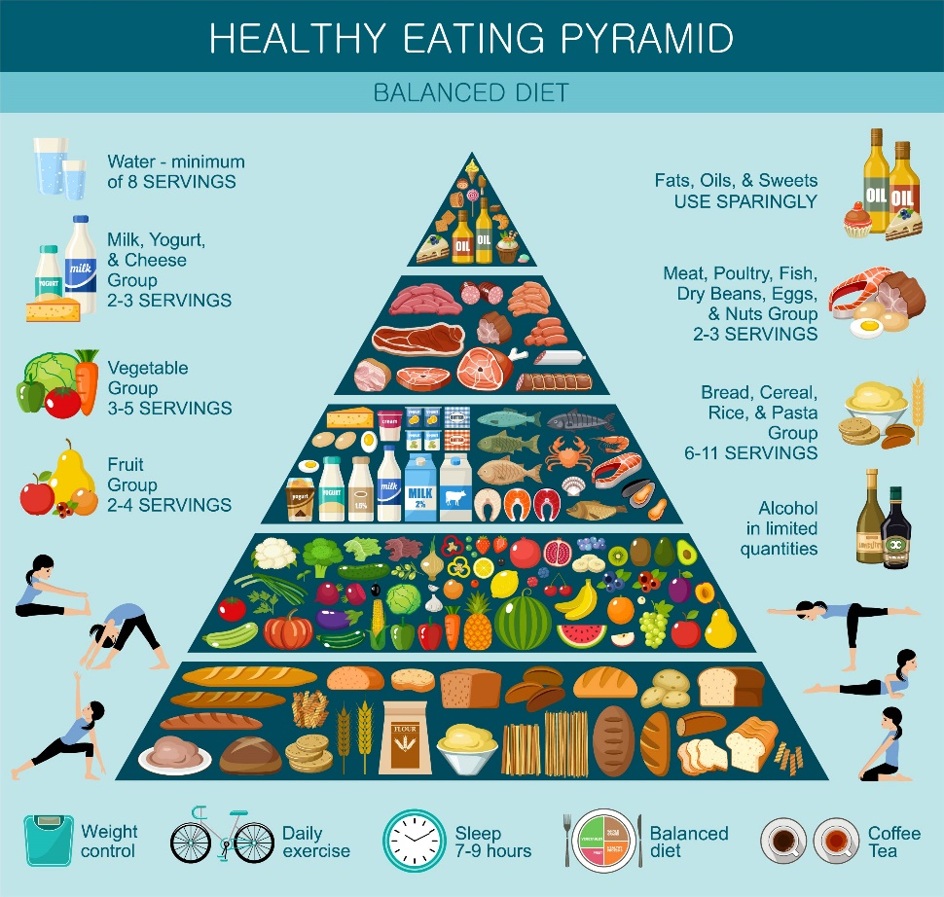
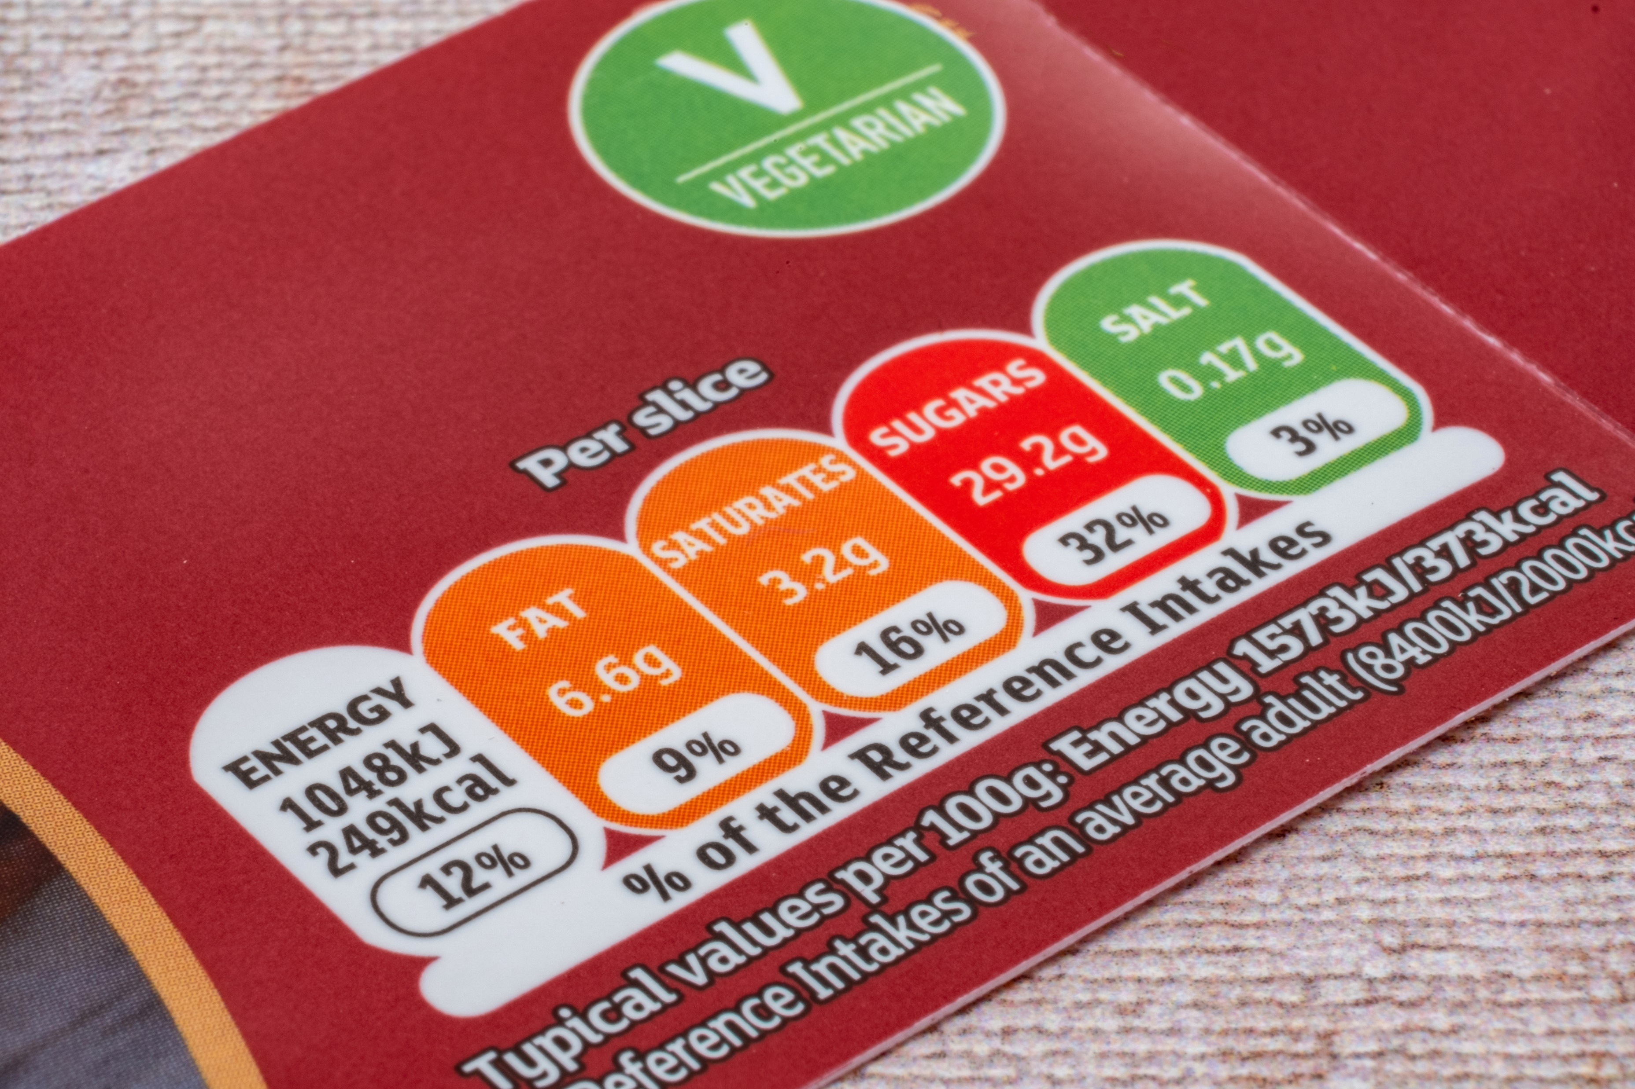
LO1 – Understand the principles and importance of a balanced diet.
1.4 Nutritional advice.
Current recommended guidelines from public health source
The Food Pyramid
Traffic lights – these can be found on food packaging and clearly indicate how good/bad each products is. Red = high – Green = low)

Slide 33
LO1 – Understand the principles and importance of a balanced diet.
1.4 Nutritional advice.
Common terminology
Learner activity:
Guess what the following acronyms stand for, they are all linked to food ☺
RDA –
OL –
SI –
EAR –

Slide 34
LO1 – Understand the principles and importance of a balanced diet.
1.4 Nutritional advice.
Common terminology
Learner activity: Answers
RDA - Recommended Daily Allowance
OL - Optimum Level
SI - Safe Intake
EAR - Estimated Average Requirement
Learner Activity
Now you understand what each acronym stand for, research OL, SI and EAR for each macro and micronutrient. Share with your group.

Slide 35
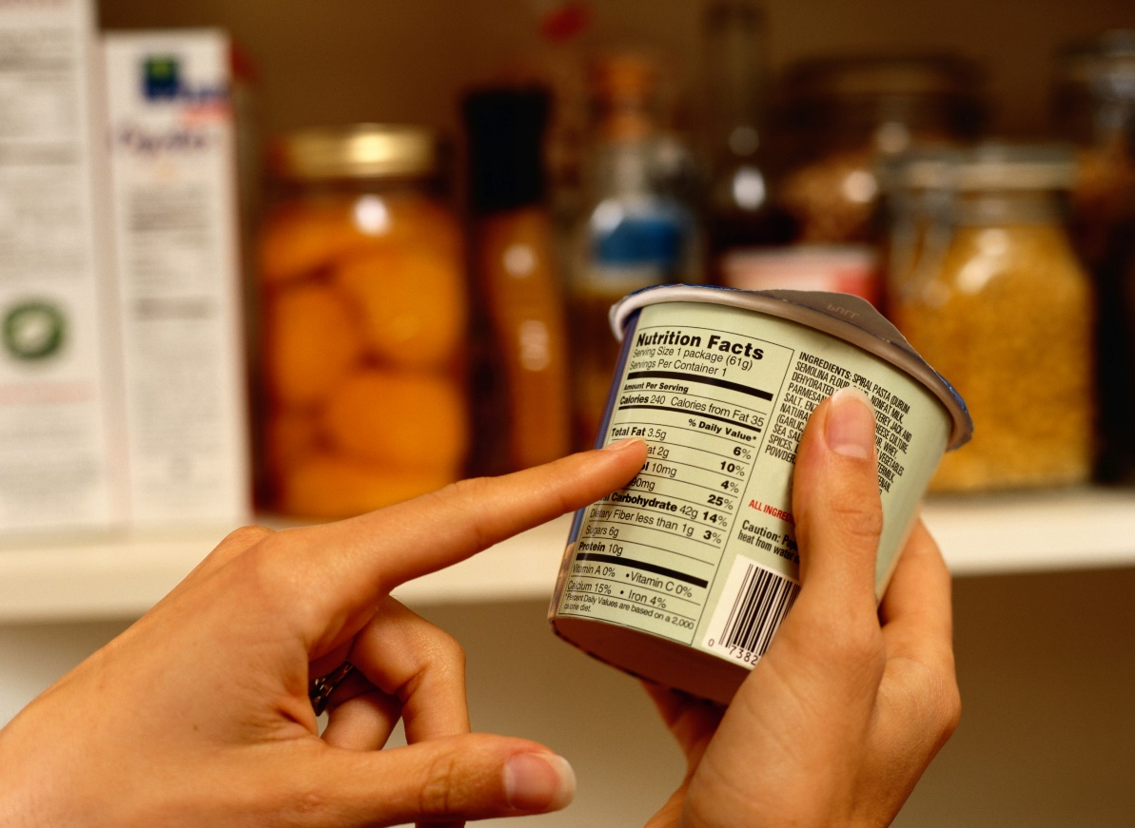
LO1 – Understand the principles and importance of a balanced diet.
1.4 Nutritional advice.
Food labelling
To sell food and drink products in the UK, the label must be:
clear and easy to read
permanent
easy to understand
easily visible
not misleading
list of ingredients
any warnings that are necessary/ allergen information
Labelling must either be on the produce, on the packaging, or if you buy products sold loose, then the information must be clearly available in the shop.

Slide 36
LO1 – Understand the principles and importance of a balanced diet.
1.4 Nutritional advice.
Current healthy eating initiatives
Change4Life - https://www.nhs.uk/change4life
Change4Life is run by the NHS and aims to help families lead healthier lives by eating well and moving more
It helps parents have the essential support and tools they need to make healthier choices for their families
Healthy Schools - https://www.healthyschools.org.uk
Aims to support schools to help their children and young people to grow healthily, safely and responsibly.
It has been revised in consultation with schools with content aligned to current Ofsted guidance.

Slide 37
LO1 – Understand the principles and importance of a balanced diet.
1.4 Nutritional advice.
Current healthy eating initiatives
Eat like a champ - https://eatlikeachamp.co.uk
Eat Like A Champ is a free six lesson programme designed to help children aged 9 and 10 years old (Year 5/Primary 6/P6) across the UK learn about healthy, sustainable lifestyles in a fun and exciting way!
Written in collaboration with the British Nutrition Foundation, British Dietetic Association and everyday sustainability experts Hubbub.
Learner Activity
Choose one healthy eating campaign and produce a poster to advertise the campaign.

Slide 38
LO1 – Understand the principles and importance of a balanced diet.
1.5 Nutritional requirements for different groups
Learner activity
Research the different nutritional requirements for two different groups below.
Present your findings to your class.
Choose two groups from the following list to complete P2
children
young people
adults
older people
athletes
physically inactive people
It is important to understand that different groups of people need different amounts of nutritional requirements.
An elderly person who has a mainly sedentary lifestyle, isn’t going to need the same amount of calories as an active 20 year old and therefore the same amount of macronutrients and micronutrients.
For you to be able to complete P2 you will need to choose 2 of the groups from above and research how they require different amounts of all the food groups, we have already looked at in P1.

Slide 39
LO1 – Understand the principles and importance of a balanced diet.
Learner activity - now you have looked at the different factors of a balanced diet, summarise all you have learnt in the table below.
7 Classes of Food | Main benefit for the body | Recommended Daily Allowance (RDA) | Effect on Sport Performance.
Carbohydrates
Fats
Protein
Vitamin
A – Fat Soluble
B – Water Soluble
C – Water Soluble
D – Fat Soluble
E – Fat Soluble
K – Fat Soluble
Minerals
Iron
Calcium
Sodium
Iodine
Fibre
Water

Slide 40
LO1 – Understand the principles and importance of a balanced diet.
Grading Criteria.
P1 – Outline the components of a healthy balanced diet, including recommended guidelines from public health sources associated with nutrition
P2 – P2: Describe nutritional requirements for different groups
For P1, learners must outline the components of a balanced diet using current dietary guidelines from at least two different authoritative sources (e.g. NHS, British Nutrition Foundation, Department of Health).
For P2, learners must describe the nutritional requirements for at least two different groups from the Teaching Content.
Children – young people – adults - older people – athletes - physically inactive people
https://www.ocr.org.uk/Images/273311-command-verbs-definitions.pdf

Slide 41
We’d like to know your view on the resources we produce. Click ‘Like’ or ‘Dislike’ to send us an auto generated email about this resource. Add comments if you want to. Let us know how we can improve this resource or what else you need. Your email will not be used or shared for any marketing purposes.
Looking for another resource? There is now a quick and easy search tool to help find free resources for your qualification.
OCR is part of Cambridge Assessment, a department of the University of Cambridge. For staff training purposes and as part of our quality assurance programme your call may be recorded or monitored. Oxford Cambridge and RSA Examinations is a Company Limited by Guarantee. Registered in England. Registered office The Triangle Building, Shaftesbury Road, Cambridge, CB2 8EA. Registered company number 3484466. OCR is an exempt charity.
OCR operates academic and vocational qualifications regulated by Ofqual, Qualifications Wales and CCEA as listed in their qualifications registers including A Levels, GCSEs, Cambridge Technicals and Cambridge Nationals.
OCR provides resources to help you deliver our qualifications. These resources do not represent any particular teaching method we expect you to use. We update our resources regularly and aim to make sure content is accurate but please check the OCR website so that you have the most up to date version. OCR cannot be held responsible for any errors or omissions in these resources.
Though we make every effort to check our resources, there may be contradictions between published support and the specification, so it is important that you always use information in the latest specification. We indicate any specification changes within the document itself, change the version number and provide a summary of the changes. If you do notice a discrepancy between the specification and a resource, please contact us.
© OCR 2021 You can copy and distribute this resource freely if you keep the OCR logo and this small print intact and you acknowledge OCR as the originator of the resource.
OCR acknowledges the use of the following content: slide 6: food chart/spxChrome/gettyimages.co.uk; slide 9: cyclist/wundervisuals/ gettyimages.co.uk; slide 10: balance/Enis Aksoy/ gettyimages.co.uk; slide 14: preparing vegan food/Oscar Wong/gettyimages.co.uk; slide 16: assorted grains and bread/Tetra Images/gettyimages.co.uk; slide 18: fast food/ Jonathan Knowles/gettyimages.co.uk; slide 21: bottle of vitamin C/Brian Hagiwara/ gettyimages.co.uk; slide 24: the human body infographic/Youst/getimages.co.uk; slide 26: wholegrain food/ fcafotodigital/gettyimages.co.uk; slide 27: woman drinking mineral water/mikroman6/gettyimages.co.uk; slide 31: balance diet/ Okea/gettyimnages.co.uk; slide 32: food pyramid/Gurzzza/gettyimages.co.uk; nutrition information label/clubfoot/gettyimages.co.uk; slide: 35: person reading nutrition label/Ryan McVay/gettyimages.co.uk; front cover/petrenkod/gettyimages.co.uk.
Whether you already offer OCR qualifications, are new to OCR or are thinking about switching, you can request more information using our Expression of Interest form.
Please get in touch if you want to discuss the accessibility of resources we offer to support you in delivering our qualifications.

