Slide 1
Leave Taking
Assessment Overview

Slide 2
Leave Taking
Component 1
Section A: Modern prose or drama

Slide 3
Introducing Leave Taking
We’ve added new diverse text options to our GCSE English Literature and A Level English Literature specifications. These will be available for first teach from September 2022 with first assessment in summer 2024.
At GCSE, Winsome Pinnock’s play Leave Taking will replace My Mother Said I Never Should as a modern drama option for Section A of Component 1: Exploring modern and literary heritage texts.
This Assessment Overview recaps the format and requirements for the Leave Taking exam questions.
Please refer to the Leave Taking Sample Assessment Materials.

Slide 4
Qualification overview
Component | Text type | Marks/Assessment Objectives
J352/01 Exploring modern and literary heritage texts 2 hours 80 marks 50% of GCSE | Section A: Modern text prose or drama: two-part question Section B: 19th century novel: choice of extract based or discursive essay | Section A: Part a) 20 marks: AO1, AO3, AO2 Part b) 20 marks: AO1, AO2 Section B: 40 marks: AO1, AO2, AO3, AO4
J352/02 Exploring poetry and Shakespeare 2 hours 80 marks 50% of GCSE | Section A: Themed poetry cluster from OCR poetry anthology: two-part question Section B: Shakespeare play: choice of extract based or discursive essay | Section A: Part a) 20 marks: AO2, AO1 Part b) 20 marks: AO1, AO2 Section B: 40 marks: AO1, AO2, AO3, AO4

Slide 5
Assessment Objective weightings for Paper 1
Component Exploring Modern and Literary Heritage Texts (J352/01) | % of GCSE |  |  |  | Total
 | AO1 | AO2 | AO3 | AO4
Section A: Modern prose or drama Part a) | 5 | 2.5 | 5 |  | 12.5
Section A: Modern prose or drama Part b) | 6.25 | 6.25 |  |  | 12.5
Section B: 19th century prose | 8.75 | 8.75 | 5 | 2.5 | 25
Total | 20 | 17.5 | 10 | 2.5 | 50

Slide 6
Paper 1, Section A
Section A: Modern prose or drama
Students study one text from set text list:
Anita and Me – Meera Syal
Never Let Me Go – Kazuo Ishiguro
Animal Farm – George Orwell
An Inspector Calls – J. B. Priestley
Leave Taking – Winsome Pinnock
DNA – Dennis Kelly
Students respond to a two-part question:
Part a) comparison of extract from set text with thematically linked modern, same-genre unseen extract
AND
Part b) related question on set text (ranging across the whole text)

Slide 7
Leave Taking sample question
Leave Taking by Winsome Pinnock and I Wanna Be Yours by Zia Ahmed
Read the two extracts below and then answer both part a) and part b).
You are advised to spend about 45 minutes on part a) and 30 minutes on part b).
For part a) you should focus only on the extracts here rather than referring to the rest of your studied text.
a) Compare how both extracts present people as outsiders. You should consider:
the situations and experiences faced by the characters
how the characters react to these situations and experiences
how the writers’ use of language and techniques creates effects. [20]
AND
b) Choose another moment in Leave Taking when a character feels like they don’t belong. [20]
AO1
AO2
AO3
AO1
AO2

Slide 8
The part a question
Compare a short extract from Leave Taking with a short extract from an unseen text. Students do not refer to the wider text in this part.
A short introduction will put both extracts in context to enable students to develop ideas about the relevant contexts for AO3.
Look for comparisons of themes, situations, characters, relationships.
Aim for comparison to be integrated throughout the response.
For part a) you should focus only on the extracts here rather than referring to the rest of your studied text.
Compare how both extracts present people as outsiders. You should consider:
the situations and experiences faced by the characters
how the characters react to these situations and experiences
how the writers’ use of language and techniques creates effects. [20]
AO3 - refer to contextual factors that are relevant to the extracts only.
These will be to do with social and cultural situations or experiences which can be inferred from the extracts themselves, for example, types of relationships, social class, gender, age.
AO1
AO2
AO3
AO2 – support points by analysing the use and effects of language, form and structure.
Aim to compare the use of language across the two extracts.
AO1 – compare how the characters react to the situations or experiences (the contexts) given in the extracts.

Slide 9
The unseen text
The extract from Leave Taking will be paired with an unseen drama extract.
The unseen extract will be taken from texts from 1914 onwards (focus on more recent texts where possible) and by writers who have clearly identifiable British heritage (would include, for example, British-Canadian descent).
The unseen extract will be thematically linked to the extract from Leave Taking.
The unseen extract will be taken from texts that should not be overly familiar to students – this is to avoid students applying a pre-conceived knowledge or reading of the unseen text to the specific extract and therefore potentially misreading the specific events in the extract, based on knowledge of the whole text.

Slide 10
The part b question
b) Choose another moment in Leave Taking when a character feels like they don’t belong. [20]
AO1
AO2
The part b question will be related to the focus of the part a question, for example, it may broadened out the theme or ask students to look at the same theme from a different angle.
Candidates are asked to explore another moment in Leave Taking. They can look at more than one moment.
They must look at language in the wider text using appropriate textual support.
To prepare for this part of the question, student will need to have thought about and prepared key moments from the text.
It is important that candidates are taught to make links between different sections of Leave Taking as they study it.
It is useful to build up a series of revision notes focusing on development of themes, characters and relationships in different parts of the text. These notes could be mind-maps, offering a clear visual path of a theme, character or relationship.

Slide 11
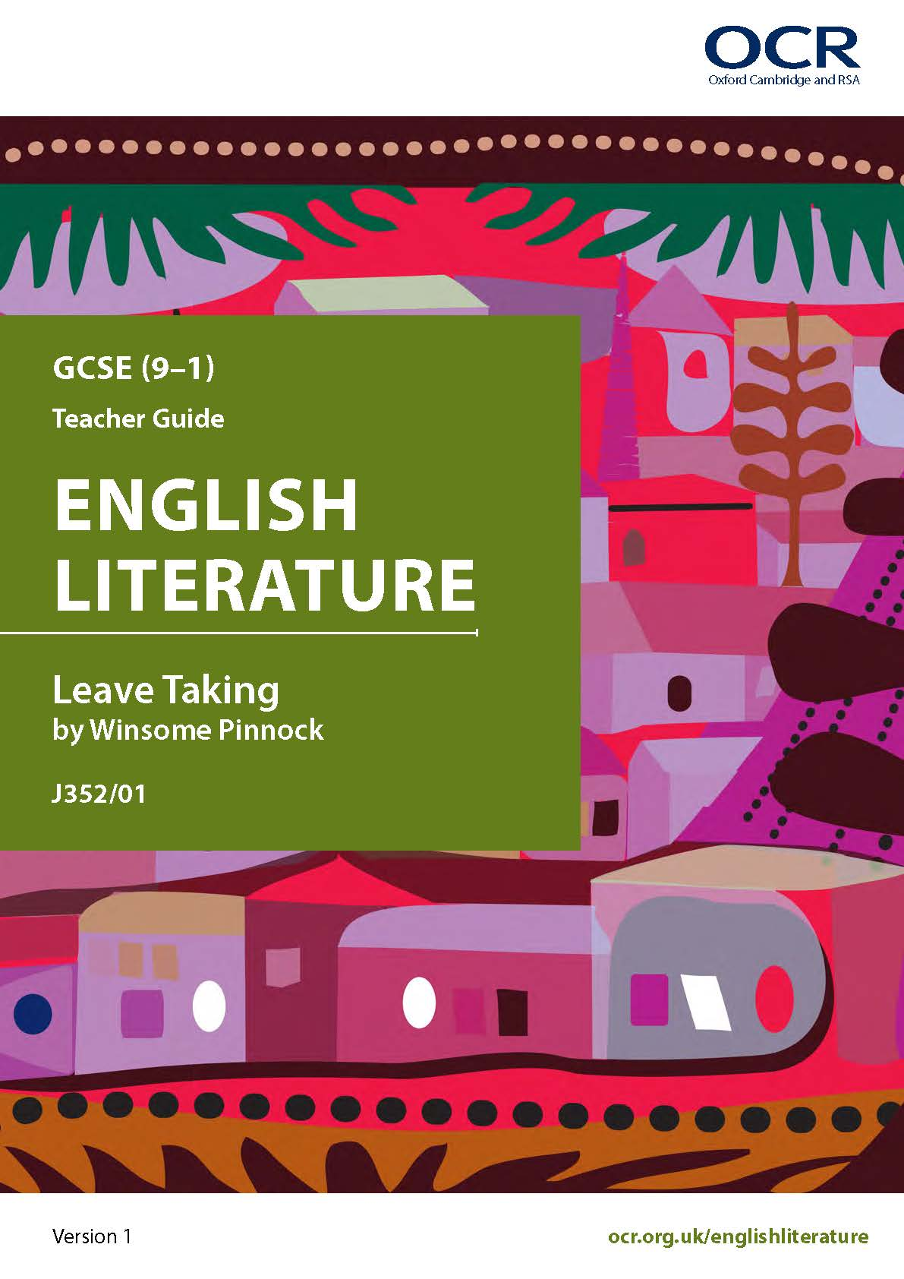
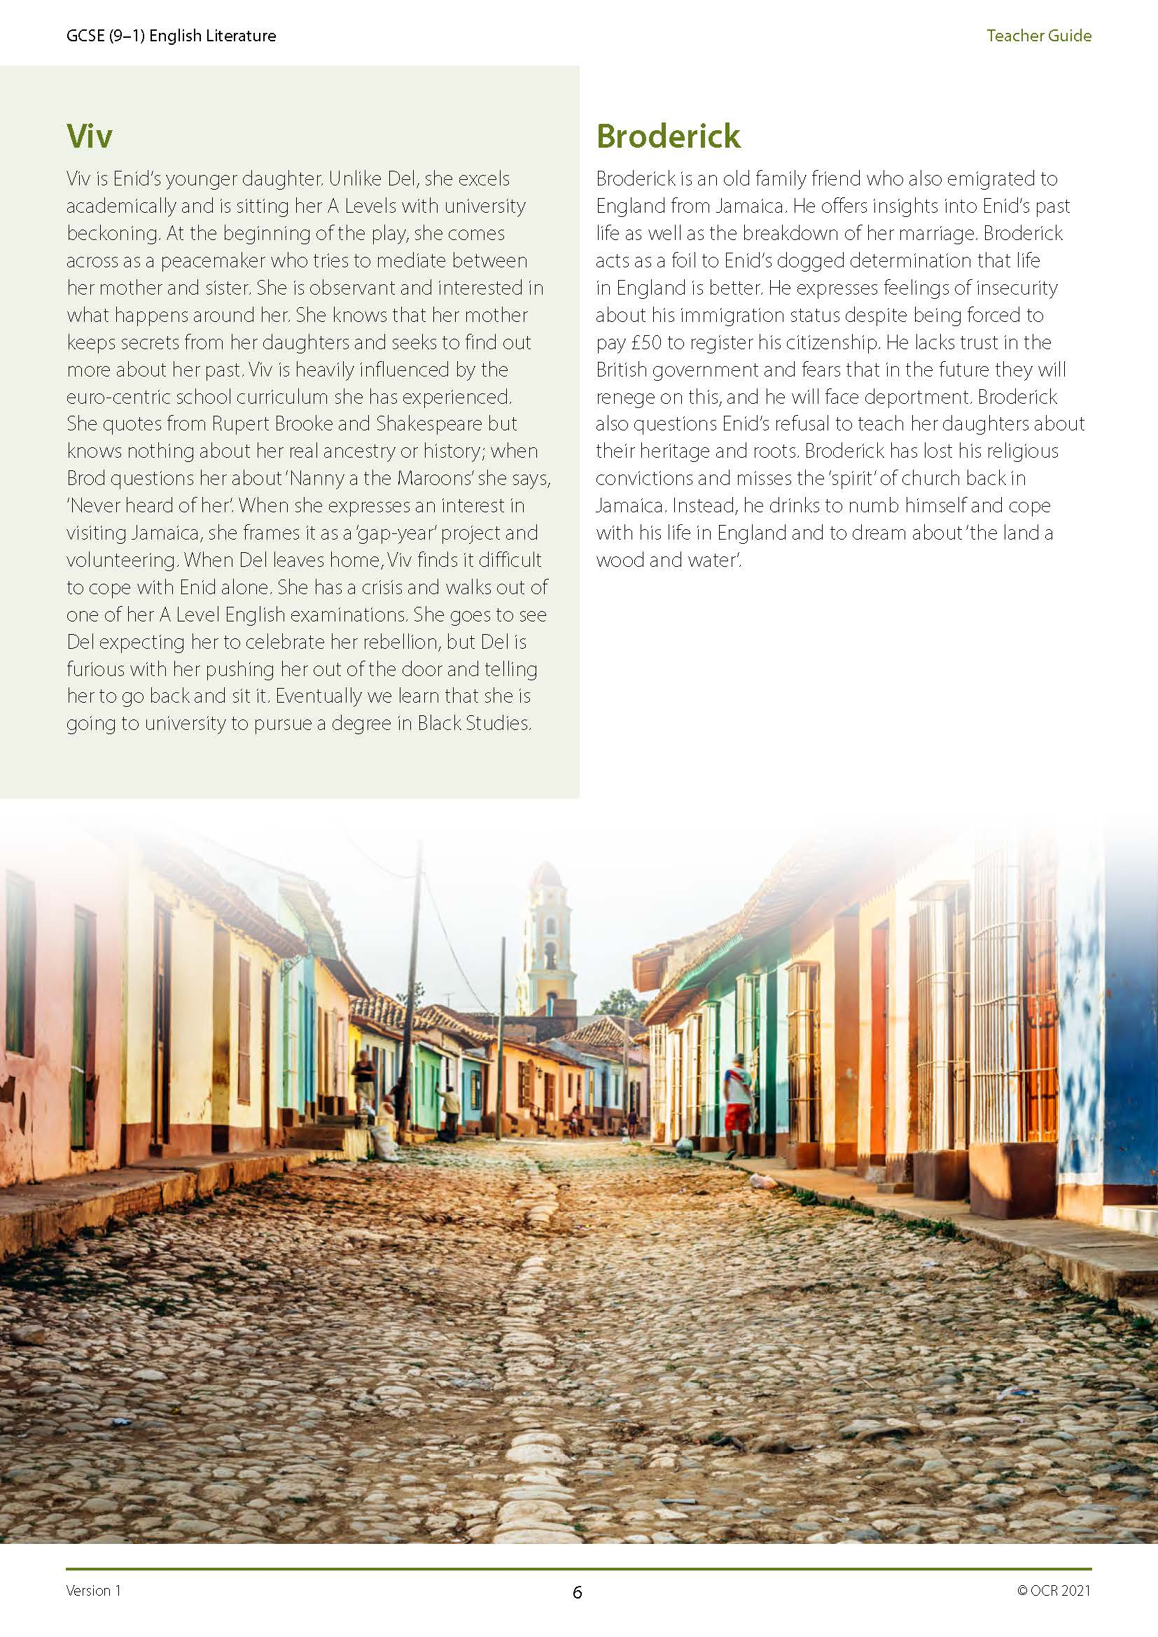
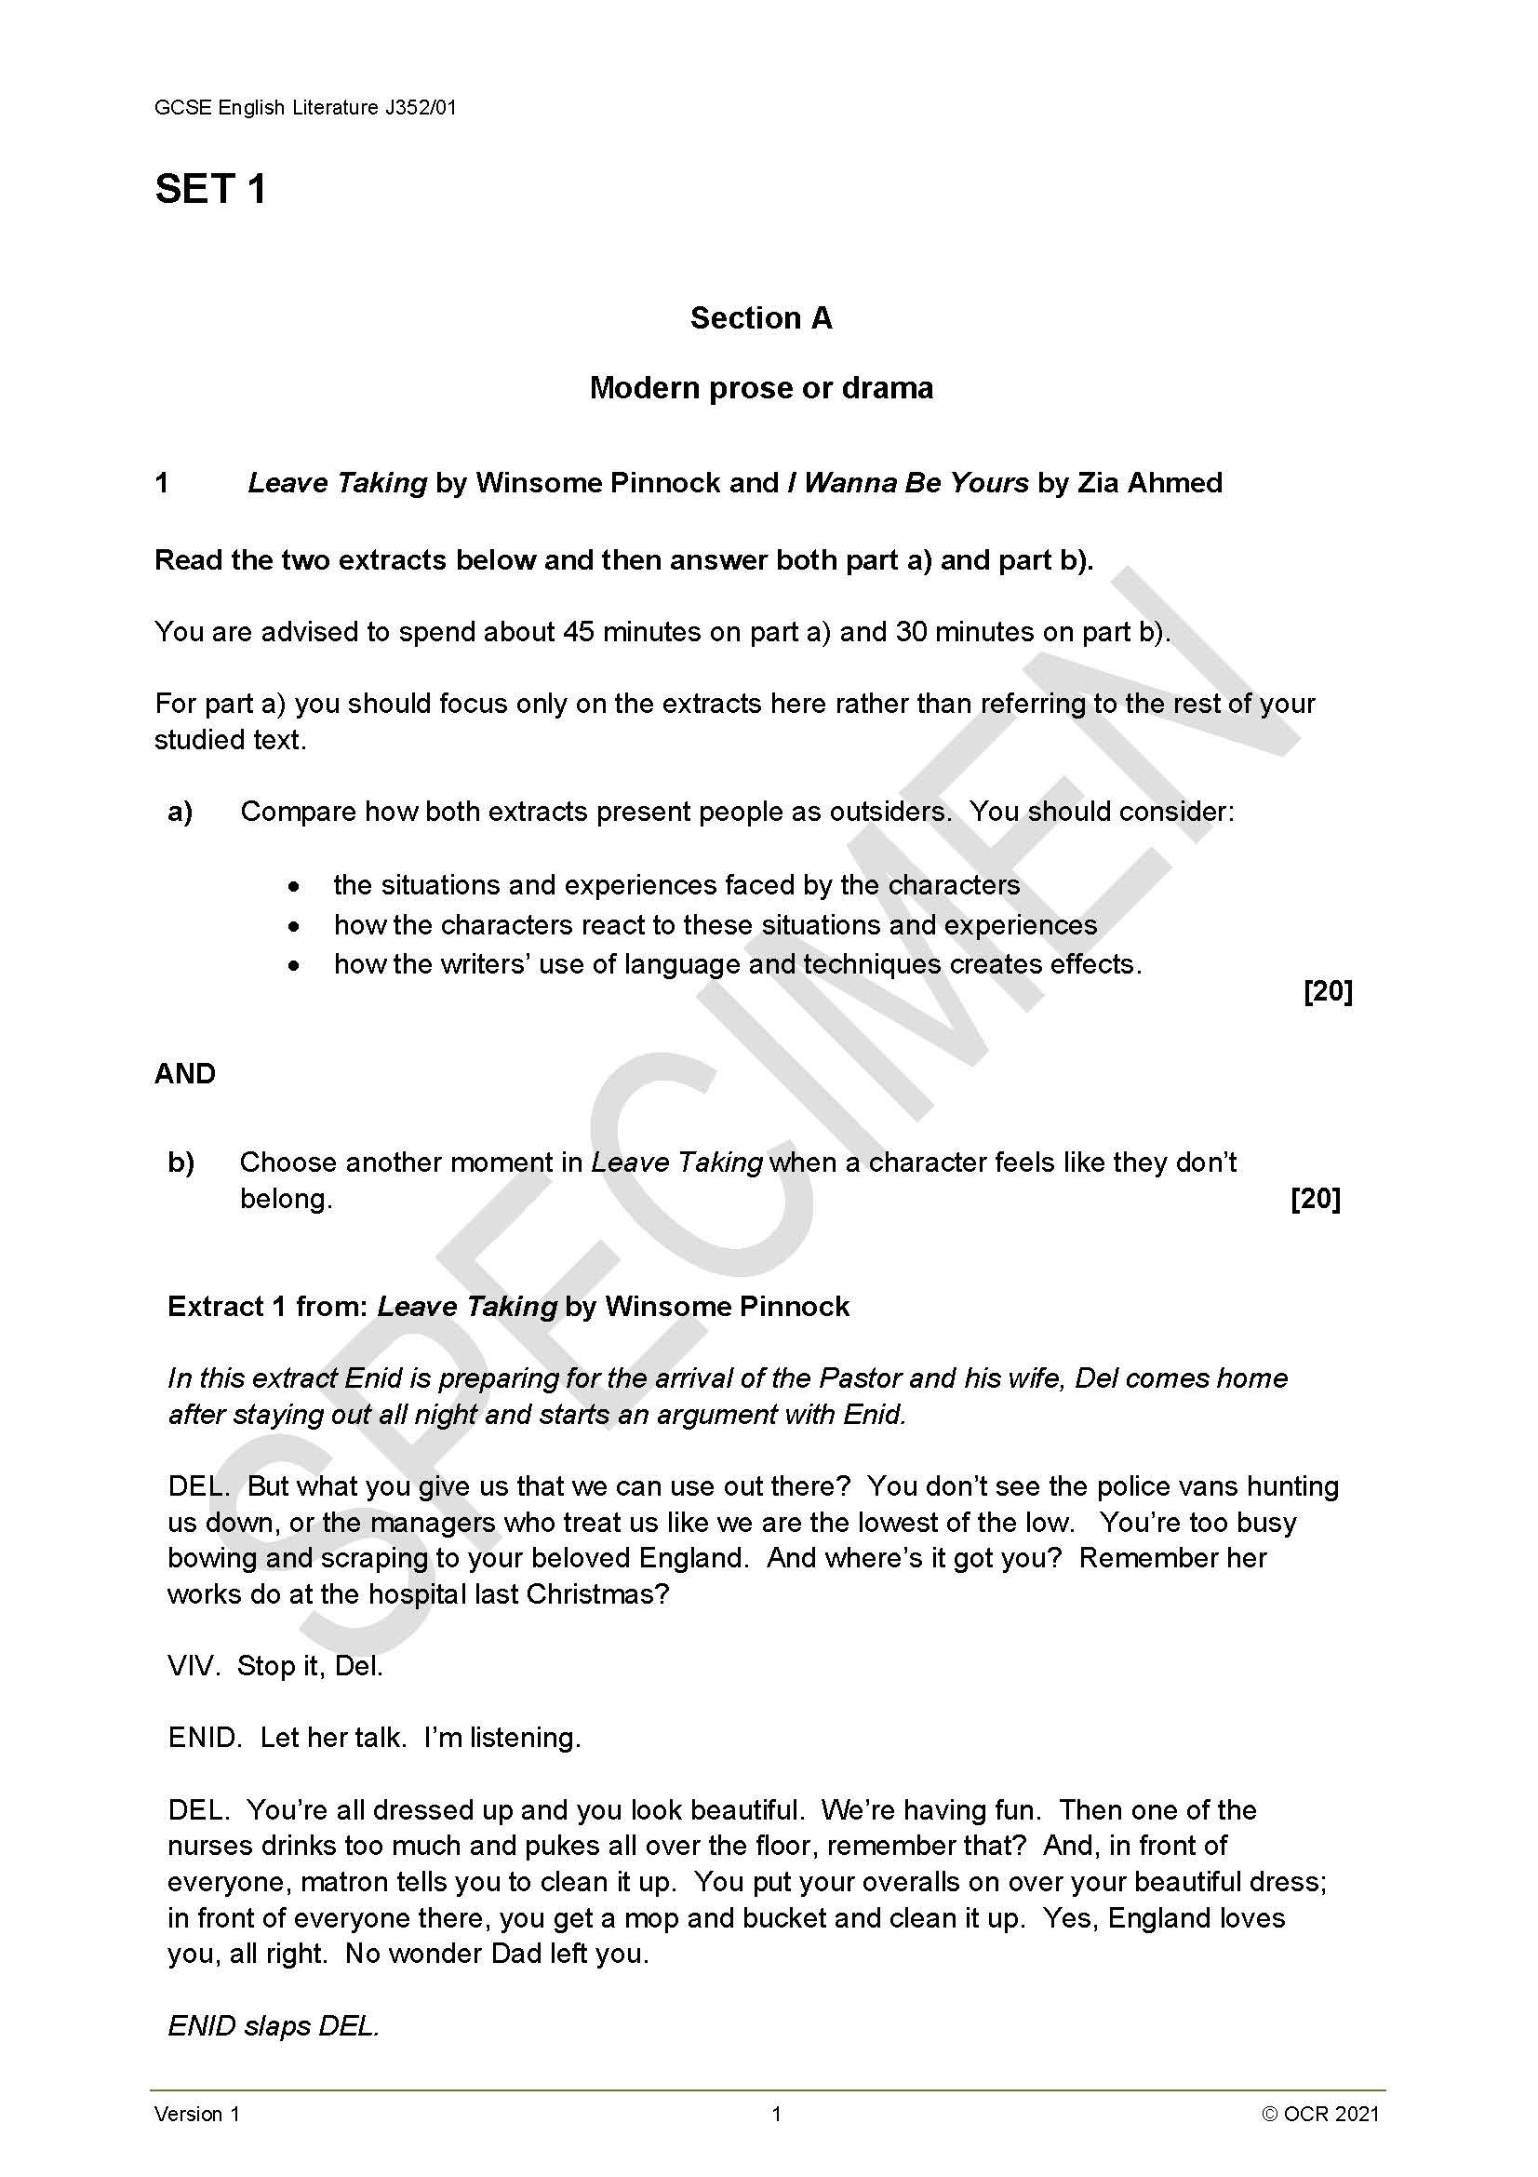
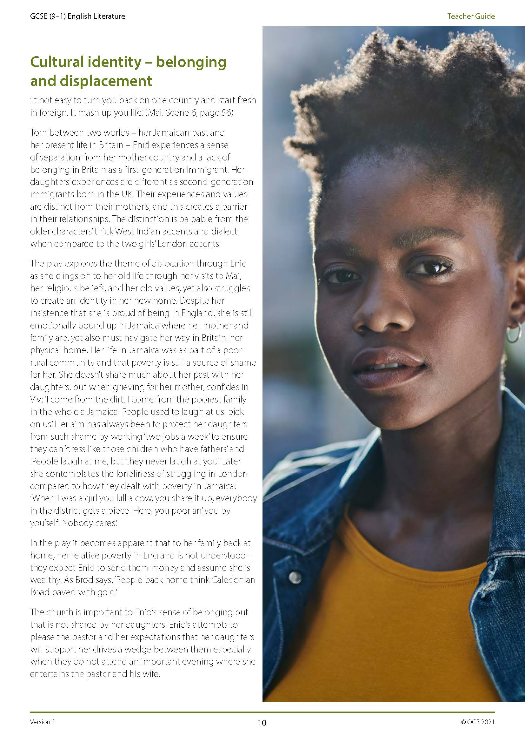
Teaching resources
Leave Taking Sample Assessment Materials
Leave Taking Teacher Guide
Using unseen prose and modern drama texts
Responding to unseen texts
Comparing texts
You may also be interested in the ‘Exploring context’ resources under the ‘Teacher guides’ section of the GCSE English Literature webpage.

Slide 12
We’d like to know your view on the resources we produce. Click ‘Like’ or ‘Dislike’ to send us an auto generated email about this resource. Add comments if you want to. Let us know how we can improve this resource or what else you need. Your email will not be used or shared for any marketing purposes.
Looking for another resource? There is now a quick and easy search tool to help find free resources for your qualification.
OCR is part of Cambridge University Press & Assessment, which is itself a department of the University of Cambridge.
For staff training purposes and as part of our quality assurance programme your call may be recorded or monitored. Oxford Cambridge and RSA Examinations is a Company Limited by Guarantee. Registered in England. Registered office The Triangle Building, Shaftesbury Road, Cambridge, CB2 8EA. Registered company number 3484466. OCR is an exempt charity.
OCR operates academic and vocational qualifications regulated by Ofqual, Qualifications Wales and CCEA as listed in their qualifications registers including A Levels, GCSEs, Cambridge Technicals and Cambridge Nationals.
OCR provides resources to help you deliver our qualifications. These resources do not represent any particular teaching method we expect you to use. We update our resources regularly and aim to make sure content is accurate but please check the OCR website so that you have the most up to date version. OCR cannot be held responsible for any errors or omissions in these resources.
Though we make every effort to check our resources, there may be contradictions between published support and the specification, so it is important that you always use information in the latest specification. We indicate any specification changes within the document itself, change the version number and provide a summary of the changes. If you do notice a discrepancy between the specification and a resource, please contact us.
© OCR 2021 - You can copy and distribute this resource freely if you keep the OCR logo and this small print intact and you acknowledge OCR as the originator of the resource.
OCR acknowledges the use of the following content: N/A
Whether you already offer OCR qualifications, are new to OCR or are thinking about switching, you can request more information using our Expression of Interest form.
Please get in touch if you want to discuss the accessibility of resources we offer to support you in delivering our qualifications.

